Slide 1
Dynamic MIG with HAMi From Static Slices to Elastic GPUs
Jifei Wang(Dynamia)

Slide 2
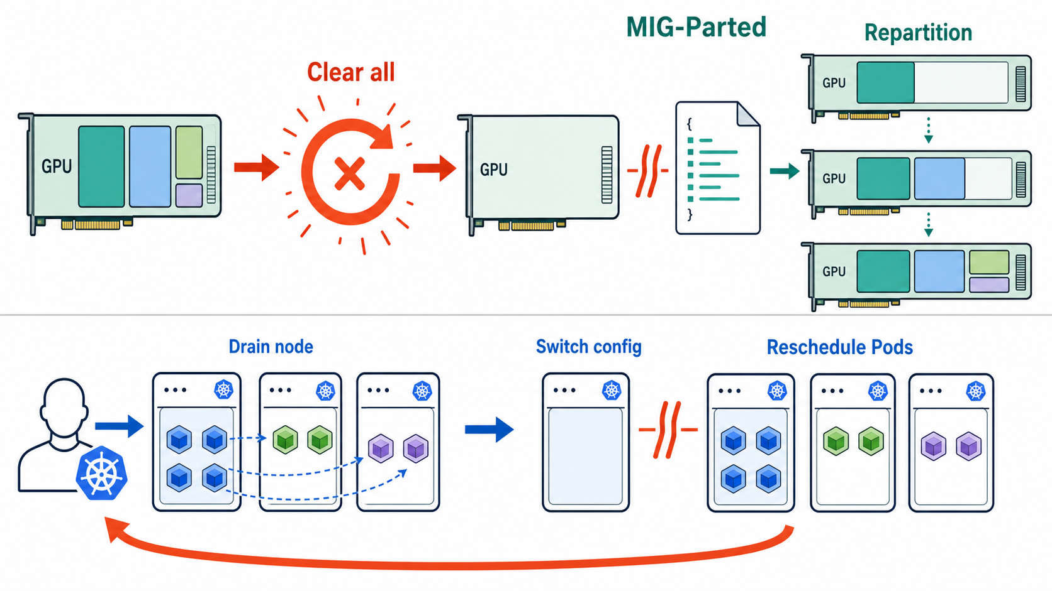
Classic MIG manager: MIG partd

Slide 3
Dynamic MIG — Publish capacity
KUBERNETES CONTROL PLANE
annotation
Pod
API Server / Pod
HAMi Scheduler
GPU WORKER NODE
NVIDIA GPU · MIG
Kubelet
Device Plugin
NVML
0
1
2
3
4
5
6
7 placement slots
The Device Plugin call NVML to find out possible MIG profiles and placement and report them to the node annotation. The scheduler use it to discover devices.

Slide 4
Dynamic MIG — Reserve allocation
KUBERNETES CONTROL PLANE
Pod
API Server / Pod
HAMi Scheduler
8G request
pick 1g.10gb
GPU WORKER NODE
NVIDIA GPU · MIG
Kubelet
Device Plugin
NVML
0
1
2
3
4
5
6
7 placement slots
When we submit a pod request the MIG device, the scheduler find out the avaliable placement and annotate the result to the pod.

Slide 5
Dynamic MIG — Allocate on the node
KUBERNETES CONTROL PLANE
Pod
API Server / Pod
HAMi Scheduler
Pod
GPU WORKER NODE
NVIDIA GPU · MIG
Kubelet
Device Plugin
NVML
0
1
2
3
4
5
6
7 placement slots
Kubelet call Device Plugin Allocate(), the Device plugin resolve Pod annotation instead of device id to build the MIG device request.

Slide 6
Dynamic MIG — Create MIG Instance
KUBERNETES CONTROL PLANE
Pod
API Server / Pod
HAMi Scheduler
GPU WORKER NODE
NVIDIA GPU · MIG
Kubelet
Device Plugin
NVML
0
1
2
3
4
5
6
GI / CI active
The Device Plugin call NVML to Create MIG instance with determined placement and profile which guarantee valid by the scheduler.

Slide 7
Dynamic MIG — Return runtime identity
KUBERNETES CONTROL PLANE
Pod
API Server / Pod
HAMi Scheduler
GPU WORKER NODE
NVIDIA GPU · MIG
Kubelet
Device Plugin
NVML
0
1
2
3
4
5
6
MIG UUID ready
After the driver return the MIG device UUID, we can finally mount the exact MIG device to the Pod using the UUID.

Slide 8
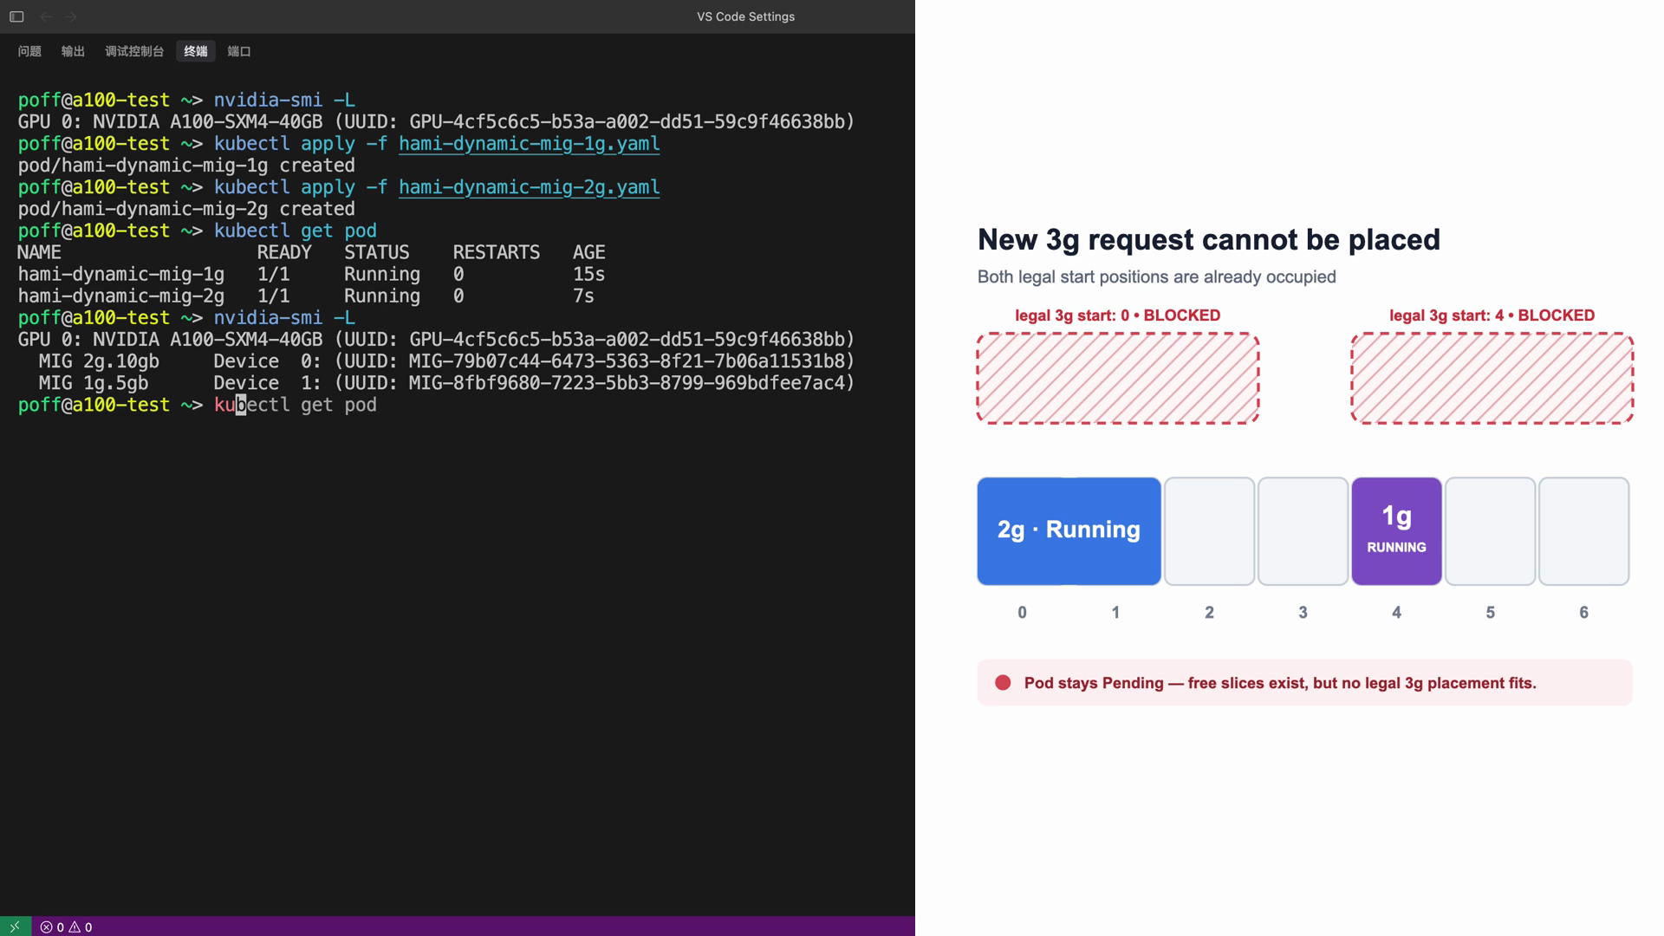

Slide 9
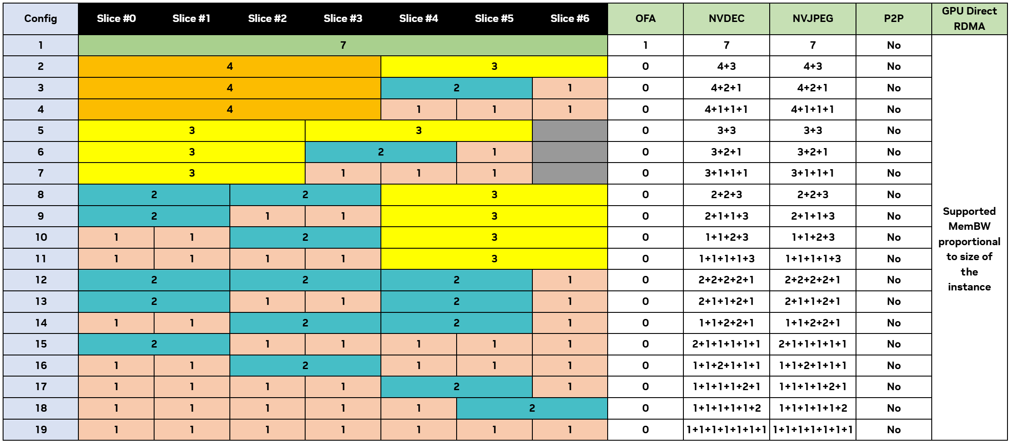
Future enhancements
Well design scheduling to maximize utilization for NVIDIA A, H and B series.

Slide 10
On the shoulders of giants
Special thanks for dra-driver-nvidia-gpu for:
Prove feasibility of dynamic MIG management
Providing reference implementation of CDI
Pushing adaptation of ecosystem like dcgm-exporter
But it still have problems:
Unable to customize scheduling strategy
DRA requires high kubernetes version
DRA is the future, but we must bring everyone along.

Slide 11
Thank you

