Slide 1

















GPU sharing with HAMi
Founds · Maintains · Drives adoption
GPUs & accelerators
LLM
Founded by HAMi Initiators
CNCF Incubating Project
LLM
Capabilities vary by device.
Xiao Zhang · CEO, Dynamia · HAMi Maintainer
Notes:
A qualitative sharing illustration. Unequal regions show different workload requests, not measured utilization, fixed partition sizes, live resizing guarantees or a universal concurrency limit. Sharing, isolation and scheduling capabilities vary by device. The 13 families are AMD, Huawei Ascend, AWS Neuron, Biren, Cambricon, Enflame, Hygon, Iluvatar, Kunlunxin, MetaX, Moore Threads, NVIDIA and Vastai, shown alphabetically by displayed name. Original brand artwork is preserved. The image of a GPU and the app queue remain native editable objects. Xiao Zhang is CEO and founder of Dynamia and a named HAMi maintainer. Dynamia invests in core development and offers HAMi-based enterprise products and technical support. The company is not the sole owner or sole maintainer of the CNCF project.
Sources
https://github.com/Project-HAMi/HAMi/blob/v2.10.0/pkg/scheduler/config/config.go
https://project-hami.io/docs/userguide/device-supported
https://project-hami.io/docs/userguide/nvidia-device/specify-device-memory-usage
https://project-hami.io/docs/userguide/awsneuron-device/enable-awsneuron-managing
https://project-hami.io/docs/userguide/biren-device/enable-biren-sharing
https://dynamia.ai/company
https://dynamia.ai/products
https://github.com/Project-HAMi/HAMi/blob/master/MAINTAINERS.md

Slide 2








HAMi in the cloud native ecosystem
Contributors
Organizations
Countries and regions
Incubating since July 2026
723
1075
44
→
HAMi-core
Per-container GPU memory limits
Schedulers
Cloud & AI platforms
Notes:
LFX all-time window from 2018-01-01 through 2026-09-05 inclusive, queried with endDate=2026-09-06 and includeCollaborations=true: 1,263 unique contributors and 216 organizations. Contributors include code and collaboration activity, not only commit authors; organizations are contributor affiliations, not customers. The geographic result has 29 known non-Unknown categories, conservatively shown as 20+ countries and regions. Do not substitute the different CNCF project-page aggregate. HAMi entered CNCF Incubating on 2026-07-02. KAI uses HAMi-core optionally; no NVIDIA-wide adoption is implied. Dynamia participates in core maintenance and ecosystem collaboration. Its public account of the CNCF/PyTorch delegation visits supports engagement with accelerator vendors. Integrations shown remain joint upstream ecosystem outcomes, not exclusively delivered by Dynamia.
Sources
https://www.cncf.io/projects/hami/
https://github.com/kai-scheduler/KAI-Scheduler/blob/main/docs/gpu-sharing/hami/README.md
https://volcano.sh/docs/userguide/user_guide_how_to_use_volcano_vgpu/
https://koordinator.sh/docs/user-manuals/device-scheduling-gpu-share-with-hami
https://kueue.sigs.k8s.io/docs/tasks/run/using_hami/
https://docs.ucloud.cn/uk8s/mdToPdf/uk8s.pdf
https://docs.alauda.io/hami/2.6/hami-en.pdf
https://opencsg.com/docs/en/releasenote/csghub_v2026.03
https://www.olares.com/changelog
https://insights.linuxfoundation.org/api/widget/contributors/active-contributors?project=hami&includeCollaborations=true&startDate=2018-01-01&endDate=2026-09-06&granularity=yearly
https://insights.linuxfoundation.org/api/widget/contributors/active-organizations?project=hami&includeCollaborations=true&startDate=2018-01-01&endDate=2026-09-06&granularity=yearly
https://insights.linuxfoundation.org/api/widget/contributors/geographical-distribution?project=hami&startDate=2018-01-01&endDate=2026-09-06&type=contributors
https://dynamia.ai/blog/dynamia-cncf-pytorch-china-tour

Slide 3












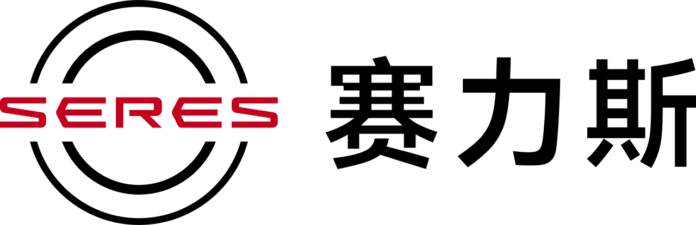
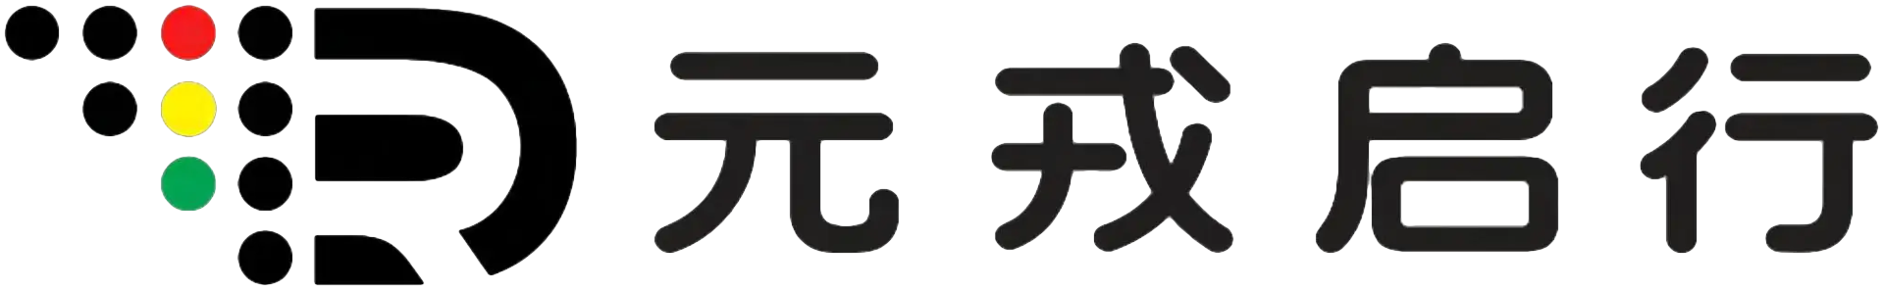
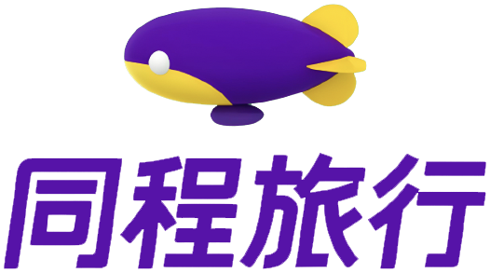








HAMi in production
+46.7%
Single-card inference throughput
ResNet 50 · batch 32
30% fewer GPU hours
50% fewer GPUs
90% of GPU infrastructure
Driving simulation
Train-to-inference pipelines
Managed by HAMi
HAMi adopters
Notes:
Seven published CNCF case studies, not seven total users or seven paid Dynamia customers. China Merchants Bank: +46.7% is the reported single-card ResNet50 batch-32 aggregate inference throughput benchmark (64.6 to 94.8 images/s). The bank developed enhancements around its Kubernetes/HAMi platform. Its 100% hardware-pool utilization and hypothetical requirement for more than eight clusters are excluded. Ke Holdings: AIStudio utilization 13% to 37%. NIO: simulation GPU hours reduced by approximately 30%; inconsistent utilization multipliers are excluded. SF Technology: EffectiveGPU, built on HAMi, ran 65 production services on 28 GPUs. SNOW: twofold reduction in GPUs needed for train-to-inference pipelines, expressed as 50% fewer; broader KEDA/observability savings are excluded. DaoCloud: D.run and DCE GPU operating costs down 20-30%, not a guarantee. PREP: 90% of GPU infrastructure is managed by HAMi; this is coverage, not utilization. All are customer-reported platform results. The slide highlights CMB with NIO, SNOW and PREP EDU as supporting examples. The lower wall shows 20 selected entries from the official HAMi adopters list, excluding the four highlighted organizations. That list includes organizations evaluating HAMi or using it in production; it is not a list of paid Dynamia customers. KE Holdings, SF Technology and DaoCloud appear in the wall and account for the remaining three published CNCF cases.
Sources
https://www.cncf.io/case-studies/?_sft_lf-project=hami
https://www.cncf.io/case-studies/china-merchants-bank/
https://www.cncf.io/case-studies/ke-holdings-inc/
https://www.cncf.io/case-studies/nio/
https://www.cncf.io/case-studies/sf-technology/
https://www.cncf.io/case-studies/snow-corp/
https://www.cncf.io/case-studies/daocloud/
https://www.cncf.io/case-studies/prep-edu/
https://github.com/Project-HAMi/website/blob/master/src/data/adopters.json

Slide 4


Dynamia’s engineering contributions
MetaX integration
Lupine
vLLM compatibility
Prefill / decode compatibility
Per-client GPU metrics
Under review
Merged upstream
Later today · 8 Sep (UTC+8)
HAMi community
WeChat assistant
09:59–10:04
PD Disaggregation vLLM Deployment
on Alternative AI Accelerators Using llm-d
11:14–11:19
Project Lightning Talk: From Static Slices
to Elastic GPUs: Dynamic MIG with HAMI
14:30–15:00
How Intsig Serves Billions of Document Scans:
GPU Virtualization at Scale with HAMi
Notes:
llm-d MetaX proposal #2308 remained open and unmerged on 2026-09-06. Its Qwen3-14B, one-prefill/one-decode, TP=1 compatibility configuration is not production-scale validation. Lupine #523, #524, #525 and #526 were merged; commit authorship and co-authorship support the Dynamia contribution attribution even where another maintainer opened the PR. Lupine is an independent upstream project. No finished integration across HAMi, llm-d and Lupine is claimed. The slide explicitly identifies these items as Dynamia engineering contributions. The team affiliation is supported by commit authorship and the proposal maintainer details; project ownership is not implied. Bringing mature capabilities into enterprise production is the stated future intention, not a claim that all shown exploratory work is commercially deployed. The three subsequent Dynamia sessions were selected by case-insensitive Dynamia matches in speaker records embedded in the official event schedule. All occur on 8 September 2026, Shanghai time (UTC+8), after the current 09:12–09:22 keynote. Official full titles and start/end times are preserved. The original QR is identified on the HAMi community page as the WeChat assistant for joining community groups; it is not the public-account or event-registration QR.
Upcoming sessions
2026-09-08T09:59:00–10:04:00 (UTC+8) | PD Disaggregation vLLM Deployment on Alternative AI Accelerators Using llm-d | Grand Ballroom II + III
2026-09-08T11:14:00–11:19:00 (UTC+8) | Project Lightning Talk: From Static Slices to Elastic GPUs: Dynamic MIG with HAMI | 5B + C
2026-09-08T14:30:00–15:00:00 (UTC+8) | How Intsig Serves Billions of Document Scans: GPU Virtualization at Scale with HAMi | Grand Ballroom II + III
Sources
https://github.com/llm-d/llm-d/pull/2308
https://github.com/lupinemachines/lupine/pull/523
https://github.com/lupinemachines/lupine/pull/524
https://github.com/lupinemachines/lupine/pull/525
https://github.com/lupinemachines/lupine/pull/526
https://llm-d.ai/docs/architecture
https://www.lfopensource.cn/kubecon-cloudnativecon-openinfra-summit-pytorch-conference-china/program/schedule/
https://www.lfopensource.cn/kubecon-cloudnativecon-openinfra-summit-pytorch-conference-china/program/schedule/?id=1313959
https://www.lfopensource.cn/kubecon-cloudnativecon-openinfra-summit-pytorch-conference-china/program/schedule/?id=1215494
https://www.lfopensource.cn/kubecon-cloudnativecon-openinfra-summit-pytorch-conference-china/program/schedule/?id=1221808
https://project-hami.io/zh/community
https://project-hami.io/zh/img/community/wechat-assistant-qr.jpg

