Slide 1
Intelligent Character Reader (ICR) using Artificial Neural Networks (ANN)

Slide 2
Presented By :
Dipayan Deb (13000113032)
Drona Banerjee (13000113033)
Karan Jaiswal (13000113039)
Payal Kumari (13000113060)
Under the guidance of: Prof. Poulami Dutta

Slide 3
Content
👉 Introduction
👉 Problem Definition
👉 Uses
👉 Related Study
👉 Project Plan
👉 Requirement Analysis
👉 Segmentation
👉 Image Processing
👉 Machine learning
👉 Machine Learning Implementing
👉 Neural Networks
👉 Neural Network Module
👉 Data Flow Diagram for ICR
👉 Data Flow Diagram for Training Set
👉 SWOT Analysis
👉 Conclusion
👉 Further scope
👉 References
:

Slide 4
Introduction
Ø conversion of hand-written or printed text to a digital format.
Ø edit and search the words in the scanned documents like PDF files.

Slide 5
Problem Definition
Humans identify real life objects easily
Tough for computers to match human accuracy level
Train neural network to infer rules for recognition

Slide 6
Uses :
Used as a form of data entry from printed documents
Eg: Passport documents, Bank statements, invoices, etc.
Vehicle license plate identification
Can be used to read foreign printed languages
Can be used to arrange letters in post offices
Helps in digitizing printed document
Benefits: Search
Compact storage
Text Mining
Machine translation

Slide 7
Project Planning :
life cycle model
-Iterative waterfall.
2. Cost analysis
Notes:
In life cycle talk about the basic reasons for choosing the life cycle model(Pictured shared in whatsapp grp)
In shedule talk about the start and top days
In cost analysis talk about the basic setup cost(as written by drone in PRD)
and then tell that it is a open source project , therefore infrastructure cost is only required.

Slide 8
Iterative Waterfall Model :
Feasibilty
Study
Requirement
Analysis
Design
Coding & Testing
Maintenance

Slide 9
Requirement analysis :
Functional requirements
Non Functional Requirements
Accuracy
Data Set for efficient training
Notes:
Tell the names of our fucntional modules i.e the image input , image segmentation etc
Tell that will be discussed in detail later.
Explain the need for the data set.

Slide 10
The Process :
Image Segmentation
Image Processing
Machine Learning Module

Slide 11


Segmentation Process :
Images
Of
Lines
Images
Of
Words
Images
Of
Characters

Slide 12
Image Processing :
Noise Removal
3D RGB Matrix
2D Grayscale Matrix
1D Vector Creation

Slide 13
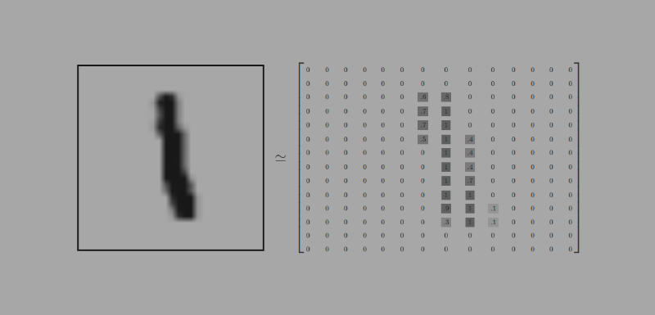
=

Slide 14
Machine Learning :
Supervised Learning
Classification problem
Hypothesis
Cost Function
Gradient Descent.

Slide 15
Machine Learning : Implementing
Linear Regression
h(x)=g(1+p₁* θ₁+p₂*θ₂+.....+p₇₈₄*θ₇₈₄)
Neural Network
-When linear regression (Basic Neural Network) fails.

Slide 16
Neural Network :
x1
a1
a2
h(x)
x2
a1=g(θ(11)*x1+θ(12)*x2+θ(13)*x3)
a2=g(θ(21)*x1+θ(22)*x2+θ(23)*x3)
a3=g(θ(31)*x1+θ(32)*x2+θ(33)*x3)
h(x)=g(θ(11)*a1+θ(12)*a2+θ(13)*a3)
x3
a3

Slide 17
Machine Learning Module :
Number Module
Character Module
Special Character Module
Logistic Regression
Classification Problem
Sigmoid Function
Neural Networks
Input : Pixel intensities of 1D array
3 Layer Neural Network
Logistic regression
Classification Problem
Sigmoid Function

Slide 18
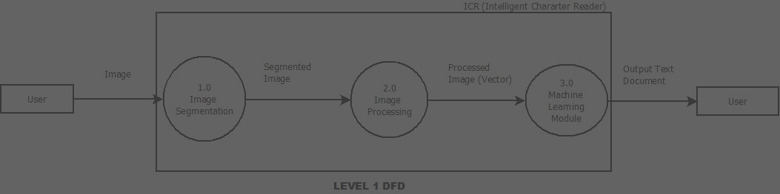
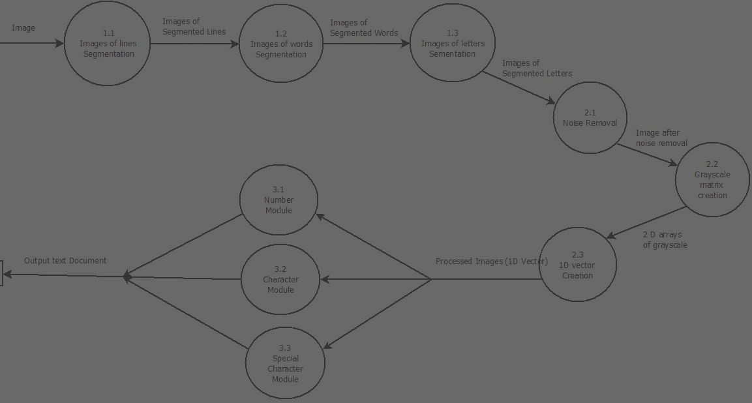
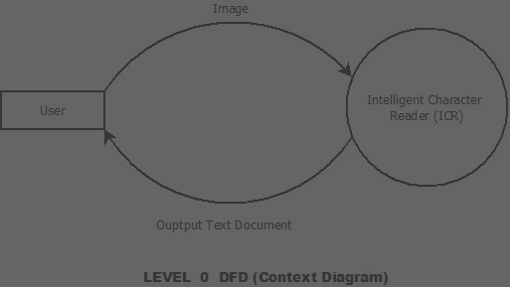

The Data Flow Diagram [DFD]

Slide 19
Images (i/p eg. )
Intelligent Character
Reader (ICR)
User
Output Text Document
(o/p eg. 1)
Level 0 (Context Diagram)

Slide 20
Image
0.1
Image
Segmentation
0.2
Image
Processing
0.3
Machine Learning Module
Segmented
Image
1D Vector
(Processed Image)
Output Text
Document
(b) Level 1

Slide 21
Image
0.1.1
Images of
Segmented lines
Segmented image
(lines)
0.1.2
Images of
Segmented
words
Segmented image
(words)
0.1.3
Images of
Segmented
letters
Segmented image
(letters)
(c) Level 2

Slide 22
Segmented Images
(letters)
0.2.1
Noise
Removal
Noise free
(image)
2D arrays of
grayscale
0.2.3
1D Vector
Creation
0.2.2
Grayscale
Matrix
Creation
1D vectors
(Processed Images)
(c) Level 2

Slide 23
0.3.1
Number
Module
Output Text
Document
1D vectors
(Processed images)
0.3.2
Character
Module
0.3.3
Special
Character
Module
(c) Level 2

Slide 24
Data Image + Label Image
Training
Script
Dataset
Theta File
Rules
Level 0 (Context Diagram for Training Script )

Slide 25

Analysis :
Strength
Weakness
Opportunities
Threats
Offline Functioning
Automation Using AI
Omni-font Featurization
High Hardware Requirements
Difference In Calligraphy (Style & Direction)
Expanding Digitization Market
Modular Extension Of Other Languages
Absence Of Preset Database For Training
No Benchmark Set For Unconfigured Languages

Slide 26
Related Study :
TESSERACT OCR
Not an application, an engine
3rd party software required
Does not focus on being user-friendly
CUNEIFORM OCR
Does not recognise handwritten text
Does not recognise decorative fonts
Accuracy drops when source image quality is low

Slide 27
Conclusion
Use of Neural Networks give high accuracy rate.
Human intervention needed in OCRs can be eliminated in ICRs.
Eg. Letter sorting machines
Useful for automated form processing.
Can be helpful for people with eye problems to read.

Slide 28
Future Scope of improvement :
Intelligent Word Readers can be built that process one word at a time.
Interpreting the sentence on basis of prior knowledge and understanding can be implemented.
Using Natural Language Processing , Artificial Intelligence and incredibly advanced machine learning.
Modules of any other language can be added.

Slide 29
References :
https://www.coursera.org/learn/machine-learning
https://en.wikipedia.org/wiki/Machine_learning
http://ieeexplore.ieee.org/document/1688109/

Slide 30
Thank You!

