Slide 1

Florida Electric Vehicles (EV)
Presented by
Sam Azhari
Christina Gangi
Joseph Williams
Altricia Latimer

Slide 2
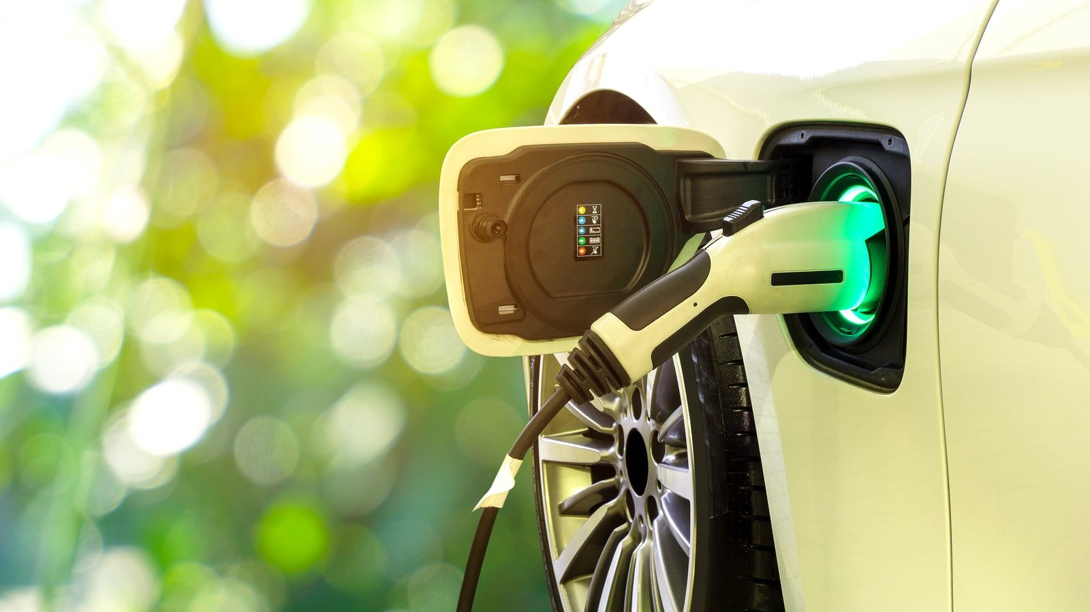
EV Cars Florida Story
Investigation in EV Cars in Florida
Data Analysis and Data Cleaning
Environmental Impact
EV Stations in Florida
Website

Slide 3
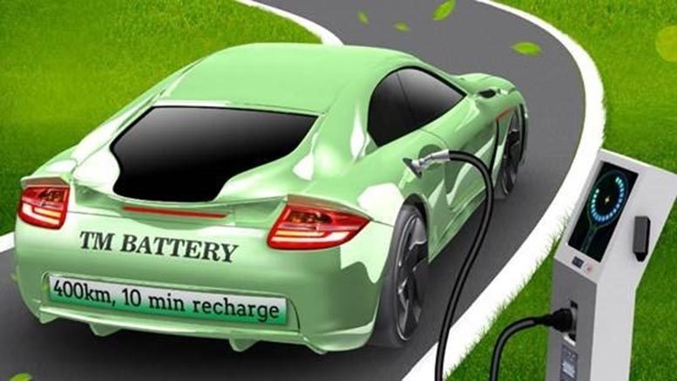
Investigation in EV Cars in Florida

Slide 4
Add a Slide Title - 2

Slide 5
Add a Slide Title - 3

Slide 6
Title and content layout with chart

Slide 7
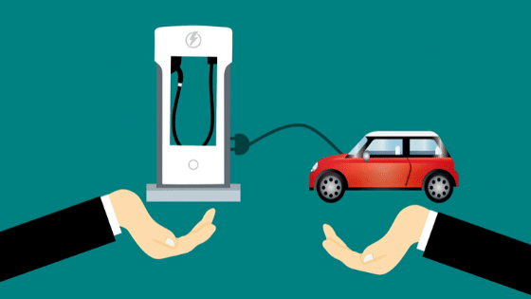
Data Analysis
&
Data Cleaning

Slide 8
Add a Slide Title - 2

Slide 9
Two content layout with table
First bullet point here
Second bullet point here
Third bullet point here
Class | Group 1 | Group 2
Class 1 | 82 | 95
Class 2 | 76 | 88
Class 3 | 84 | 90

Slide 10
Two content layout with SmartArt
First bullet point here
Second bullet point here
Third bullet point here
Goal
Step 1
Step 2
Step 3

Slide 11
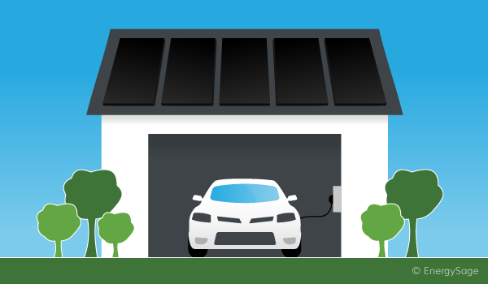
EV Cars Environmental Impact

Slide 12
Add a Slide Title - 2

Slide 13
Add a Slide Title - 3

Slide 14
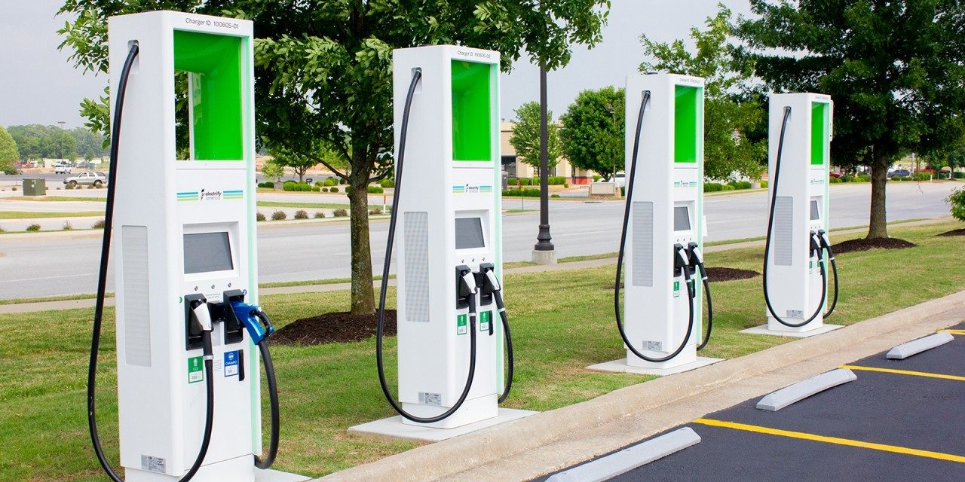
EV Cars Charging Stations in Florida

Slide 15
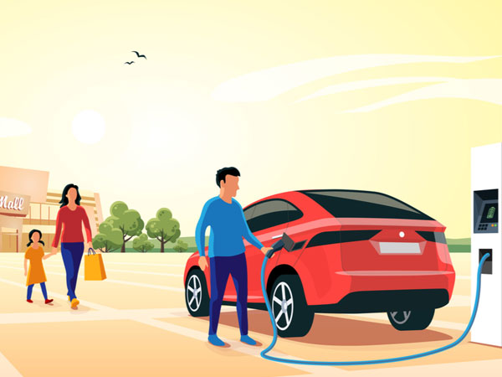
Florida EV Cars Website

Slide 17
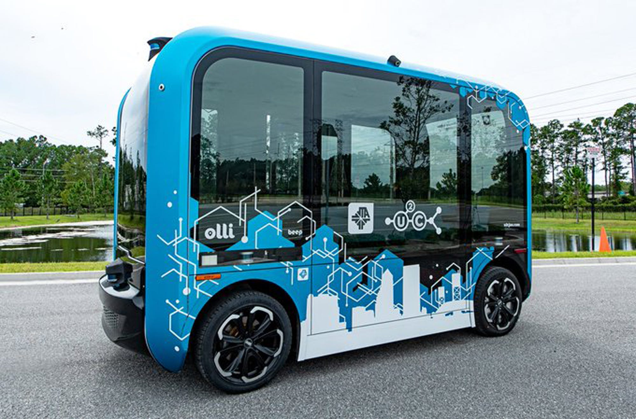
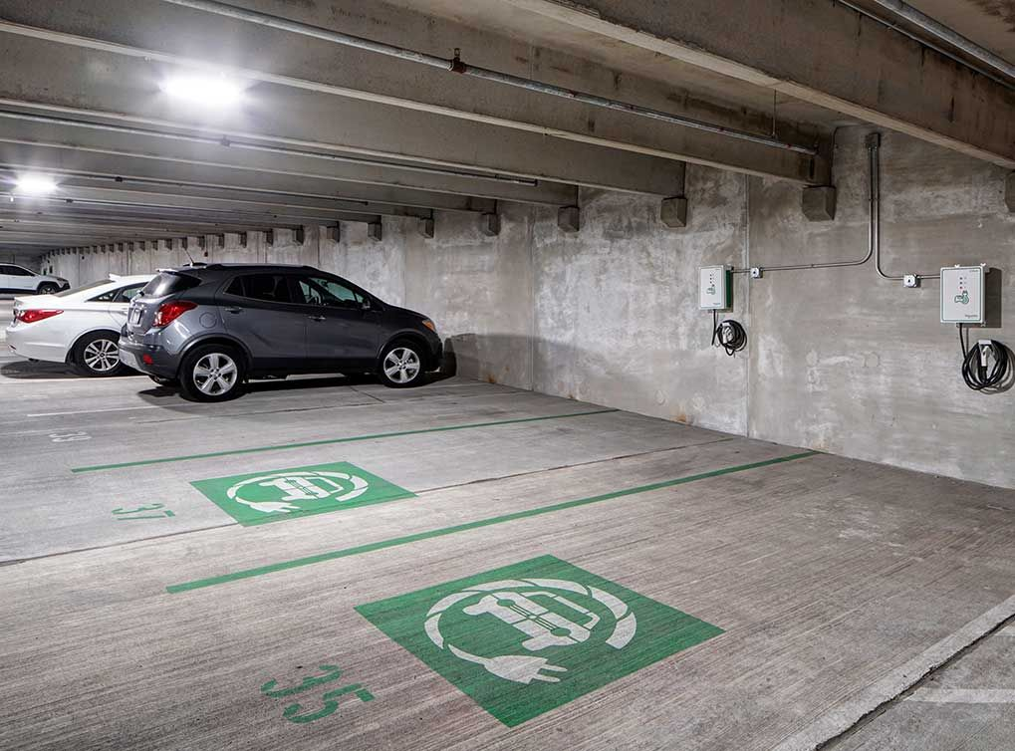
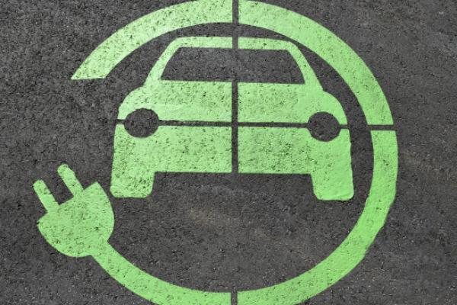
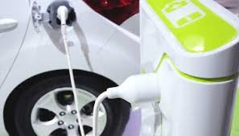

Slide 18
Add a Slide Title - 4

Slide 19

Thank you letting us share our story!

