Slide 1

Florida Electric Vehicles (EV)
Presented by
Sam Azhari
Christina Gangi
Joseph Williams
Altricia Latimer

Slide 2
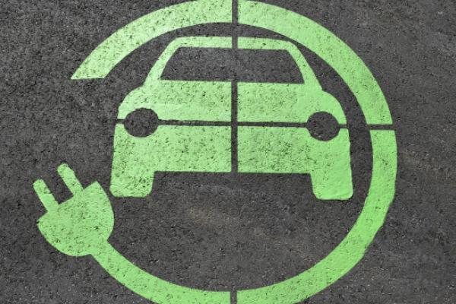
EV’s Florida Story
Investigation in EV’s in Florida
Data Analysis and Data Cleaning
Environmental Impact

Slide 3
Title and content layout with chart

Slide 4
Two content layout with table
First bullet point here
Second bullet point here
Third bullet point here
Class | Group 1 | Group 2
Class 1 | 82 | 95
Class 2 | 76 | 88
Class 3 | 84 | 90

Slide 5
Two content layout with SmartArt
First bullet point here
Second bullet point here
Third bullet point here
Goal
Step 1
Step 2
Step 3

Slide 6
Add a Slide Title - 1

Slide 7
Add a Slide Title - 2

Slide 8
Add a Slide Title - 3

Slide 10
Add a Slide Title - 4

Slide 11
Add a Slide Title - 5

