Slide 1

Florida Electric Vehicles (EV)
Presented by
Sam Azhari
Christina Gangi
Joseph Williams
Altricia Latimer

Slide 2
Project Overview
Goal
Find Data
Clean Data
Store Data
Access Data
Filter Data
Chart Data
Find Data
Clean Data
Store Data
Access Data
Filter Data
Chart Data

Slide 3
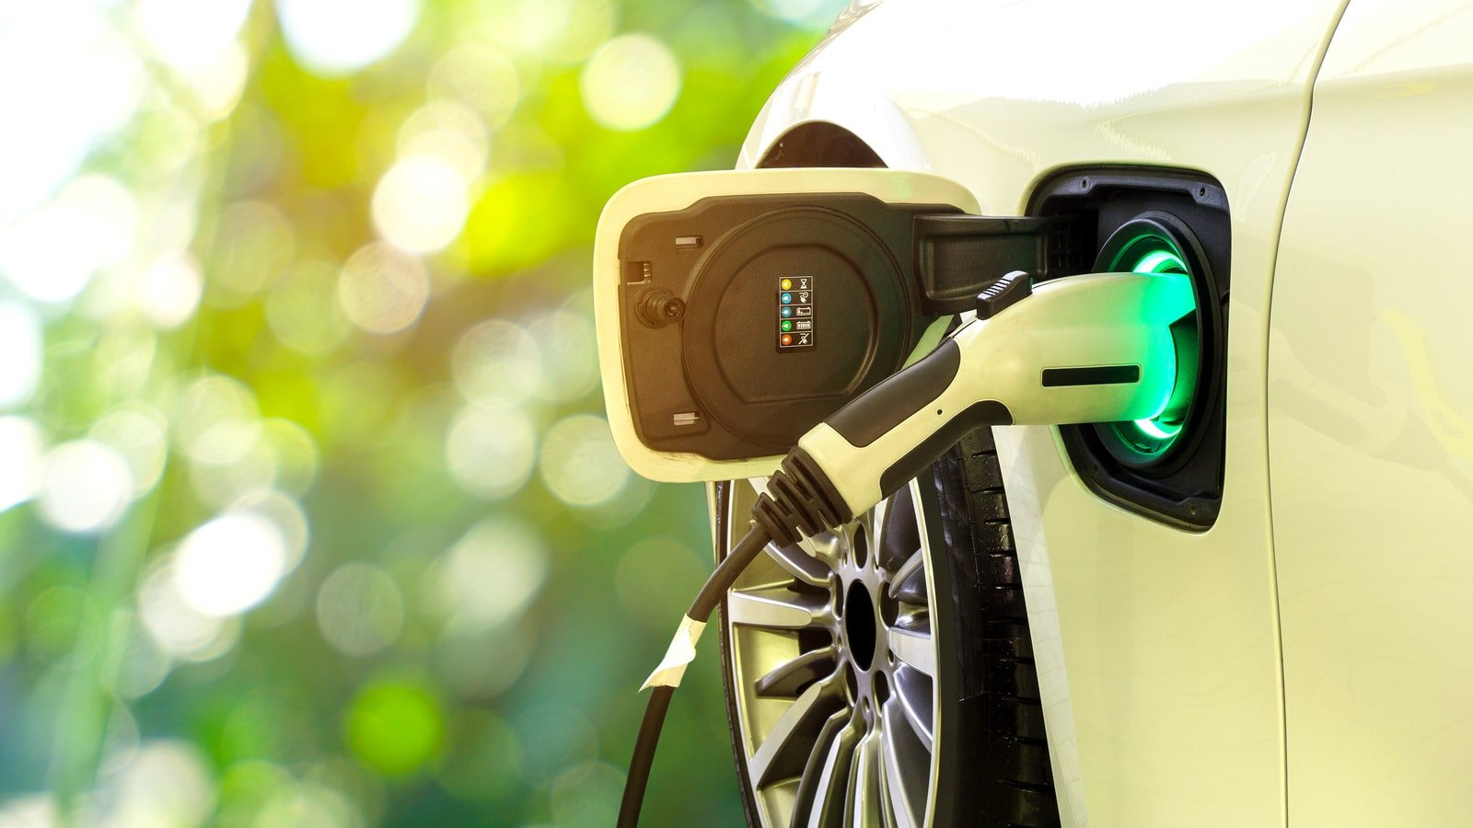
EV Cars Florida Story
Environmental Impact
Investigation in EV Cars in Florida
Data Munging
EV Stations in Florida
Website

Slide 4

EV Cars Environmental Impact

Slide 5
EV Cars Environmental Impact
Are Electric Cars Really Greener?
Are Electric Cars Really Better for the Environment?
Electrical Vehicles and EV Infrastructure
Transportation Electrification in Florida
Drive Electric Florida
Electric Cars vs. Gas Cars: Everything You Need to Know

Slide 6
Environmental Impact Driving Factors for EV Car Purchase
Environmental and sustainability objectives drive electric vehicle policy support at all governance levels
Policies are being tailored to support market transition
Electric car sales drive cost reductions in batteries, which boosts deployment across all road vehicle categories
Electric vehicles increase electricity demand but reduce oil demand and well-to-wheel greenhouse gas emissions
Battery technologies improve and costs drop
Battery manufacturing

Slide 7
EV Environmental Impact

Slide 8
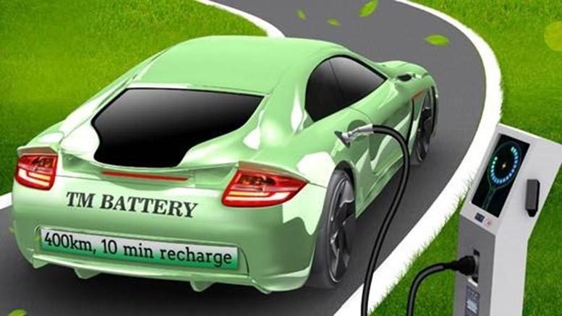
Investigation in EV Cars in Florida

Slide 9

Coding Approach

Slide 10
Coding Approach
Access Data
Filter Data
Setup a Flask app
Connect to SQLite DB
Setup 2 app routes
Home
Renders index.html template
Data
Runs SQL query to join tables
Returns query to json
Additional json files for map layers
Read json from data route with D3
Used .map and .filter to create unique variable with data needed for each specific visual
Passed that variable to build chart helper functions

Slide 11
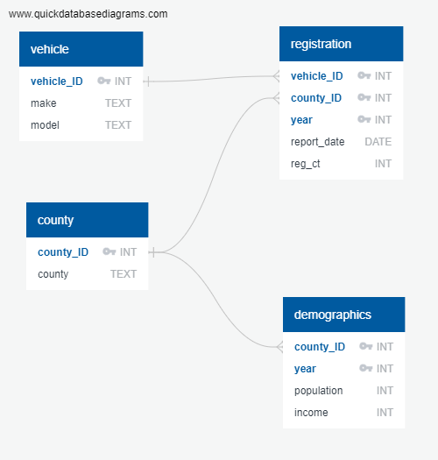
Coding Approach
Store Data
Access Data
SQLite Database
Vehicle table
County table
Registration table
Demographic table
Combined data using SQL query
Deployed data in json format using Flask app route

Slide 12
Coding Approach
Filter Data
Chart Data
SQLite Database
Vehicle table
County table
Registration table
Demographic table
D3 Bar Chart
Plotly Pie Chart
Leaflet Map

Slide 13
Coding Approach
Find Data
Clean Data
All data was for 2018,2019,2020
CSV of EV Registrations by county
CSV of EV Charging stations
API of Population & Income by county
Utilized Pandas and Python for most data cleaning
Store Data
Access Data
SQLite Database
Vehicle table
County table
Registration table
Demographic table
Combined data using SQL query
Deployed data in json format using Flask app route

Slide 14
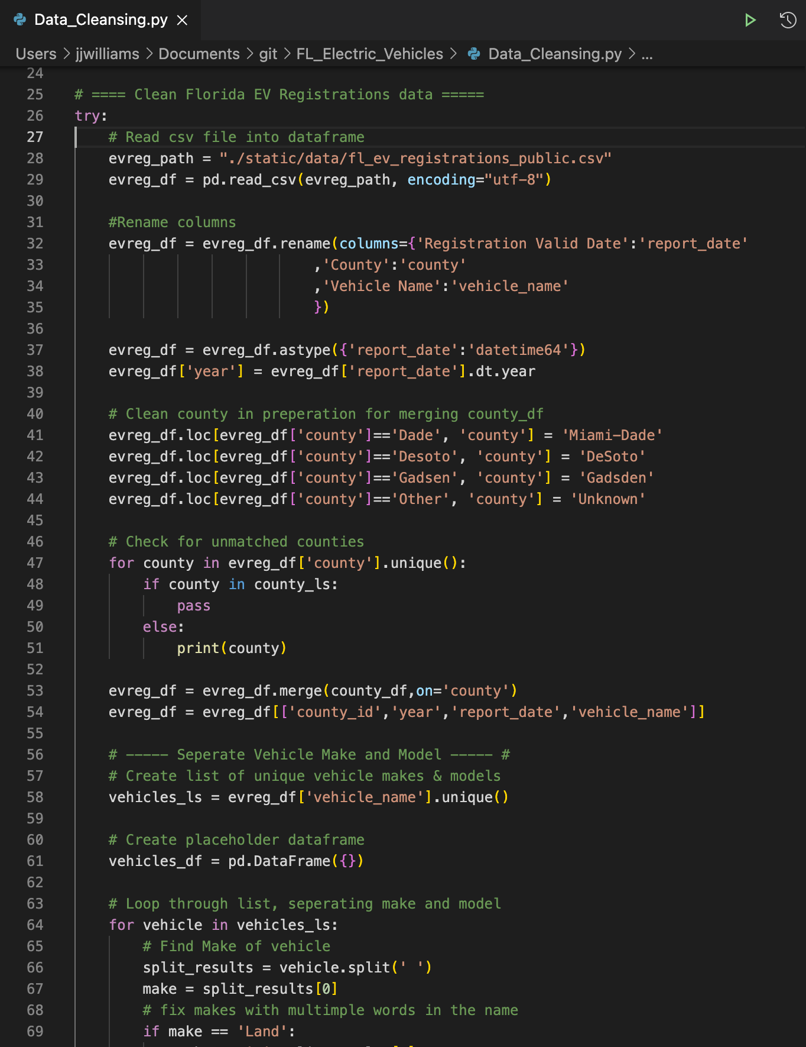



Coding Approach
Find Data
Clean Data
All data was for 2018,2019,2020
CSV of EV Registrations by county
CSV of EV Charging stations
API of Population & Income by county
Utilized Pandas and Python for most data cleaning

Slide 15
Add a Slide Title - 2

Slide 16
Two content layout with table
First bullet point here
Second bullet point here
Third bullet point here
Class | Group 1 | Group 2
Class 1 | 82 | 95
Class 2 | 76 | 88
Class 3 | 84 | 90

Slide 17
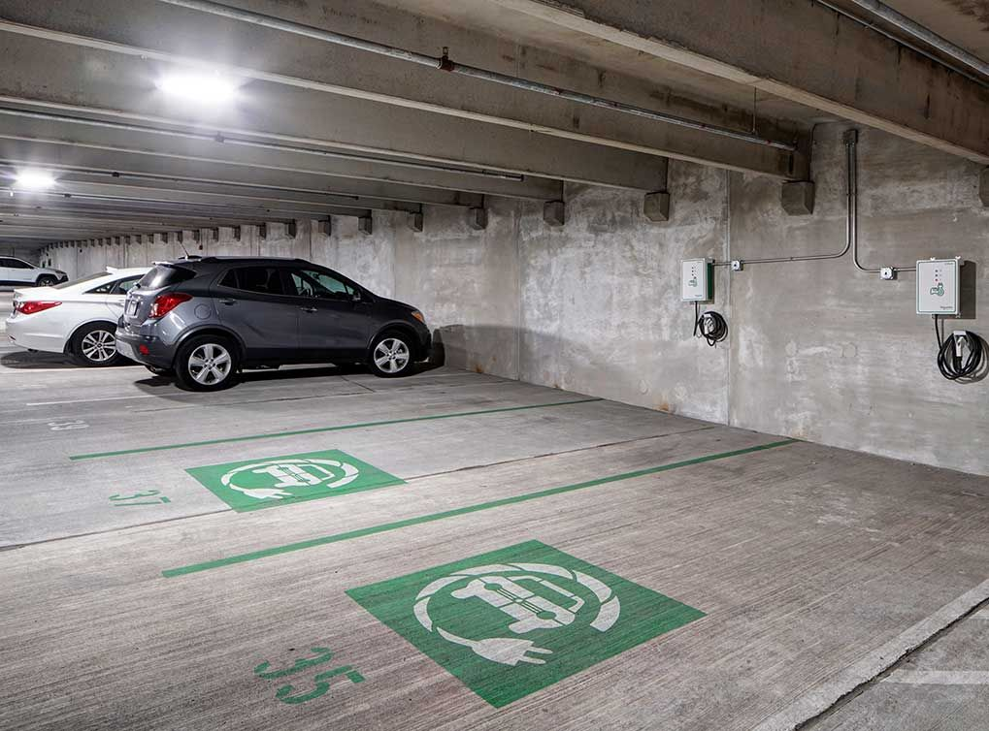
Data Cleaning

Slide 18
Two content layout with SmartArt
First bullet point here
Second bullet point here
Third bullet point here
Goal
Step 1
Step 2
Step 3

Slide 19
Add a Slide Title - 2

Slide 20
Add a Slide Title - 3

Slide 21
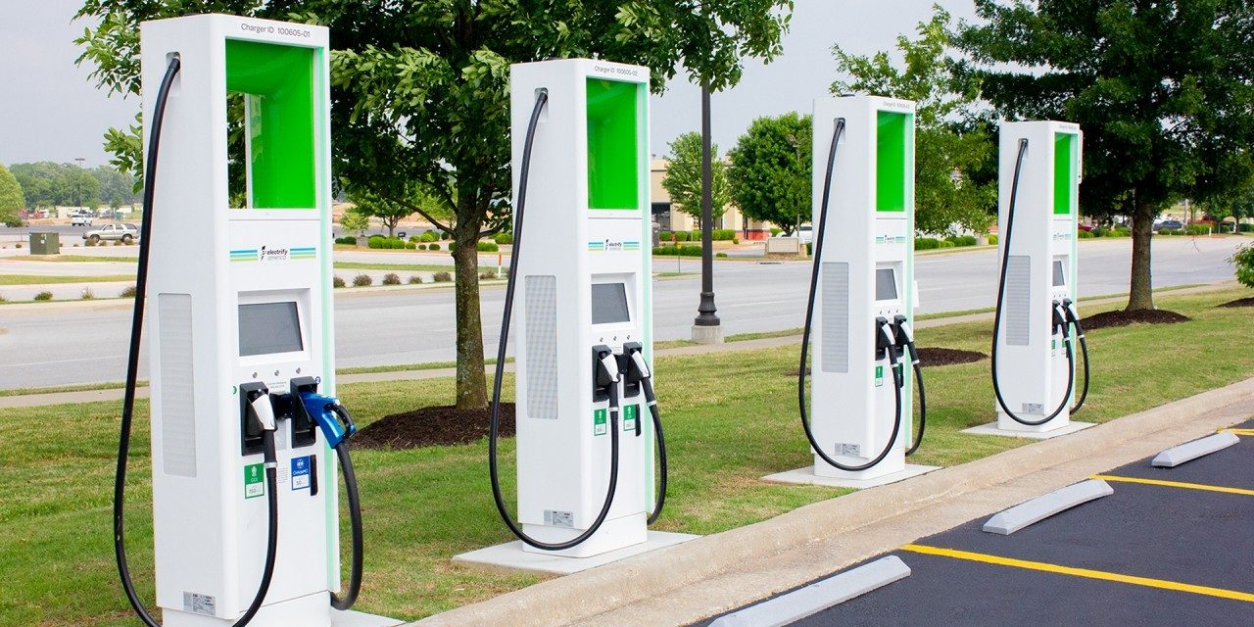
EV Cars Charging Stations in Florida

Slide 22
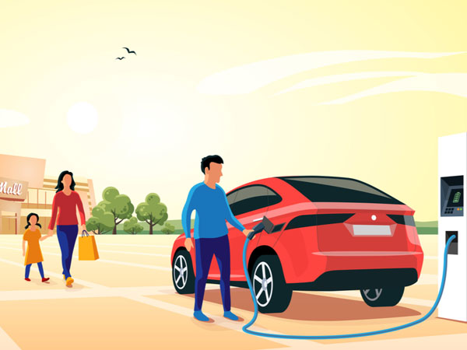
Florida EV Cars Website

Slide 23
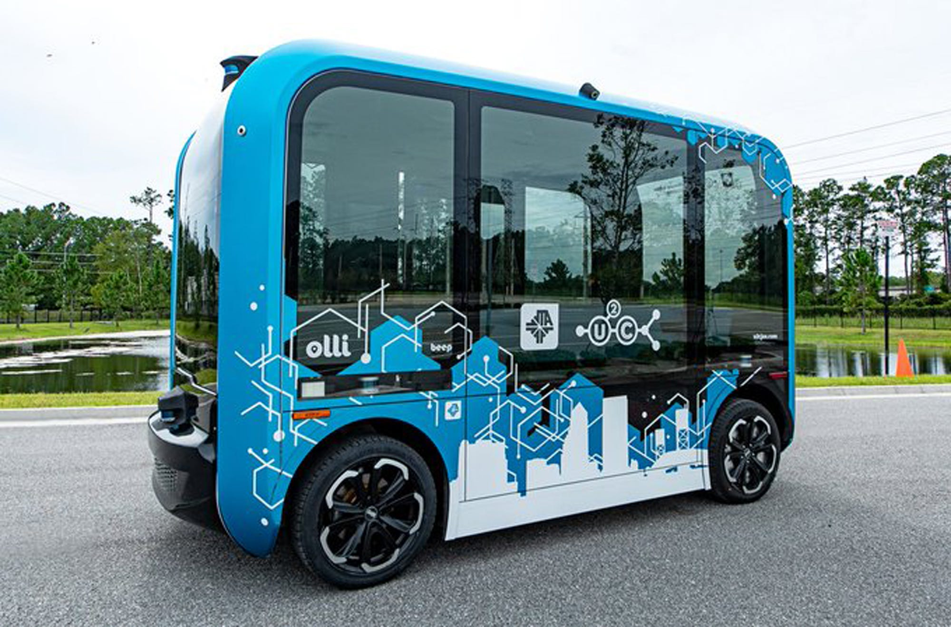
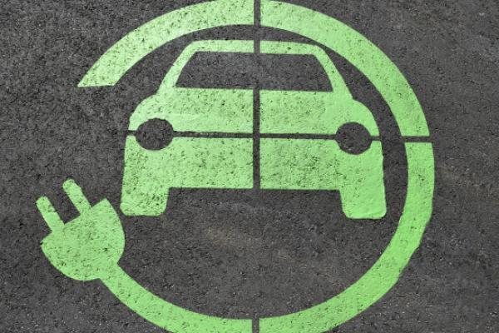
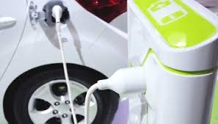

Slide 24

Thank you letting us share our story!

