Slide 1

Data Munging Techniques

Slide 2
Data Munging
FL EV Registrations (csv)
Census Data (json api & csv)
Charging Stations (csv)
SQLite Database
Exploring
What is available and what format is it in?
Exploratory Analysis in Jupyter Notebook
Cleansing
Standardize County names
Remove unnecessary records and columns
Validation
Are there missing values?

Slide 3
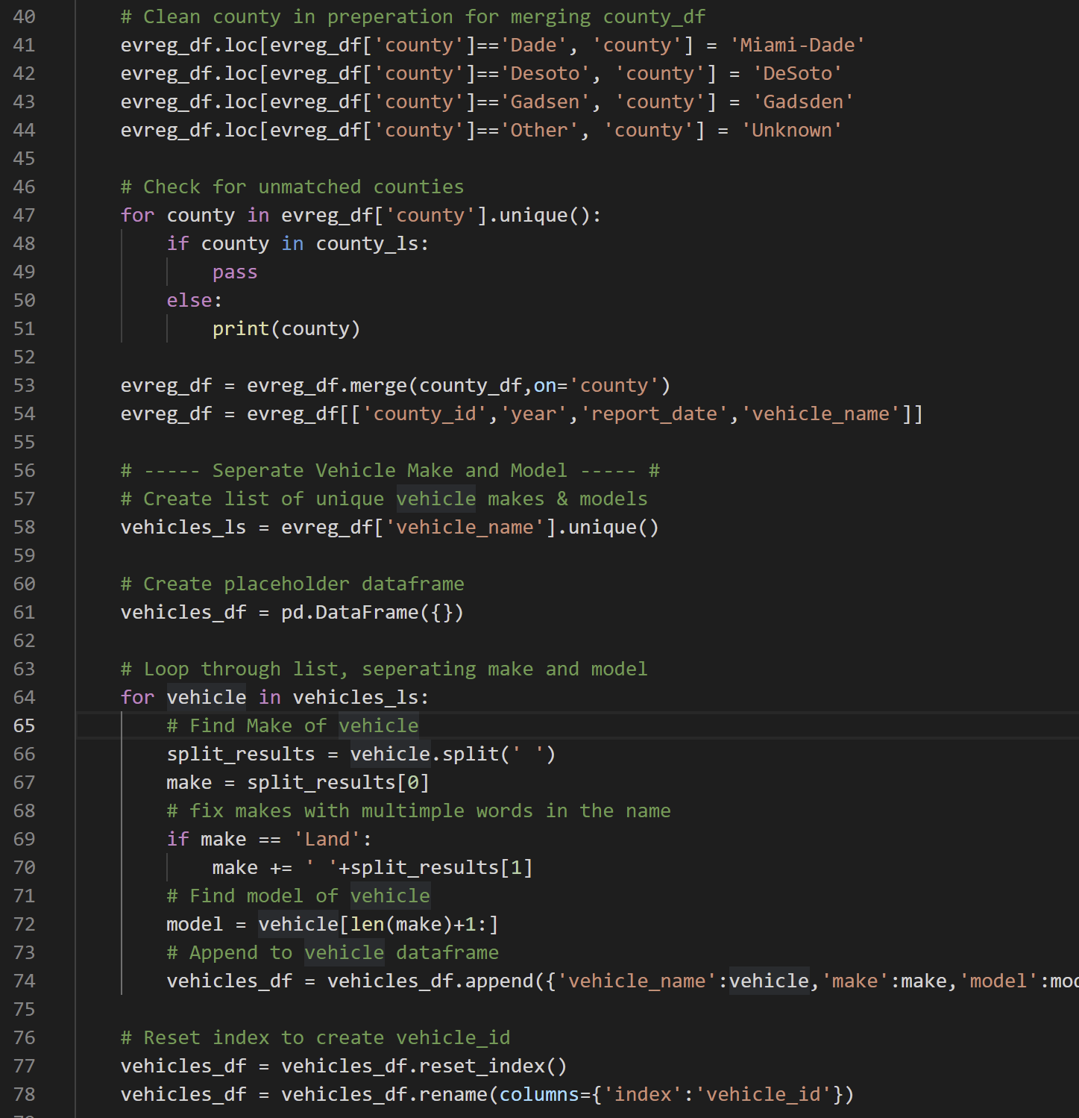
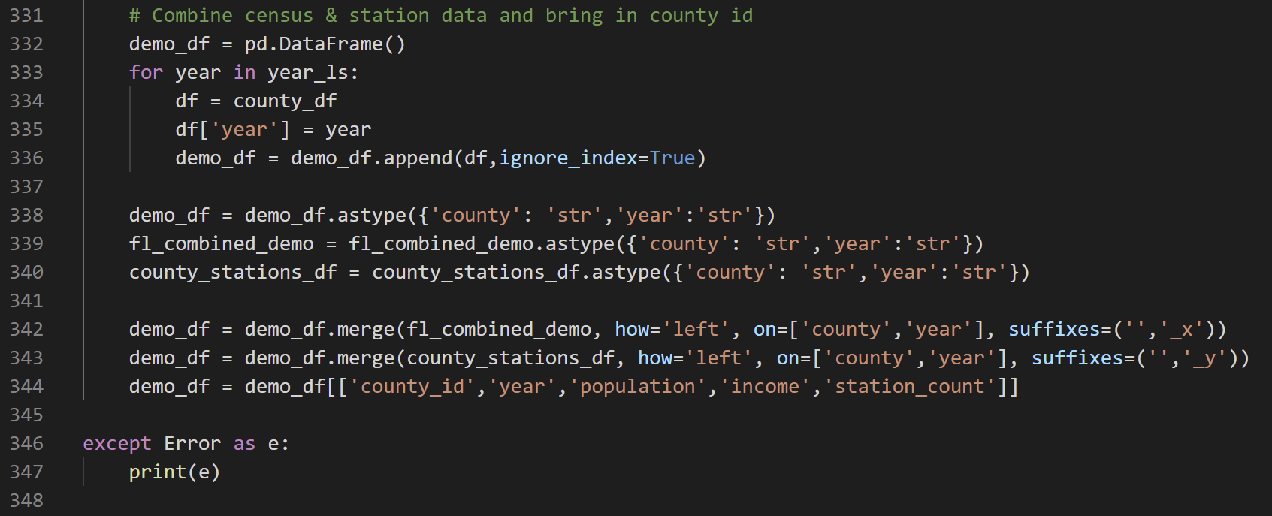
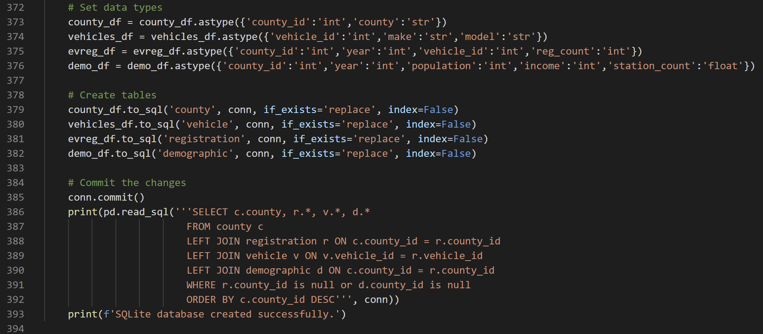
Data Munging

