Slide 1

Florida Electric Vehicles (EV)
Presented by
Sam Azhari
Christina Gangi
Joseph Williams
Altricia Latimer

Slide 2
Project Overview
Goal
Find Data
Clean Data
Store Data
Access Data
Filter Data
Chart Data
Find Data
Clean Data
Store Data
Access Data
Filter Data
Chart Data

Slide 3

Coding Approach

Slide 4
Coding Approach
Access Data
Filter Data
Setup a Flask app
Connect to SQLite DB
Setup 2 app routes
Home
Renders index.html template
Data
Runs SQL query to join tables
Returns query to json
Additional json files for map layers
Read json from data route with D3
Used .map and .filter to create unique variable with data needed for each specific visual
Passed that variable to build chart helper functions

Slide 5

Thank you letting us share our story!

Slide 6
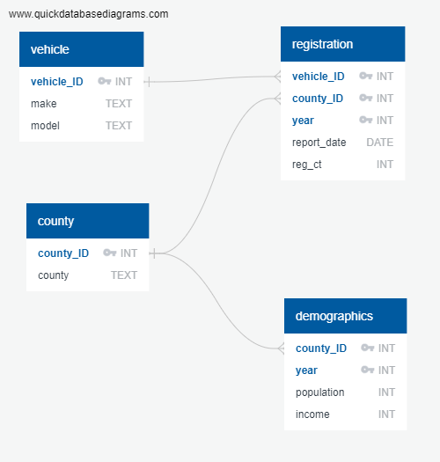
Coding Approach
Store Data
Access Data
SQLite Database
Vehicle table
County table
Registration table
Demographic table
Combined data using SQL query
Deployed data in json format using Flask app route

Slide 7
Coding Approach
Filter Data
Chart Data
SQLite Database
Vehicle table
County table
Registration table
Demographic table
D3 Bar Chart
Plotly Pie Chart
Leaflet Map

Slide 8
Coding Approach
Find Data
Clean Data
All data was for 2018,2019,2020
CSV of EV Registrations by county
CSV of EV Charging stations
API of Population & Income by county
Utilized Pandas and Python for most data cleaning
Store Data
Access Data
SQLite Database
Vehicle table
County table
Registration table
Demographic table
Combined data using SQL query
Deployed data in json format using Flask app route

Slide 9
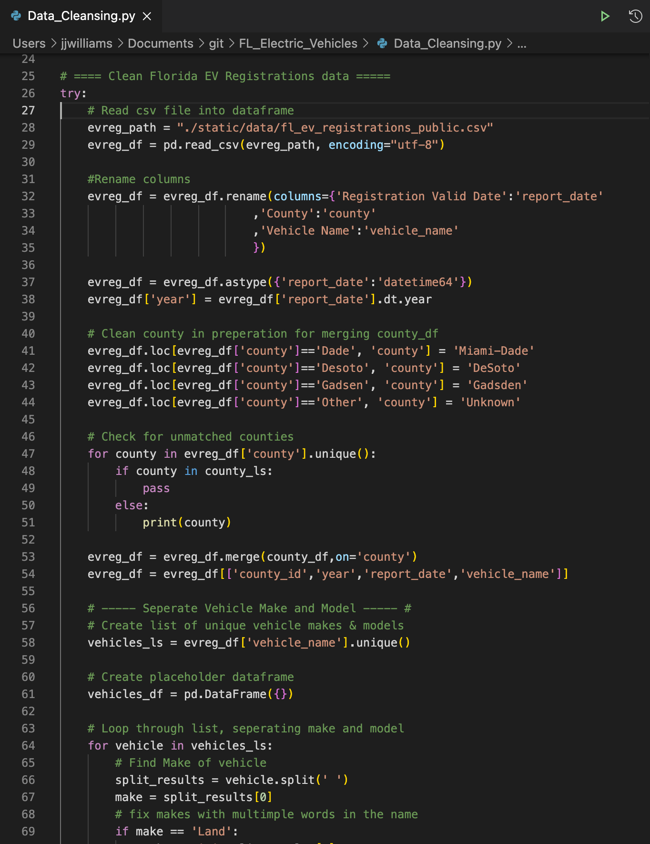



Coding Approach
Find Data
Clean Data
All data was for 2018,2019,2020
CSV of EV Registrations by county
CSV of EV Charging stations
API of Population & Income by county
Utilized Pandas and Python for most data cleaning

