Slide 1

Florida Electric Vehicles (EV)
Presented by
Sam Azhari
Christina Gangi
Joseph Williams
Altricia Latimer

Slide 2
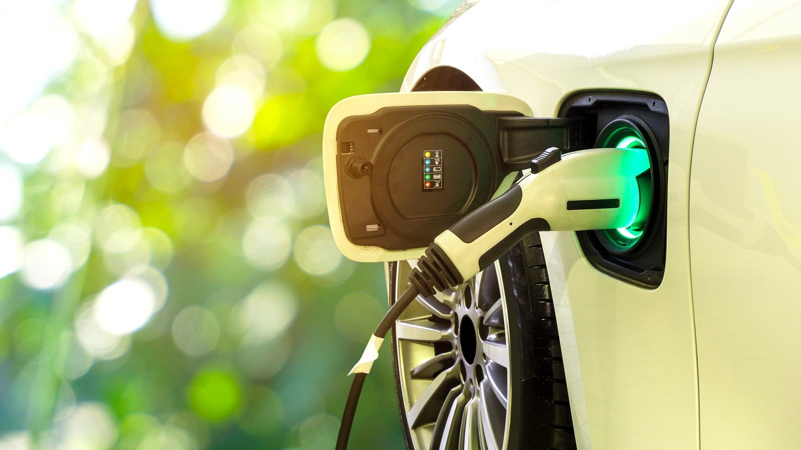
EV Cars Florida Story
Environmental Impact
Investigation in EV Cars in Florida
Data Munging
EV Stations in Florida
Website

Slide 3
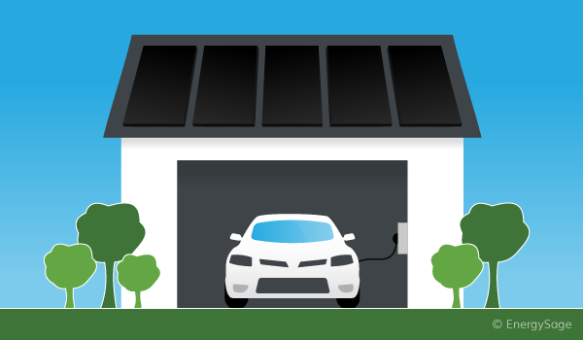
EV Cars Environmental Impact

Slide 4
EV Cars Environmental Impact
Are Electric Cars Really Greener?
Are Electric Cars Really Better for the Environment?
Electrical Vehicles and EV Infrastructure
Transportation Electrification in Florida
Drive Electric Florida
Electric Cars vs. Gas Cars: Everything You Need to Know

Slide 5
Environmental Impact Driving Factors for EV Car Purchase
Environmental and sustainability objectives drive electric vehicle policy support at all governance levels
Policies are being tailored to support market transition
Electric car sales drive cost reductions in batteries, which boosts deployment across all road vehicle categories
Electric vehicles increase electricity demand but reduce oil demand and well-to-wheel greenhouse gas emissions
Battery technologies improve and costs drop
Battery manufacturing

Slide 6
EV Environmental Impact

Slide 7
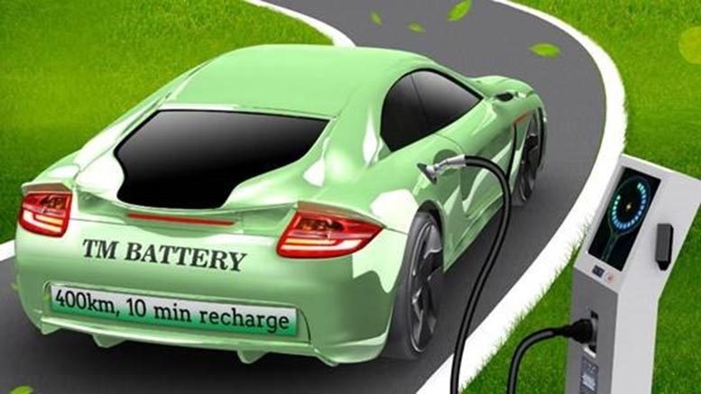
Investigation in EV Cars in Florida

Slide 8
Title and content layout with chart

Slide 9

Data Analysis

Slide 10
Add a Slide Title - 2

Slide 11
Two content layout with table
First bullet point here
Second bullet point here
Third bullet point here
Class | Group 1 | Group 2
Class 1 | 82 | 95
Class 2 | 76 | 88
Class 3 | 84 | 90

Slide 12
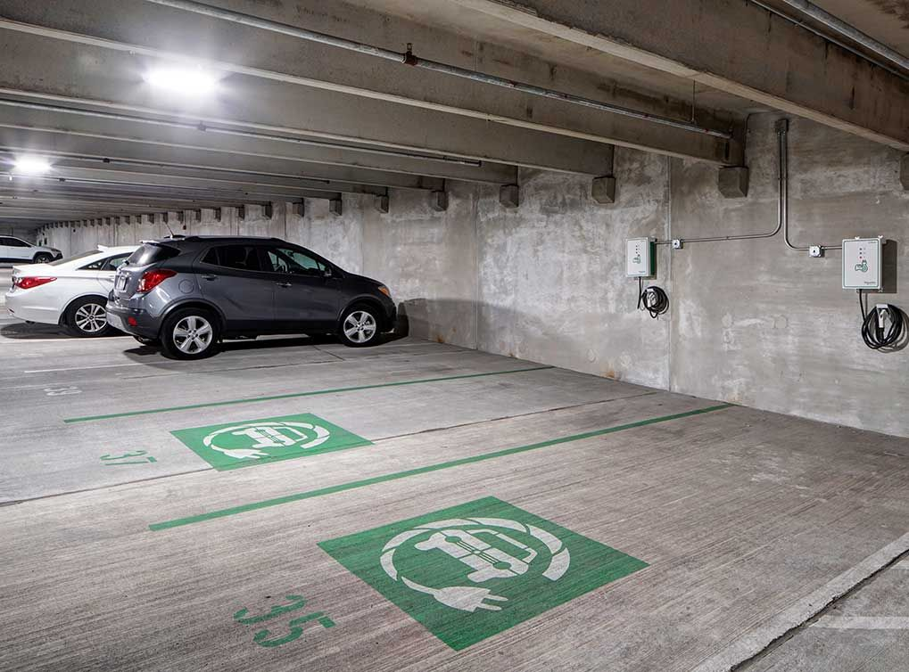
Data Cleaning

Slide 13
Two content layout with SmartArt
First bullet point here
Second bullet point here
Third bullet point here
Goal
Step 1
Step 2
Step 3

Slide 14
EV Cars Environmental Impact

Slide 15
Add a Slide Title - 2

Slide 16
Add a Slide Title - 3

Slide 17
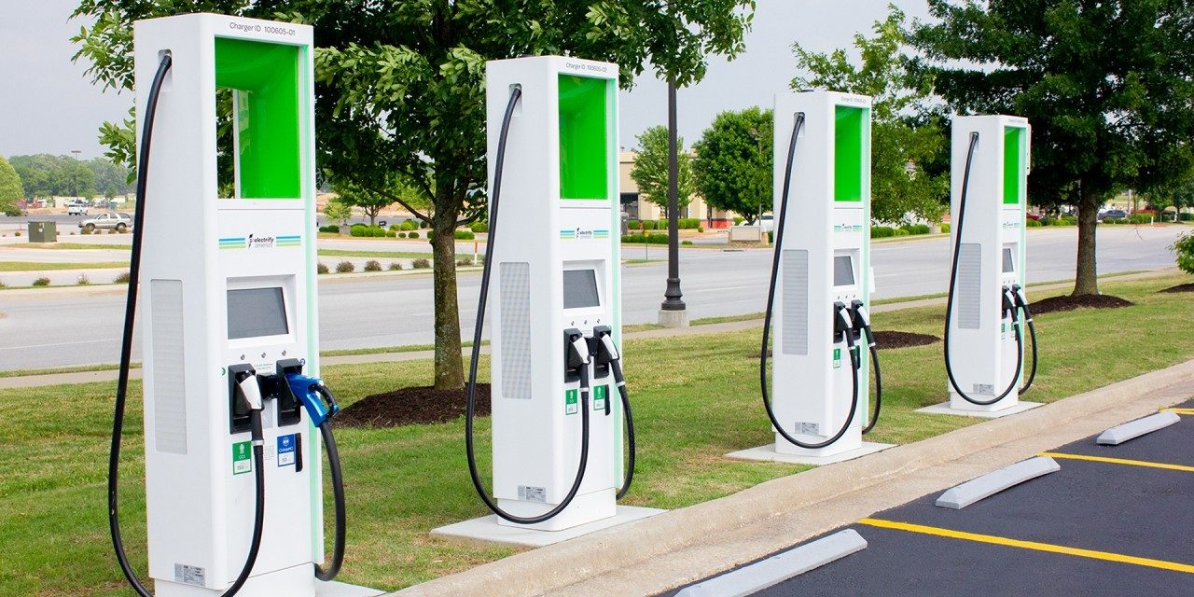
EV Cars Charging Stations in Florida

Slide 18
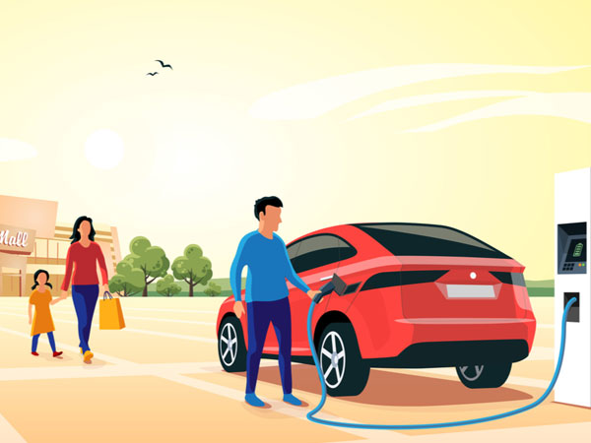
Florida EV Cars Website

Slide 19
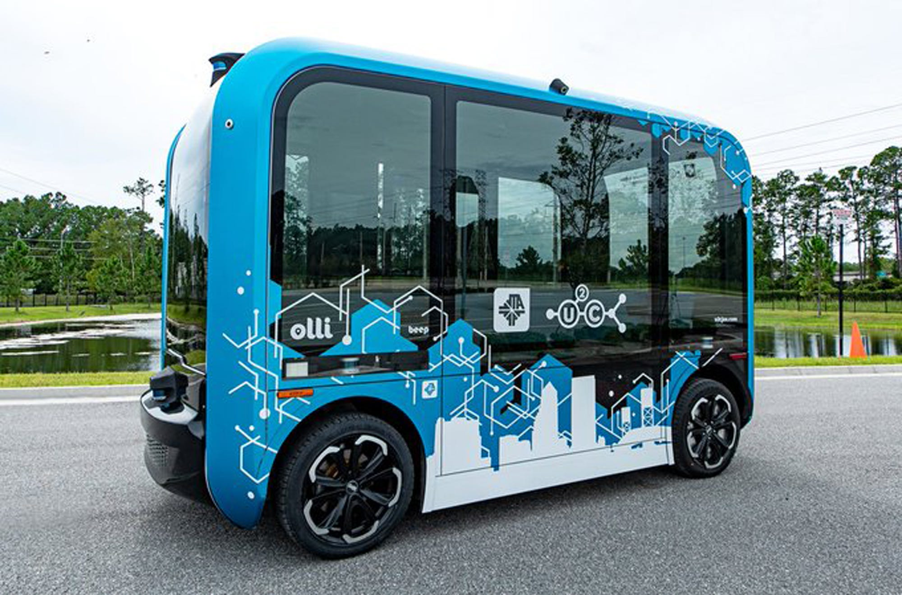
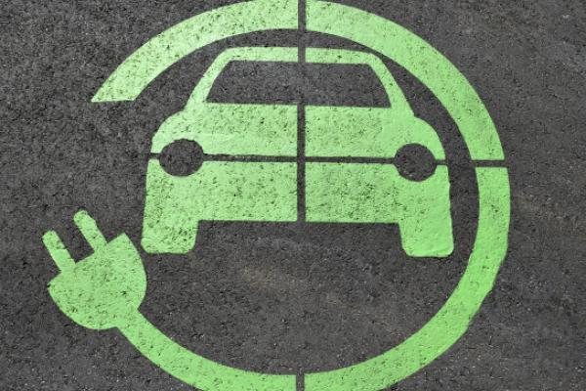
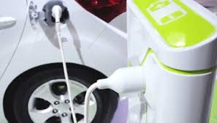

Slide 20
Add a Slide Title - 4

Slide 21

Thank you letting us share our story!

