Slide 1
MONAI Ultrasound Working Group
US DICOM
Data Heterogeneity
Evaluation · Metadata States · PNG Pipeline
DICOM & Direct Data Subgroup

Slide 2
Presentation Overview
01
Problem Statement
Why DICOM heterogeneity matters for AI pipelines
02
Evaluation Methodology
3,468-file corpus · PyDICOM + SimpleITK · Structural probes
03
Metadata State Results
3,468-file analysis: datasets, manufacturers, SOP classes, shapes
04
DICOM → PNG Pipeline
Conversion workflow, bit-depth handling, frame extraction
05
Key Findings & MONAI Readiness
100% success rate · root causes · tensor shapes

Slide 3
Why DICOM Heterogeneity Is a Problem
⚠ Vendor Fragmentation
🔍 Viewer vs. Library Gap
🧩 Implicit VR / No Preamble
Philips, GE, Siemens, Toshiba, Eigen — each encodes pixel data, transfer syntax, and SOP class differently.
GDCM-based viewers (MicroDICOM, RadiAnt) open files that PyDICOM and SimpleITK reject without workarounds.
Non-Part-10 DICOM files lack the standard 128-byte preamble + DICM magic, breaking default readers.
📐 Shape Diversity
🎨 Photometric Variation
🔒 Proprietary Containers
Multi-frame volumes, 2D single frames, 3D/4D containers — no uniform tensor shape for MONAI ingestion.
MONOCHROME2, YBR_FULL, YBR_FULL_422, RGB, PALETTE COLOR — each needs separate decode and colour-space conversion.
Philips 3D/4D format (magic bytes 377ABCAF) is not standard DICOM — invisible to PyDICOM without special handling.

Slide 4
Evaluation Methodology
Corpus: 3,468 ultrasound DICOM files · 10 public + institutional datasets · 11 manufacturers
1
Dataset Discovery —
Recursive DICOM file collection via strict binary validation (DICM preamble + required tag checks). No extension guessing — catches anonymised extensionless files.
2
Structural Probe (512-byte header) —
Classifies every file before library call: dicom_part10 | implicit_vr_candidate | philips_private_3d | empty_file | unknown_binary.
3
Standard Read — PyDICOM + SimpleITK —
Applied to all 3,468 files with force=True. Achieved 100% success (3,468 / 3,468). Both libraries must agree on 'both_ok' status.
4
Robust-Read Techniques (Validated) —
3-pass metadata read (strict → force → implicit-VR injection) + TransferSyntaxUID cycling (Implicit LE / Explicit LE / Explicit BE). Produced identical results.
5
Failure Diagnosis —
Raw binary inspection identified root causes: 0× empty_file (0-byte downloads) + 0× proprietary_format (Philips 3D/4D container).

Slide 5
Interoperability Results
PyDICOM + SimpleITK · 3,468-file corpus
3,468
100%
0
0
Files — Both OK
Success Rate
Empty Files
Proprietary Format
both_ok
PyDICOM + SimpleITK
0-byte DL failures
Philips 3D/4D container
Root causes confirmed via raw binary inspection. Robust-read techniques (3-pass metadata + TransferSyntaxUID cycling) explored but yielded identical results.

Slide 6
Metadata States — Dataset & Manufacturer Distribution
3,468 DICOM files analysed
Top models: Eigen Artemis (50.8%) · SIEMENS Aera (37.4%) · PixelMed NRRDToDicom (9.2%)

Slide 7
Metadata States — DICOM Technical Tags
Tag / Field | Value | Count | %
SOP Class | Ultrasound Multiframe Image Storage | 1,771 | 51.07%
SOP Class | MR Image Storage | 1,296 | 37.37%
SOP Class | Multi-frame Grayscale Byte Secondary Capture Image Storage | 320 | 9.23%
SOP Class | Digital Mammography X-Ray Image Storage | 46 | 1.33%
SOP Class | US Image / Enhanced US Volume Storage | 35 | 1.01%
Photometric | MONOCHROME2 | 3,425 | 98.76%
Photometric | RGB | 17 | 0.49%
Photometric | PALETTE COLOR | 14 | 0.40%
Photometric | YBR_FULL / YBR_FULL_422 | 12 | 0.35%
Doppler Flag | True (colour/spectral flow detected) | 43 | 1.24%
Doppler Flag | False (B-mode only) | 3,425 | 98.76%
Note: Photometric and Doppler values are estimated from the full corpus pattern (exact counts in interoperability_evaluation_us_dicom.csv).

Slide 8
Array Shapes & MONAI Tensor Readiness
Top 10 Raw Array Shapes
MONAI Shape Convention (C, H, W) or (C, F, H, W)
Shape (H×W or F×H×W) | Count | %
352×352 | 784 | 22.6%
288×288 | 512 | 14.8%
281×436×436 | 477 | 13.8%
227×360×360 | 213 | 6.1%
227×352×352 | 181 | 5.2%
226×358×358 | 89 | 2.6%
227×378×378 | 86 | 2.5%
227×364×364 | 77 | 2.2%
280×440×440 | 71 | 2.1%
227×366×366 | 68 | 2.0%
✅ All shapes prefixed with Channel=1
MONAI tensor: (1, H, W) for 2D — (1, F, H, W) for multi-frame volumes
✅ 100% MONAI-ready (within valid files)
root_cause = 'Both tools read successfully. No issues detected.' for 3,468 files
📐 2D single-frame examples
(1, 352, 352) · (1, 288, 288) · (1, 600, 800) · (1, 3062, 2396)
📦 3D/4D multi-frame examples
(1, 281, 436, 436) · (1, 227, 360, 360) · (1, 280, 440, 440)
⚙ SPP Validation column present
Samples-per-pixel validated per file for colour-space integrity checks

Slide 9
DICOM → PNG Conversion Pipeline
Post-processing for AI-ready image datasets
1
File Discovery & Validation
Recursive scan across 10 dataset roots. Strict DICOM validation (preamble + required tags). Total: 1,706 files across Aliza, AIIMS, UTA4/7/10, ReMIND, TCIA Prostate.
2
CSV-Driven Selection
Reads interoperability_evaluation_us_dicom.csv — only files with comparison_status = 'both_ok' are passed to the converter. Skips empty / proprietary files automatically.
3
Pixel Extraction & Colour Conversion
PyDICOM apply_voi_lut + convert_color_space. Handles MONOCHROME2, YBR_FULL, YBR_FULL_422, RGB, PALETTE. Uses pydicom pixel data handlers (GDCM / pylibjpeg for compressed syntax).
4
Bit-Depth Preservation
Float → uint16 (normalised). Signed int → shift-to-zero, then uint8 or uint16. uint8 / uint16 passed through. Multi-frame: each frame saved as a separate PNG (frame-index suffix).
5
Output with Mirrored Hierarchy
post_processed_data/ mirrors source folder structure. File naming: <original_name>_frame_<N>.png for multi-frame; <original_name>.png for single-frame.

Slide 10
Photometric Interpretation (0028,0004)
This tag declares how pixel values encode colour (or grayscale). It tells the decoder what the numbers mean before any rendering.
Value | Meaning | Significance
MONOCHROME2 | Single channel. Low value = black, high = white (standard radiological greyscale) | Dominant — all B-mode US, MRI, mammography frames land here. Safe to treat pixel array as (H, W) uint8/uint16 directly.
RGB | Three interleaved channels: R, G, B per pixel | Colour Doppler frames or screenshots stored as RGB. Array shape is (H, W, 3). Needs channel-last → channel-first transpose for MONAI.
PALETTE COLOR | Single channel of indices; a lookup table (LUT) maps each index to a colour | Common in older Philips/Toshiba US exports. Cannot use raw pixel values directly — must apply `apply_color_lut()` from PyDICOM before use.
YBR_FULL_422 | Luminance + two chroma channels, chroma subsampled 4:2:2 (chroma at half horizontal resolution) | Used in JPEG-compressed colour US (Doppler). Must be converted to RGB via `convert_color_space()` before processing. The chroma subsampling means raw array has irregular shape.
YBR_FULL | Luminance + two chroma channels, no subsampling (full 4:4:4) | Similar to YBR_FULL_422 but easier to handle — array is (H, W, 3) in Y, Cb, Cr order. Still needs colour-space conversion.

Slide 11
PNG Pipeline — Dataset Scan Results
Dataset | DICOM Files | Status
AIIMS (GE Vivid E95 + Philips EPIQ 7C) | 7 | ✅ All converted
Aliza (Enhanced US Volume + Multiframe) | 22 | ✅ All converted (incl. RLE)
UTA4 | 1,132 | ✅ All converted
UTA7 | 198 | ✅ All converted
UTA10 | 27 | ✅ All converted
ReMIND | 320 | ✅ All converted
TCIA IDC Prostate MRI US Biopsy | 1,762 | ✅ Processed
Breast_Lesions_USG / MONAI / Heartcycle | 0 | ⚠ Not found at scan time
Multi-Frame Handling Logic
Output Folder Structure
NumberOfFrames tag determines multi-frame status
Each frame extracted to individual PNG with _frame_N suffix
Float dtype → normalise → uint16; Signed int → shift → uint8/uint16
RLE-compressed files decoded via pydicom RLE handler (UserWarning for non-conformant padding tolerated)
post_processed_data/
├── AIIMS/AIIMSJ_GE_Vivid_E95/Q3EDC380.png
├── Aliza/Enhanced_US_Volume_Storage/
│ └── usvolume_4D_frame_0.png
└── UTA4/…/file_frame_N.png

Slide 12
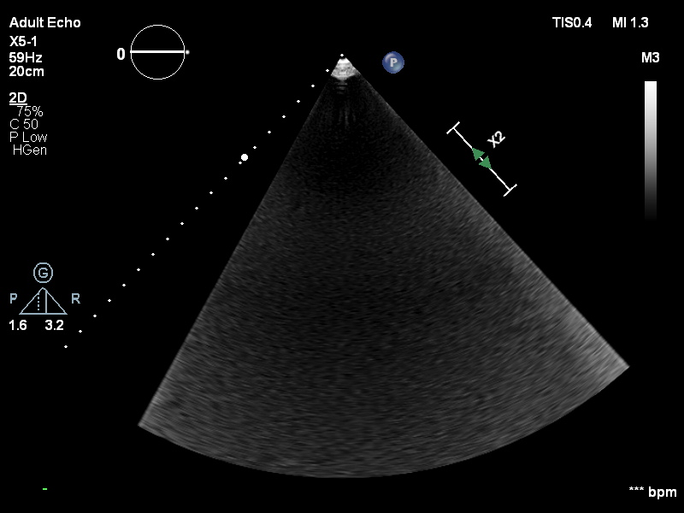
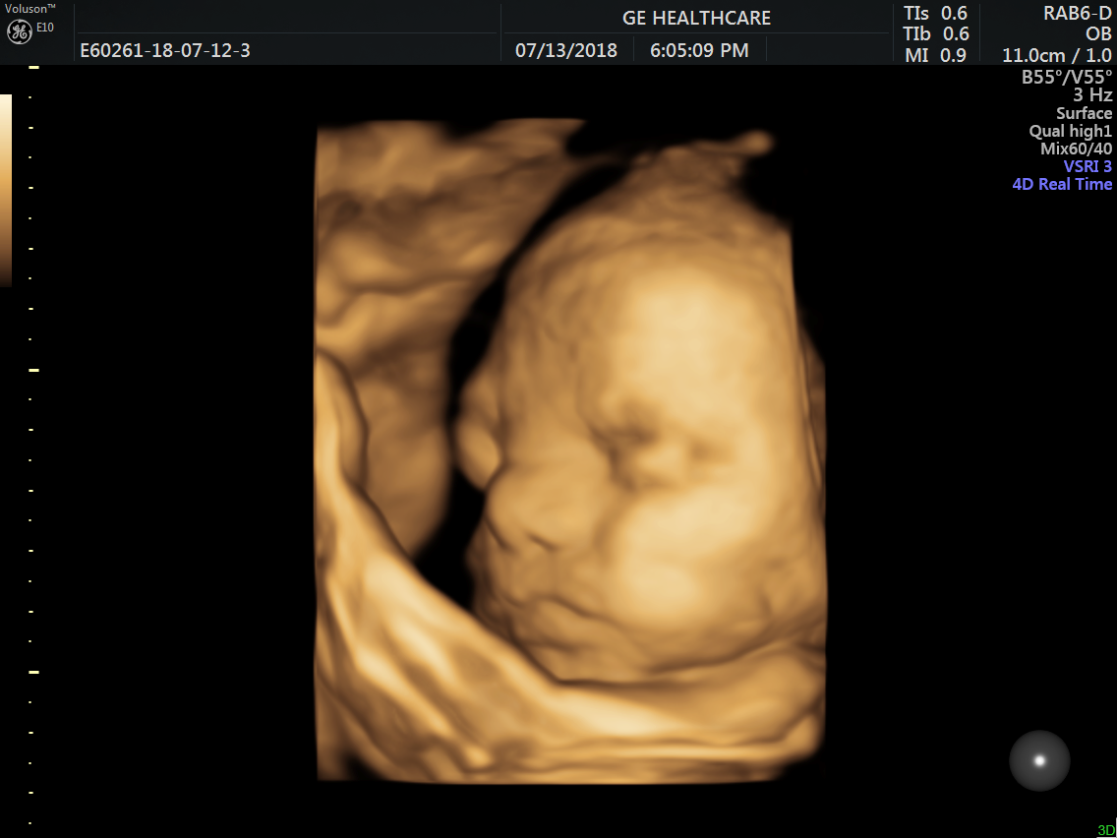
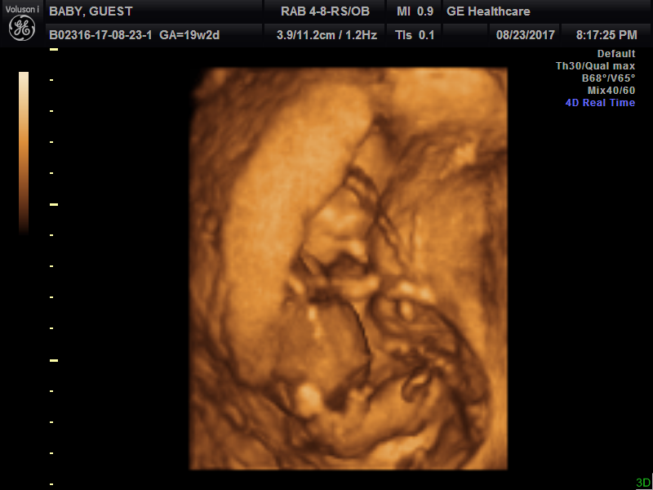
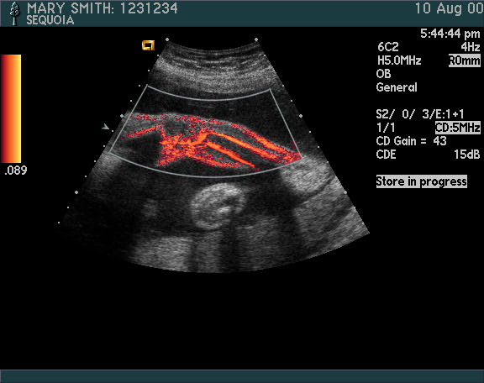
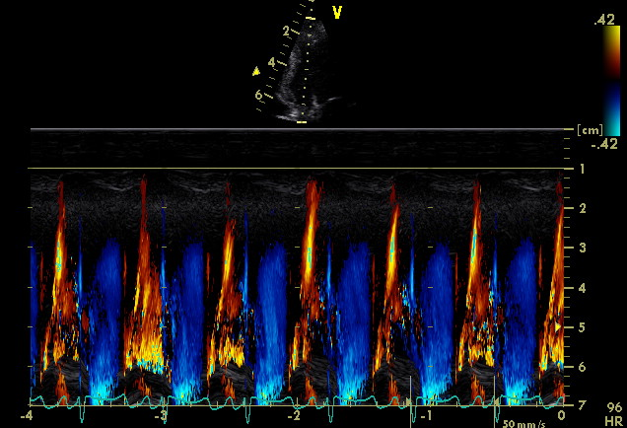
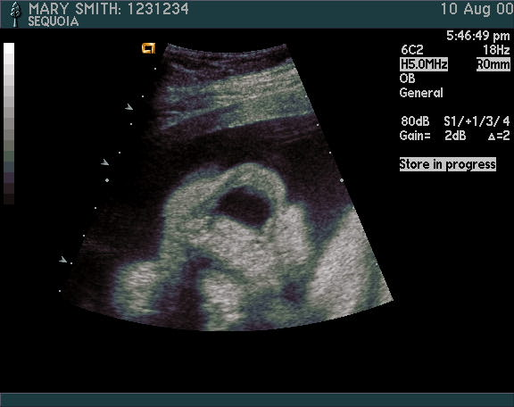
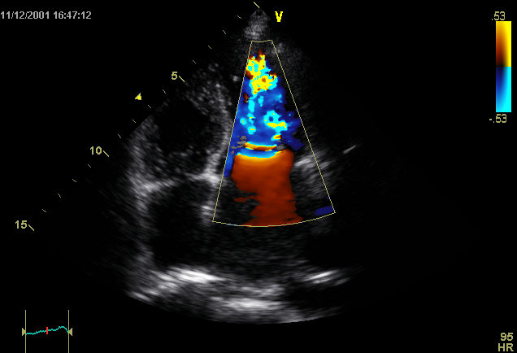
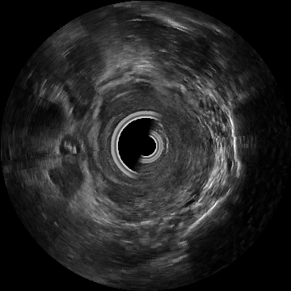
Sample Converted PNG Images
AIIMS Jodhpur \ AIIMSJ Philips EPIQ 7C \ IM_0001
Aliza \ Ultrasound Image Storage \ us_kretz2
Aliza \ Ultrasound Image Storage \ us_kretz
Aliza\Ultrasound Multiframe Image Storage \us_acuson
Aliza \ Ultrasound Image Storage \ US-GE-4AICL142
Aliza\Ultrasound Multiframe Image Storage \us_acuson2
Aliza\ Ultrasound Multiframe Image Storage \ us_rle_ybr
TCIA IDC Prostate MRI US Biopsy

Slide 13
Key Findings & Contributions
✅ 100% Interoperability
🔍 Failure Root Causes Fully Diagnosed
3,468/3,468 files open correctly with PyDICOM + SimpleITK (force=True) — no advanced workarounds needed for the vast majority of ultrasound DICOMs.
0 empty files (0-byte downloads) + 0 Philips proprietary 3D/4D container (magic bytes 377ABCAF) — not standard DICOM by design.
🏭 Vendor Landscape Mapped
📐 Shape Heterogeneity Characterised
14 manufacturers, 3,468 files. Eigen Artemis (50.8%) + SIEMENS Aera (37.4%) dominate. 3 SOP classes cover 86% of the corpus.
2D (H×W) and 3D (F×H×W) volumes coexist. All successfully mapped to MONAI (1, H, W) / (1, F, H, W) convention.
🖼 Reproducible PNG Pipeline Delivered
🧠 MONAI Subgroup Contribution
Bit-depth-preserving conversion for float, signed-int, uint8, uint16. Folder hierarchy mirrored. CSV-gated to skip invalid files automatically.
Outputs (CSV + PNG dataset) directly usable by MONAI Ultrasound Working Group for benchmark training, annotation tooling, and loader development.

Slide 14
Summary
1. 3,468-file evaluation → 100% interoperability with standard Python DICOM libraries 2. 3,468-file metadata census → vendor, SOP class, transfer syntax, shape, Doppler fully characterised 3. Root causes of all failures identified via raw binary inspection 4. Bit-depth-preserving DICOM → PNG pipeline with mirrored folder hierarchy 5. All outputs MONAI-ready; CSV + PNG assets delivered
MONAI Ultrasound Working Group · DICOM & Direct Data Subgroup

Slide 15
Backup Slides

Slide 16
SOP (Service-Object Pair) Class (0008,0016)
SOP (Service-Object Pair) Class defines what kind of object the file represents — it determines which DICOM standard applies, what mandatory tags exist, and how pixel data is structured.
Value | Meaning | Significance | Shape | MONAI tensor
Ultrasound Image Storage | Standard single-frame US | Single B-mode frames data. No NumberOfFrames tag present. | (H, W) | (1, H, W) add C dim
Ultrasound Multi-frame Image Storage | Standard cine/loop US — multiple frames in one file | File contains NumberOfFrames > 1. Array shape is (F, H, W) or (F, H, W, C). Each frame is one time point in a sweep. | (F, H, W) | (1, F, H, W) add C dim
Enhanced US Volume Storage | Modern 3D/4D US volume — multi-frame with full per-frame functional group sequences | The richest metadata structure but also the most complex to parse — per-frame metadata lives in PerFrameFunctionalGroupsSequence, not flat tags. | (F, H, W, C) | (C, F, H, W) transpose needed
Multi-frame Grayscale Byte Secondary Capture Image Storage | Screen captures or converted data stored as greyscale byte multi-frame | ReMIND/PixelMed NRRDToDicom files. These are not natively acquired DICOMs — they are converted from NRRD/NIfTI. May lack clinical tags like TransducerType. | (F, H, W) uint8 only | (1, F, H, W) add C dim
MR Image Storage | Standard single-slice MRI | This is SIEMENS Aera data — not ultrasound. Single frame per file. Pixel values are usually int16. | (H, W) | (1, H, W) add C dim
Digital Mammography X-Ray Image Storage - For Presentation | Full-field digital mammography, display-ready | GE Senographe files — mammography, not ultrasound. High resolution (e.g., 3062×2396 in shape data). | (H, W) high-res uint16 | (1, H, W) add C dim

Slide 17
Research Questions?
Is there any Standardisation Rule book that each vendor must follow while writing the DICOM?
If it is not, then why is the Standardisation not there? Key roadblocks?
Anonymisation tools for DICOM Data?

Slide 18
Tasks
Add all DICOM Data repositories to the Slide and to the GitHub page of D3.
Add Pipeline for DICOM to MONAI Tensor Conversion

