Slide 1
Computer
A computer is a device

Slide 2
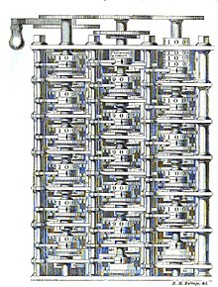
Computer
According to the Oxford English Dictionary, the first known use of the word "computer" was in 1613 in a book called The Yong Mans Gleanings
In the 1770s Pierre Jaquet-Droz, a Swiss watchmaker, built a mechanical doll (automata) that could write holding a quill pen
Charles Babbage, an English mechanical engineer and polymath, originated the concept of a programmable computer.

Slide 3
Chart

Slide 4
Table
Variable | Mean | SD
Group size | 385.31 | 455.22
Group closeness | 0.20 | 0.02
Group AggConstraint | 0.18 | 0.20

