Slide 1
Convolutional Neural Network For Decision Making in Competitive Snake Game
Presented by:
Joshua Bruton ○ Or Hanoch ○ Devon Jarvis
Instructor:
Dr. Richard Klein

Slide 2
What is a Convolutional Neural Network
Neural networks are a biologically-inspired programming paradigm which enables a computer to learn from observational data.
Convolutional neural networks are a deep learning method, using multi-layer neural networks that aim to learn feature hierarchies within data.

Slide 3
Our Goal
To use a convolutional neural network to imitate the behavior or decisions of a “master” snake when competing in the competitive snake game.
The master snake was determined during training as being the snake that is winning on the overall leader board at any given time.
Thus our snake would not attempt to imitate a single snake but learn a general best behavior from a group of the best snakes.

Slide 4
Our Network
Convolutional Layer
Input: 52x52x3
Kernel size: 7x7
Number of features: 32
Max Pooling 2x2 Layer 1
Convolutional Layer 2:
Input: 23x23x32
Feature size: 5x5
Number of Features: 64
Max Pooling 2x2 Layer 2
Fully-connected Layer 1:
Input: 5184
Output: 4096
Dropout: 50%
Fully-connected Layer 2:
Input: 4096
Output: 3
General:
Mini-batch size: 500
Learning rate: 0.0005
Optimizer: Adam
Cost Function: Cross-entropy
Activation function: ReLU
Conv1
MaxPool
FullyConnected with Dropout 50%
Conv2
MaxPool
FullyConnected

Slide 5
Training Techniques
Supervised Learning: a form of machine learning in which the network receives labelled data, examples and expected results, and attempts to infer a function.
Training Data: A game state (board map) labelled with the action our network should make in that state (move left, right or straight). The master snake is chosen as the snake that currently has the highest overall score in the current game at that state.
“Sphering”: Centering the board map around the master snakes head so that it is always facing North in the middle of the map. In this way the network sees the game world from the snakes perspective, making it easier to make the correct decision for the snake.

Slide 6
Training Techniques (Cont.)
Layering: Splitting of the game-state into different dimensions each providing unique information. The layers consisted of:
Layer 1: Enemy snakes and walls
Layer 2: The master snake
Layer 3: Apples (normal and super apple)
Transitioning to playing the game: For our network to translate its learning to playing of the game we let our snake take the place of the master, and thus our network would make decisions on the next best move for our snake based on what it had learned from observing the master.

Slide 7
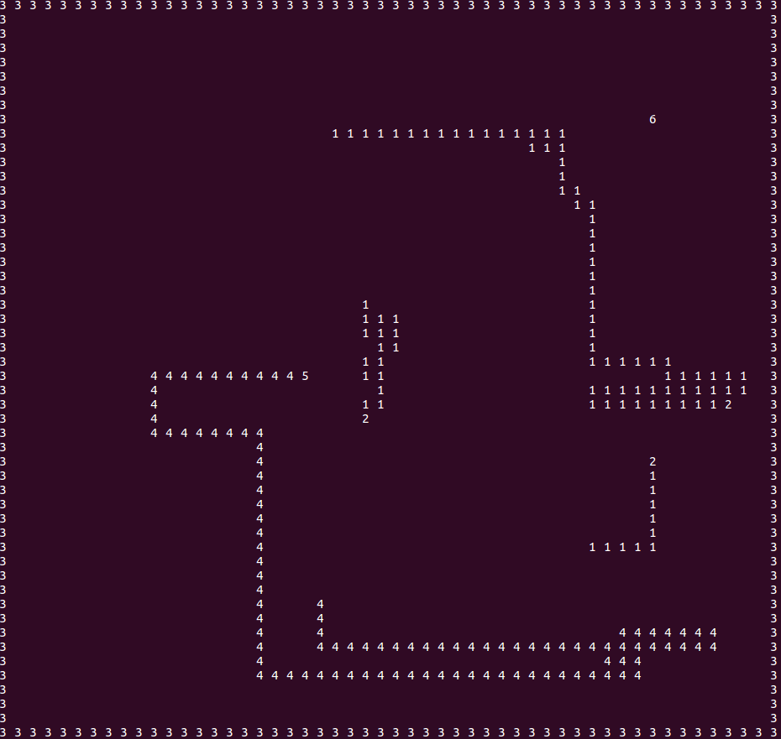
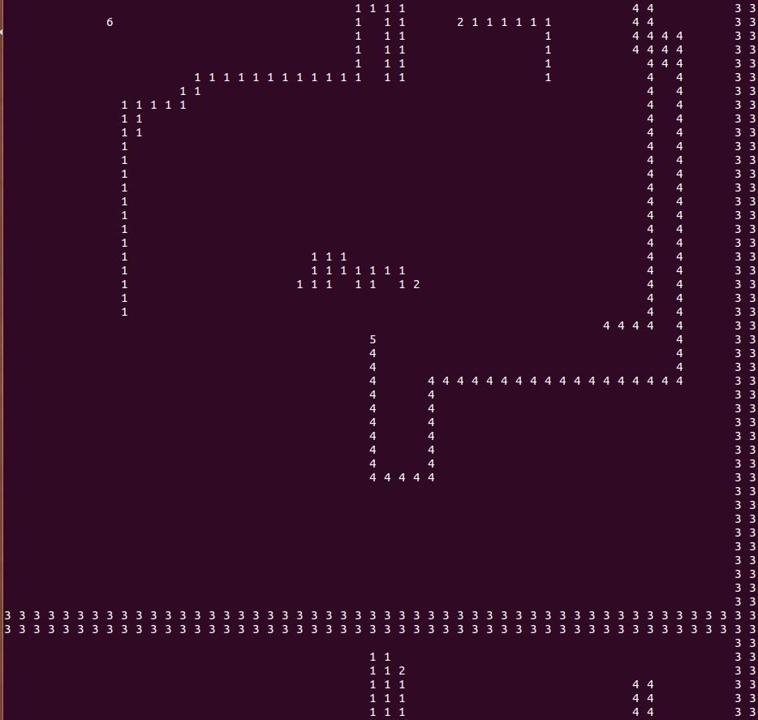
Sphering Game-State Example
Unsphered game-state
Sphered game-state

Slide 8
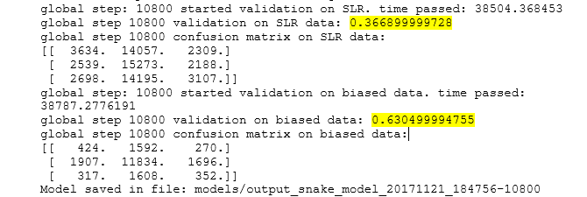
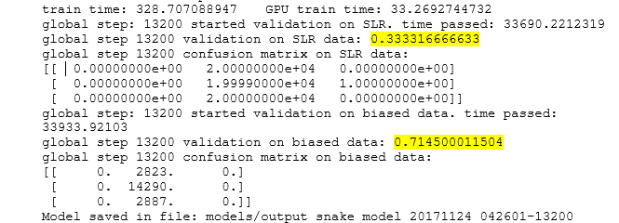
Results and Comparisons
We trained models for our network training on sphered data, our network training on unsphered data and Alexnet on sphered data.
Alexnet On Sphered Data:
Unbiased accuracy: 36.69%
Biased accuracy: 63.05%
Note: that it learnt to heavily favour straight and thus in reality almost exclusively goes straight
Unsphered Data:
Unbiased accuracy: 33.33%
Biased accuracy: 71.45%
Note: learns to only go straight

Slide 9
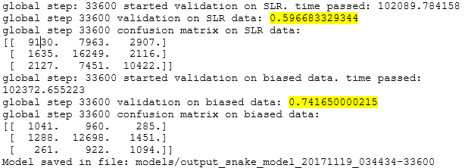
Results and Comparisons
Our Network Sphered Data:
Unbiased accuracy: 59.67%
Biased accuracy: 74.17%
Note: Less variance between the biased and unbiased accuracies

Slide 10
References
Michael Nielsen (August 2017) http://neuralnetworksanddeeplearning.com/
Google Brain Team (Last Updated November 2017) https://www.tensorflow.org/get_started/mnist/pros
Ankit Sachan (2017) http://cv-tricks.com/tensorflow-tutorial/save-restore-tensorflow-models-quick-complete-tutorial/

