Slide 1


STUDENT PORTAL APP Final Project Demo
Group 26
Abhay Aigal, 230341220002
Karan Keshwani, 230341220084

Slide 2
PROBLEM STATEMENT
Major manual efforts in overall modus operandi of the different courses at IACSD, Pune and no single platform for the students to fulfil their day to day demands for a overall smooth learning experience.

Slide 3
OBJECTIVE
“A web application for every student joining IACSD, Pune as a portal to facilitate all the day to day activities and reducing major manual effort of the Course Coordinators by introducing automation at various levels.”

Slide 4
UI MOCKUP

Slide 5
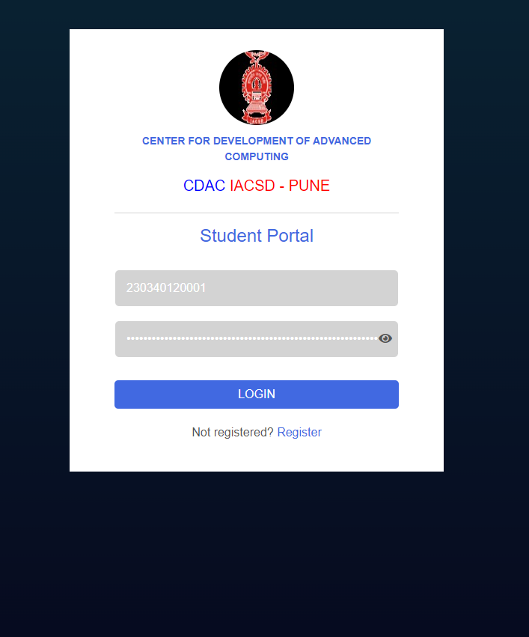
SCREEN – 1 (Login Page)

Slide 6
1. Student Flow

Slide 7
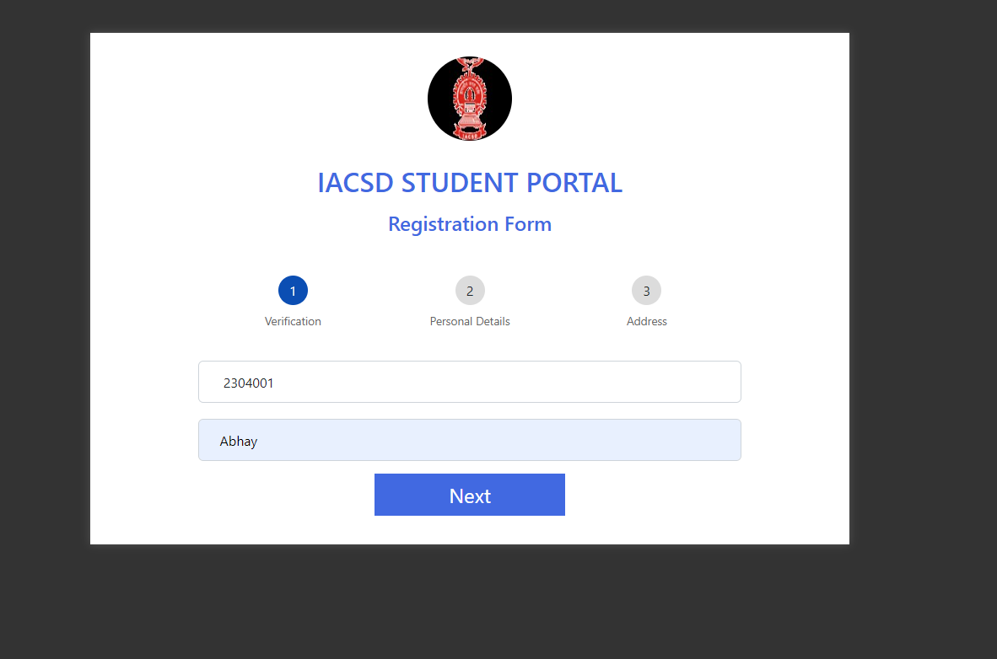
SCREEN – 2 (Registration Page)

Slide 8
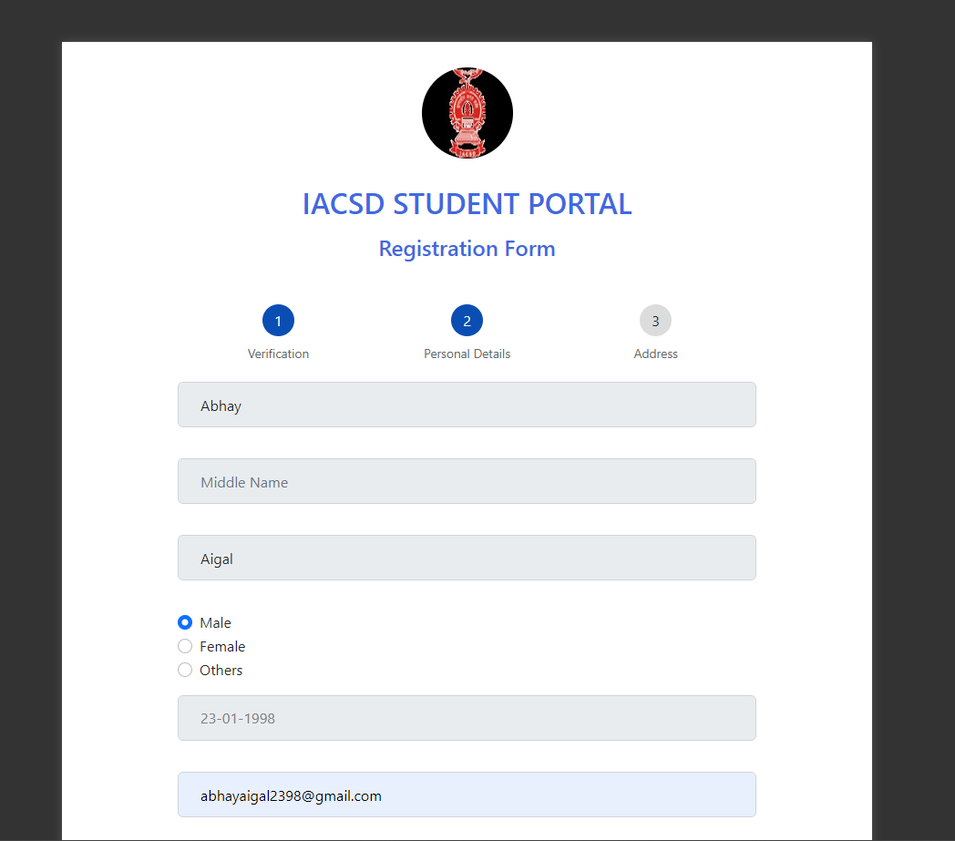

Slide 9
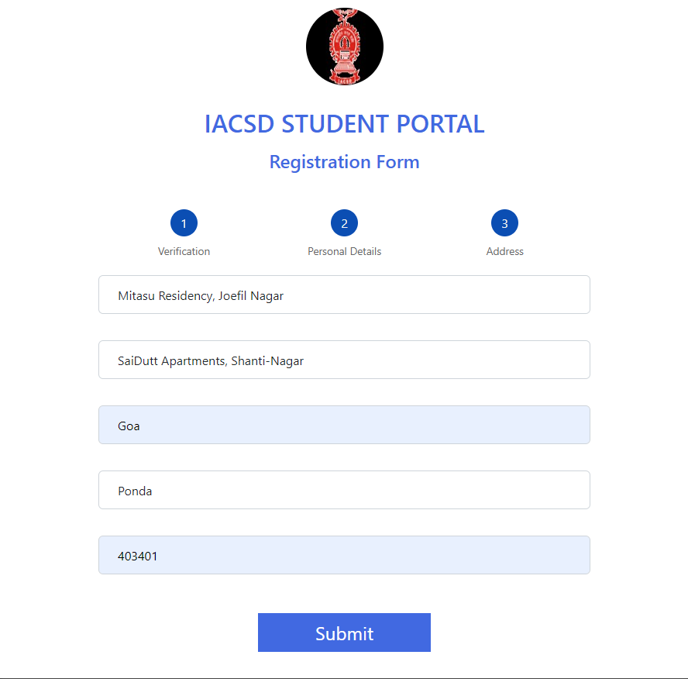

Slide 10
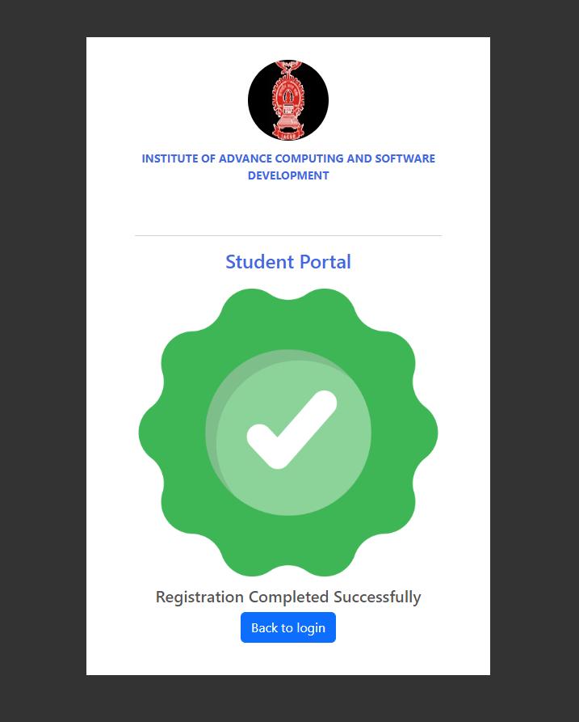

Slide 11
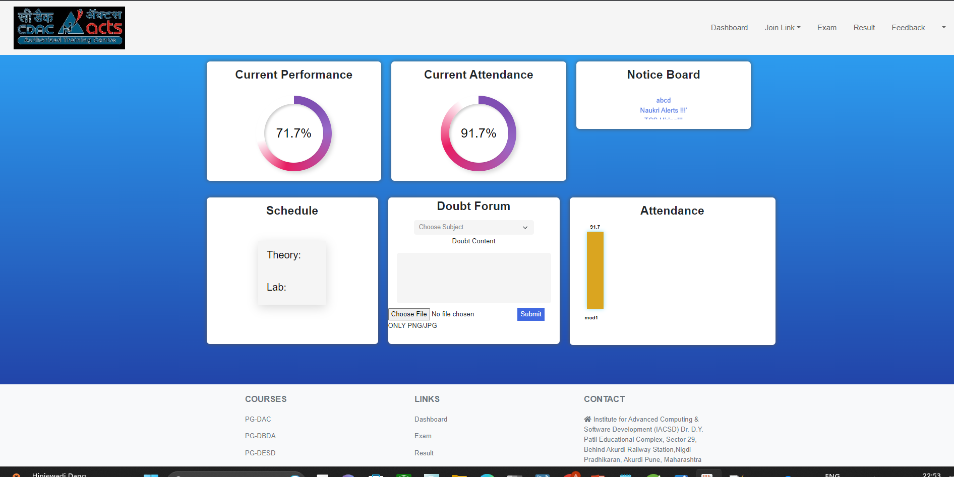
SCREEN – 3 (Student Dashboard)

Slide 12
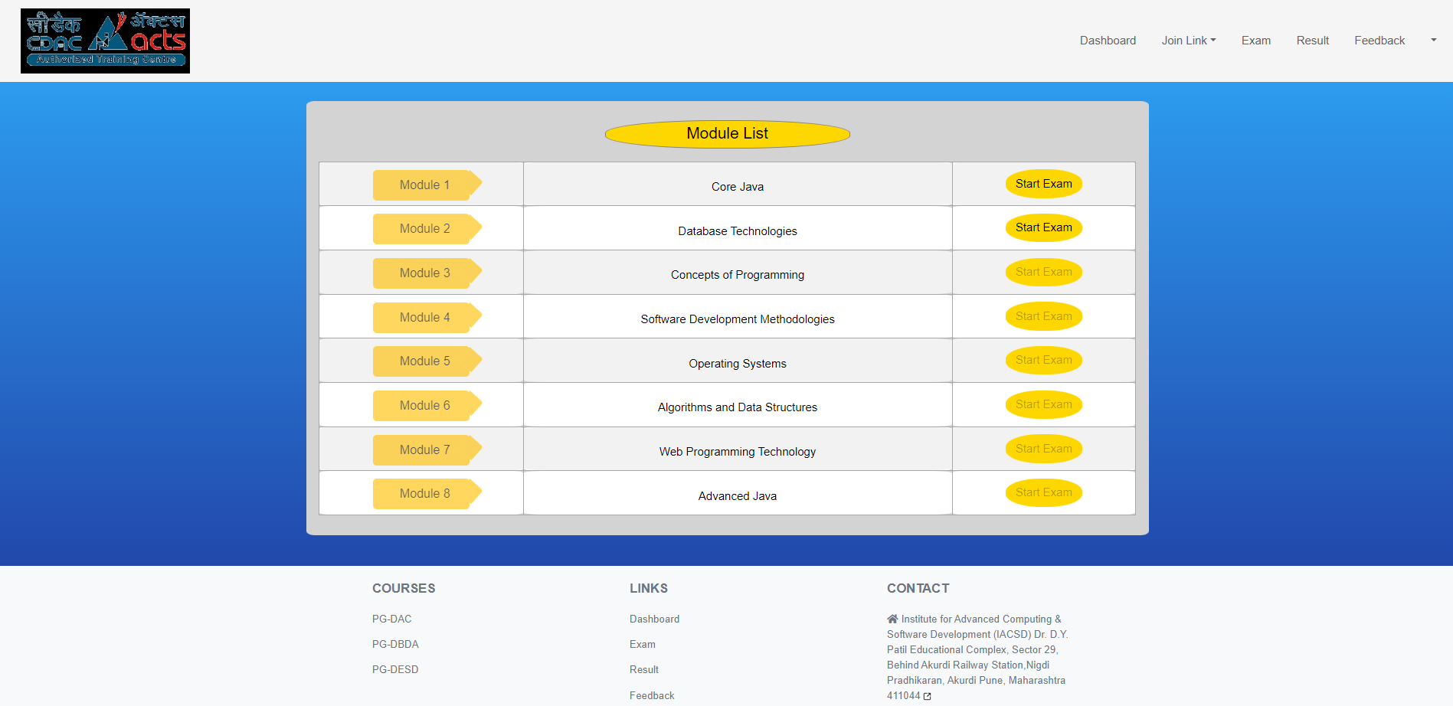
SCREEN – 4 (Exam Page)

Slide 13
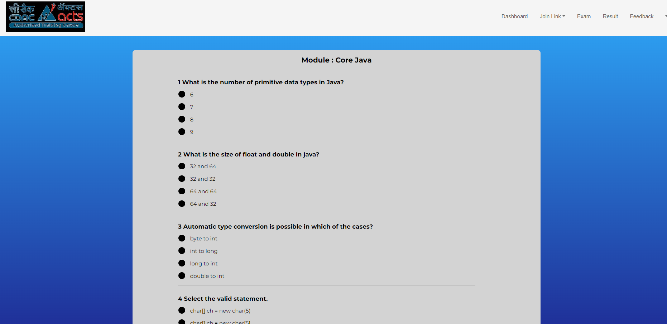
SCREEN – 5 (Question Paper)

Slide 14
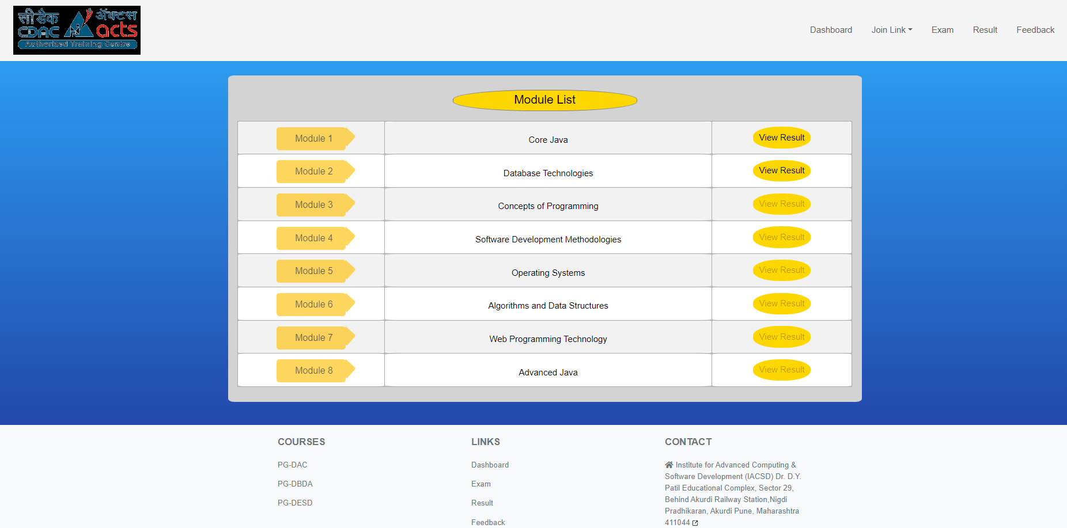
SCREEN – 6 (Result Page)

Slide 15
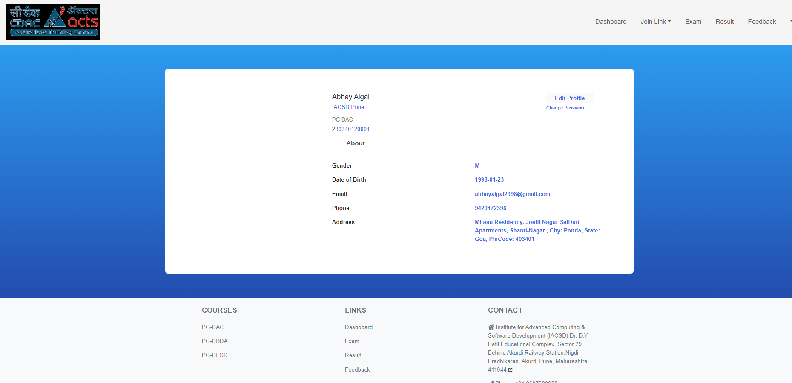
SCREEN – 8 (MY PROFILE)

Slide 16
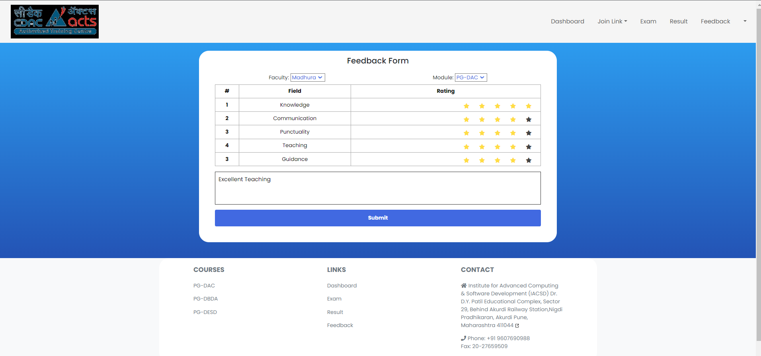
SCREEN – 9 (FEEDBACK PAGE)

Slide 17
2. Admin Flow

Slide 18
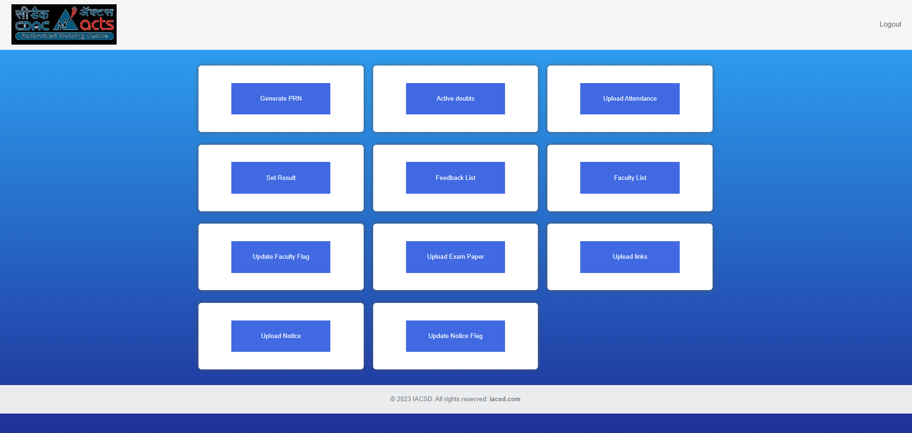
SCREEN – 2 (ADMIN)

Slide 19
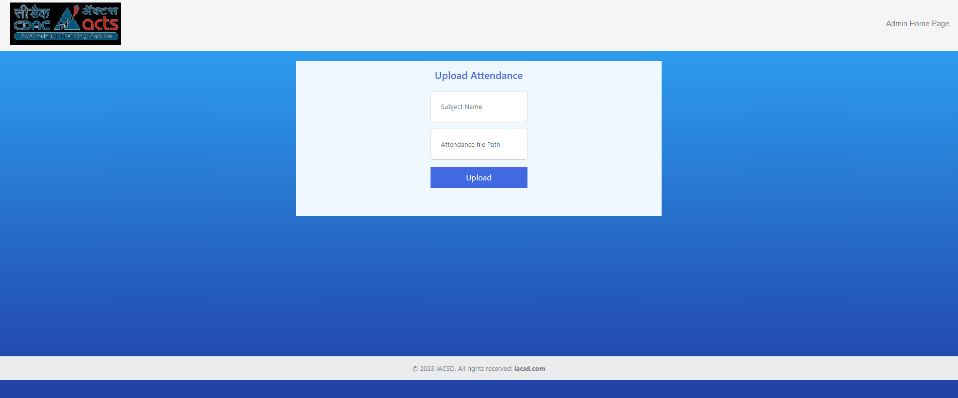
SCREEN – 3 (Example of a functionality)

Slide 20
CHALLENGES
Step wise registration form
JWT Token implementation
Navigation as a single page application
CSV import (input type = file, HTML5 Security)
Handling AJAX

Slide 21
Image upload
Password Encryption
Setting cards in dashboard UI
Animations in dashboard screen
ResponseEntity as return type of Controller Methods

Slide 22
Sending and receiving data through AJAX
JScript injection in JSP pages
Update query in JPA

Slide 23
FUTURE ASPECTS
Develop and Deploy the entire project using React Framework as a front end technology.

Slide 24
THANK YOU !!!

