Slide 1




Synopsis Presentation on
Intelligent Real-Time Street Parking Solutions - ParkHub
Guided By:
Prof. Pawan Kumar Gupta
Presented By:
Nikita Porwal(0827IT231095) Rajnandani Patidar(0827IT231109) Sidhant Narkhede(0827IT231133) Vishal Nakum (0827IT231147)

Slide 2
Contents
Introduction
Overview
Purpose
Literature Review
Problem Statement
Proposed Solution
Objectives
Theoretical Analysis
Block Diagram
Hardware Requirements
Software Requirements
Applications REFERENCES

Slide 3
1. Introduction
Overview
As cities grow in population and the number of vehicles in India spikes, parking space has turned into a serious challenge for authorities and citizens, making the challenge multifaceted. On-street parking space is limited, and the continuous search for free parking spots creates traffic and environmental issues. The problem of user frustration gets compounded. The Smart Vehicle Parking App solves this problem and to monitor open parking spaces for users to reserve and access the parking facilities. enables parking lot administrators
Purpose
The primary goal of this project is to create a smart and easy-to-use parking management system that benefits both administrators and citizens.These are the following purposes:
For administrators, the objective is to manage parking lots efficiently, monitor occupancy, and earn revenue through optimal utilization of available space
For users, the objective is to offer an easy method to reserve, occupy, and vacate parking spaces without inconvenience..
By minimizing search time, managing congestion, and providing fair pricing, the project aims to make city parking more structured, transparent, and sustainable.

Slide 4
3. Problem Statement
:Parking infrastructure and technology already exist across Indian cities, though most lack the simplicity and accessibility central to our proposed web-based system and therefore have several limitations:
No web-based booking system, heavily reliant on costly physical infrastructure.
No dynamic pricing or web-based reservation system, hardware intensive.
Absence of a user-friendly booking dashboard to drive usage.

Slide 5
4. Proposed Solution
The proposed solution is to the project follows a systematic flow of operations between the Admin and User, ensuring smooth management of parking lots and spots.
The platform will include the following features:
User Registration & Login: Users can register with name, email, and password. Users can log in to
access the dashboard Profile Management.
Parking Spot Booking: Logged-in users can view available parking lots, book an available spot, and release it when done. The system calculates total cost based on hours parked.
Admin Dashboard: Admin can create, edit, and delete parking lots. The Parking Lot can delete only if all spots in the parking lot are empty. For each lot, they can manage the number of spots and view detailed information.
Booking History: Users can view their full booking history along with duration and charges

Slide 6
4. Proposed Solution
Charts and Analytics: Admins can view bar charts of available and occupied spots across lots. Users get insights like most visited locations, total hours parked, and amount spent.
Search Features: Admins can search for parking spots by lot name or spot ID and view the current booking user if occupied.
Security: Session-based access control is implemented to restrict views to respective roles (admin
or user).

Slide 7
5. Objectives
The primary objectives of the project are :
The primary goal of this project is to create a smart and easy-to-use parking management system that benefits both administrators and citizens.
For administrators, the objective is to manage parking lots efficiently, monitor
occupancy, and earn revenue through optimal utilization of available space.
For users, the objective is to offer an easy method to reserve, occupy, and vacate parking spaces without inconvenience.
By minimizing search time, managing congestion, and providing fair pricing, the project
aims to make city parking more structured, transparent, and sustainable.

Slide 8

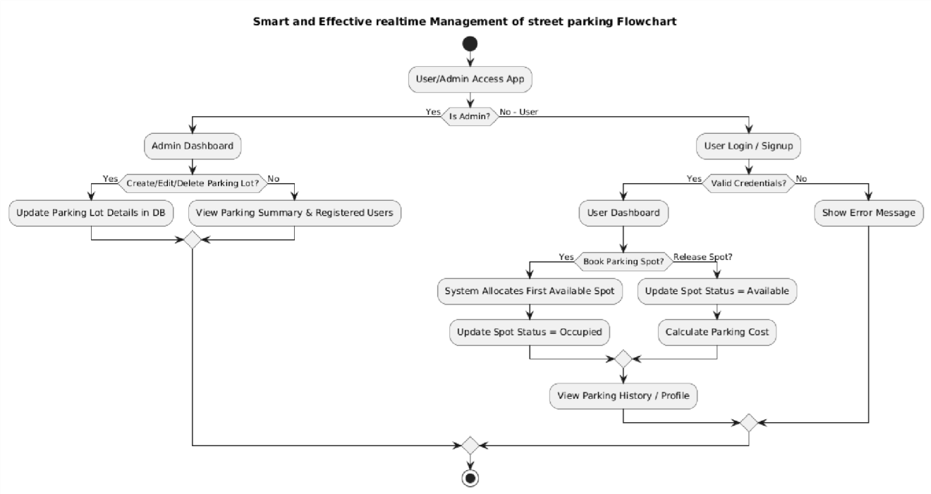
6. Theoretical Analysis
6.1 Block Diagram

Slide 9
6. Theoretical Analysis
6.2 Hardware Requirements
Component | Specification
Server RAM | Minimum Requirement 16 GB
Server CPU | Quad/Octa core ,2.4 – 3.0+ GHz
Storage | 256GB – 1TB SSD
Client Hardware | Minimal requirements – standard computer, laptop, or mobile device
Browser Support | Modern web browser (e.g., Chrome, Firefox, Edge, Safari)
10

Slide 10
2. Literature Review
Sr. No. | Author Name | Features | Limitations/ Drawbacks
1. | NDMC’s Smart Parking Management (New Delhi) R. Deepika , Dr. K. Santhi | Provides vehicle flow tracking. | No user-facing reservation system
2. | . Fully Automated Multi-Level Parking (Hyderabad, Vedha Sree .G | Severe congestion in dense urban parking zones. | No web-based booking system
3. | Puzzle Parking (Noida Sector 63) P. Murugan, Dr. V. Sathya | High demand and limited space in office districts. | No dynamic pricing or web-based reservation system
4. | . Hydraulic Multi-Level Parking (Patna, Maurya Lok) Leena Patil , Aayush Vaibhaw | Chaotic roadside parking and shortage of structured parking. | Absence of a user-friendly booking dashboard to drive usage.

Slide 11







6. Theoretical Analysis
6.3 Software Requirements
Category | Requirement & Purpose
Frontend | React.js: Dynamic, responsive pages HTML5, CSS3, JS: Structure, styling, interactivity
Backend | Node.js + Express: Server-side logic, APIs, request handling
Database | MongoDB: Store user profiles, events, discussions
Authentication | JWT / OAuth: Secure login for alumni, students, and admin
Development Tools | VS Code: Code editor Git / GitHub: Version control & collaboration Postman: API testing & debugging
Hosting / Deployment | AWS: Host the web application online
Browser Support | Chrome, Edge, Firefox: Ensure compatibility across major browsers
11

Slide 12
Applications
Municipal Street Parking Management : Provides city municipal corporations with a centralized system to manage on-street parking zones, monitor occupancy, and generate revenue reports in real time.
Educational Institution Campus Parking : Helps colleges and universities manage separate parking
allocations for faculty, students, and visitors, reducing congestion during peak hours
Commercial Complex and Mall Parking : Enables shopping malls and commercial buildings to manage paid customer parking with automated hourly billing and quick spot lookup.
Office Park and IT Hub Parking Management : Allows large office complexes to allocate and monitor
parking for employees and visitors, with analytics to support future infrastructure planning
Residential Society Visitor Parking : Offers gated communities a simple way to track and manage visitor parking, maintaining clear records of vehicle entry, exit, and duration.

Slide 13
REFERENCES
[1]. Smart Mobility Today, “How Indian Cities Are Tackling the Urban Parking
https://www.smartmobilitytoday.in/urban-parking
Crisis,” Jan. 2026.
[2]. Urban Tech Insights, “Dynamic Pricing Models in Smart Parking Systems,” Whitepaper,Sept.2022,Available: https://www.urbantechinsights.com/reports/smart-parking-pricing
[3]. Parking Network, “Global Trends in Web-Based Parking Solutions,” Industry Blog,Dec 2021. https://www.parkingnetwork.com/blog/web-based-solutions
[4]. City Data India, “Case Study: NDMC Smart Parking Initiative in New Delhi,” Available:
https://www.citydataindia.org/reports/ndmc-parking
[5]. Tech4Urban, “User-Centric Design in Smart Parking Platforms,” Technology Blog, Oct,2022. https://www.tech4urban.in/blog/user-centric-parking

Slide 14
Queries ?

