Slide 1
Major project presentation
Kappeta Srinivasa Reddy – 14115042
Kaveti Anirudh Reddy- 14115046
Taggi Kishore- 14115089

Slide 2
GENE EXPRESSION CLASSIFICATION WITH HYBRID MULTI OBJECTIVE EVOLUTIONARY ALGORITHM ON PUBLIC CLOUD PLATFORM
Guided By:
Dr. Manu Vardhan
Assistant Professor
CSE Dept., NIT Raipur

Slide 3
Objective
Gene expression data helps in advancement of clinical study. The sample dimension of gene expression data is very less than gene dimension of gene expression data. This mismatch in data causes difficult to use this data for classification and prediction. Only small number of genes are strongly correlated in this data. This causes the need for selection for features.
Use different Multi Objective Optimization (MOO) algorithms like NSGA-II, MOPSO and Hybrid Evolutionary Algorithm to select features.
Optimize multiple objective function and generate best solutions.

Slide 4
Introduction
Obtained data from mammograms.
Bioinformatics datasets is the biological data of life sciences info i.e., Gene Data.
Microarray database containing microarray gene expression data
Used Lung Cancer datasets.
Applied feature selection algorithms to reduce dimensionality and redundancy
Gene selection is done to reduce irrelevant, redundant and noisy expressions.

Slide 5
Dataset
Lung Cancer:
Diagnostic Classes: 5
Squamous cell carcinoma (Squamous): 20 examples (9.85%)
Adenocarcinoma (Adenocarcinoma): 17 examples (8.37%)
Normal lung tissue (Normal): 21 examples (10.34%)
Coid: 6 samples (2.95%)
SMCL: 139 examples (68.47%)
Number of genes: 12600
Number of samples: 203

Slide 6
Contd…
NSGA-II Algorithm:
Used to solve Multi-Objective Optimization (MOO) problems.
Generated population is sorted based on non-domination sorting into each front
Each individual in each front are assigned rank (fitness values)
Crowding distance is used to measure how close an individual is to its neighbours.
Parents are selected using Binary Tournament Selection (BTS)
Generates offspring from crossover and mutation and sorted again and best N individuals are selected

Slide 7
Contd…
MOPSO Algorithm:
Also used to solve Multi Objective Optimization (MOO) problem
Swarm Intelligence (SI) techniques are used
Extension of Particle Swarm Optimization (PSO) algorithm
Velocities and Positions of particles considered.
Obtains near-optimal non-dominated solutions i.e., Pareto front
Uses highly directional mutation operation to manipulate individuals
Finds set of solutions close to optimal solutions and diverse enough to represent true spread of optimal solutions

Slide 8
Working Methodology
Start
Initialize the parameters
Generate population of size nPOP
Store fitness of population in POP
Store non-dominated solutions in ePOP
A
Flow diagram of Hybrid algorithm

Slide 9
Contd…
Extend EPOP archive using EPOP-propagating strategy
Extend POP archive using POP-propagating strategy
Mutate POP using Bit Flip Mutation
Update POP using POP-update strategy
Stop
Update EPOP using EPOP-update strategy
Loop until the no. of generations reached
A

Slide 10
IMPLEMENTATION

Slide 11

Selecting Subset Of Features
Using ReliefF feature selection algorithm (Similarity Based)
Deals with noisy, incomplete, and multiclass dataset
60 features are selected using ReliefF

Slide 12
Classifier Used: SVM
Using Support Vector Machine classifier, we generate AUC score of each individual in the population
AUC Score is one of the objective
small datasets contain class imbalances which make AUC score as best measure to indicate performance of classifier used.
Another objective is the Number of Features

Slide 13
NSGA-II Algorithm
Randomly initialize the population.
Calculate the fitness of the population
Initialize an empty offspring
Repeat the following steps until the offspring size is equal to the size of the population, N
Select two population using Binary Tournament Selection
Apply HUX crossover and Bit Flip Mutation on the population and add these individuals to the offspring
Calculate the fitness values of the offspring.
Combine the old population into the offspring

Slide 14
Contd…
Apply non-dominated sort on the offpsirng
Using crowding distance, we select the N individual chromosomes and rest of the offspring is rejected.
The best N chromosomes make it into the new population.
Go to step 2, unless maximum number of generations have been reached.
The highest ranked Pareto non-dominated set from the latest population is the solution set.

Slide 15
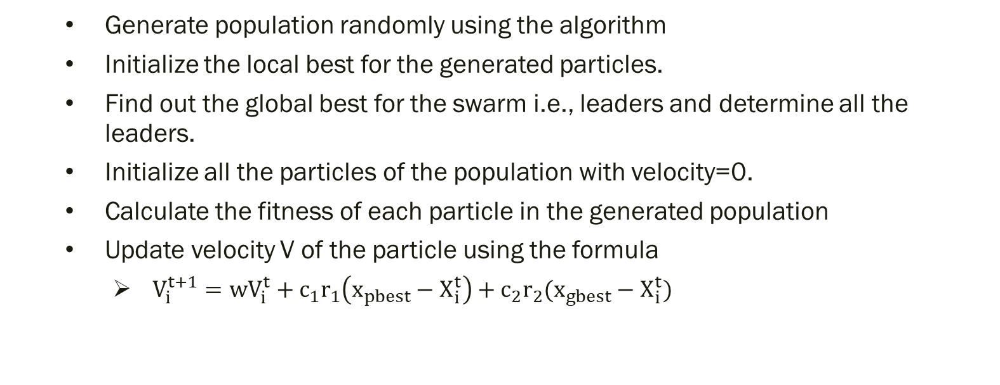
MOPSO Algorithm
Generate population randomly using the algorithm
Initialize the local best for the generated particles.
Find out the global best for the swarm i.e., leaders and determine all the leaders.
Initialize all the particles of the population with velocity=0.
Calculate the fitness of each particle in the generated population
Update velocity V of the particle using the formula
$V_{i}^{t+1}=wV_{i}^{t}+c_{1}r_{1}\left(x_{pbest}−X_{i}^{t}\right)+c_{2}r_{2}(x_{gbest}−X_{i}^{t})$

Slide 16
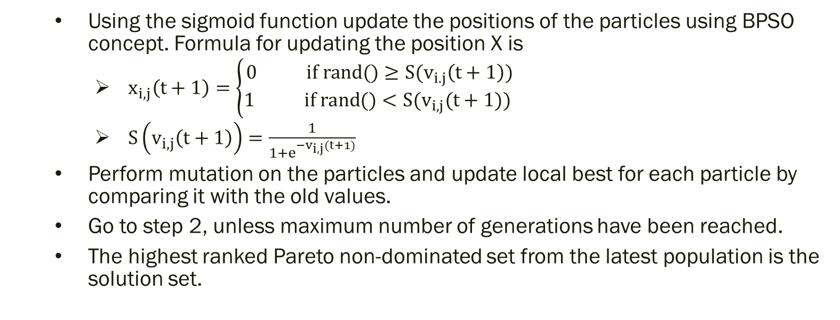
Contd…
Using the sigmoid function update the positions of the particles using BPSO concept. Formula for updating the position X is
$x_{i,j}\left(t+1\right)=\left\{\begin{aligned}0 if rand()≥S(v_{i.j}\left(t+1\right)) \\ 1 if rand()<S(v_{i,j}(t+1)) \end{aligned}\right.$
$S\left(v_{i,j}\left(t+1\right)\right)=\frac{1}{1+e^{−v_{i,j}(t+1)}}$
Perform mutation on the particles and update local best for each particle by comparing it with the old values.
Go to step 2, unless maximum number of generations have been reached.
The highest ranked Pareto non-dominated set from the latest population is the solution set.

Slide 17
Hybrid Multi-Objective Feature Selection Algorithm
Initialize number of generations, mutation probability, external population size(nEPOP), size of population(nPOP).
Generate population of size nPOP and evaluate each individual.
Store each individual with fitness values in population(POP)
Store the non-dominated solutions in external population archive (EPOP).
Repeat the following steps number of generations times:
Extend external population archive using EPOP-propagating strategy described below.

Slide 18
Contd…
Extend population archive using POP-propagating strategy as described below.
Mutate the population (POP) using bit-flip mutation.
Update population using POP-update strategy.
Update external population using EPOP-update strategy.
Return the non-dominated individuals in external population.

Slide 19
External Population-Propagating Strategy
1) Initialize empty list offspring
2) Repeat the following steps until size of offspring less than nEPOP:
2.1) Select parents using binary tournament selection from EPOP.
2.2) Generate new individuals using HUX crossover.
2.3) Add this individuals to offspring list.
3) Evaluate the individuals in offspring.
4) Store the non-dominated solutions in EPOP.

Slide 20
Population-Propagating Strategy
1) Initialize empty list offspring.
2) Repeat the following steps until size of offspring less than nPOP:
2.1) Select two parents randomly each from EPOP and POP.
2.2) Generate new individuals using HUX crossover.
2.3) Add this individuals to offspring list.
3) Evaluate the individuals in offspring.
4) Store the offspring individuals in POP.

Slide 21
Population-Update Strategy
1) Repeat the following steps for each individual in POP:
1.1) If individual is dominated by any individual in POP, discard this individual.
1.2) Else remove those individuals dominated by this individual and add this to POP.
2) If POP size greater than nPOP, randomly delete individuals.

Slide 22
External Population-Update Strategy
1) Repeat the following steps for each individual in POP:
1.1) If individual is dominated by any individual in EPOP, discard this individual.
1.2) Else remove those individuals dominated by this individual add this to EPOP.
2) If EPOP size greater than nEPOP, individuals are selected using crowding distance

Slide 23
Implementation in Cloud
Hybrid algorithm is implemented on Google Cloud with high computational power
52 Gb RAM
8 vCPUs

Slide 24
EXPERIMENTAL ANALYSIS

Slide 25
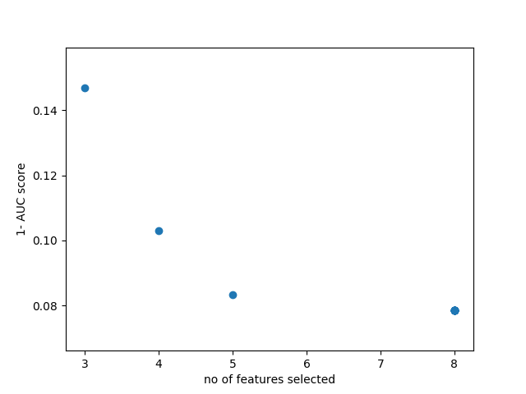
Pareto Front on Lung Cancer dataset using NSGA-II Algorithm:
No. of generations: 2000
Size of initial population: 15
Fig. 1: Pareto front obtained using NSGA-II on Lung cancer dataset

Slide 26
AUC score & No. of Features selected using NSGA-II
Individual | No of Features selected | AUC score
1 | 8 | 0.921569
2 | 5 | 0.91667
3 | 4 | 0.852941
4 | 3 | 0.897059
Table. 1 AUC score & No. of Features selected using NSGA-II

Slide 27
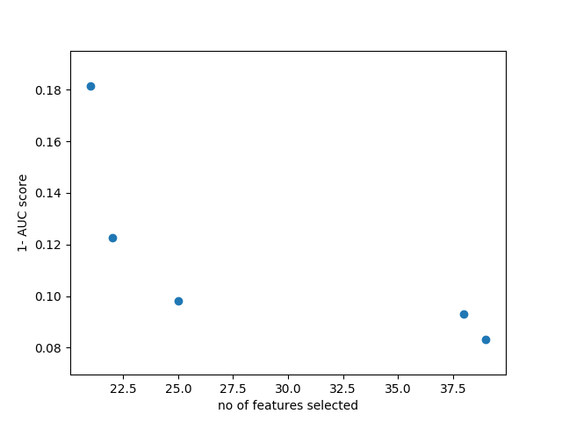
Pareto Front on Lung Cancer dataset using MOPSO Algorithm:
No. of generations: 2000
Size of swarm: 15
Fig. 2: Pareto front obtained using MOPSO on Lung cancer dataset

Slide 28
AUC score & No. of Features selected using MOPSO:
Individual | No of Features selected | AUC score
1 | 21 | 0.818627
2 | 22 | 0.877451
3 | 25 | 0.901961
4 | 38 | 0.906863
5 | 39 | 0.916667
Table. 2 AUC score & No. of Features selected using MOPSO

Slide 29
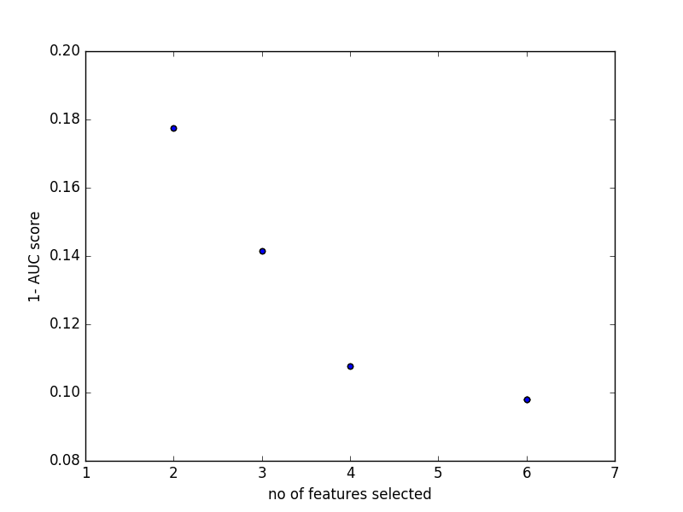
Pareto Front on Lung Cancer dataset using Hybrid Algorithm:
No. of generations: 100
Size of population: 15
Fig. 3: Pareto front obtained using Hybrid Algo on Lung cancer dataset

Slide 30
AUC score & No. of Features selected using Hybrid Algorithm:
Individual | No of Features selected | AUC score
1 | 6 | 0.901961
2 | 4 | 0.892157
3 | 3 | 0.858612
4 | 2 | 0.822376
Table. 3 AUC score & No. of Features selected using Hybrid

Slide 31
Conclusion
The project addresses the issue of presence of redundant features or unnecessary features which cause overfitting of classifier and also errors in predicting the output.
Use of multi objective optimization feature selection algorithms decreases the dimensionality of the data. This also reduces the overfitting problems. In Lung cancer dataset there are 12600 features, initially we selected 60 features using Relief-F feature selection and this 60 features are further reduced by multi objective optimization algorithms. AUC score has been used to study the performance of classifier .
We can observe that selecting less than 10 features using multi objective optimization algorithms, AUC score obtained is greater than 90 in most of the cases.

Slide 32
Future works
In our project, we used only one type of crossover to obtain new population. In future we try to use different crossover operators and selecting them randomly using roulette wheel selection for each parent.
Improve running time of hybrid algorithm used in this project.

Slide 33
References
[1] V. Bolón-canedo, N. Sánchez-maroño, A. Alonso-betanzos, J. M. Benítez, and F. Herrera, “A review of microarray datasets and applied feature selection methods,” vol. 282, pp. 111–135, 2014.
[2] A. Brazma and J. Vilo, “Gene expression data analysis,” vol. 480, pp. 17–24, 2000.
[3] W. Awada, T. M. Khoshgoftaar, D. Dittman, R. Wald, and A. Napolitano, “A Review of the Stability of Feature Selection Techniques for Bioinformatics Data,” pp. 356–363.
[4] L. Yu and H. Liu, “Efficient Feature Selection via Analysis of Relevance and Redundancy,” J. Mach. Learn. Res., vol. 5, pp. 1205–1224, 2004.
[5] F. Fortin, “Revisiting the NSGA-II Crowding-Distance Computation,” pp. 623–630, 2013.
[6] A. E. Smith, “Multi-objective optimization using evolutionary algorithms [Book Review],” IEEE Trans. Evol. Comput., vol. 6, no. 5, pp. 526–526, 2002.
[7] “Evaluating the Performance of Multi-Objective Particle Swarm Optimization Algorithms,” 2016.
[8] S. Lee, S. Soak, S. Oh, W. Pedrycz, and M. Jeon, “Modified binary particle swarm optimization,” Prog. Nat. Sci., vol. 18, no. 9, pp. 1161–1166, 2008.
[9] D. K. Srivastava and L. Bhambhu, “Data classification using support vector machine,” J. Theor. Appl. Inf. Technol., vol. 12, pp. 1–7, 2009.

Slide 34
THANK YOU!!!

