Slide 1

Notes:
We are the Team That Shall Not Be Named

Slide 2
Our Team
Tyler Guillaume
Cheryl Heinrichs
Rincy Mary Varghese
Nathan Scherr
Notes:
Our team members consist of Tyler Guillaume, Cheryl Heinrchs, Rincy Mary Varghese, and myself Nathan Scherr. Tyler why don’t you tell us a little about yourself, your role in the game and significate contributions.

Slide 3
Tyler Guillaume
Lead Graphic Designer
Lead Quality Assurance
Assistant Programmer
Assistant Documenter
Notes:
Lets learn about Cheryl now.

Slide 4
Cheryl Heinrichs
Business Analyst
Assistant Graphic Designer
Assistant Records Keeper
Assistant Documenter
Notes:
Thank you Cheryl. Rincy lets hear about you, your role in the game and significate contributions.

Slide 5
Rincy Mary Varghese
Lead Programmer
Lead Technical Advisor
Assistant Documenter

Slide 6
Nathan Scherr
Project Manager
Documentation Specialist
Assistant Programmer
Assistant Graphic Designer
Notes:
My name is Nathan. I enjoy playing sports like volleyball and curling. Lots of team activities, getting people out for trivia nights or even having a table top gaming day. I am the Project Manager for this game. Primarily I completed a lot of the documentation. I assisted in some of the programming features so that our Lead Programmer Rincy wasn’t overloaded. I also assisted in some minor graphic designs.

Slide 7
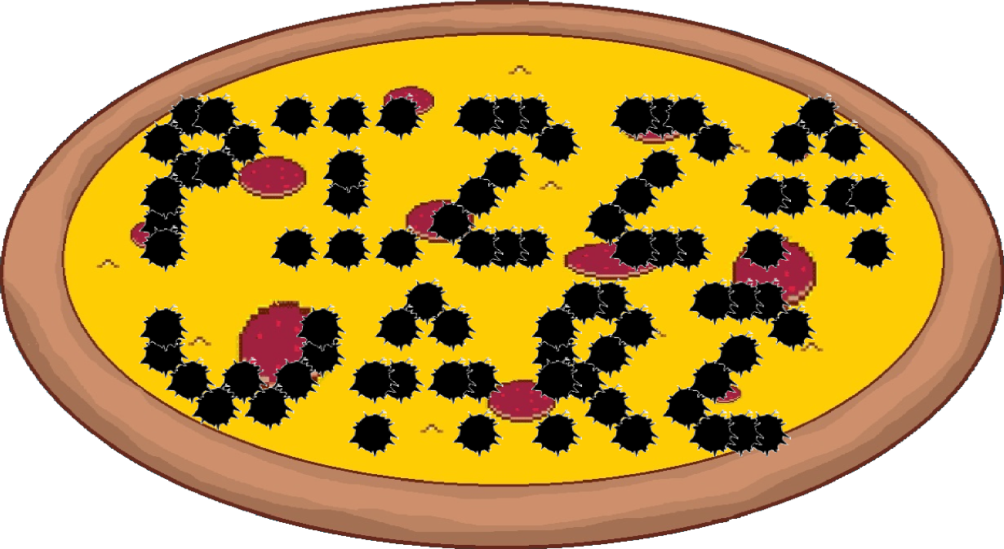
Notes:
Now I would like to introduce to you, the ultimate experience in entertainment today, our main attraction and a real piece of each of us up here: Pizza Warz!

Slide 8

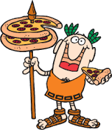
Pizza Warz: Hot and Fresh!
It is the dawn of a new age in the civilized world. The convenience of having pizza so easy to deliver has created a lucrative business opportunity for many companies. Now there is a new pizza delivery company making moves, and they are taking no prisoners.

Slide 9

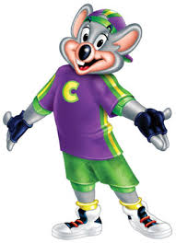
Pizza Warz: Going Deep……Dish!
Your job as a delivery driver is to make sure you deliver pizza to all your customers as quickly as you can to make the most money.
Once you have made a set of deliveries, head back to the pizzeria to accept more deliveries.

Slide 10
Pizza Warz: What Am I?
Time Based Game
Race around the Map
Deliver Pizza
Earn Tips
Notes:
We created Pizza Warz as a time based game giving the player 5 minutes of play time. (We have cut the time for Demo purposes.) In that time frame the player is to race around the map and complete their objectives. The objective we have made in our game is to deliver pizzas to houses and other locations in the map. For each pizza delivered if you can deliver it in time you will earn tips. The quicker the delivery is made the more money you earn.

Slide 11
Pizza Warz: Where Do Games Come From?
Brain Storming Session
Bullet Hell
Obstacle Course
Treasure Hunt
Notes:
We held a brain storming session to where I asked the team what is something they wanted to do as a game. Some of the ideas that came out from that were: Bullet Hell, Obstacle Course, and a Treasure Hunt. With those in mind I pulled out an idea I had for a game that would include all of those functions.
It would have bullets flying from rival pizza drivers and you could fire back (this was moved to our wish list and didn’t make it to the game. There would be an obstacle course as the city would be randomly generated for each game to make navigating through the city more difficult. There was also a little bit of a treasure hunt as you drive through the city to locate where to make each delivery.

Slide 12
Pizza Warz: I Think My Voice Just Changed?
Map Movement -> Player Movement
Sprites -> Custom Font
Timer
High Scores
Radio
Notes:
When we first came up with the idea we wanted to have the map move around the player. We hoped this would give a more natural look to you driving. We were not able to get it turn properly so we changed that to the player moving around the and changing it’s angles.
Next we thought of having some sprites such a “Game Start”, “Game Over”, “Successful Delivery”, and “Failed Delivery”. Instead we created our own font and used that for all text in our game. Including the credits and High Scores.
Lastly we implemented a Radio that can play through songs in the game.

Slide 13
Pizza Warz: Look, I Can Drive!
Demo Game

Slide 14
Pizza Warz: Why Am I So Special?
Hand Drawn Sprites
Mini Map
Random Map
Vehicles Spawned
Vehicles Movement
Radio
Music Sound Map
Game Flow Map
Notes:
For Pizza Warz we decided to create our own sprites by drawing most of what we used. In addition we also held a drawing contest for all BIS students. The winner and other 4 top vehicles were added into the game.
The Mini Map in the bottom corner to help guide drivers around the map and to delivery points.
Each time you play the game a new City Map is generated. This makes it new, different, and challenging every time.

Slide 15
Pizza Warz: I Had Some Temper Tantrums!
Challenges During Project
What Went Wrong
Random Movement of Cars
Persistence
Fonts Proper Size
GitHub

Slide 16
Pizza Warz: How I Became Successful!
What Went Right
Attitude
Mind Set
Determination
Invested

