Slide 1
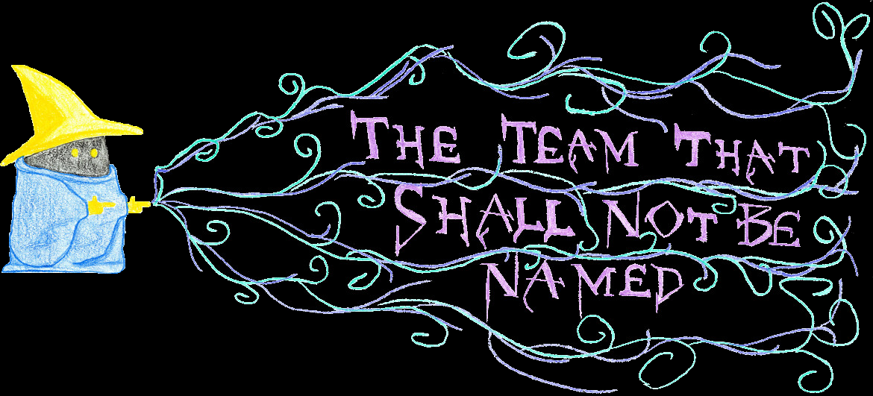
Notes:
We are the Team That Shall Not Be Named

Slide 2
Our Team
Tyler Guillaume
Rincy Mary Varghese
Cheryl Heinrichs
Nathan Scherr
Notes:
Our team members consist of Tyler Guillaume, Rincy Mary Varghese, Cheryl Heinrchs, and myself Nathan Scherr. I would like to have go through who each member is now and their part on the team.

Slide 3
Tyler Guillaume
Lead Graphic Designer
Lead Quality Assurance
Assistant Programmer
Assistant Documenter
Notes:
Here we have Tyler, his main role in the project is Lead Graphic Designer. In addition to that he was also the Lead QA, an Assistant Programmer, and Assistant Documenter. Contrary to the popular stereotype of graphic designers Tyler is not fond of Apple products. However, he does fit into the IT stereotype of rarely being seen without his coffee mug. Now lets learn about Rincy.

Slide 4
Rincy Mary Varghese
Lead Programmer
Lead Technical Advisor
Assistant Documenter
Notes:
Rincy is our Lead Programmer. She is also the Lead Technical Advisor and Assistant Documenter. She loves traveling and learning new things. She is from India and enjoys being in Canada as she gets to experience lots of different new things. Next lets hear about Cheryl.

Slide 5
Cheryl Heinrichs
Business Analyst
Assistant Graphic Designer
Assistant Records Keeper
Assistant Documenter
Notes:
Cheryl is the Business Analyst for our team. In addition to this she was also an Assistant Graphic Designer, Assistant Records Keeper, and Assistant Documenter. Cheryl loves running, playing volleyball with her classmates, listening to music and baking. Lastly we have Nathan.

Slide 6
Nathan Scherr
Project Manager
Documentation Specialist
Assistant Programmer
Assistant Graphic Designer
Notes:
Nathan is the Project Manager for our team. He assisted in other areas as the Documentation Specialist, Assistant Programmer, and Assistant Graphic Designer. Nathan enjoys playing sports like volleyball and curling. Lots of team activities, getting people out for trivia nights or even having a table top gaming day.

Slide 7
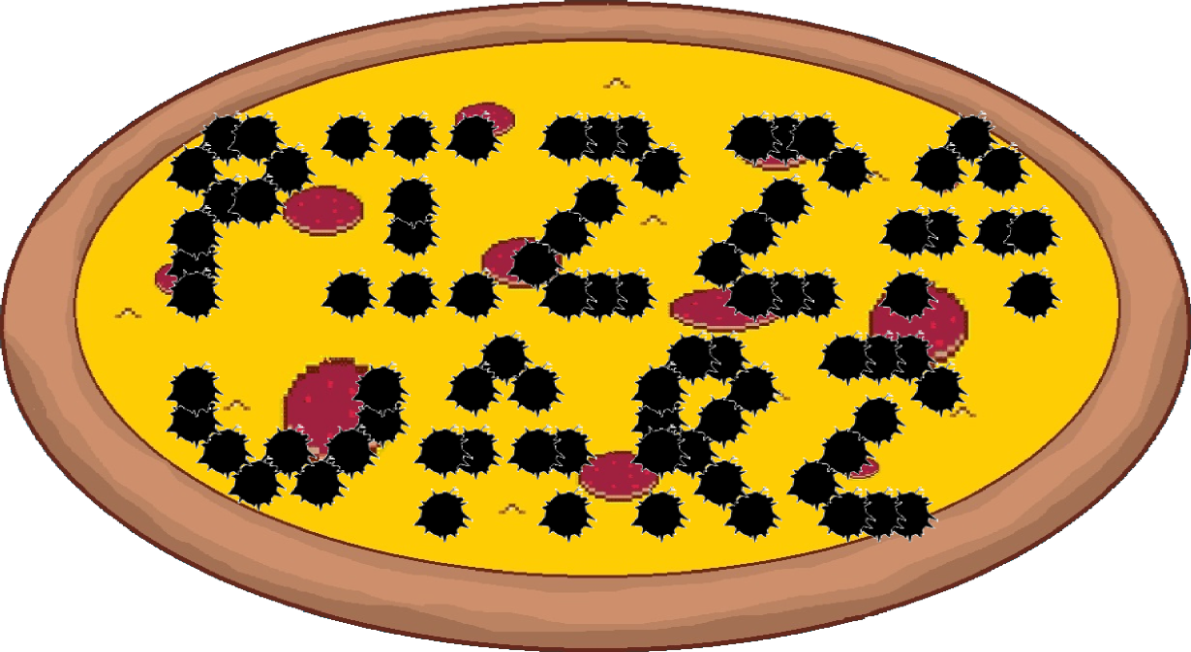
Notes:
Thank you Cheryl. Now without further delay, I would like to introduce to you, the ultimate experience in entertainment today, our main attraction and a real piece of each of us up here: Pizza Warz!

Slide 8

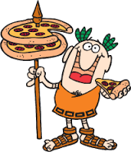
Pizza Warz: Hot and Fresh!
It is the dawn of a new age in the civilized world. The convenience of having pizza so easy to deliver has created a lucrative business opportunity for many companies.
Now there is a new pizza delivery company making moves, and they are taking no prisoners.

Slide 9
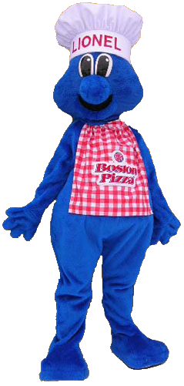
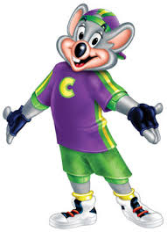
Pizza Warz: Going Deep……Dish!
Your job as a delivery driver is to make sure you deliver pizza to all your customers as quickly as you can to make the most money.
Beware though and make sure you can make it out before you total off your car.

Slide 10
Pizza Warz: What Am I?
Time Based Game
Race around the Map
Deliver Pizza
Earn Tips
Notes:
We created Pizza Warz as a time based game giving the player 5 minutes of play time. (We have cut the time for Demo purposes.) In that time frame the player is to race around the map and complete their objectives. The objective we have made in our game is to deliver pizzas to houses and other locations in the map. For each pizza delivered if you can deliver it in time you will earn tips. The quicker the delivery is made the more money you earn.

Slide 11
Pizza Warz: Where Do Games Come From?
Brain Storming Session
Bullet Hell
Obstacle Course
Treasure Hunt
Notes:
We held a brain storming session to where I asked the team what is something they wanted to do as a game. Some of the ideas that came out from that were: Bullet Hell, Obstacle Course, and a Treasure Hunt. With those in mind I pulled out an idea I had for a game that would include all of those functions.
It would have bullets flying from rival pizza drivers and you could fire back (this was moved to our wish list and didn’t make it to the game. There would be an obstacle course as the city would be randomly generated for each game to make navigating through the city more difficult. There was also a little bit of a treasure hunt as you drive through the city to locate where to make each delivery.

Slide 12
Pizza Warz: I Think My Voice Just Changed?
Map Movement -> Player Movement
Timer
High Scores
Sprites -> Custom Font
Radio
Notes:
When we first came up with the idea we wanted to have the map move around the player. We hoped this would give a more natural look to you driving. We were not able to get it turn properly so we changed that to the player moving around the and changing it’s angles.
We added in a timer setting a limit for the playing time. We included a high score system.
Next we thought of having some sprites such a “Game Start”, “Game Over”, “Successful Delivery”, and “Failed Delivery”. Instead we created our own font and used that for all text in our game. This would include the credits, timer, and High Scores.
Lastly we implemented a Radio that can play through a wide variety of songs in the game.

Slide 13
Pizza Warz: Look, I Can Drive!
Demo Game
Notes:
Parental Warning, as some of the songs are uncensored
Pressing Space bar will take you through a tutorial screen.
Backspace will go through Credits
Ctrl will let you view the opening again.
Now lets Play. Press enter.
Most of our assets have been hand drawn. We also created our own custom font.
When the map is created it is done randomly so it will be different each time.
Throughout the map you’ll see obstacles of other drivers getting in your way.
First you have 5/3 minutes for the game once the time is out it’s game over, The game could end sooner if your health reaches 0.
Top corner you can see a direction arrow telling you where to go
In the bottom here we have a mini map, the mini map shows delivery points, and other cars
In the other corner we have the total dollar earned and your health.
Lane changing in the movement. Turning at high speeds will slow you down.
Pressing F1 during the game will pause it and take you back to the tutorial.
Here is the flashing pizza indicating where to stop for the delivery, you’ll either get a successful delivery with a tip or be unsuccessful and no tip.
Now you can see the arrow in the corner has changed to blue. This indicates to head back to the pizzeria for additional deliveries
The pizza boxes indicate where to stop for more deliveries.
At the beginning and when picking up more deliveries it will generate anywhere between 1-4 to be made.
During the game play you ca switch the songs playing between 5 music categories: Classical, Rock, Electronic, Eminem, Metal, or you can turn it off. In each station there are 3 different songs for a variety of music.
Easter Egg = <200 regular credits music, > 200 special credits music.
Bugs: Vehicles turn too soon, player vehicle gets stuck sometimes during collisions, spawns on top of other vehicles, player is not restricted when entering high score.

Slide 14
Pizza Warz: Why Am I So Special?
Hand Drawn Sprites
Mini Map
Random Map
Vehicles Spawned
Vehicles Movement
Radio
Music Sound Map
Game Flow Map
Notes:
For Pizza Warz we decided to create our own sprites by drawing most of what we used. In addition we also held a drawing contest for all BIS students. The winner and other 4 top vehicles were added into the game.
The Mini Map in the bottom corner to help guide drivers around the map and to delivery points.
Each time you play the game a new City Map is generated. This makes it new, different, and challenging every time.

Slide 15
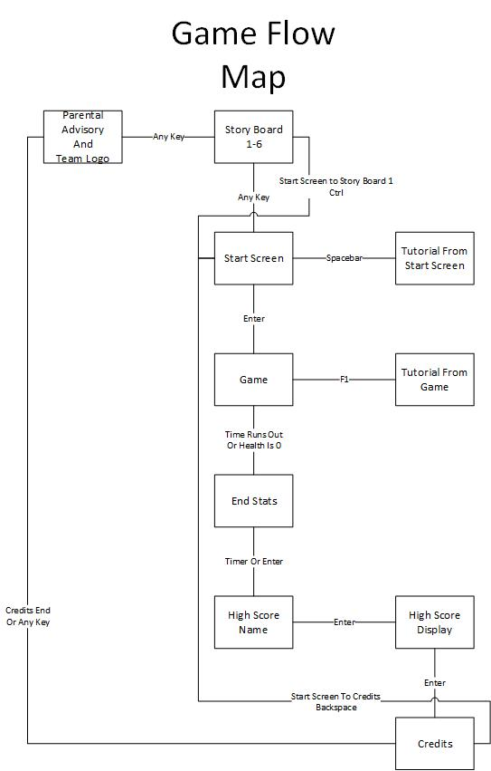
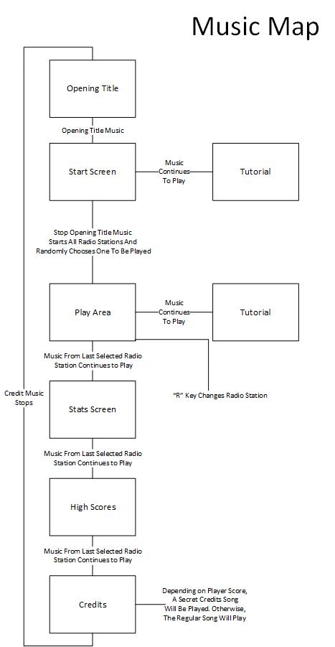

Slide 16
Pizza Warz: I Had Some Temper Tantrums!
At Home Time
GameMaker
GitHub
Random Movement of Cars
Persistence
Fonts Proper Size
Notes:
At home time was hard to come by. Some of us had part time jobs, no hardware, bad internet. New to GameMaker and having to learn what it can and cannot do. Github was difficult to work with trying to sync and getting commit errors. Coming up with the logic for making the cars move around the map randomly properly. Trying to keep the persistence of the room when going back and forth from the tutorial/pause menu. Getting the fonts sized properly to work in the game.

Slide 17
Pizza Warz: How I Became Successful!
Sharepoint
GitHub
Hand Drawn Assets
Random Map Generation
High Score System
Group Chat
Invested
Attitude
Determination
Notes:
Using the Sharepoint site, and GitHub once we got the hang of it. Using the hand drawn sprites was really inspired. Having the map generate differently every time increases the playability. Including High Scores gives you something to achieve and beat. We used What’s App to keep everyone in contact and be notified of absences. Everyone was really invested in the success of this project.
The attitude of all team members was positive and encouraging. We were all very determined to produce the best game we could.

Slide 18
Pizza Warz: Speak up Sunny!
?

