Slide 1
Learn To Program With Python 3
Introduction
Learn Full Stack Web Development
www.projectfullstack.com

Slide 2
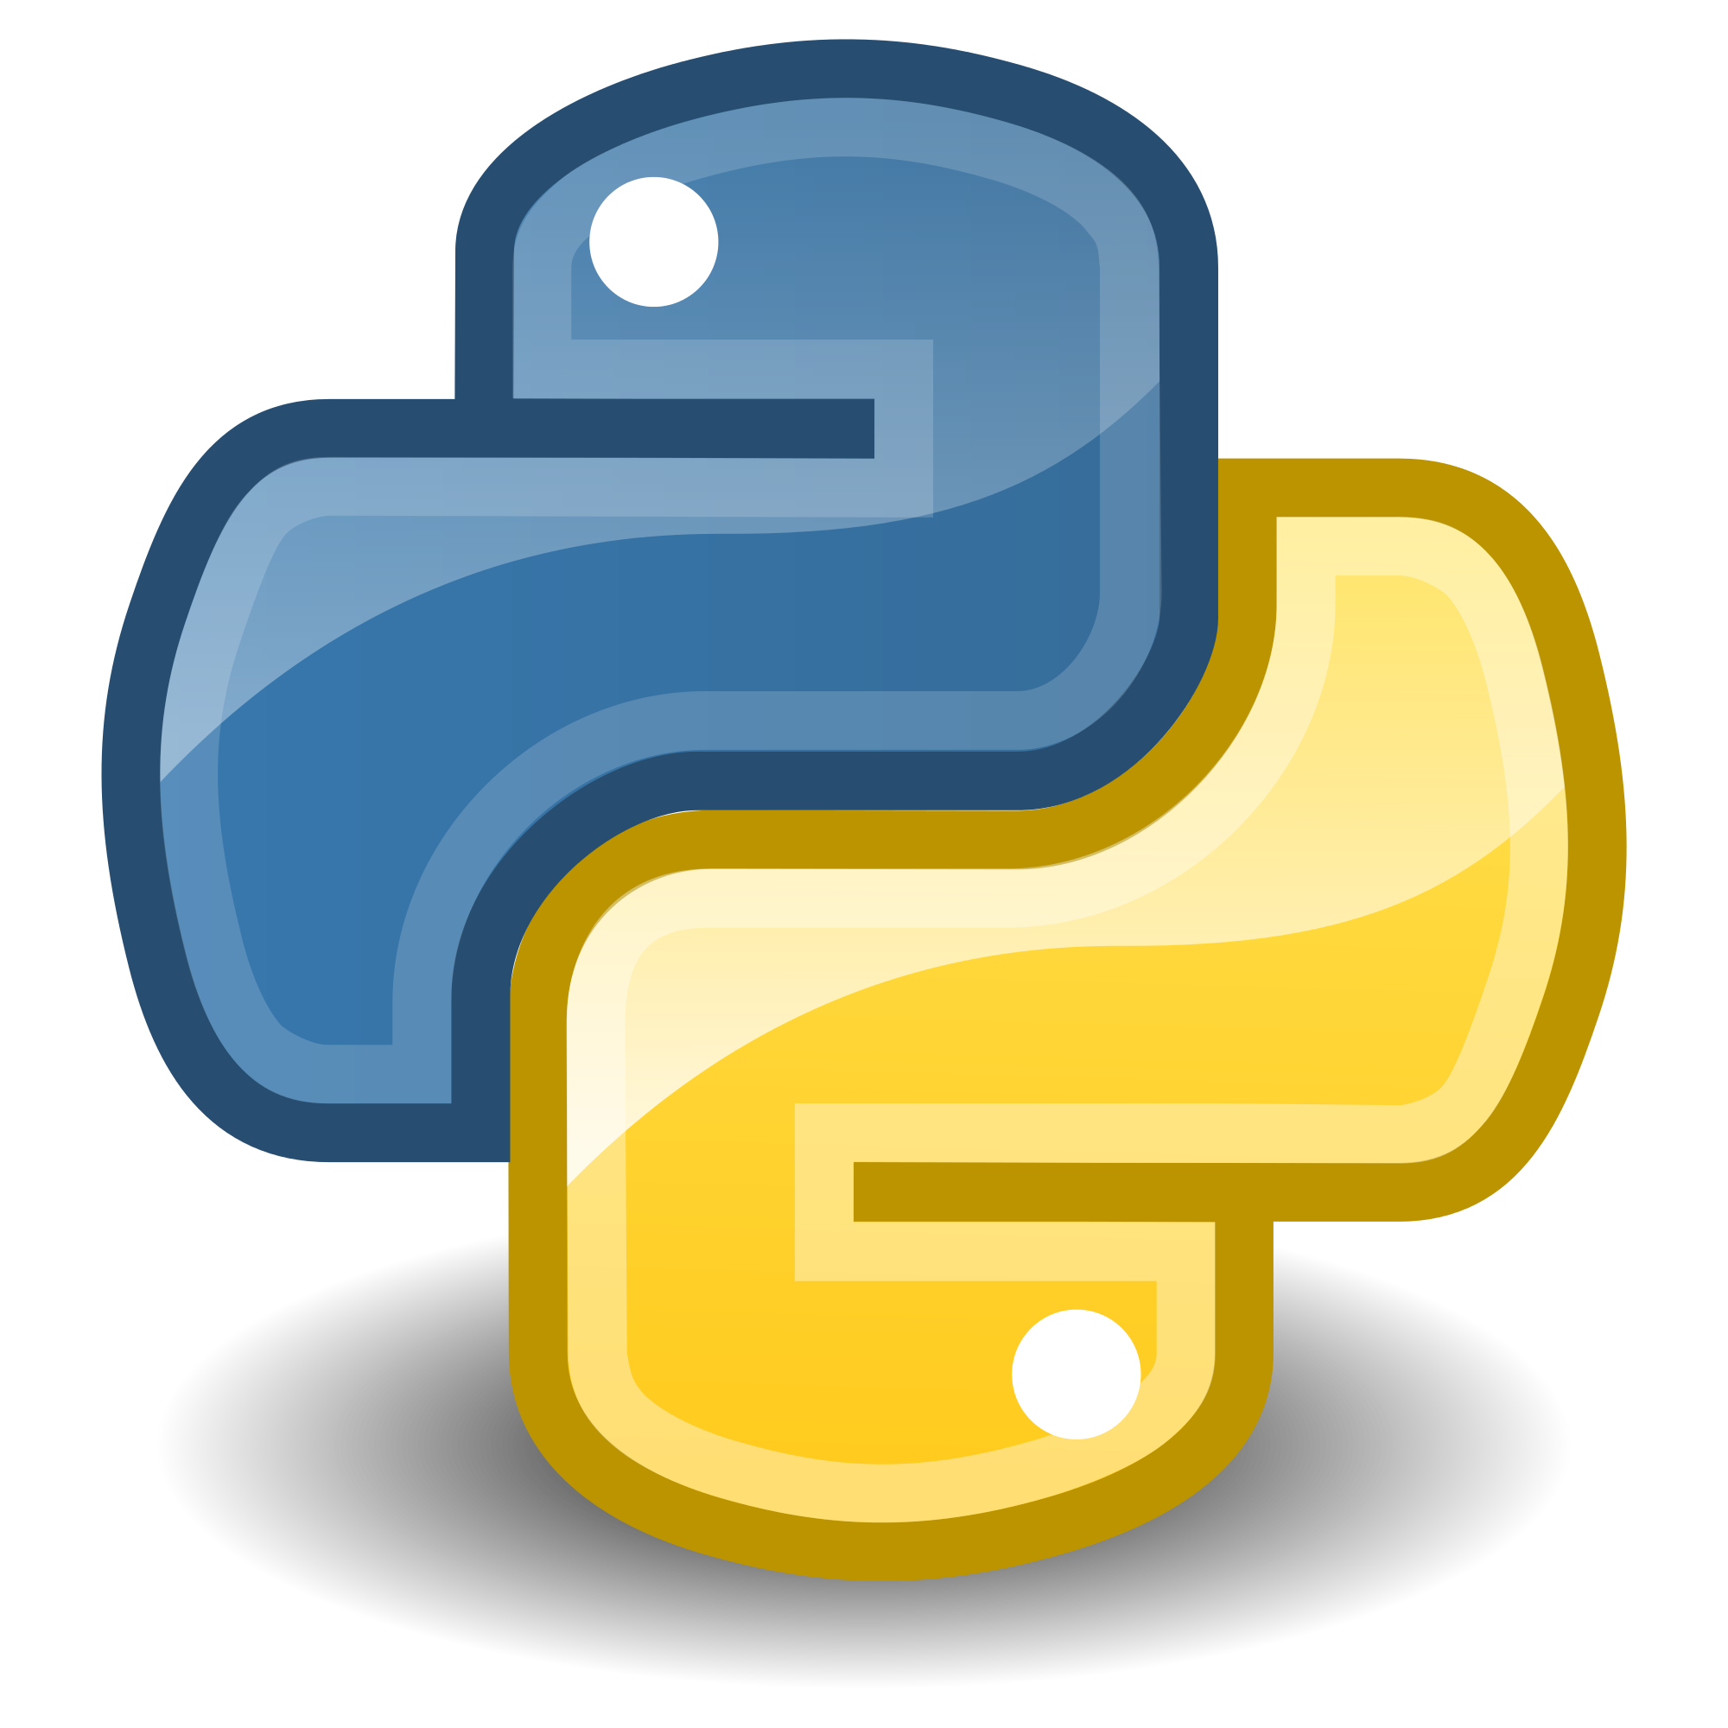
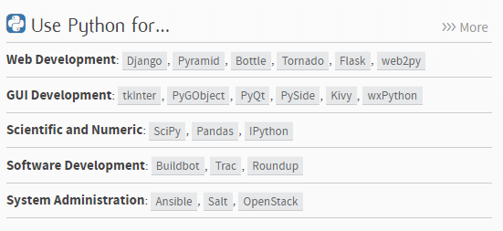
What is Python?
Python is an:
Compiled/Interpreted
High-level
General-Purpose programming language
Python emphasizes code readability
Released in 1991
Python 2 & Python 3
Python has many uses:
Scripting
Web Development
Data Analytics
Machine Learning
Learn Full Stack Web Development
www.projectfullstack.com

Slide 3
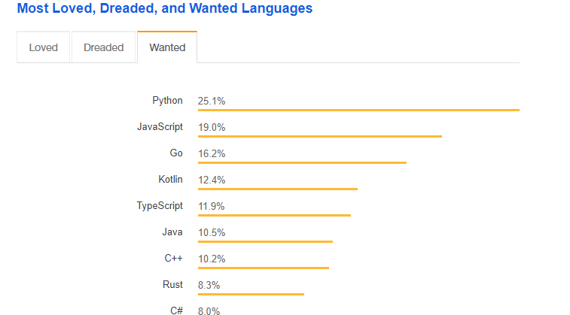
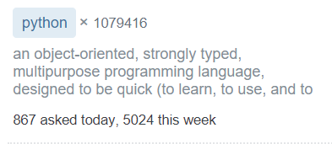
Why Python?
Python is well documented
Python has a thriving community
Python is the #1 most wanted language
And the #3 most loved language
https://insights.stackoverflow.com/survey/2018/#technology
Learn Full Stack Web Development
www.projectfullstack.com

Slide 4
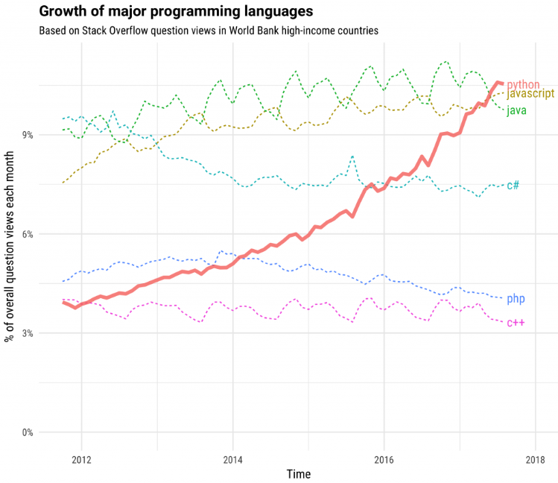
Why Python?
Python popularity is growing!
Learn Full Stack Web Development
www.projectfullstack.com

Slide 5

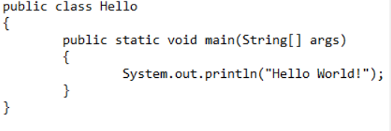
Why Python?
Python is beginner friendly!
Which of the below code samples makes more sense?
JAVA ‘Hello World’ Program
Python ‘Hello World’ Program
Learn Full Stack Web Development
www.projectfullstack.com

Slide 6
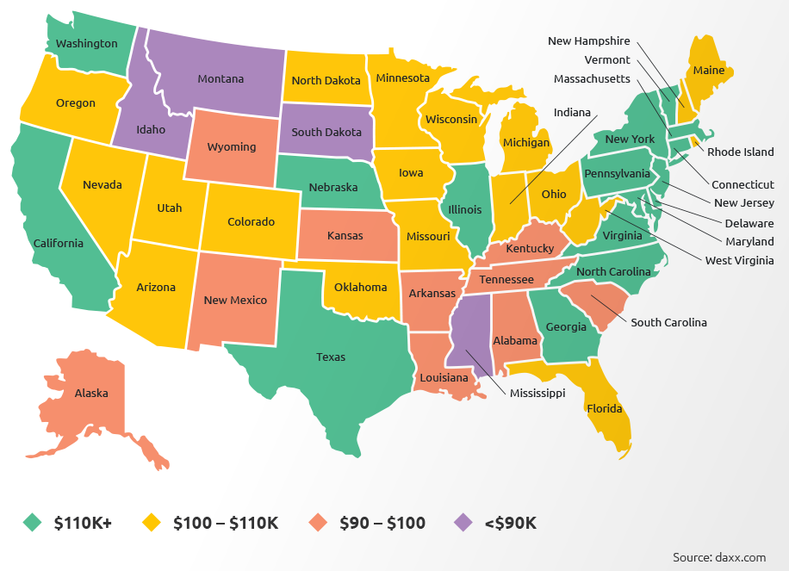
Why Python?
Python pays!
Learn Full Stack Web Development
www.projectfullstack.com

Slide 7
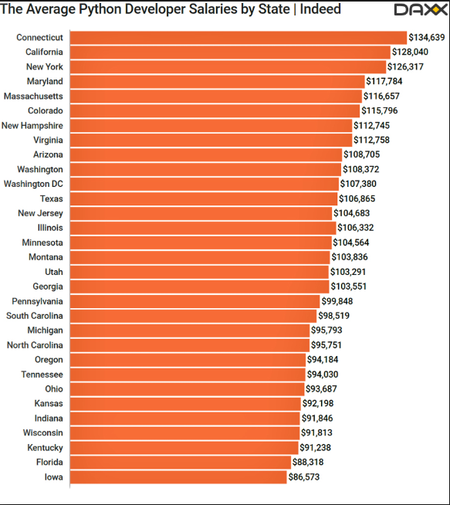
Why Python?
Python pays!
Learn Full Stack Web Development
www.projectfullstack.com

Slide 8
Why This Course
Free!
Beginner Focused!
Learn more than just Python
Some Computer Science theory
Command Line
Read official documentation
Introduction to Github
Interactive Community
Ask questions in the comments or the Discord chat server
See projectfullstack.com for Discord server link
Learn Full Stack Web Development
www.projectfullstack.com

Slide 9
How To Use This Course
Do not skip videos.
Instead, watch videos multiple times
Use the command line as much as possible
Search first, then ask
Search the internet first
Then ask in the comments / discord server
Help others
If you encounter a problem and solve it, let others know in the comments / discord server
Be patient
Programming is difficult
Don’t get frustrated
Learn Full Stack Web Development
www.projectfullstack.com

Slide 10
Learn To Program With Python 3
Learn Full Stack Web Development
www.projectfullstack.com

