Slide 1
Learn To Program With Python 3
Setting Up Your Development Environment
Learn Full Stack Web Development
www.projectfullstack.com

Slide 2
What is a Development Environment?
We know that source code is plain text file, so we need a text editor.
We also need to download the programming language to run our programs.
You SHOULD save all your programs in an organized repository on your computer.
All the tools you use for testing and debugging your program is known as your development environment.
Example: Visual Studio Code (text editor) and Python 3.8 (Python version)
Example: Notepad++ (text editor) and Python 2.7 (Python version)
Learn Full Stack Web Development
www.projectfullstack.com

Slide 3
Our Development Environment
My Development Environment
Text editor: Visual Studio Code
Python Version: 3.8
Repository: Desktop/workspace/
Text editor alternatives: atom, notepad++, brackets, pycharm
Python alternatives: Use Python 3.8. If you use different version than me things might not work as shown.
Repository alternatives: Any place that is easy to find on your computer.
Learn Full Stack Web Development
www.projectfullstack.com

Slide 4
Installing Visual Studio Code
Download from https://code.visualstudio.com/
Windows, Linux, and MacOS version available
Learn Full Stack Web Development
www.projectfullstack.com

Slide 5
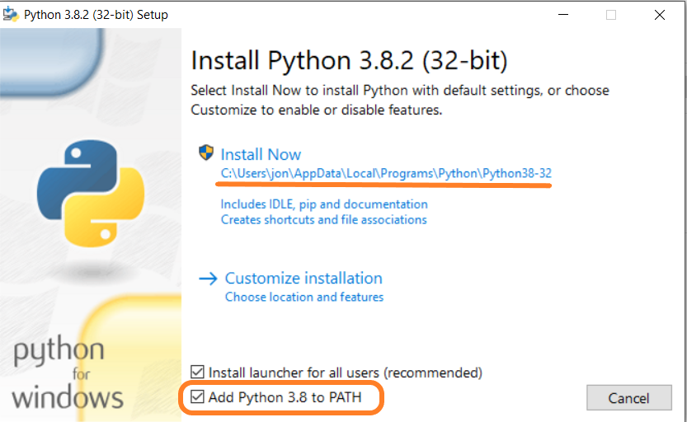
Installing Python
Download from https://www.python.org/
Following the one screen prompts
Make sure the “Add Python 3.8 to PATH” is checked.
Write down the install path, you may need this in the future!
Note: you may need to enable “view hidden files/folders” to see this directory in the future.
Learn Full Stack Web Development
www.projectfullstack.com

Slide 6
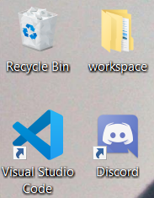
Creating Your Repository
You SHOULD save all your programs in an organized repository on your computer.
I personally like creating a new directory on the desktop called “workspace”.
Your repository can be located anywhere on your computer as long as it is easy for you to find and navigate to.
Learn Full Stack Web Development
www.projectfullstack.com

Slide 7
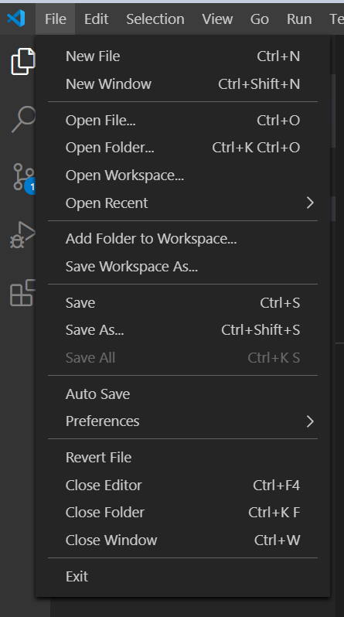
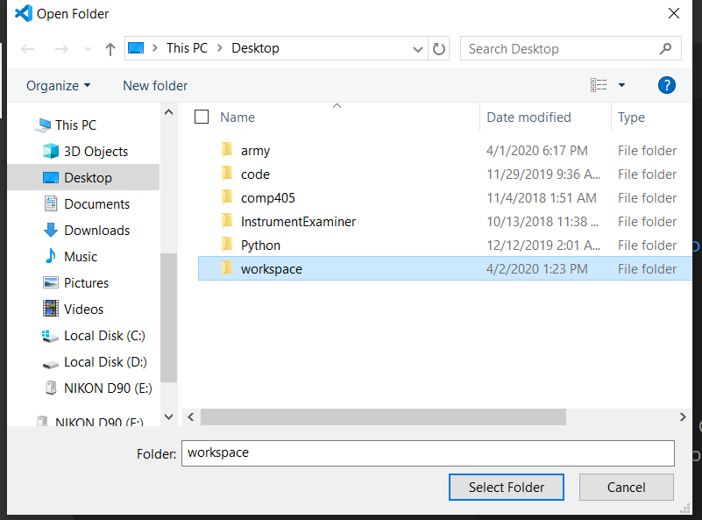
First Python Program: “Hello World!”
Open visual studio code
In the top left navbar, click “File”
This is one spot where you can open files/folders or create new files/folders
Select “Open Folder…” then browse to your workspace. and select “Select Folder”

Slide 8
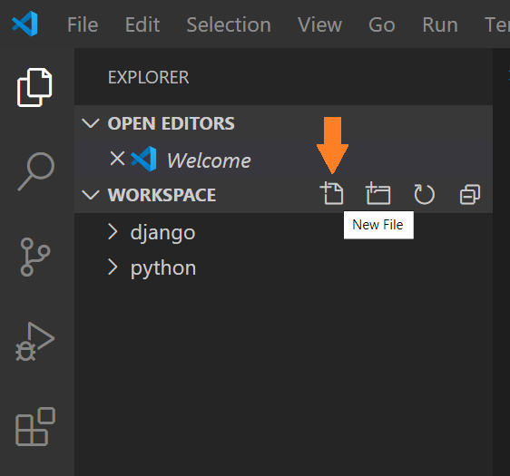
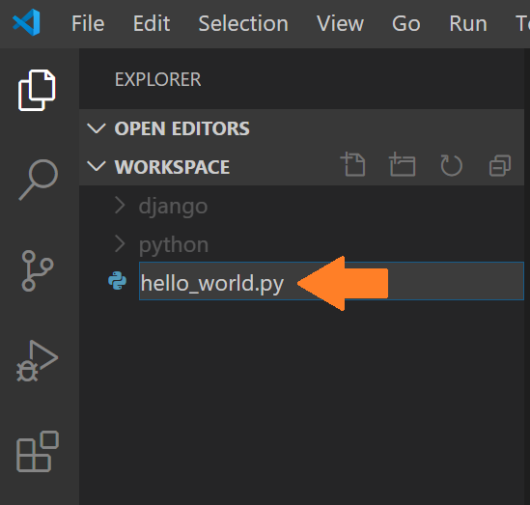
First Python Program: “Hello World!”
This will open your “workspace” in the visual studio code explorer.
Hover your mouse over the “WORKSPACE” list item in the explorer and click the “New File” Icon.
Type “hello_world.py” as the new file name and press enter

Slide 9
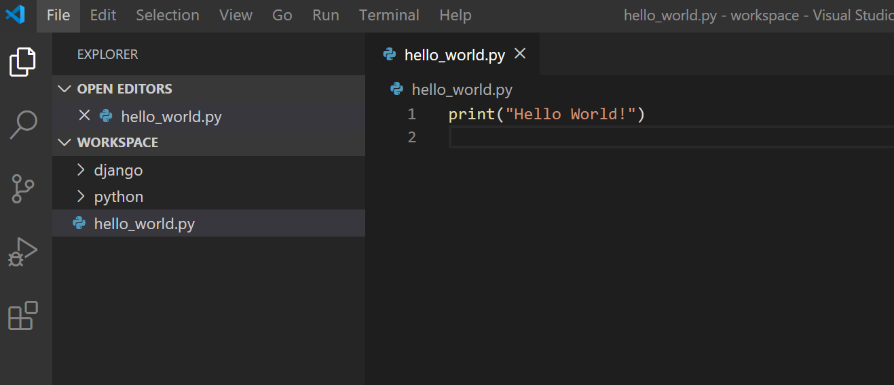
First Python Program: “Hello World!”
Your file should open as a tab in Visual Studio Code.
TYPE (do not copy and paste) the line below as line 1 in hello_world.py:
print(“Hello World!”)
Save the file: Click file on the top navbar, select “Save”

Slide 10
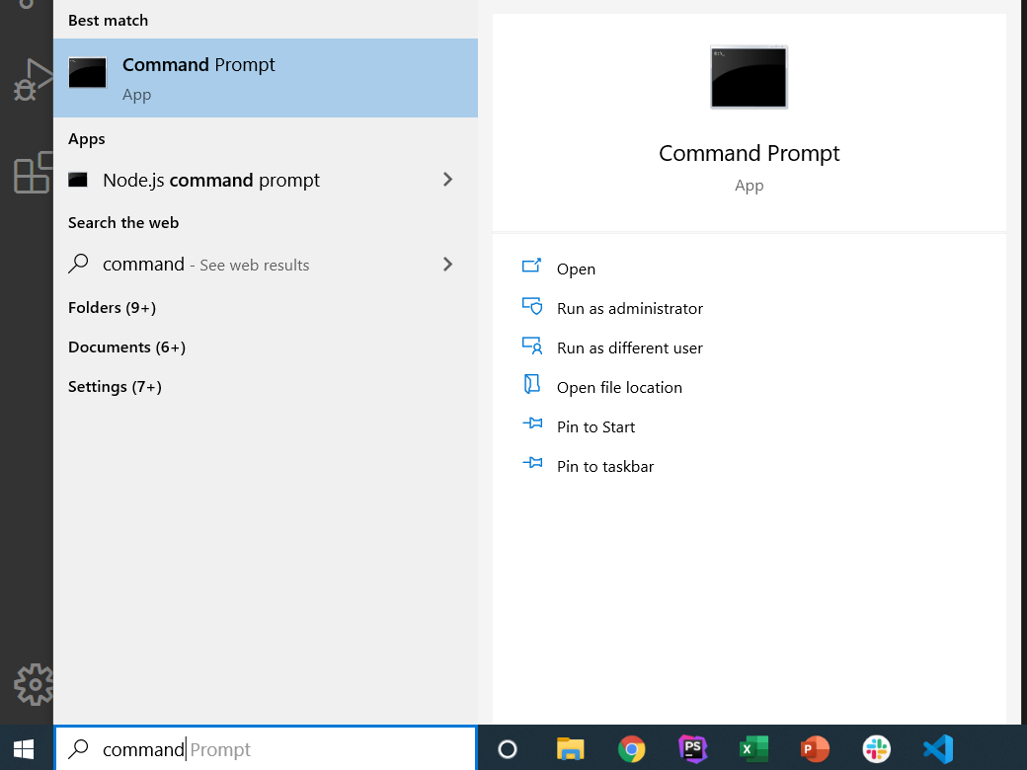
First Python Program: “Hello World!”
To run the program we will use our Terminal/Command prompt.
Terminal/Command prompt allows us to write commands directly to our computer as opposed to using the graphical user interface.
Example: To create a new directory earlier you probably used your mouse, clicked on your desktop, selected “New Folder”, entered a name, and pressed enter. The same thing can be done with one command in the terminal: “mkdir workspace”
In MacOs: Search for “terminal” app
In Windows: Search for “command prompt”

Slide 11
First Python Program: “Hello World!”
Terminal Commands We Will Use:
“cd” – Change Directory. Requires “cd” followed by a space, followed by the directory name to change to
Example: “cd Desktop”
Example: “cd ..” The “dot dot” here is a special case that says “go up one directory”
“mkdir” – Make Directory. Requires “mkdir” followed by a space, followed by the directory name create
Example: “mkdir workspace”
Example: “mkdir python”
“dir” (“ls” in MacOS) – List the contents of the directory. Does not require anything following the command.
“python” – Python command (requires Python executable to be on your PATH, remember when we clicked “Add Python 3.8 To Path”?
Has many different commands you can use with python.
We will use “python” followed by a space, followed by our file name.
Example: “python hello_world.py” – Note: This assumes your terminal/command prompt is already in the directory “hello_world.py” is saved in. You have to “cd” (change directory) to it BEFORE running the python command!

Slide 12
First Python Program: “Hello World!”
Lets do it!
Note: this assumes you saved “hello_world.py” in Desktop/workspace/python
“cd” to your desktop: ex “cd Desktop”
Then “cd” to your workspace: ex “cd workspace”
The above two lines can be combined into one command: “cd Desktop/workspace”
Then “dir” (“ls” MacOS) to list the contents of the directory. Verify hello_world.py is listed!
If it is not, the next command will not work. Find where you saved hello_world.py and “cd” to that directory.
Then “python hello_world.py” to run your program!

Slide 13
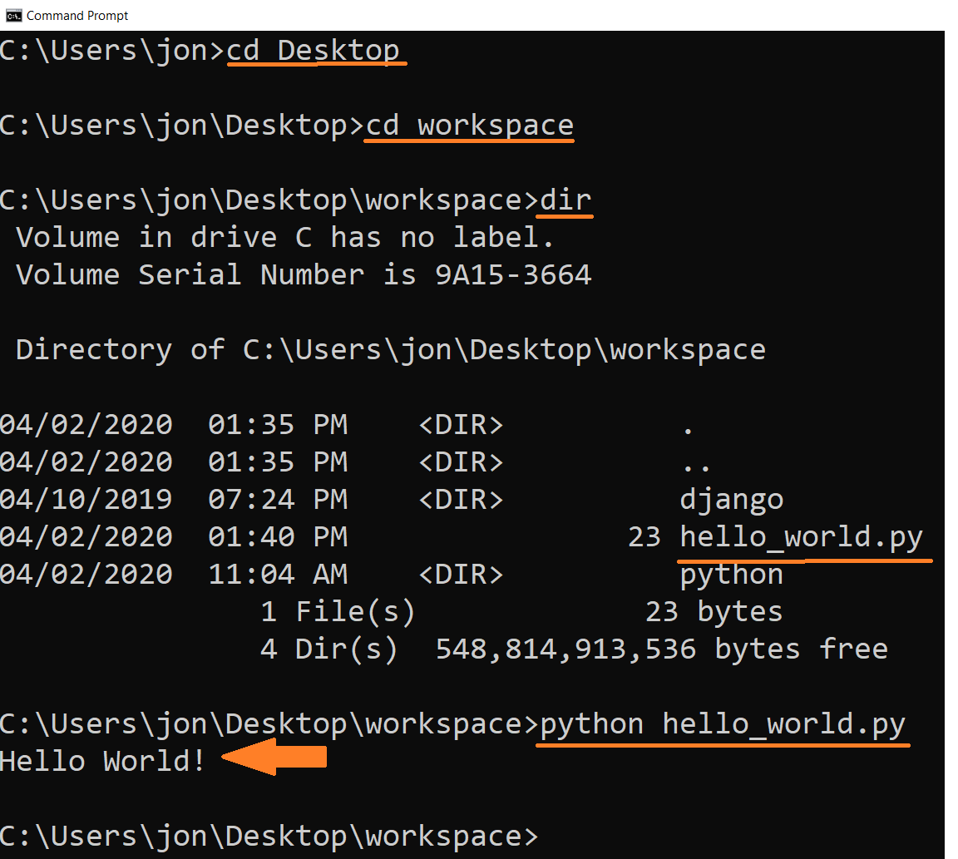
First Python Program: “Hello World!”

Slide 14
Learn To Program With Python 3
Learn Full Stack Web Development
www.projectfullstack.com

