Slide 1
Learn To Program With Python 3
Data Types & Variables
Learn Full Stack Web Development
www.projectfullstack.com

Slide 2
Learn To Program With Python 3
Data Types

Slide 3
Data Types and Values
Data: the quantities, characters, or symbols on which operations are performed by a computer
Data Type: a data type or simply type is an attribute of data which tells the compiler or interpreter how the programmer intends to use the data.
Data types define the operations that can be done on that data.
Value: The evaluated product of a singular piece of data.
Learn Full Stack Web Development
www.projectfullstack.com

Slide 4
Python Basic Data Types
There are four “basic” types of data we will focus on.
Boolean – True/False (Research George Boole for background)
Example values: True, False
Integer – A whole number (not a fraction) that can be positive, negative, or 0. Do not use commas to separate the hundreds, thousands, etc places.
Example values: -1, 0, 1, 1028, 1238129127301012
Float – Represents high-precision fractional values (rational numbers).
Example values: 3.14, 1.5, 23.19283
String – A character is a letter of some alphabet, a digit, a blank space, a punctuation mark, etc. A String in python is sequence of one or more characters. Strings are usually used to represents words and text.
Example values: “a”, “1”, “1028”, “3.14”, “b”, “cat”, “dog”, “the quick brown fox jumped over the fence!”
- Remember “FIBS” – Float, Integer, Boolean, String

Slide 5
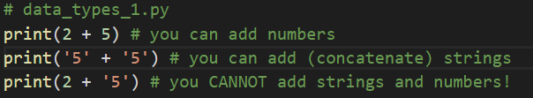
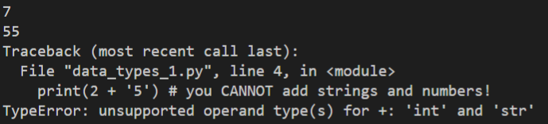
Why do data types matter?
Data types define the operations that can be done on that data.
ALWAYS think about what data type you are using, and what operations you can do with that data type!
Learn Full Stack Web Development
www.projectfullstack.com

Slide 6
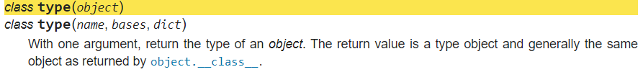
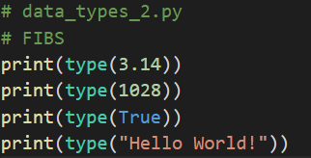
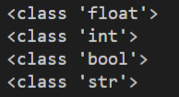
How to find the data type?
You will not always immediately know what data type you are working with.
You can use the built-in function known as type
Learn Full Stack Web Development
www.projectfullstack.com

Slide 7
ALWAYS think about what data type you are using, and what operations you can do with that data type!
Learn Full Stack Web Development
www.projectfullstack.com

Slide 8
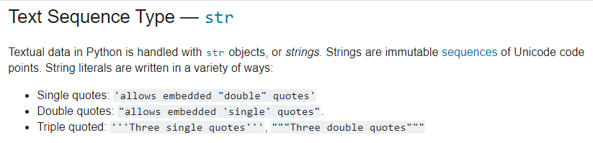
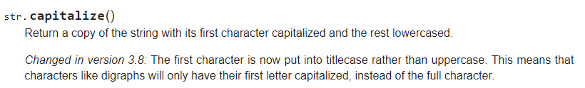
Exercises – Working With Strings
Read the documentation on strings here
Read the documentation on string methods here
There are many methods, only read a couple of them
Learn Full Stack Web Development
www.projectfullstack.com

Slide 9
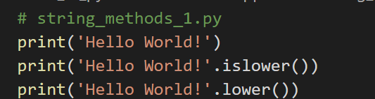
Exercises – Working With Strings
Like a compiler (line by line, character by character), study the code to the right.
Do you see anything new?
What will it do?
Try it!
Learn Full Stack Web Development
www.projectfullstack.com

Slide 10

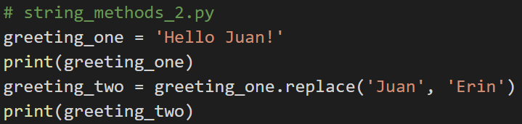
Exercises – Working With Strings
Like a compiler, study the above.
Do you see anything new?
What will it do?
Try it!
Learn Full Stack Web Development
www.projectfullstack.com

Slide 11
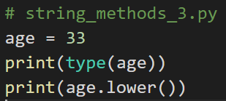
Exercises – Working With Strings
Like a compiler, study the code to the right.
Do you see anything new?
What will it do?
Try it!
Learn Full Stack Web Development
www.projectfullstack.com

Slide 12
Learn To Program With Python 3
Variables
Learn Full Stack Web Development
www.projectfullstack.com

Slide 13
Solve the following algebra problem:
X = 5
Y = 3
Solve: X + 2 + Y = ?
- If you can do the above problem, you already know what variables are!
Learn Full Stack Web Development
www.projectfullstack.com

Slide 14
Defining and Using Variables
- What does the following sentence mean?
“ST 0900EST 4 121 IOT discuss DOD”
We don’t know what these acronyms (variables) mean.
We need to be told what they mean (they need to be defined) BEFORE we can use them.
Learn Full Stack Web Development
www.projectfullstack.com

Slide 15
Defining and Using Variables
ST = “Show Time”
EST = “Eastern Standard Time”
4 = “For”
121 = “One to One
IOT = “In Order To”
DOD = “Duties of the Day”
Now read the sentence again: “ST 0900EST 4 121 IOT discuss DOD”
Now that the acronyms (variables) have been defined, we can read the sentence!
Learn Full Stack Web Development
www.projectfullstack.com

Slide 16
Variables
A variable is a placeholder for a value
If it the compiler finds a variable that has not been defined, it throws an error.
Once defined, you can use the variable name to refer to the value
You can use the variable name to manipulate the value (change the value, update the value, etc)
Variable names:
Can be arbitrarily long.
Must start with a letter but can contain letters and numbers.
Should be lowercase, with words separated by underscores as necessary to improve readability. This is known as “snake case”
this_is_a_good_snake_case_variable_name -> Snake case = good
Read more here
Learn Full Stack Web Development
www.projectfullstack.com

Slide 17
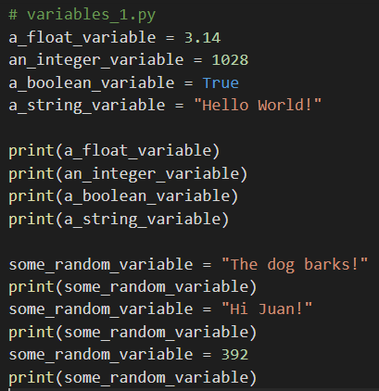
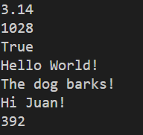
Variables
Learn Full Stack Web Development
www.projectfullstack.com

Slide 18

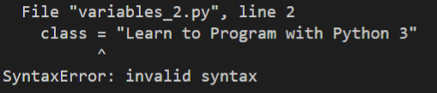
More on Variable Names
There are certain variable names that the compiler will understand (starts with a letter, contains letters or numbers) but will not allow (throws syntax errors).
For example: try creating a variable called “class”
“class” is a keyword (or “reserved word”) in python!
Learn Full Stack Web Development
www.projectfullstack.com

Slide 19
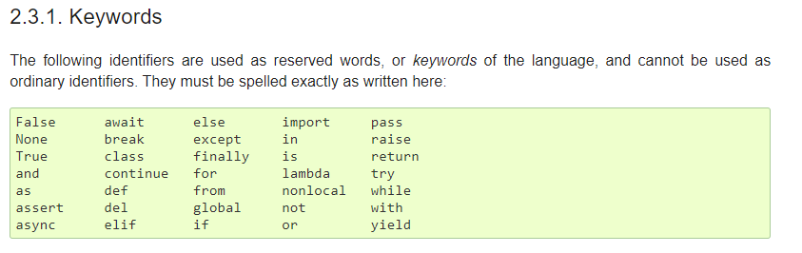
More on Variable Names
Certain variables names are already taken by the Python programming language itself.
These are known as reserved words, or keywords, and cannot be used as ordinary variable names. (source)
Learn Full Stack Web Development
www.projectfullstack.com

Slide 20
Learn To Program With Python 3
Learn Full Stack Web Development
www.projectfullstack.com

