Slide 1
Learn To Program With Python 3
Thinking About Programs
Learn Full Stack Web Development
www.projectfullstack.com

Slide 2
What is Program?
A collection of instructions that can be executed by a computer to perform a specific task.
Written by a computer programmer in a programming language.
Human readable programs are compiled (translated) into machine readable code (binary) and then executed by a computer
Think of the compiler as a “translator”. It translates are source code written in English, to binary which the computer can understand.
Learn Full Stack Web Development
www.projectfullstack.com

Slide 3
How do programs work?
A program is a plain text document with a certain file extension:
program_one.py
program_two.java
program_three.php
program_four.c
This file, also known as the source code, is converted from the plain text document to a computer readable file by the compiler.
The compiler starts at the TOP of the file and reads character by character, line by line, until the bottom of the file
The compiler only understands the programming languages rules: it’s syntax
Learn Full Stack Web Development
www.projectfullstack.com

Slide 4
Learn To Program With Python 3
Example Programs
Learn Full Stack Web Development
www.projectfullstack.com

Slide 5

“Hello World!” Program
The image to the right is a valid python program.
What do you think it does?
Do you notice any patterns in the code?
Learn Full Stack Web Development
www.projectfullstack.com

Slide 6
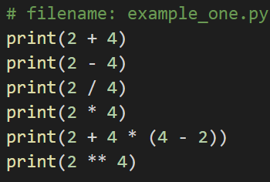
Example Two
The image to the right is a valid python program.
What do you think it does?
Do you notice any patterns in the code?
Learn Full Stack Web Development
www.projectfullstack.com

Slide 7
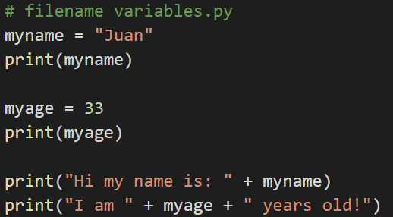
Example Three
The image to the right is a valid python program.
What do you think it does?
Do you notice any patterns in the code?
Learn Full Stack Web Development
www.projectfullstack.com

Slide 8
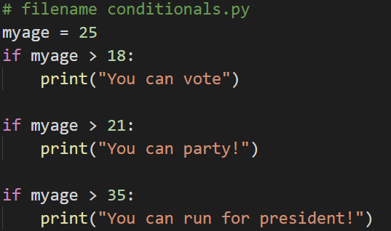
Example Four
The image to the right is a valid python program.
What do you think it does?
Do you notice any patterns in the code?
Learn Full Stack Web Development
www.projectfullstack.com

Slide 9
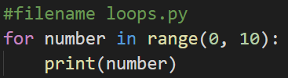
Example Five
The image to the right is a valid python program.
What do you think it does?
Do you notice any patterns in the code?
Learn Full Stack Web Development
www.projectfullstack.com

Slide 10
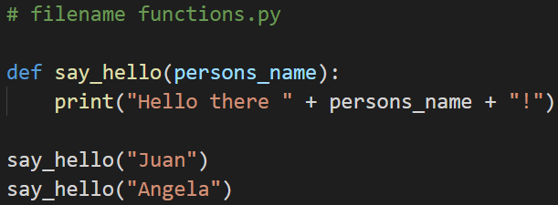
Example Six
The image to the right is a valid python program.
What do you think it does?
Do you notice any patterns in the code?
Learn Full Stack Web Development
www.projectfullstack.com

Slide 11
Syntax
Syntax: the syntax of a computer language is the set of rules that defines the combinations of symbols that are considered to be a correctly structured document or fragment in that language.
Different languages have different syntax.
An error in the programming languages rules is called a syntax error.
Compilers only understand STRICT syntax rules. They will not know “what you meant to type” when you make a syntax error.
Learn Full Stack Web Development
www.projectfullstack.com

Slide 12
Syntax Error and Debugging
You will make many mistakes while programming. Embrace it.
Some errors are easy to solve, some are very hard.
The process of finding and resolving errors in your program is called debugging.
ALWAYS THINK LIKE A COMPILER (character by character, line by line)
Learn Full Stack Web Development
www.projectfullstack.com

Slide 13
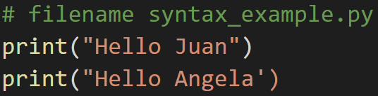
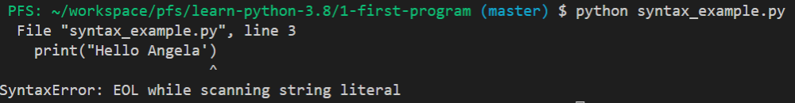
Syntax Error and Debugging
The program on the right has a syntax error.
What do you think is?
Pay close attention to the error statement below.
Learn Full Stack Web Development
www.projectfullstack.com

Slide 14
Learn To Program With Python 3
Learn Full Stack Web Development
www.projectfullstack.com

