Slide 1
Learn To Program With Python 3
Working With Strings
Learn Full Stack Web Development
www.projectfullstack.com

Slide 2
Working With Strings
Documentation:
Python Docs Informal Tutorial: https://docs.python.org/3/tutorial/introduction.html#strings
Python Docs Built-In Types: https://docs.python.org/3/library/stdtypes.html#text-sequence-type-str
Python Docs String Methods: https://docs.python.org/3/library/stdtypes.html#string-methods
Learn Full Stack Web Development
www.projectfullstack.com

Slide 3
Working With Strings
Textual data in Python is handled with str objects, or strings.
Strings are immutable sequences of Unicode code points
String literals are written in a variety of ways
Single quotes: 'allows embedded "double" quotes'
Double quotes: "allows embedded 'single' quotes".
Triple quoted: '''Three single quotes''', """Three double quotes"""
Learn Full Stack Web Development
www.projectfullstack.com

Slide 4
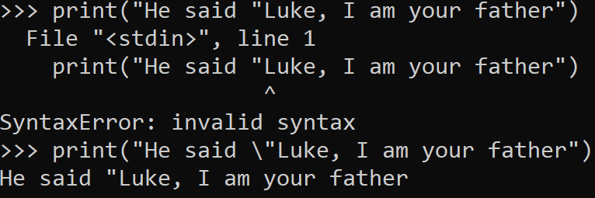
Escape Character
The backslash “\” can be used an escape character
This tells the compiler to change its normal behavior, such as ignoring a quotation mark in a string instead of assuming it is the end of the string.
This is very common in programming is used in many different languages.
Learn Full Stack Web Development
www.projectfullstack.com

Slide 5
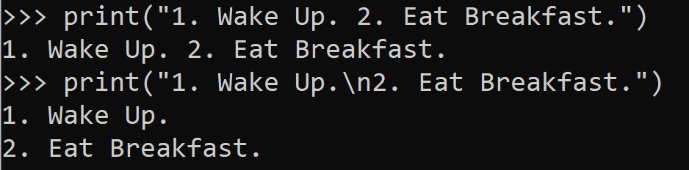
New Line Character
The backslash followed by an n “\n” can be used to create a new line, such as pressing enter normally does in a text editor
Learn Full Stack Web Development
www.projectfullstack.com

Slide 6
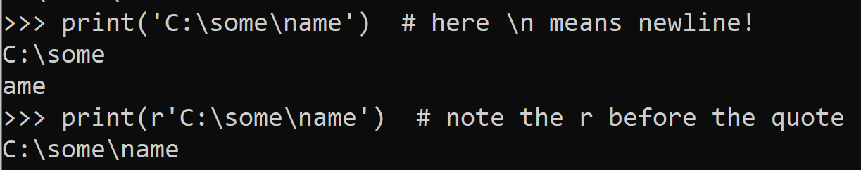
Escaping the Escape Character – Raw Strings
Sometimes you may want to use a backslash but NOT escape a character or create a new line.
In this case you can use raw strings
Raw strings are denoted by putting the ‘r’ (for raw) character in FRONT of your OPENING quotation mark
Learn Full Stack Web Development
www.projectfullstack.com

Slide 7
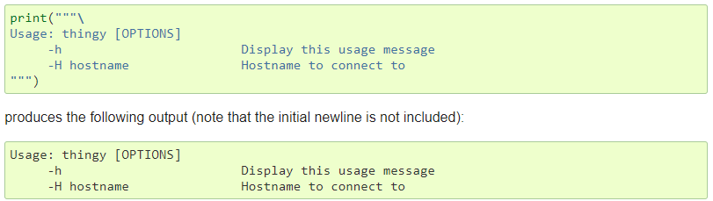
Spanning Multiple Lines
Strings can span multiple lines by using triple-quotes (“””…””” or ‘’’…’’’)
Any new lines (when you press enter) are automatically included in the string (and don’t need an explicit \n newline character)
Learn Full Stack Web Development
www.projectfullstack.com

Slide 8

Spanning Multiple Lines
Another way to span multiple lines, is that two or more strings next to each other are AUTOMATICALLY concatenated (joined together)
Note: this method only works with two string literals, not with variables or expressions
Learn Full Stack Web Development
www.projectfullstack.com

Slide 9
Zero Based Index
What is the first character in the following string “Caution! Wet Floor”
In Python, strings can be indexed (subscripted), with the first character having index 0
Zero-based indexing is normal in programming!
Index 0 in “Caution! Wet Floor” is the character “C”
Index 1 in “Caution! Wet Floor” is the character “a”
Index 2 in “Caution! Wet Floor” is the character “u”
Index 3 in “Caution! Wet Floor” is the character “t”
Learn Full Stack Web Development
www.projectfullstack.com

Slide 10
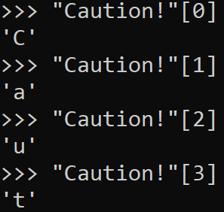
Zero Based Index
Use “brackets” to “subscript” or access an index
“Caution!”[0] – Access the zero index in the string “Caution!”
“Caution!”[1] – Access the one index in the string “Caution!”
Note: Indexing is used widely in programming for more advanced data types such as lists. We will see more of this in the future.
0 | 1 | 2 | 3 | 4 | 5 | 6
C | A | U | T | I | O | N
Learn Full Stack Web Development
www.projectfullstack.com

Slide 11
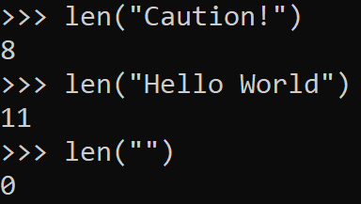
Len() built-in function
The built-in function len() will return the length of a string
Documentation: https://docs.python.org/3/library/functions.html#len
Learn Full Stack Web Development
www.projectfullstack.com

Slide 12
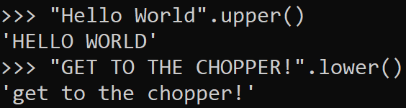

String Methods
There are many methods (also known as functions) that ALL STRINGS have access to.
https://docs.python.org/3/library/stdtypes.html#string-methods
The syntax is “some string”.some_method()
The string itself
A Period
The method call – method name followed by parentheses and any arguments the method needs
Learn Full Stack Web Development
www.projectfullstack.com

Slide 13
Working With String Exercises
Use the link below to find some practice exercises that deal with working with strings.
https://github.com/ProjectFullStack/Learn-To-Program-Python3/blob/master/exercises/working_with_strings.txt
Learn Full Stack Web Development
www.projectfullstack.com

Slide 14
Learn To Program With Python 3
Learn Full Stack Web Development
www.projectfullstack.com

