Slide 1
Learn To Program With Python 3
Control Flow - Functions
Learn Full Stack Web Development
www.projectfullstack.com

Slide 2
Documentation
Wikipedia “Control Flow” - https://en.wikipedia.org/wiki/Control_flow
Python docs tutorial on functions: https://docs.python.org/3/tutorial/controlflow.html#defining-functions
Learn Full Stack Web Development
www.projectfullstack.com

Slide 3
Control Flow
In computer science, control flow is the order in which individual statements, instructions or function calls of a program are executed or evaluated.
Learn Full Stack Web Development
www.projectfullstack.com

Slide 4
Control Flow
Previously we have said to “think like the compiler”
Line by line, character by character
“Line by Line” assumes a linear control flow, each line is executed immediately after the line above it.
We can, and will, regularly change that.
Learn Full Stack Web Development
www.projectfullstack.com

Slide 5
Control Flow
Think of it as there being a “pointer” pointing to the current line to be executed.
The compiler will execute the line that “pointer” is on, and then move the pointer to the next line and execute that line
It will continue doing this until the end of the program.
When we first start a program, the “pointer” points at the first line and code (and goes line by line from there)
We can tell the pointer to move to a different line of code
You can tell it to “jump” or “go to” different lines of your program.
It then resumes the normal behavior – line by line
Learn Full Stack Web Development
www.projectfullstack.com

Slide 6
Types of Control Flow
Functions – reusable blocks of code referred to by a name (like a variable)
Conditionals – execute a block of code only during certain conditions
If Statements (and “else” or “else if” statements)
Loops - continuously execute a block of code until an exit condition is met
While loops
For loops
Break / Continue statements
Pass statements
Learn Full Stack Web Development
www.projectfullstack.com

Slide 7
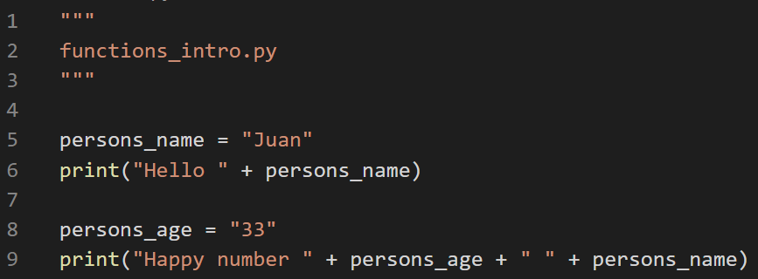
Linear Control Flow
Previously we have used patterns like this.
We expect this to execute line by line, we are not altering the control flow
Learn Full Stack Web Development
www.projectfullstack.com

Slide 8
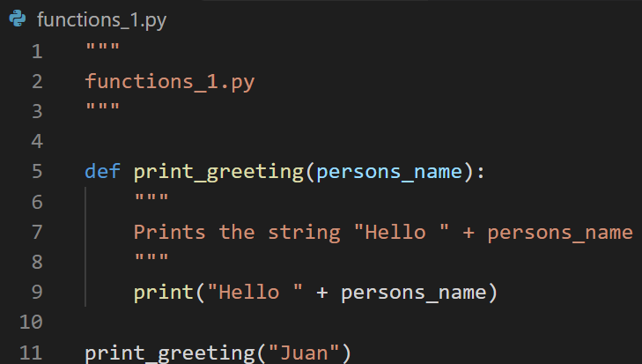
Control Flow - Functions
What do you think it does?
Do you notice any patterns in the code?
Try it!
Learn Full Stack Web Development
www.projectfullstack.com

Slide 9
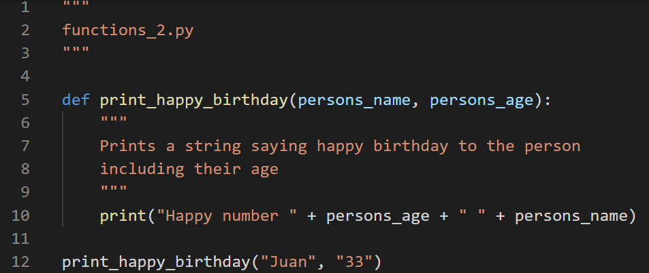
Control Flow - Functions
What do you think it does?
Do you notice any patterns in the code?
Try it!
Learn Full Stack Web Development
www.projectfullstack.com

Slide 10
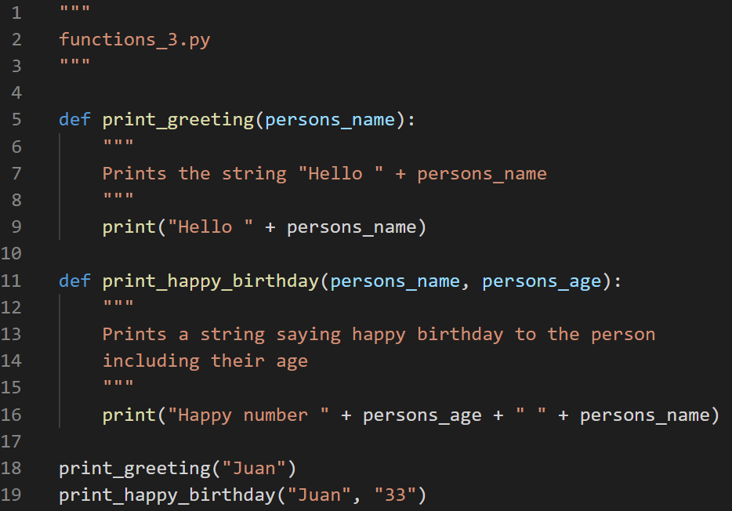
Control Flow - Functions
Try it!
Learn Full Stack Web Development
www.projectfullstack.com

Slide 11
Exercise!
We will talk about the syntax of functions in a second, but first….
Try to write a function that prints three lines of your favorite song
Learn Full Stack Web Development
www.projectfullstack.com

Slide 12
Functions
In computer programming, a function is a sequence of program instructions that performs a specific task, packaged as a unit. This unit can then be used in programs wherever that particular task should be performed.
Think of functions of “mini programs inside your program”
Used to keep large programs organized in smaller easy to manage (and debug) sections.
Eliminates repetitive code, makes our program smaller
Learn Full Stack Web Development
www.projectfullstack.com

Slide 13
Function Syntax - Signature
“def” keyword defines a new function
“def” must be followed by the function name
The name is like a variable name, you can name it whatever you want and refer to the function in other parts of your code using that name
The function name must be followed by a parenthesized list of parameters
List of parameters can be empty () or a comma-separated list (parameter1, parameter2) of expressions
A colon : must follow the list of parameters
This syntax is commonly known as the “function signature”
Learn Full Stack Web Development
www.projectfullstack.com

Slide 14
Function Syntax
“def” keyword
function name
parenthesized list of parameters
Colon terminates the function signature
1
2
3
4
Learn Full Stack Web Development
www.projectfullstack.com

Slide 15
Function Syntax - Body
The sequence of instructions you want the function to perform are known as the “function body”
The statements that form the body of the function start at the next line (after the function signature ending colon) and must be indented.
Indentation throughout your program can be done using tabs or spaces
But you can not mix the two!
Pro Tip: Never use tabs for indentation, always use four spaces
Learn Full Stack Web Development
www.projectfullstack.com

Slide 16
Function Syntax
Each line in the function body is indented by four spaces
4
4
4
4
Learn Full Stack Web Development
www.projectfullstack.com

Slide 17
Function Syntax – Calling Functions
When you want to use a function you “call” it
A function call is similar to the function signature EXCEPT:
You do not use the “def” keyword (you are calling an already defined function, not defining a new one)
You do not include the colon (again, you are calling an already defined function, not defining a new one)
You DO still include the parenthesized parameter list
This is what actually makes the function call execute
Changes the control flow “pointer” to move to the function body
Whatever expressions you include in the parameter list will be used inside the function body
Learn Full Stack Web Development
www.projectfullstack.com

Slide 18
Function Syntax
Function Call
The parameters in the function signature take on the value of the passed in parameters (arguments) from the function call
“Juan”
“Juan”
Learn Full Stack Web Development
www.projectfullstack.com

Slide 19
Function Syntax
When using a function with multiple parameters, the parameters takes on the value of the calling arguments in POSITIONAL ORDER
“persons_name” is the first positional parameter – takes on the value of the first argument in the calling function – “Juan”
“persons_age” is the second positional parameter – takes on the value of the second argument – “33”
“Juan”
“33”
Learn Full Stack Web Development
www.projectfullstack.com

Slide 20
Exercise!
Write a function that prints the same thing twice, it will need one parameter (the value to print)
Write a function to square a number (multiply it by itself), it will only need one parameter (the number to square). The function should print the result.
Write a function to exponentiate a number, it will need two parameters. The function should print the result of the first parameter raised to the power of the second parameter.
Learn Full Stack Web Development
www.projectfullstack.com

Slide 21
Learn To Program With Python 3
Learn Full Stack Web Development
www.projectfullstack.com

