Slide 1

Department of Computer Science and Engineering
PROJECT TITLE : IDENTITY MANAGEMENT USING BLOCKCHAIN
Batch No: 2018_CSE_17
Team Members:
Chandan M
Bharath B R
Koppresh Putpak
Madhu M Pandurangi

Slide 2

BlockIdentity-BI
One nation one identity
Area : blockchain

Slide 3
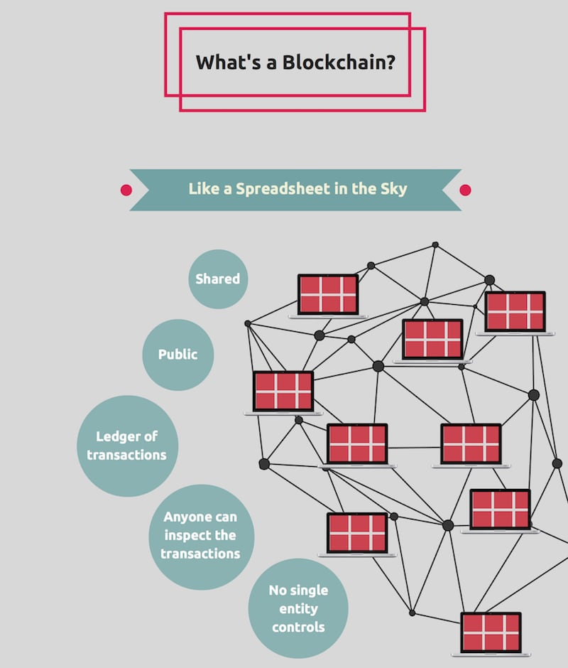
Inroduction
What is Blockchain?
A blockchain is simply a continuous list of records, which are linked together through cryptography. These records or blocks, all correspond to a distributed ledger, which records transactions. Every block contains a timestamp and transaction data, locking the content and preventing unauthorized modification.

Slide 4
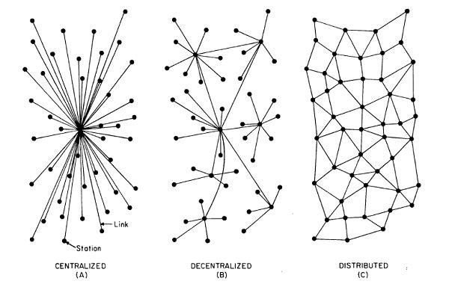
LITERATURE SURVEY
Why De-centralized..?
Decentralized means that there is no single point where the decision is made. Every node makes a decision for its own behavior and the resulting system behavior is the aggregate response.
Think of Bitcoin, no one place where the validation happens any miner can validate a block through mining .
In Identity context, this would mean all our identities are on a public blockchain with the network validating our identity and skills. Although we are heading in this direction we got to set the foundation strong so that the de-centralized community has a solid ground to work on.

Slide 5
PROBLEM IDENTIFICATION
Limited access by more than one person to the same set of data as there is only one copy of it and it is maintained in a single location. This can lead to major decreases in the general efficiency of the system.
If there is no fault-tolerant setup and hardware failure occurs, all the data within the database will be lost.
PROBLEM STATEMENT
The idea is to use a blockchain for storing identities that could potentially be used across different services but also leave a person in control of their information - a concept referred to as self-sovereign identity.

Slide 6
REQUIREMENTS
HARDWARE
Processor - Intel core family
RAM - 4GB
Disk Space- 250GB
SOFTWARE & PLATFORM
solidity
Windows OS
Etherium - Computing platform

Slide 7
Thank You

