Slide 1


Machine Learning Model for
Detecting Bug in Inconsistent Code Clones
Chowdhury Ashabul Yeameen Seungtack Baek

Slide 2
The basics
What is Code Clone?

Slide 3
1. Write code
2. Copy and paste
3. Discover error in one copy
4. Fix inconsistently

Slide 4
File “A”
nsCOMPtr<nsIPrivateDOMEvent> privateEvent(do_QueryInterface(event));
if (!privateEvent)
return;
privateEvent->SetTrusted(PR_TRUE);
nsRefPtr<nsPLDOMEvent> plevent = new nsPLDOMEvent(content, event);
if (!plevent)
return;
plevent->PostDOMEvent();
Potential Buggy Differences
File “B”
nsCOMPtr<nsIPrivateDOMEvent> privateEvent(do_QueryInterface(event));
if (!privateEvent)
return;
privateEvent->SetTrusted(PR_TRUE);
nsRefPtr<nsPLDOMEvent> plevent = new nsPLDOMEvent(content, event);
if (plevent)
plevent->PostDOMEvent();
Potential Buggy Differences

Slide 5
File “A”
nsTreeBodyFrame::ScrollByLines(PRInt32 aNumLines)
{
if (!mView)
return NS_OK;
PRInt32 newIndex = mTopRowIndex + aNumLines;
if (newIndex < 0)
newIndex = 0;
else {
PRInt32 lastPageTopRow = mRowCount - mPageLength;
if (newIndex > lastPageTopRow)
newIndex = lastPageTopRow;
}
...
Potential Buggy Differences
nsTreeBodyFrame::ScrollByPages(PRInt32 aNumPages)
{
if (!mView)
return NS_OK;
PRInt32 newIndex = mTopRowIndex + aNumPages
* mPageLength;
if (newIndex < 0)
newIndex = 0;
else {
PRInt32 lastPageTopRow = mRowCount - mPageLength;
if (newIndex > lastPageTopRow)
newIndex = lastPageTopRow;
}
...
File “B”
Potential Buggy Differences

Slide 6
Our contribution
So, what did we DO?

Slide 7
Features
For each clone pair, the diff will have certain semantic features, such as…
Introduction of new branch (if, #ifdef, #endif, etc.)
Change in the number of conditions (for same decision)
Change in return statement
Change in branching logic (continue, break, etc)
Introduction of new variable definition
Calling a resource allocation/release function
…

Slide 8
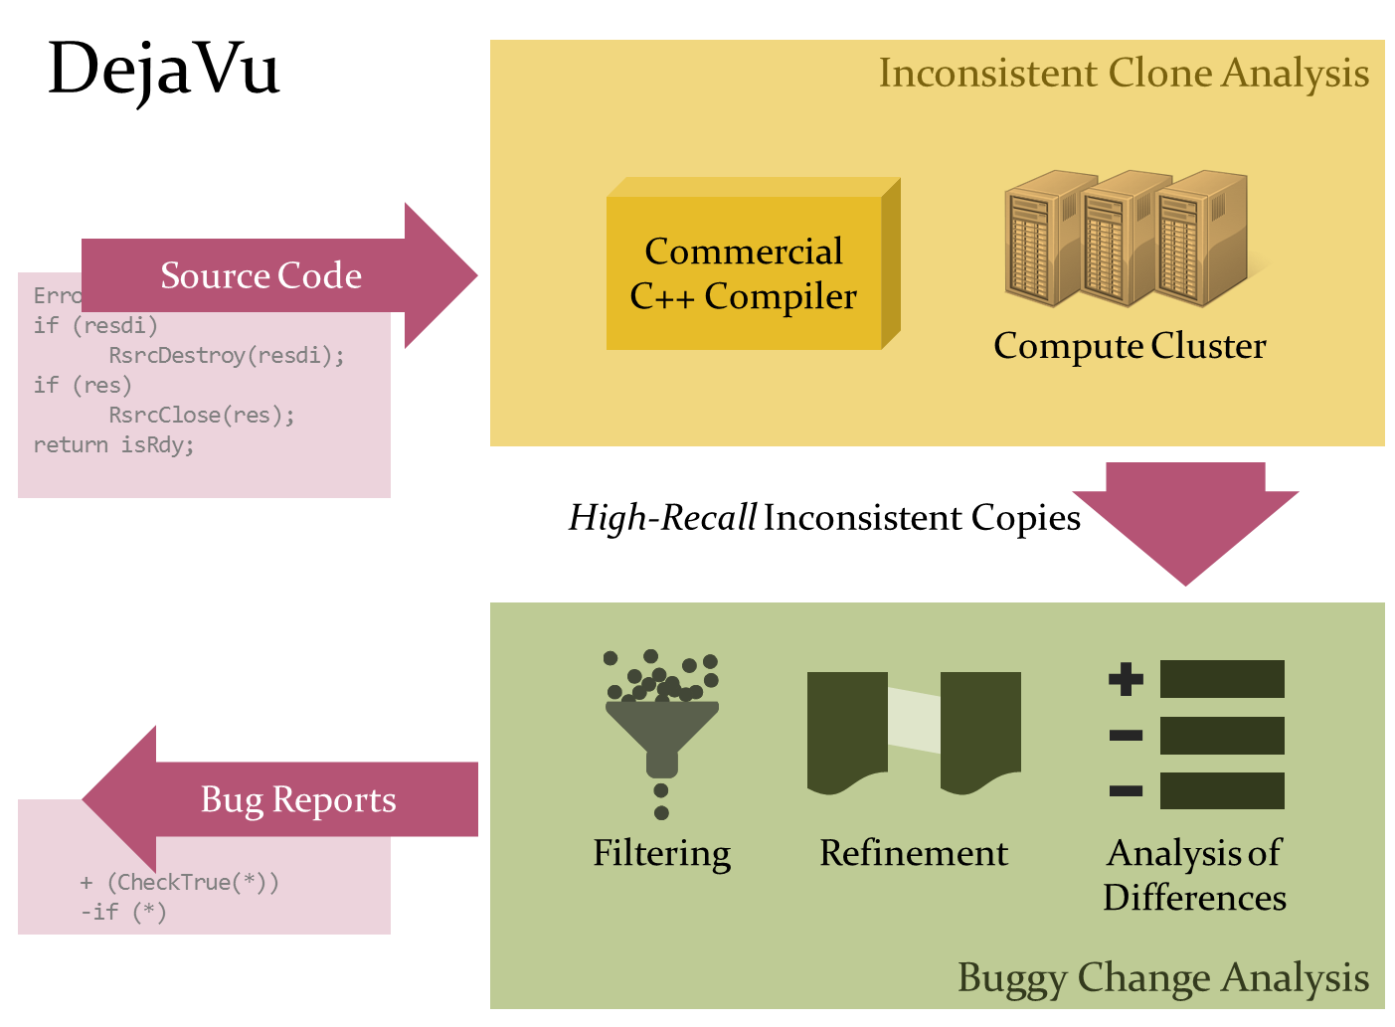
BENIGN
BUGGY
Machine Learning
Reports Contains:
1. Source Code of the candidates
2. Potential buggy difference
3. Other attributes (e.g. TextSim,
Distance, etc.)
ARFF File
1. Source Code of the candidates
2. Potential buggy difference
Extract Features
3. Other attributes (e.g. TextSim,
Distance, etc.)
Extract Attributes

Slide 9
Result 1:
Algorithm | Parameter | Meta | Classified Harmful | Missed Harmful | Recall in Harmful cases(%) | Classified Benign | Missed Benign | Recall in Benign cases (%) | Overall Accuracy (%)
SVM | gamma=0.2 |  | 92 | 4 | 95.8 | 8 | 26 | 23.5 | 76.92
SVM | gamma=0.2, I=30 | AdaBoost | 83 | 13 | 86.5 | 17 | 17 | 50 | 76.92
SVM | gamma=.2, I=30 | Bagging | 92 | 4 | 95.8 | 8 | 26 | 23.5 | 76.92
NB |  |  | 83 | 13 | 86.5 | 22 | 12 | 64.7 | 80.77
NB | I=30 | Bagging | 85 | 11 | 88.5 | 21 | 13 | 61.8 | 81.53
Harmful=Bug, Check, Smell (96 cases)
Benign= Style, False (34 cases)

Slide 10
Result 2:
Algorithm | Meta | Parameters | Classified harmful | Misclassified Harmful | Recall in harmful cases (%) | Classified Benign | Misclassified Benign | Recall Benign (%) | Overall Accuracy (%)
NB |  |  | 98 | 8 | 92.5 | 17 | 7 | 70.8 | 88.46
NB | AdaBoost | I=30, P=100 | 98 | 8 | 92.5 | 16 | 8 | 66.7 | 87.69
NB | AdaBoost | I=30, P=50 | 98 | 8 | 92.5 | 18 | 6 | 75 | 89.23
SVM |  | G=.2 | 106 | 0 | 100 | 7 | 17 | 29.2 | 86.92
SVM | AdaBoost | G=.2, I=30 | 100 | 6 | 94.3 | 15 | 9 | 62.5 | 88.46
SVM | AdaBoost | G=.2, I=30, P=50 | 100 | 6 | 94.3 | 16 | 8 | 66.7 | 89.23
SVM | Bagging | I=10 | 105 | 1 | 99.1 | 9 | 15 | 37.5 | 87.7
Harmful=Bug, Check, Smell, Style (106 cases)
Benign= False (34 cases)

Slide 11
How many of these are real BUGs?

Slide 12
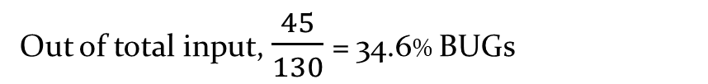
Result 1: How many real bugs?
Algorithm | Parameter | Meta | Classified Harmful | Missed Harmful | Recall in Harmful cases(%) | Classified Benign | Missed Benign | Recall in Benign cases (%) | Overall Accuracy (%)
SVM | gamma=0.2 |  | 92 | 4 | 95.8 | 8 | 26 | 23.5 | 76.92
SVM | gamma=0.2, I=30 | AdaBoost | 83 | 13 | 86.5 | 17 | 17 | 50 | 76.92
SVM | gamma=.2, I=30 | Bagging | 92 | 4 | 95.8 | 8 | 26 | 23.5 | 76.92
NB |  |  | 83 | 13 | 86.5 | 22 | 12 | 64.7 | 80.77
NB | I=30 | Bagging | 85 | 11 | 88.5 | 21 | 13 | 61.8 | 81.53
Harmful=Bug, Check, Smell (45+51 cases)
Benign= Style, False (34 cases)
Out of total input, $\frac{45}{130}$ = 34.6% BUGs

Slide 13
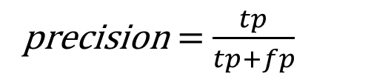

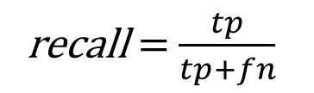
Precision and Recall
 |  | Condition as determined by Gold standard
 |  | True | False
Test outcome | Positive | True positive | False positive
 | Negative | False negative | True negative
So far we considered,
accuracy = $\frac{tp+tn}{tp+fp+fn+tn}$
May be more important,
precision = $\frac{tp}{tp+fp}$
recall = $\frac{tp}{tp+fn}$

Slide 14
Precision and Recall
Problem
Keeping track of real bugs in modified classification
Cross validation
No example number in default result
Solution
Write your own validation
Choose a method which suffers minimum overfitting problem

Slide 15
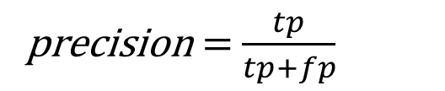
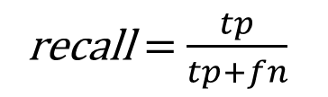
Precision and Recall
Harmful | Benign | Total data in Harmful | Detected bugs in Harmful | Missing bugs in Harmful | Recall in Bug | Precision | Recall in Harmful
BUG | CHECK,SMELL, STYLE, FALSE | 54 | 30 | 15 | 66.67% | 55.56% | 66.67%
BUG,CHECK | SMELL,STYLE,FALSE | 75 | 38 | 7 | 84.44% | 50.67 | 78.57%
BUG,CHECK,SMELL | STYLE,FALSE | 95 | 43 | 2 | 95.56% | 45.74% | 89.58%
precision = $\frac{tp}{tp+fp}$
recall = $\frac{tp}{tp+fn}$

Slide 16
Precision and Recall
Harmful | Benign | Total data in Harmful | Detected bugs in Harmful | Missing bugs in Harmful | Recall in Bug | Precision | Recall in Harmful
BUG | CHECK,SMELL, STYLE, FALSE | 54 | 30 | 15 | 66.67% | 55.56% | 66.67%
BUG,CHECK | SMELL,STYLE,FALSE | 75 | 38 | 7 | 84.44% | 50.67 | 78.57%
BUG,CHECK,SMELL | STYLE,FALSE | 95 | 43 | 2 | 95.56% | 45.74% | 89.58%
precision = $\frac{tp}{tp+fp}$
recall = $\frac{tp}{tp+fn}$

Slide 17
Threat to Validity
Small dataset, in terms of both number & platform
Including other bad practices along bugs
Manual extraction of some features

Slide 18
Future extension
Complete automatic extraction of features
Try with larger dataset on variety of projects
Project specific tool to learn over time
Tool idea: On commit, automatically detecting and suggesting to take a look at clone copy

Slide 19
Question?

Slide 20
Thanks!

