Slide 1
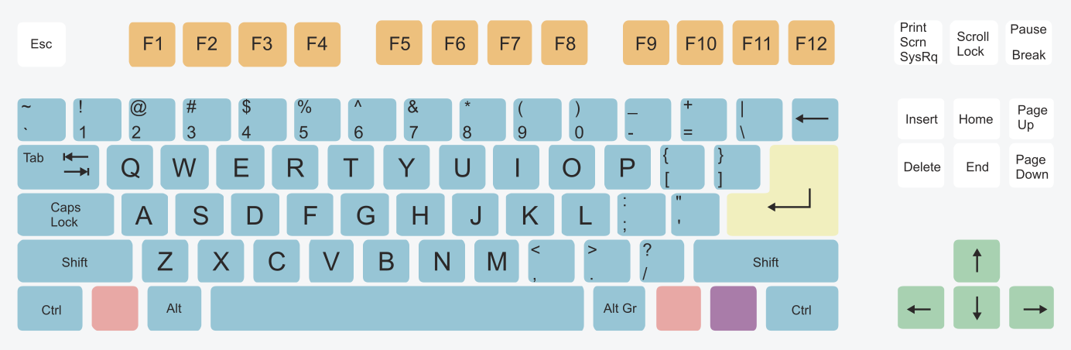
“q” Set Starttime
“w” Process & Plot
“e” Set endtime
“Ctrl+R” Detect events
“Ctrl+R” Run auto-pick
“Ctrl+y” Open events
“h” Select a seismogram
“j” deselect a seismogram
“a” Plot Spectrum over selection
“f” Plot Spectrum all selections
“m” Select to export to TF analysis seismogram
“z” Plot Spectrogram over selection
“r” Load last project and apply search filters
“Ctrl+N” Plot all Seismograms
“Ctrl+B”Stack Seismograms

Slide 2

“Click + drag” select part of the waveform, for all seismograms
“Click + drag” = select part of the waveform in individual seismogram
“Doble click” = Pick selected phase in individual seismogram
Hold “+” while Double click left to attach ↑ polarity
Hold “-” while Double click left to attach ↓ polarity
Press “i” to activate the drawing refrence “|” and press “o” to deactivate
“one click over marked phase” = Remove the pick in individual seismogram

Slide 3
Shortcut | Action
'a' | Compute trace spectrum
'f' | Compute all spectrums
'z' | Compute Scalogram
'q' | Set Start Time
'w' | Process and Plot
'e' | Set End Time
‘i’ | Activate Multicursor
‘o’ | Deactivate Multicursor
‘r’ | Load last Project and apply filters
‘u’ | Open Uncertainity picking box
‘m’ | Select to export waveform to TF
‘h’ | Select specific trace to Process
‘j’ | Deselect specific trace to Process
‘p’ | Plot Record Section
‘d’ | Deselect trace chop

Slide 4
Shortcut | Action
'Ctrl+D' | Run Script
'Ctrl+L' | Open Macro
'Ctrl+U' | View Picks
'Ctrl+C' | Clean events detected
'Ctrl+M' | Concatenate Seismograms
'Ctrl+P' | Open phases comboBox
'Ctrl+K' | Save CFs (STA/LTA, Wavelet CF, Envelope, Entropy…)
'Ctrl+N' | Plot_all_seismograms
'Ctrl+B' | Stack_all_seismograms
'Ctrl+I' | Deselect all
'Ctrl+J' | Deselect chop from page

Slide 5
Shortcut | Phase | Polarity
1 | P | ?
2 | P | Up
3 | P | Down
4 | S | ?
5 | S | Up
6 | S | Down

