Slide 1
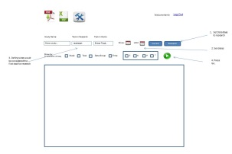
PITracking.html
Submit()
PITracking.java
AJAX POST
Global: ManageCach.java
getCurrentStudies()
getHistoryStudies()
getQueryResults()
RandomStudyConfigReader.java
Query requests would be sent to the servlet. response in the form of CSV would be sent back.
Production: Research
ManageCach.java
StringBuffer[] CSV
Scheduler()
saveToDisk()
SessionDAO
queryResearch()
queryDemo()
Production: Demo
Warehouse

