Slide 1
BLE mouse controlled by head movements
MBDE - Project
Stefan Schönbauer
st16m027

Slide 2
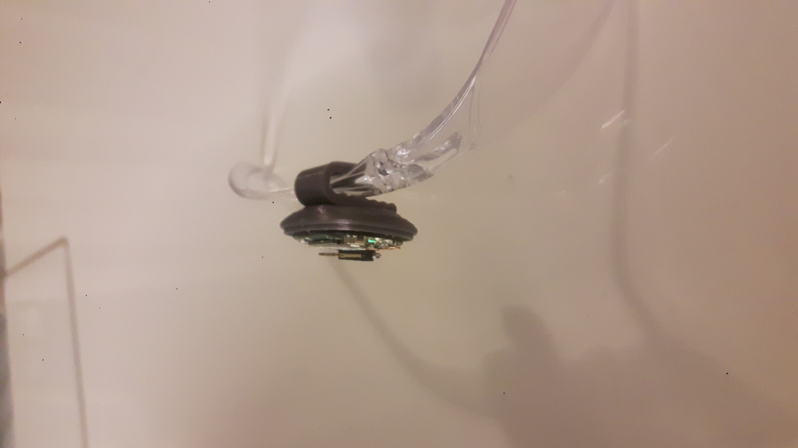
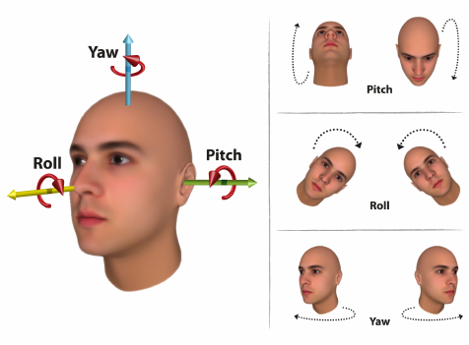
Introduction
BLE Mouse controlled by head-movements
IMU to detect head-movements
z
y
x

Slide 3
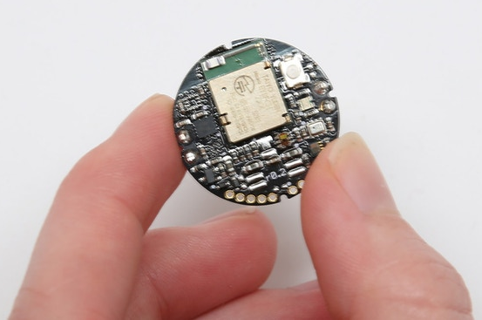
Hardware – Metawear C
nRF51 – Nordic Semiconductors
2.4 GHz transceiver
ARM® Cortex™-M0 32 bit MCU
256 kB flash program memory
16 kB RAM
BMI160 – Bosch Sensortec
3-Axis Accelerometer
3-Axis Gyroscope
Proprietary Firmware onboard

Slide 4
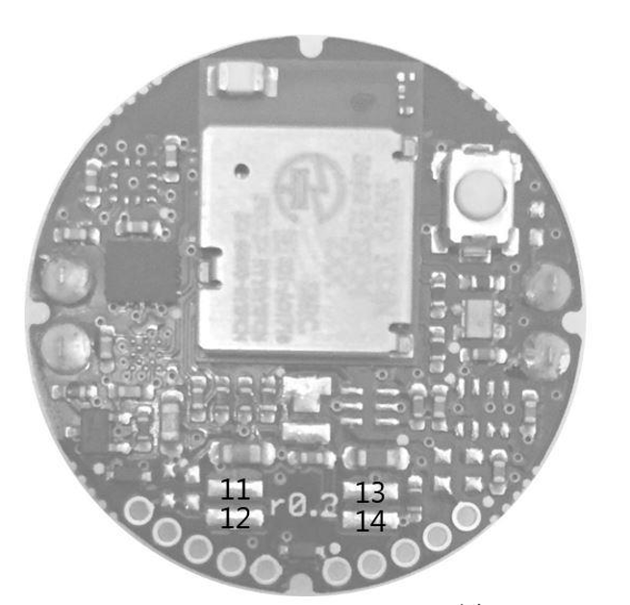
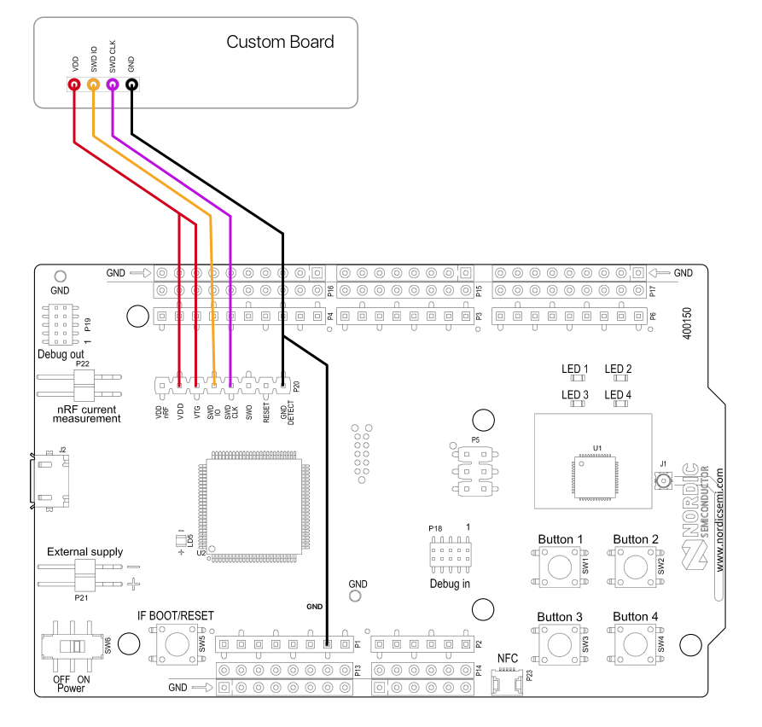
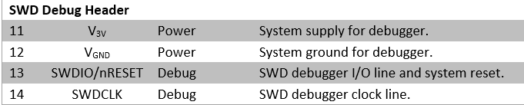
Hardware - nRF51 DK
nRF5x development kit
Onboard JLINK interface
Programming / debugging other nRFx chips via single wire debug interface

Slide 5
Toolchain / SDK / Drivers
Eclipse with GNU Arm Embedded Toolchain
GCC
GDB
nrfjprog - Programming Tool
Command line tool to load FW via SWD
SDK nRF5 12.3.0
Examples with makefiles for GCC
Provides HID mouse BLE profile
BMI160 Driver
Gyroscope configuration (sample rate, measurement range)
Interrupt configuration
Auto calibration

Slide 6
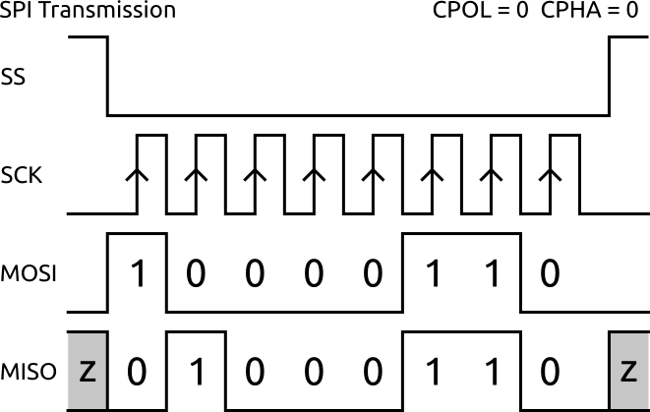
SPI – Serial Peripheral Interface
Master
Slave
nRF51
BMI160
SS: Slave Select (active low, output from master)
SCK: Serial Clock (output from master)
MOSI: Master Out Slave In (data output from master)
MISO: Master In Slave Out (data output from slave)

Slide 7
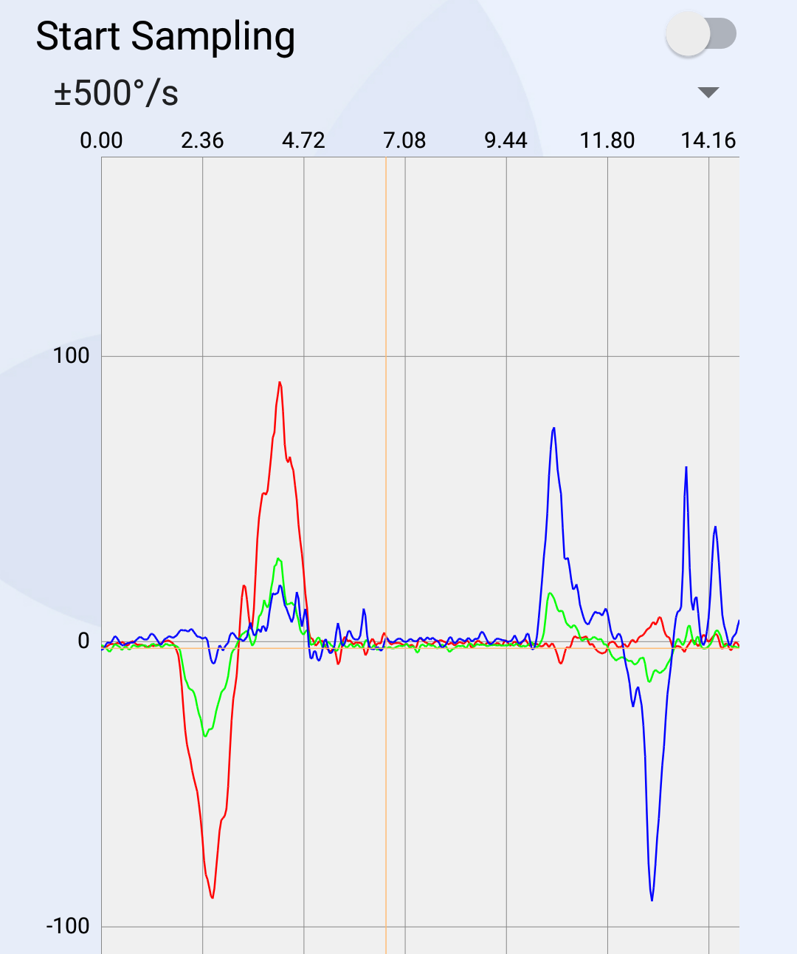
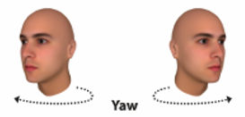
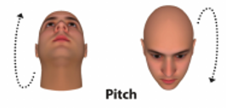
Implementation
Start
SPI INIT
BMI160 INIT
GPIOTE INIT
BLE INIT
DATA Ready?
Read GYRO
Send Mouse Pos

Slide 8
Issues
SPI connection between nRF51 and BMI160
Hardware connection for debug interface
Bias error of gyroscope → autocalibration
Auto-Click
No motion interrupt works
The packet is not send

Slide 9
Outlook
Device Firmware Update
Power optimization
Fix mouse click issue
Better case

