Slide 1
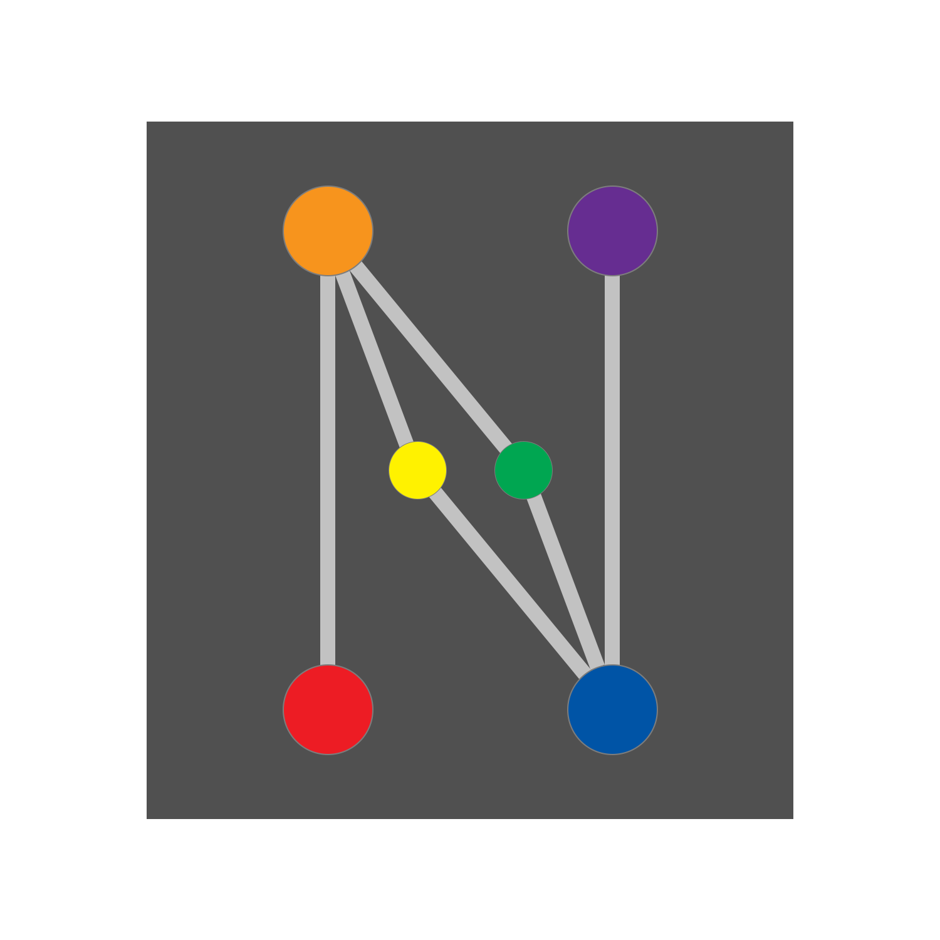
LEADS: Lightweight Embedded Assisted Driving System
Enable your racing car with powerful, data-driven instrumentation, control, and analysis systems, all wrapped up in a gorgeous look
PROUDLY PRESENTED BY PROJECT NEURA

Slide 2
LEADS: 轻量化嵌入式辅助驾驶系统
用强大的数据驱动系统赋能你的赛车，结合仪表、控制和分析功能，同时以精美的外观包裹
PROUDLY PRESENTED BY PROJECT NEURA

Slide 3
LEADS ECOLOGY
LEADS VeC
LEADS VeC RC
LEADS VeC DP
LEADS
LEADS Jarvis
Project Thor
LEADS Framework
LEADS Arduino

Slide 4
OUR MISSION
Provide a Template for Racing Cars
Whether it is an electric racing drive system or a modern control system, LEADS can meet your needs. It has the potential to adapt to racing cars of any size and category.
Throughout the development of LEADS, we have never forgotten our beginning – an amateur-developer-friendly project initialized by high school students. We have always tried our best to give back to the community by making it easy to understand while ensuring professionalism and safety. Whether it is the framework or other out-of-the-box modules in the ecology, our goal is to make users feel as easy and happy as building a LEGO.
Establish a Solid Data Platform
All data from hundreds of sensors and cameras can be displayed in a gorgeous look, shared in real-time, and saved in popular formats.
Change Driving like AlphaGo Changed Go
Enhanced by deep learning, training a driver is no longer what it used to be. The closer you get to Jarvis, the better you are, and Jarvis knows you better than you do.

Slide 5

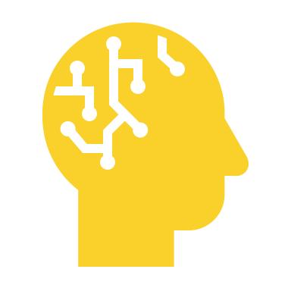
EMBRACE ARTIFICIAL INTELLIGENCE
Ever since the birth of LEADS, AI has been destined to play a role of importance that does not overshadow but assists the driver.
Both traditional machine learning and deep learning are widely used everywhere in LEADS. They provide users with robust and intelligent experiences in various scenarios, big and small.
Performance Checker
Data Inference
Driver Scoring
Data Inference
EBI
ATBS
Training Quantification
Jarvis

Slide 6



Simple, Mature, and Universal
Microcontroller Unit
Single-board Computer
Standard Computer
C / C++
Python
Python
Arduino
Raspberry Pi
Workstation
C / C++
JavaScript
Rust
NVIDIA Jetson
Cloud Server
STM32
…
…
…
BOTTOM
TOP

Slide 7







OUR AMBITION
Phase I
Vehicle Instrument Display Cluster
Phase II
Cloud Data Repository with Live Video Feed
Open-source codes
Phase III
Remote Analyst and Onboard Control System
Published papers
Phase IV
Road Datasets with Comprehensive Annotation
ProjectNeura/LEADS
Phase V
Deep Learning Models Trained on the Road Datasets
https://leads.projectneura.org

