Slide 1
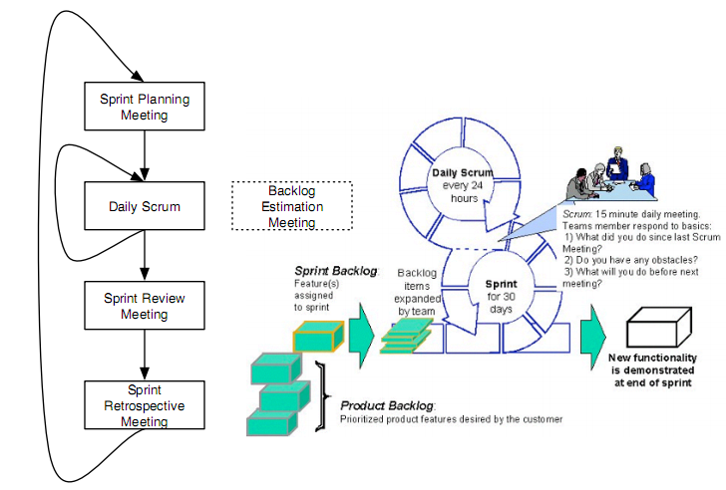
User Stories and
Agile Planning
Richard de Koning
Stefan Leijnen
Remco van Swieten

Slide 2
User Stories
Definition, template
Assignment
  Find epics and construct an epic hierarchy
Qualities: Invest and done
Assignment
  Construct stories to INVEST in

Slide 3
User stories
A user story is a short template description of an software element such as a feature or a requirement.
  “As a [role] I can [function] so that [rationale].”
  “As a [role] I want [goal] so that [reason].”
Examples
  As a player I want a pause button, so I can halt a long level.
  As a player I want to see my health level, so I can adjust my gameplay (duck for bullets!)

Slide 4
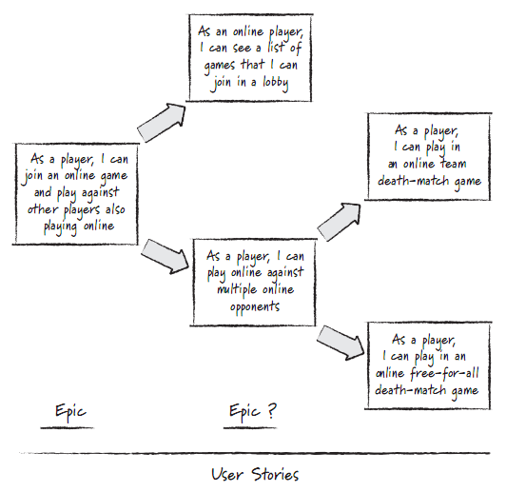
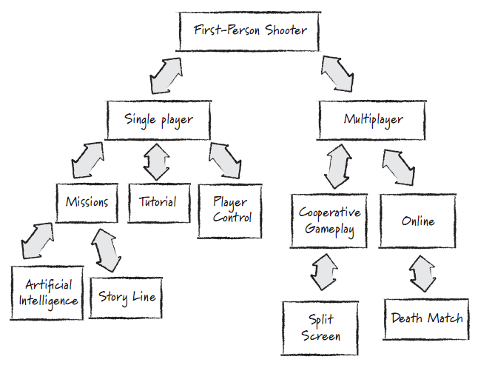
SCRUM assignment (10 Min)
Break down your epics into stories.
Construct an epic hierarchy

Slide 5
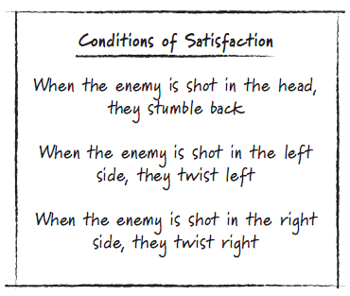
Qualities of a User Story
INVEST (Bill Wake), Why???
  Independent
  Negotiable
  Valuable
  Estimatable
  Sized appropiately
  Testable (COS, DefOfDone)

Slide 6
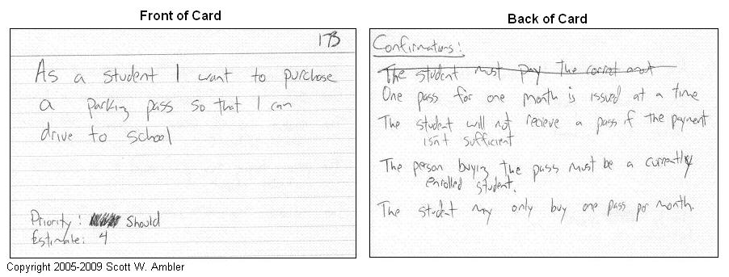
SCRUM assignment (10 Min)
Check the quality of your stories
Improve at least 2 stories so they are worth to INVEST in

Slide 7
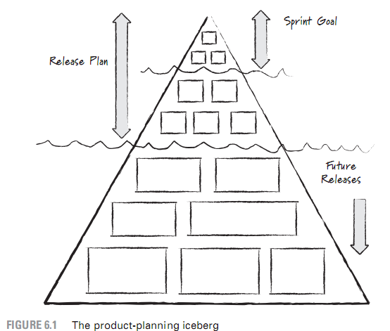
Agile Planning
A quick process
Sharing knowledge
  Expert opinion
Estimate by analogy
Disaggregation
Anchoring effect
Affects Story Quality!
Story points
Fibonacci effort

Slide 8
Agile Planning
The ice-berg and estimation
Assignment: playing poker
Tools overview
Assignment: tool impression

Slide 9
Planning Poker
http://www.youtube.com/watch?v=0FbnCWWg_NY

Slide 10
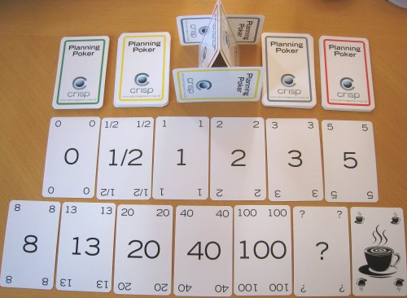
SCRUM assignment (10 Min)
Estimate your stories in a poker game

Slide 11
Tools overview
agilescout.com/best-agile-scrum-tools/

Slide 12
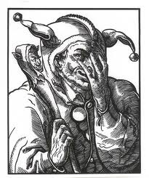
SCRUM assignment (10 Min)
Study the tools overview
Discuss possible alternatives
Decide who to install what tool
Evaluate and use the best tool
Be able to motivate choice in Assessment!!!!

