Slide 1

Project Introduction
1. Project name
Manufacturing Analytics
2.Modules
Excel
Tableau
Power bi
SQL

Slide 2
Our Team members(Group2)
POOJA
AMINA AZMATH
LATHA SREE RAJYAM
KIRAN
PRASANNAKUMAR

Slide 3

Manufacturing Data Analysis in Various Organizational Functions
Demand Forecasting
Inventory Management
Risk Management
Product Development
Price Optimization

Slide 4
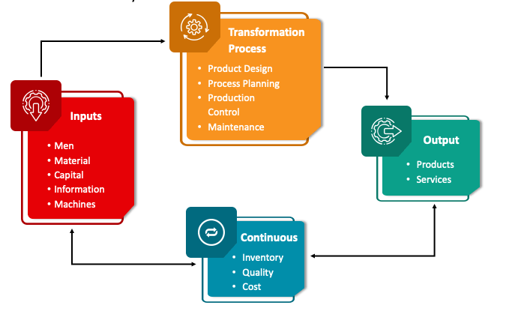
Goal & Operations Management

Slide 5
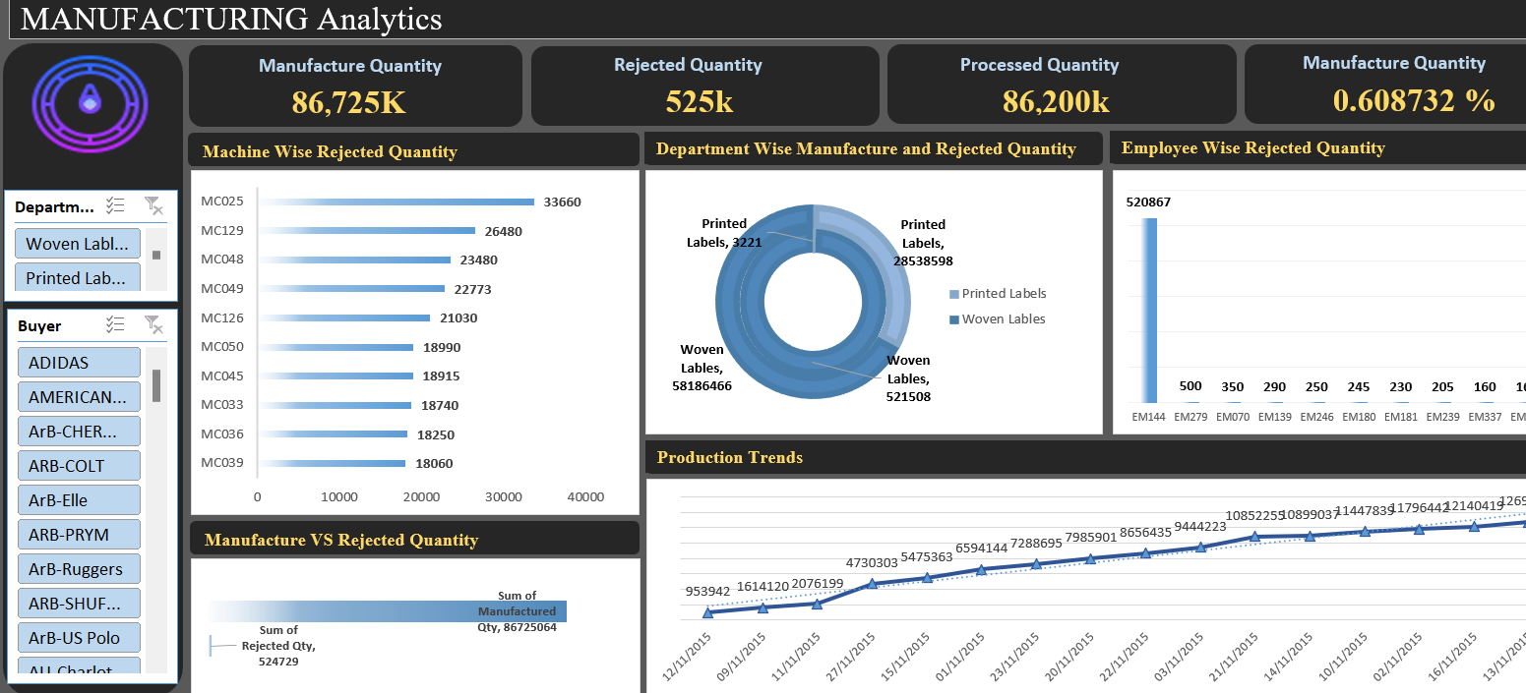
Excel Report

Slide 6
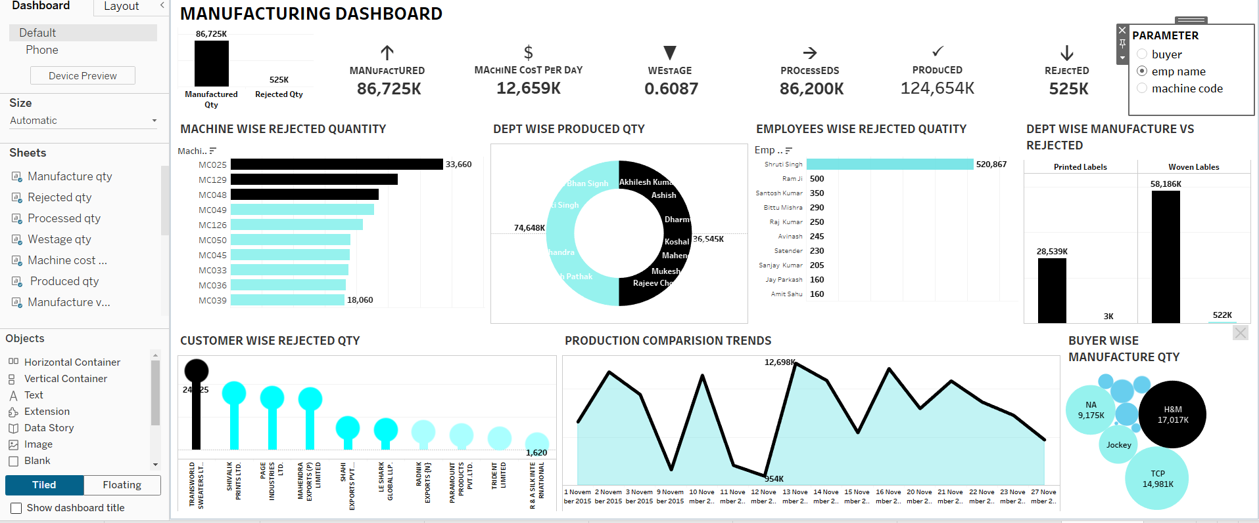
Tableau Report

Slide 7
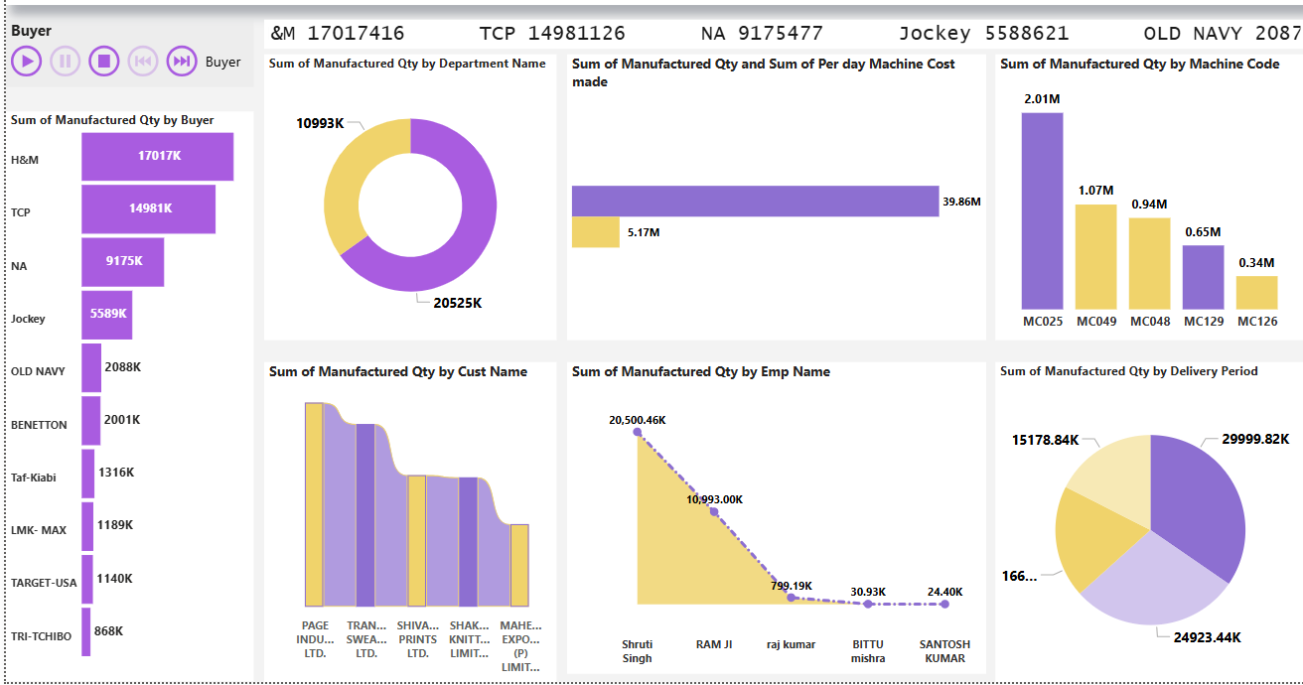
Power BI Report

Slide 8
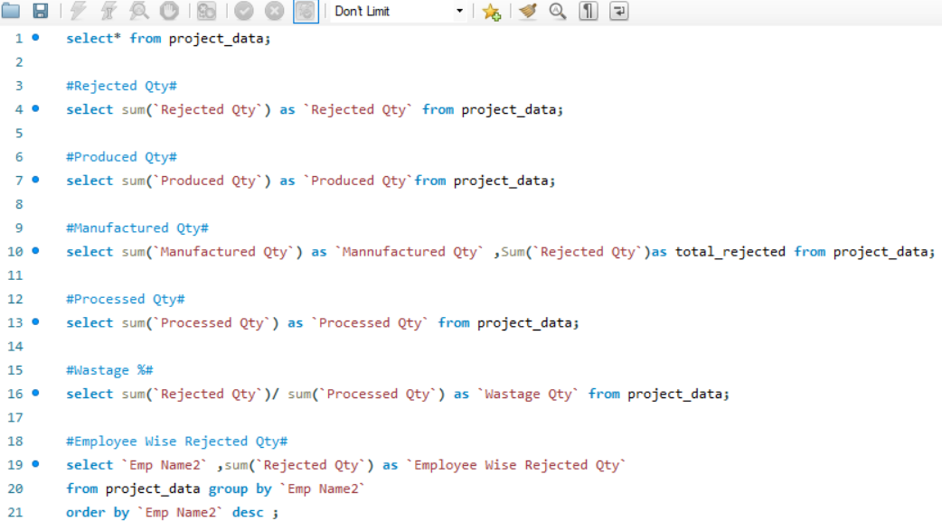
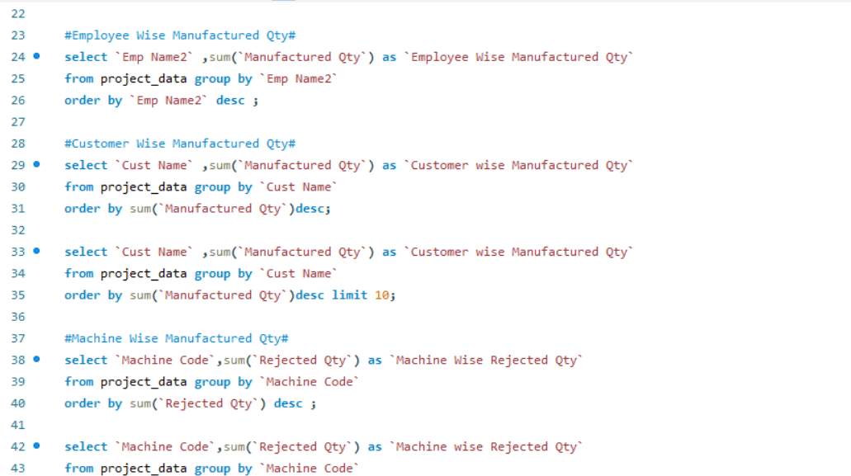
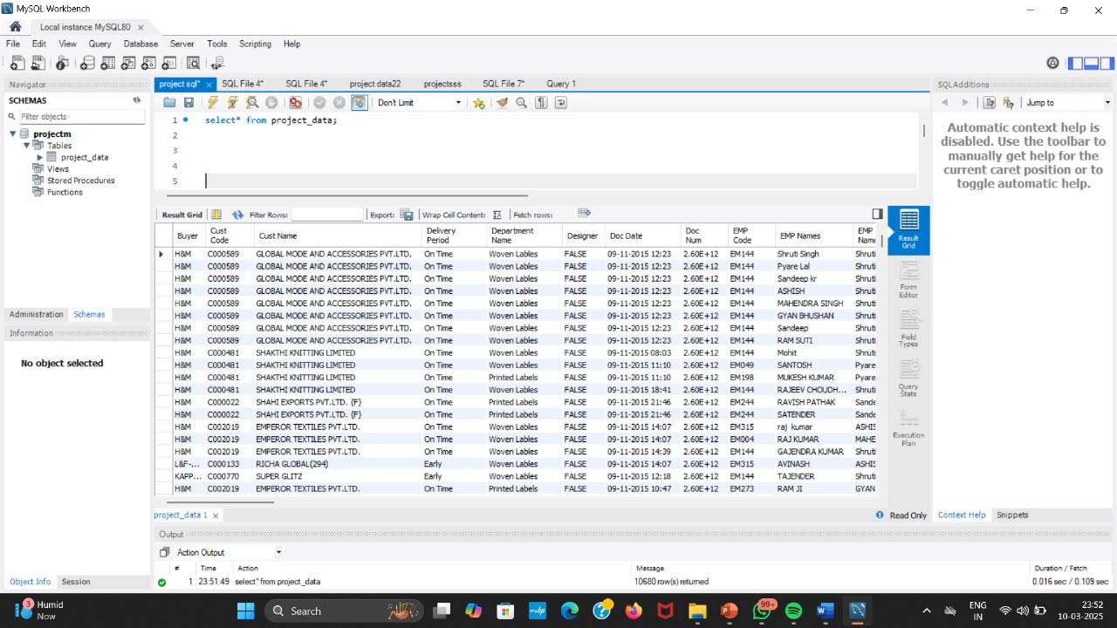
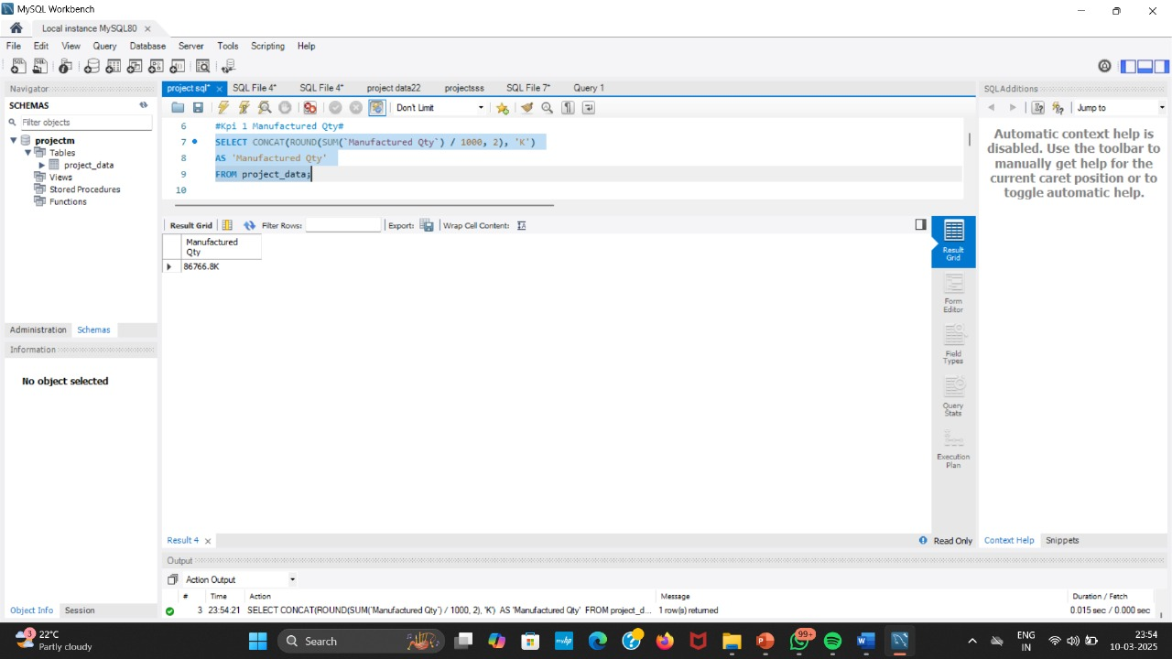
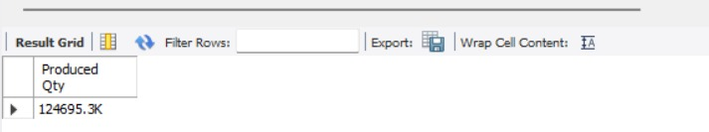
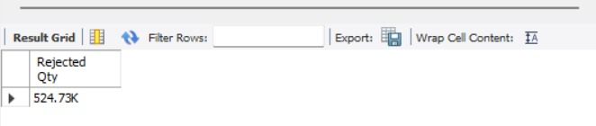
SQL

Slide 9
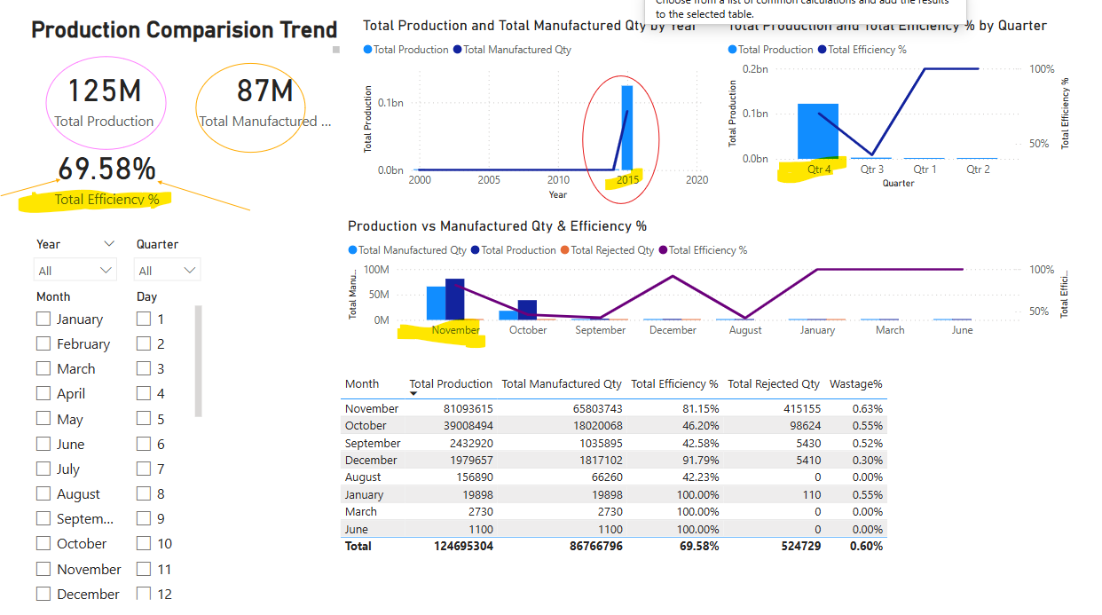
Key Insights
Analysis suggests maximum orders are manufactured in the Qtr 4 compared to other quarters that have a negligible amount compared to Qtr. 4
From this we can suggest that this company needs focus more on other Qtrs.
Total Production is around 125M
Total manufactured qty for this company is 87M
production efficiency of this company is around 70%
Key Findings
company is operational since 2000 but the highest production trend is seen in year 2015
highest production is in Qtr4 and the peak performing months are Nov & October whereas production in other months is purely negligible.
This may be mainly because they are getting their highest orders in the peak festival seasons
Recommendation: One way to achieve this could be, Since Qtr3 falls in summer and school holidays may be giving priority to taking orders for summer wear clothes may lead to more orders and do promotions.

Slide 10
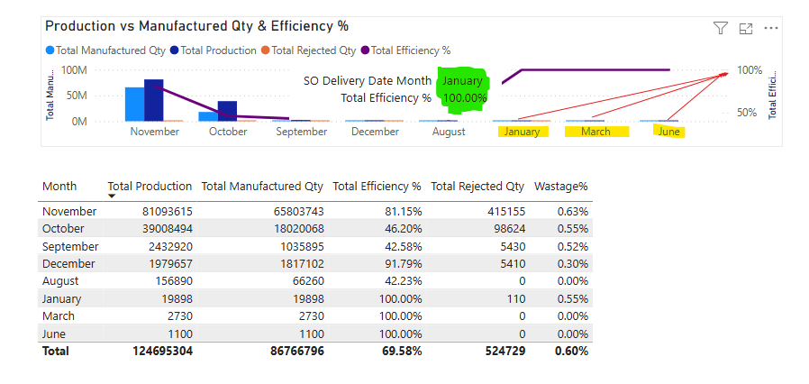
Key Insights
Increase in Manufactured Qty results in Decreased Efficiency
This needs to be addressed to see a significant increase in revenue.
This can bee seen in the case of lesser productive months January March and June.
With 100% efficiency
This indicates
with the increase in production rate there is a decrease in efficiency.
this needs to be addressed to see a significant increase in revenue.

Slide 11
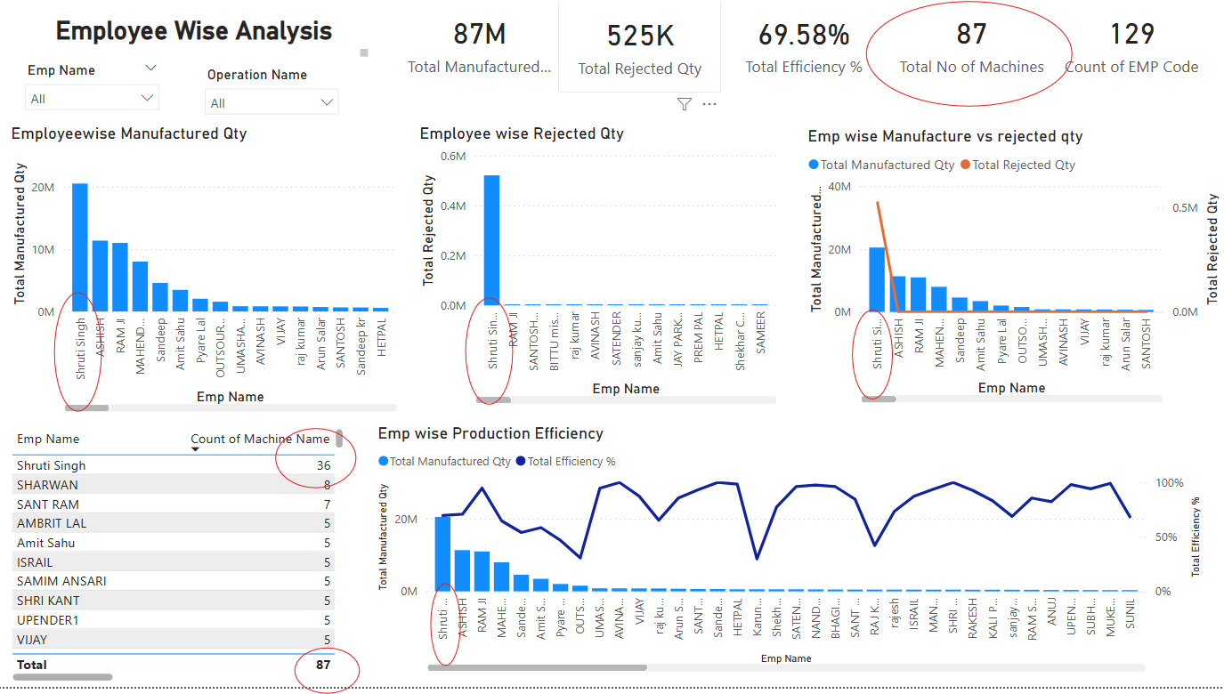
Key Insights
Way too many machines are allocated to one Employee
This results in drop in total efficiency
Problem Statement : Results for a particular Employee Shruti Singh are too high than expected.
Total Employee : 129
Total Machines : 87
Operations :Cut & Fold
Total Machines for Cut & Fold : 36
Number of Machines allocated to Shruti Singh : 34

Slide 12
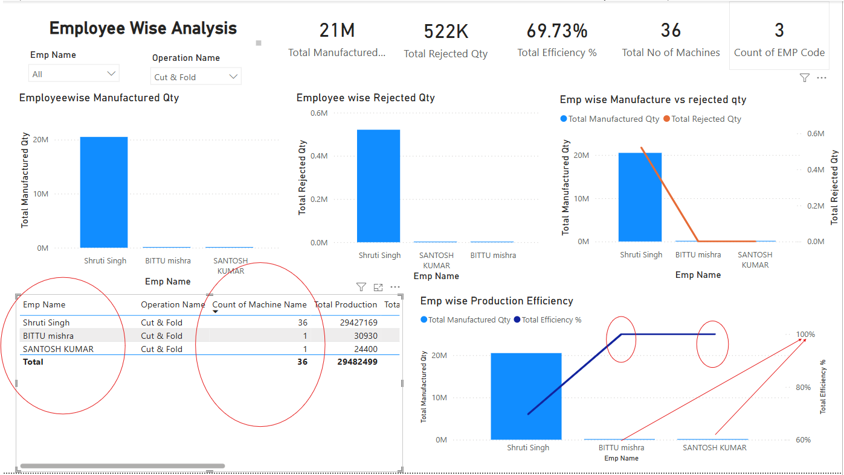
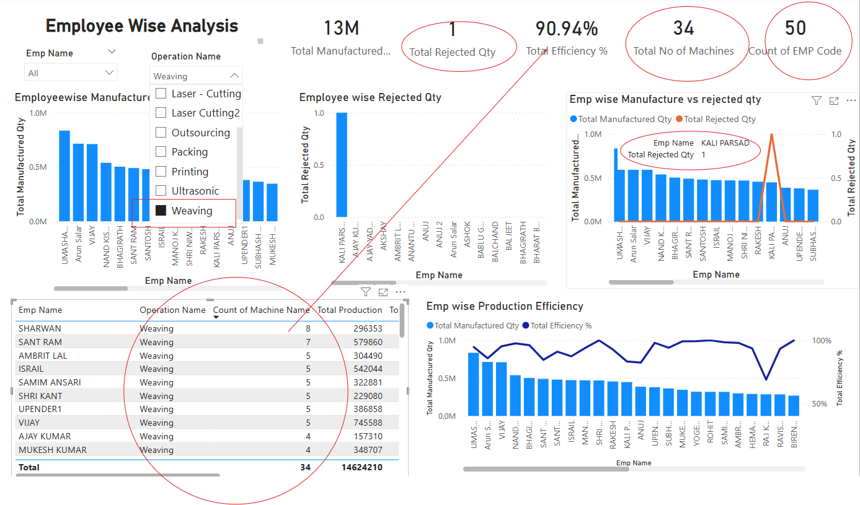
Recommendations
To increase efficiency, divide the work proportionately among all employees
Hire more Employees for Cut & Fold operations department
Insights: By comparing with weaving department that have a similar count of machine (34) have allocated 50 employees.
Total machines :Employees = 34:50
Max machines allocated to an individual person is 8
This has resulted in increased the over all efficiency to 91%
Compared to Total machines :Employees = 36:3
Max machines allocated to an individual person is 34
This has resulted in increased the over all efficiency to 69%

Slide 13
Conclusion
Production Quantity Analysis: Production quantity decreased by 30% over the last 5 days.
Rejection Quantity Increased: Sum of Rejected Qty was highest for C007 at 33660, followed by C039 and C022.﻿
Production Comparison Trends: Analysis of production comparison trends reveals opportunities for process improvement.
Processed QTY by Machine Name: At 13700293, CR001 had the highest Sum of Processed Qty and was 878,123.91% higher than F2, which had the lowest Sum of Processed Qty at 1560.﻿
Production Efficiency Increased: Production efficiency improved by 50% through data-informed process adjustments.
Future Analysis Planned: Future analysis will focus on further optimizing production processes and reducing rejection quantities.
Difference between 3 modules: Power BI is more tightly integrated with Microsoft products, such as Excel and SQL Server, whereas Tableau can connect to a wider range of data sources, including cloud-based databases and web services.

Slide 14
THANK YOU

