Slide 1

Pyrad architecture and principles
Jordi Figueras i Ventura, Daniel Wolfensberger AMS Radar conference 2023 - Open Radar Short Course

Slide 2
Contents
Introduction
Pyrad working philosophy
Launching Pyrad
Constructing the processing chain
Config files : an example

Slide 3
1. Introduction

Slide 4
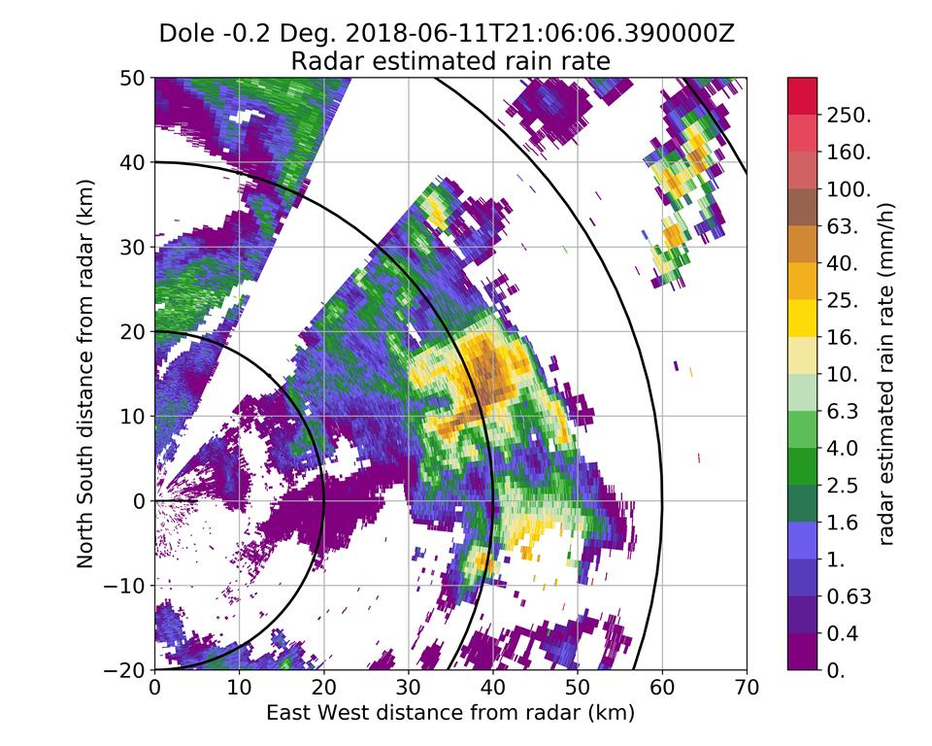
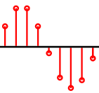
What is Pyrad ?
Pyrad is a processing framework that allows the creation of flexible and replicable data processing chains with no programming. It is capable of operating in real time or off-line. It is aimed mainly for weather radar data processing but has some limited functionality allowing to process data from other sensors.
Pyrad

Slide 5
General characteristics
Python-based (> v. 3.7)
Linux platform
Open source, version controlled (https://github.com/MeteoSwiss/pyrad)
Core based on our own version of ARM-DOE Py-ART (The Pyrad project contributes back regularly)
Possibility to ingest data from multiple radars
Ingests multiple data types: IQ data, spectral data, polarimetric and Doppler moments, Cartesian data, etc.
Capable of reading the main file formats used for volume radar data storage
Automatic documentation published online based on doc-strings
Easy to install (PyPI, conda)

Slide 6
2. Pyrad working philosophy

Slide 7
General characteristics
KEY CONCEPT : Separation between dataset generation and product generation
Dataset : New data generated from the processing of a Pyrad data object. It can be in the form of a new field of the same object type or a completely new object. It can be re-ingested in the data processing chain. Examples :
- rainfall rate field generated from a reflectivity field contained in a radar object
- Reflectivity generated from a spectral data object
Product : Output generated out of a dataset for human or machine consumption. Examples :
- PPI of reflectivity
- File containing timeseries of values at a point of interest

Slide 8
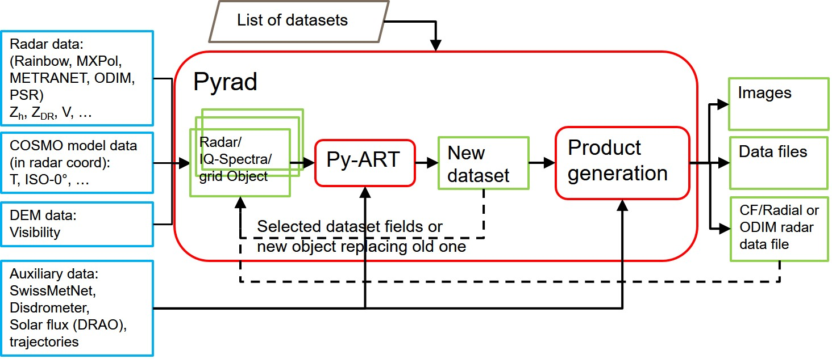
Pyrad flow diagram

Slide 9
Configuration files
Main config file | Base paths of data Location of config files Base path for output data and image format(s)
location config file | Radar(s) name and scan list General radar and scan characteristics (scan periodicity, radar constant, …) Images configuration
product config file | List of datasets to generate For each dataset List of inputs Dataset specific configuration List of products to generate MAKE_GLOBAL SUBSTITUTE_OBJECT FIELDS_TO_REMOVE
Internally all the configuration parameters are stored in a dictionary cfg
From cfg pyrad creates :
- datacfg : necessary parameters to read the input data
- dscfg : parameters to create the datasets (one per dataset)
- prdcfg : parameters to create products (one per product)
Pyrad config files examples

Slide 10
3. Launching Pyrad

Slide 11
Pyrad processing status
Status 0 : Initialization of datasets
Status 1 : Sequential processing of input data. Persistent data and parameters are stored internally
Status 2 : All input data consumed. Final dataset production if necessary

Slide 12
Pyrad Launching scripts
main_process_data.py | Process data sequentially according to starttime and endtime defined in command line or by input file
main_process_data_period.py | Process available data within time intervals specified by user between dates specified by user. Useful to obtain daily statistics
main_process_data_rt.py | Real time data processing

Slide 13
6. Constructing the processing chain

Slide 14
Constructing the processing chain
Each dataset type is identified by a keyword that internally is associated to a processing function
Internally the datasets are grouped in families. Those families can generate similar products
The user can define up to 99 levels of processing for each input data object
Datasets that are not inter-dependent can be generated at the same processing level. There is an option to generate those in parallel
Levels will be processed sequentially. At the end of each processing level the keywords MAKE_GLOBAL, SUBSTITUTE_OBJECT and FIELDS_TO_REMOVE will control the behaviour of the new dataset created
For each new dataset as many products as specified by the user will be generated. There is an option to generate those in parallel. If desired no product needs to be generated

Slide 15
Constructing the processing chain
MAKE_GLOBAL | 1 - The newly generated dataset fields will be added to the data object and will be available for the next processing level. Assumes that the generated dataset is compatible with the current data object. If a field with the same name exists it will be overwritten 0 – The dataset will not be added to the data object
FIELDS_TO_REMOVE | List of fields to remove. The fields removed will not be available for the next processing level. Useful to remove intermediate fields to reduce the memory footprint
SUBSTITUTE_OBJECT | 1 - The data object used at the current level will be erased and substituted by the newly generated dataset. Useful for e.g. transition from a volume radar object to a grid

Slide 16
Dataset families. Most common
VOL | generate_vol_products | Radar volume output
TIMEAVG | generate_time_avg_products | Radar volume time averaging products. Same products as above but with different time stamp
SPECTRA | generate_spectra_products | Spectra or IQ volume output
GRID | generate_grid_products | Cartesian grid data ouput
GRID_TIMEAVG | generate_grid_time_avg_products | Time-averaging or accumulation of grid data. Same products as above but with different time stamp
QVP | generate_qvp_products | Time-column data (e.g. QVP, columns, etc.)
TIMESERIES | generate_timeseries_products | Time series of POIs products
List of Datasets
List of Products

Slide 17
Identification of data fields
Internally pyrad uses the naming convention of Py-ART which follows closely the CF/Radial convention for radar data fields.
There are some fields that are non-standard and therefore defined by Pyrad
The Py-ART names used internally are defined in the Py-ART config file
Since the Py-ART naming is very long, Pyrad uses short keywords in the Pyrad config files. The short keywords are mapped internally using the function get_fieldname_pyart in io_aux.py
The special keyword « all_fields » allows to load all data saved in a Pyrad generated volume
List of data fields

Slide 18
Generation of images
Standard radar images (PPI, CAPPI, RHI, etc.) are generated using the plotting functions from Py-ART
Standard Cartesian images (Surface, cross-sections, etc.) are generated using the plotting functions from Py-ART
Other images (e.g. B-scope) and graphics (e.g. time series) are generated by Pyrad itself
Colormap and value limits, field name to show, units, etc. are generally defined at the Py-ART config file. Pyrad allows using a discrete colormap
The image size, resolution and area plotted are defined by ImageConfig structs in the pyrad loc config file
Images can be overplot on a map generated by cartopy

Slide 19
Generation of images
ppiImageConfig | PPI-like image configuration
rhiImageConfig | RHI-like image configuration
ppiMapImageConfig | PPI-like image overplotted on a map configuration
gridMapImageConfig | Cartesian grid image overplot on a map configuration
sunhitsImageConfig | Sun hits image (delta_az, delta_ele)

Slide 20
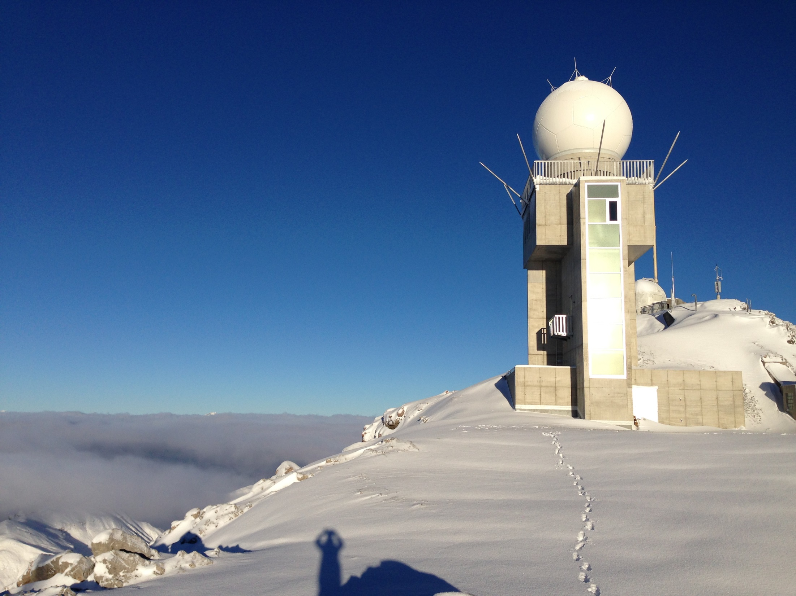
Thank you! Grazie mille! Moltes Gràcies! Merci!

