Slide 1
E-commerce Web Application Using React
A Modern Online Shopping Platform
By Opurum Paula Adanna

Slide 2
Introduction
Goal: Create a simple and user-friendly shopping platform
Tech Stack: React, React Router, Context API, CSS
Features: Product listing, shopping cart, subtotal calculation

Slide 3
Technologies Used
React: Frontend library
React Router: For page navigation
Context API: For managing global cart state
CSS: Styling components

Slide 4
Project Structure
/components/navbar: Navigation bar
/pages/shop: Shop page (product listing)
/pages/cart: Cart page (view/edit cart)
/context/shopcontext.js: Global cart state
/products.js: Product data

Slide 5
Features Implemented
View products from a catalog
Add products to cart
Increase/decrease item quantity
Subtotal calculation
Navigate between pages (Shop & Cart)

Slide 6
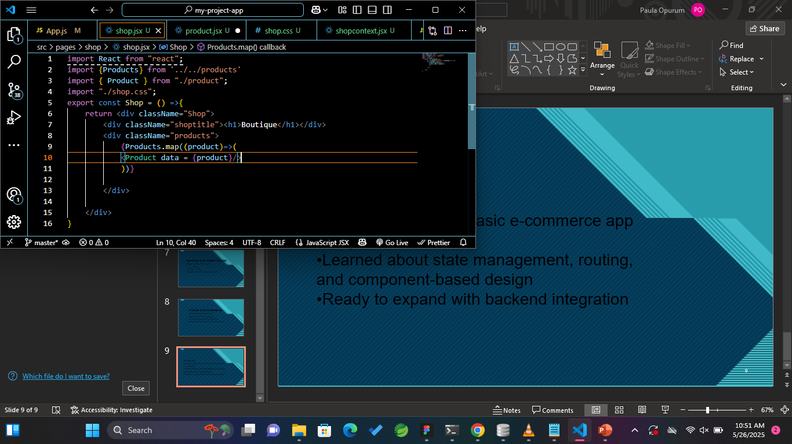
Description: Displays all products using .map() and reusable <Product /> component

Slide 7
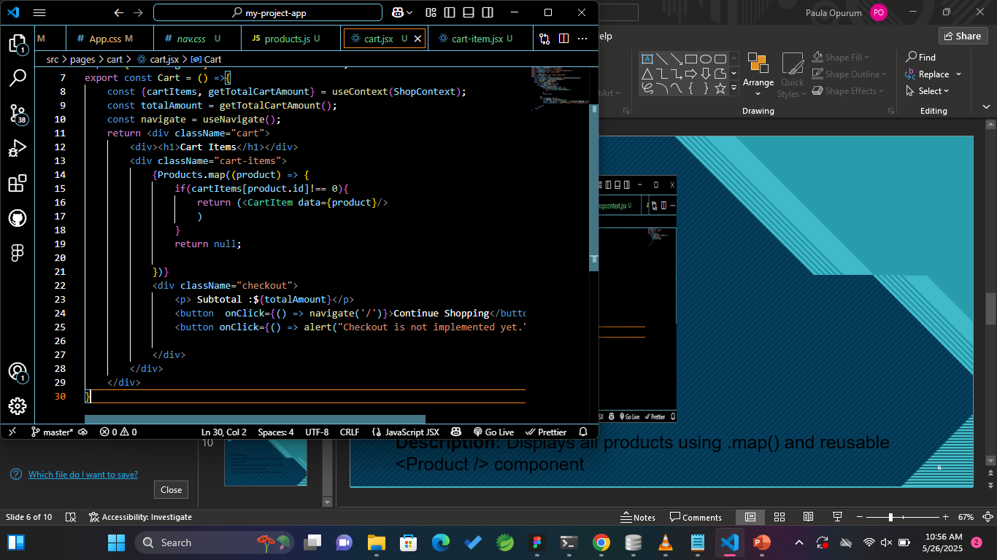
Description:
Displays items in cart
Shows quantity per item
Subtotal is calculated using context function

Slide 8
State Management with Context API
Context allows sharing data (like cart items) globally
No need to pass props between components
Functions:
addToCart()
removeFromCart()
getTotalCartAmount()

Slide 9
Routing with React Router
Routes defined in App.js
/ → Shop
/cart → Cart
Navbar provides navigation links

Slide 10
Future Improvements
Add login/authentication
Store cart in local storage
Checkout/payment integration
Backend database for storing orders

Slide 11
Conclusion
Successfully built a basic e-commerce app using React
Learned about state management, routing, and component-based design
Ready to expand with backend integration

