Slide 1
Weather APp
A simple react app to display the current weather of a place

Slide 2
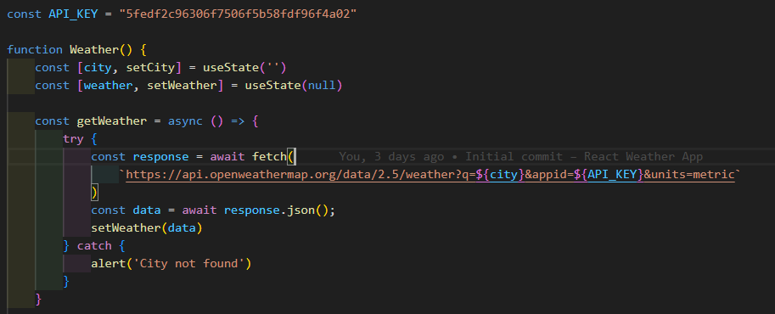
First, we define a function to get the weather data from OpenWeather Services After which we can store the data. When using fetch it stores your data as raw text. Then we convert to json format using the json method (json())

Slide 3
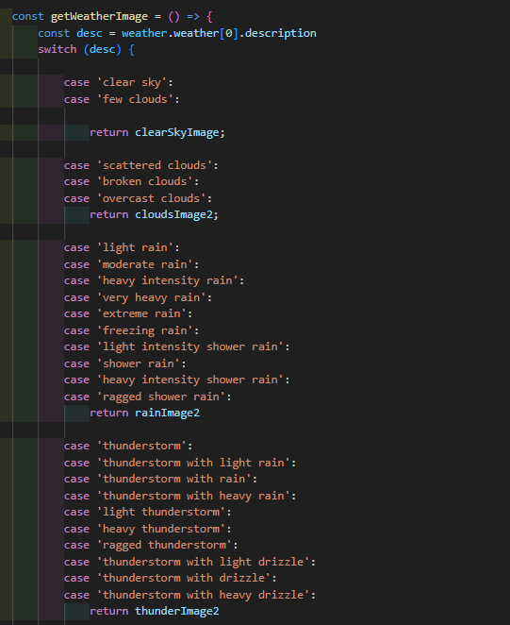
Setting weather image
I used a switch to set the value form the image describing the type of weather in a particular city, depending on the weather description.

Slide 4
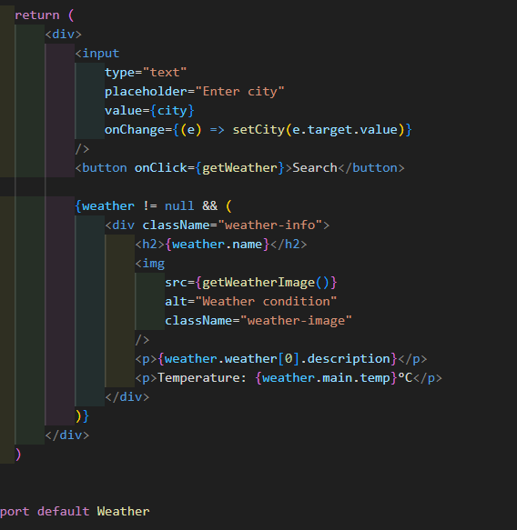
Returning and exporting
Here we define what was to be returned by our component. It gives an input field to specify what city the api is getting weather info from.
Then it return the data on the city which was stores in our weather variable

Slide 5
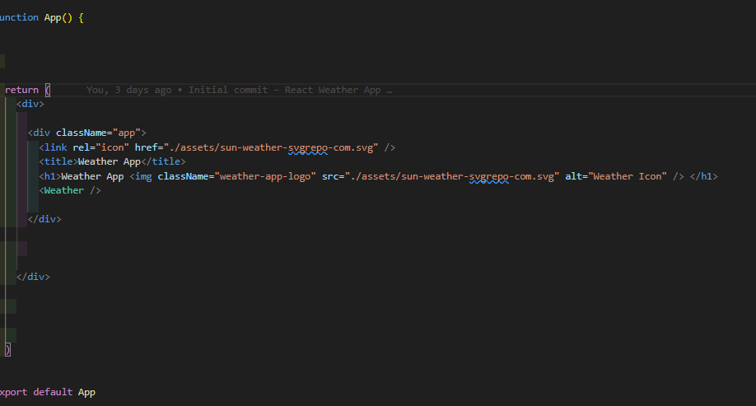
Rendering in the main app component

Slide 6
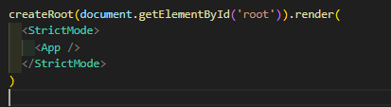
Rendering in the root id in default index.html

