Slide 1
MakidoCart – A Simple React Shopping Cart
Defence Presentation
Uche Mac‑Anthony Chibuike
VUG/SEN/24/11533
June 2025

Slide 2
Objective
Showcase a minimal e‑commerce cart built with React.
Demonstrate useState & Context for state management.
Foundation to scale to real APIs.

Slide 3
Tools & Concepts
React 18 (Functional Components)
React Hooks: useState, useContext
Context API for global cart state
JavaScript (ES6+), HTML5, CSS3
Git for version control

Slide 4
Core Features
Product listing with 'Add to Cart'
Cart view (list, total, remove)
Dark / Light mode toggle
Clean modular folder structure

Slide 5
Key Code Snippet – App.js
const [darkMode, setDarkMode] = useState(false);
<CartProvider> wraps ProductList, Cart, Checkout
toggleDarkMode() switches themes

Slide 6
Component Structure
App
├── ProductList
├── Cart
└── Checkout
CartProvider supplies cart state

Slide 7
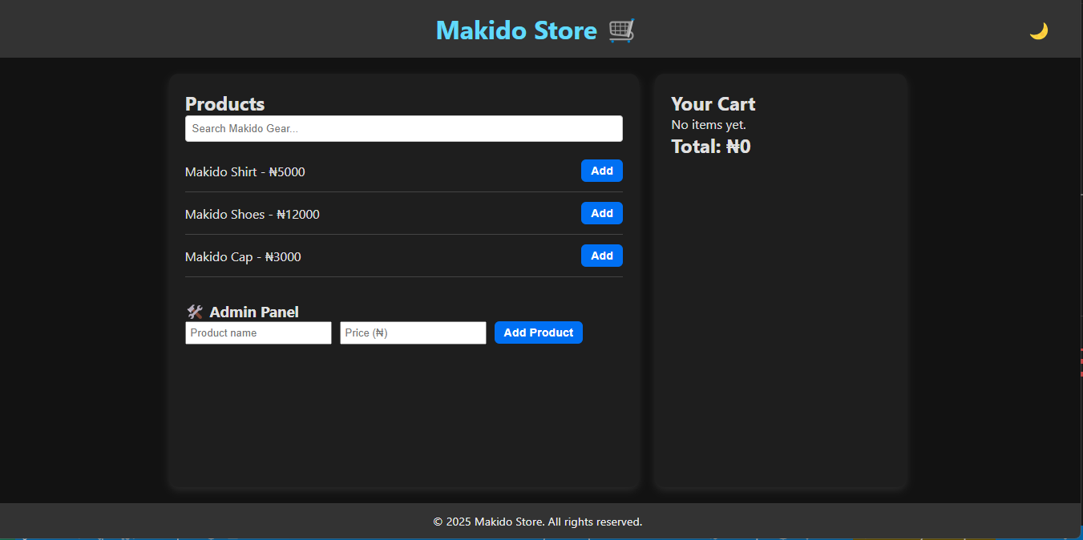

Slide 8
Conclusion & Future Work
Demonstrates core React patterns clearly.
Future: integrate product API, authentication.
Questions?

