Slide 1
DevOps

Slide 2



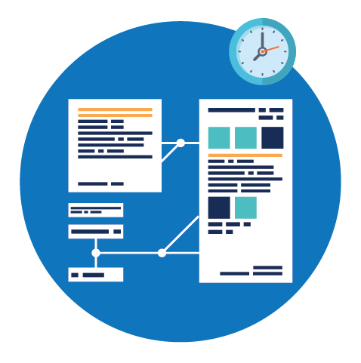
Current Challenges
Current IT operating models are not designed for today’s high-velocity business environment.
More time spent on testing, deploying and releasing software than designing and developing it.
High priority on robustness and stability but lower priority placed on speed and agility
A high proportion of production incidents are a result of human errors in the manual release process
Siloed and process driven approach rather than a focus on the business goals of software
Notes:
More time spent on testing, deploying and releasing software than designing and developing it.
A high proportion of production incidents are a result of human errors in the manual release process
Historically many organizations have been vertically structured with poor integration among development, infrastructure, security and support teams. Frequently the groups report into different organizational structures with different corporate goals and philosophies.

Slide 3
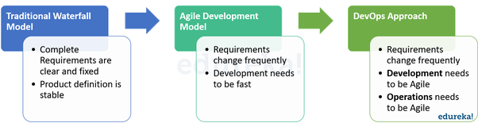
Evolution of DevOps

Slide 4
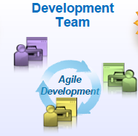
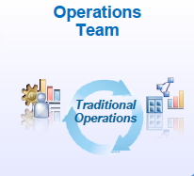
Evolution of DevOps
Traditional Waterfall Model
Agile Development Model
DevOps Approach
Requirements change Frequently
Requirements change Frequently
Development Need to be Agile
Development Needs to be fast
Operations Need to be Agile
GAP

Slide 5
Evolution of DevOps

Slide 6
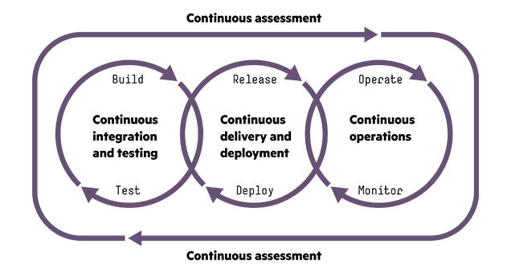
What is Devops
DevOps is a new term that primarily focuses on improved collaboration, communication, and integration between software developers and IT operations. It’s an umbrella term that some describe as a philosophy, cultural change, and paradigm shift

Slide 7
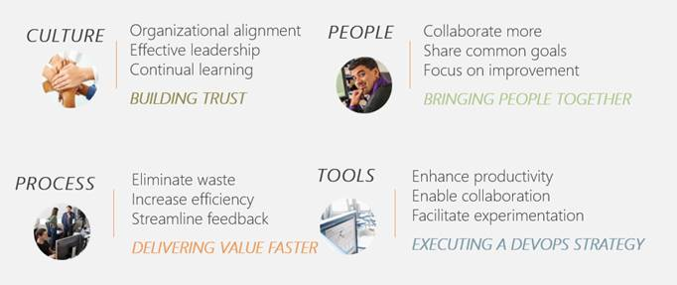

Slide 8
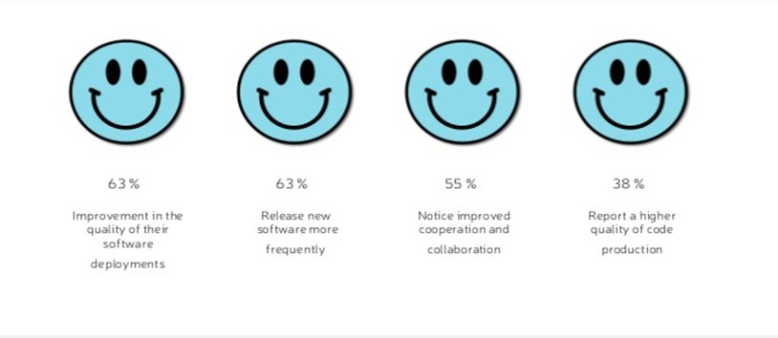
Benefits of Devops
Key benefits identified by the organizations who implemented DevOps
Introduction
Notes:
splitting work into small batches and implementing customer feedback) predicts higher IT performance and less deployment pain.
High-performing IT organisations deploy 200 times more frequently than low performers, with 2,555 times faster lead times.
Lean management and continuous delivery practices create the conditions for delivering value faster, sustainably.
And they spend 22 percent less time on unplanned work and rework.

Slide 9
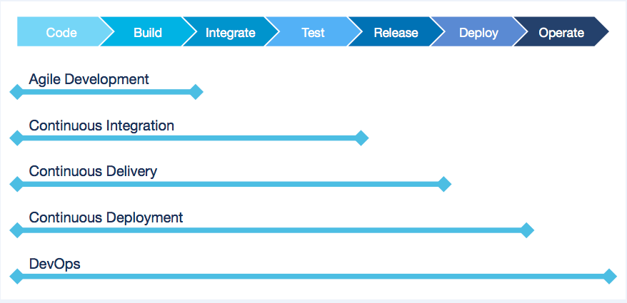
Devops Practices

Slide 10
Deployment Pipeline
DevOps is enabled through the Deployment Pipeline:
– Build
– Deployment
– Test
– Release
The purpose of the deployment pipeline:
– Visibility: All aspects of the delivery system are visible to all team members promoting collaboration.
– Feedback:Team members learn of problems as soon as they occur so that issues are fixed as soon as possible.
– Continually Deploy: Through a fully automated process, you can deploy and release any version of the software to any environment.

Slide 11
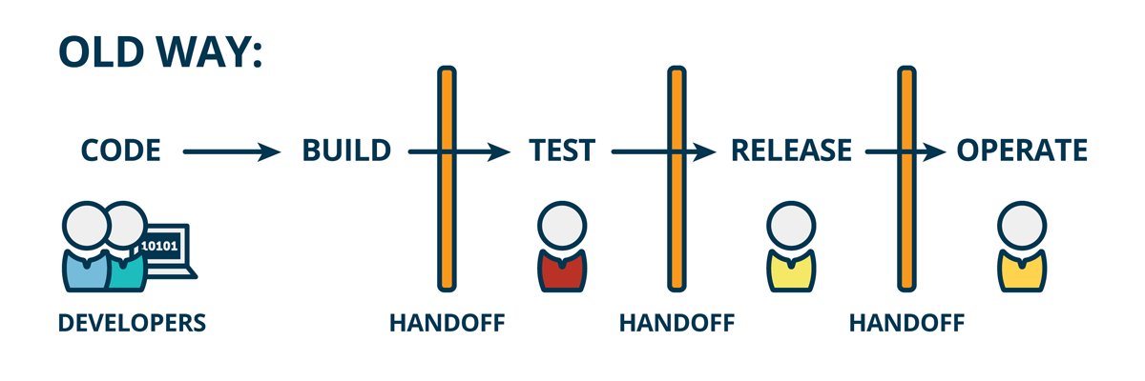
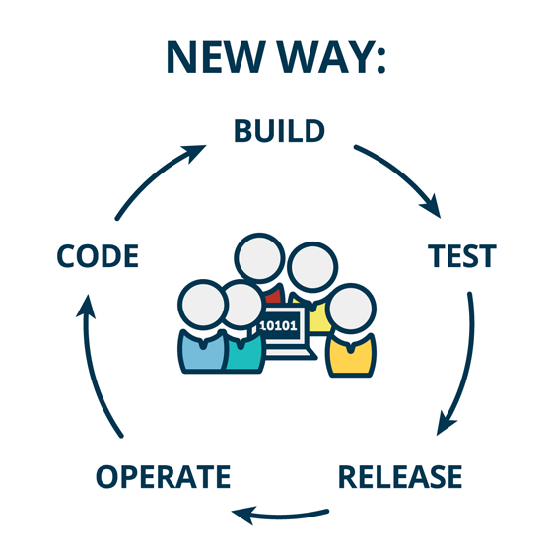
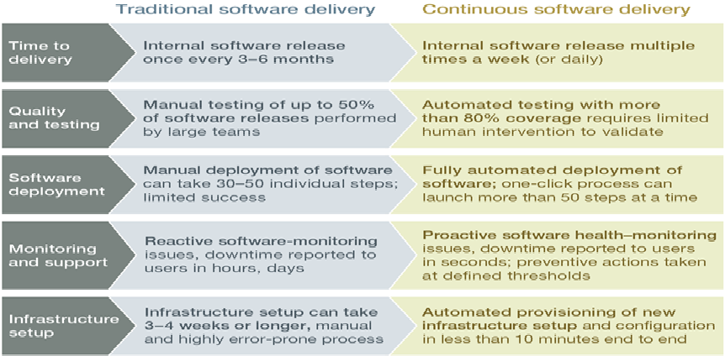
Difference Between Traditional & Continuous Software Delivery

Slide 12
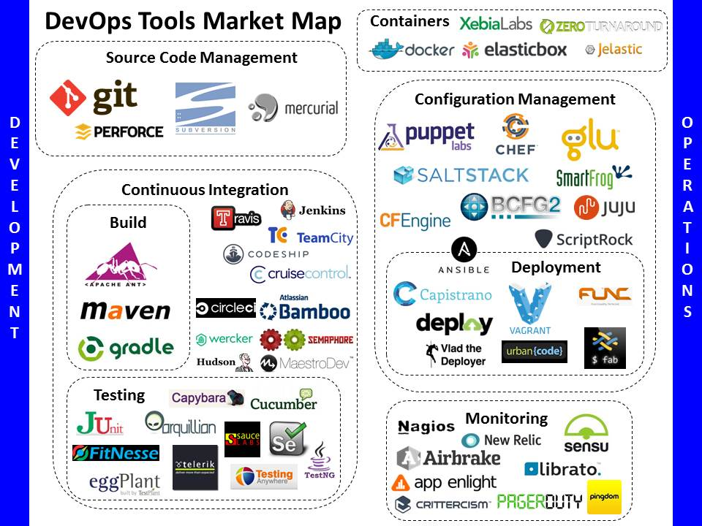

Slide 13
DevOps Case Study
Business Problem
DevOps Solution
Business Team wanted IT to provide agility and speed to market, by helping its business rapidly release products and make changes to existing products. They also wanted IT to reduce cost and improve quality of releases by automating many tasks related to building, testing and deploying software.
Implementing CI / CD capabilities using various tools (tool chain approach)
Tools used
Git for Version Control
Jenkins – Continuous integration
Maven for third party libraries, JIRA for tracking,, Ant and Maven Scripts CI / CD processes
Sonar for Code Quality Analysis
JIRA Release tracking to provide accurate status of each environment.
IBM Urban Code -Automating and Orchestrating Application Package deployment.
Nagios –Monitor production logs and feedback.
DevOps Approach
DevOps Team will review the client’s needs for continuous integration and delivery keeping.
The client’s requirements included the need for releasing code more frequently to production, an automated way to build and unit test code and inform developers about errors, a way to keep track of all the required libraries and dependencies across various modules, perform integration test, and deploy code to on premise and cloud based servers.
DevOps Team will work closely with different stakeholders to implement continuous integration, continuous delivery and other DevOps capabilities.
Benefits
Automation for build, unit and integration tests greatly improved developer productivity, improved product quality and facilitated shorter release cycles.

Slide 14
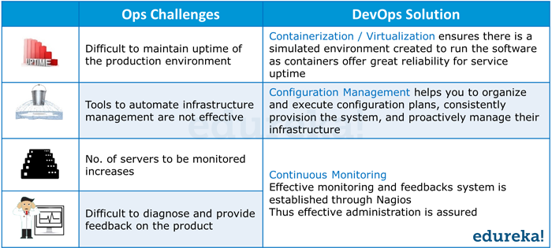

Slide 16
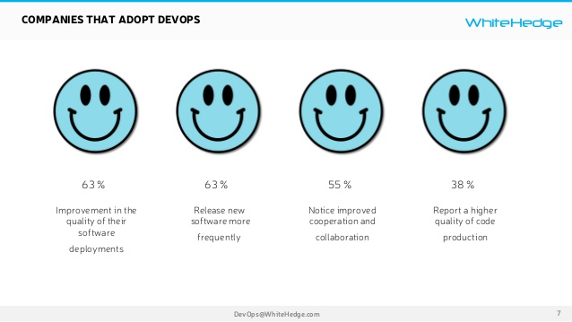

Slide 17
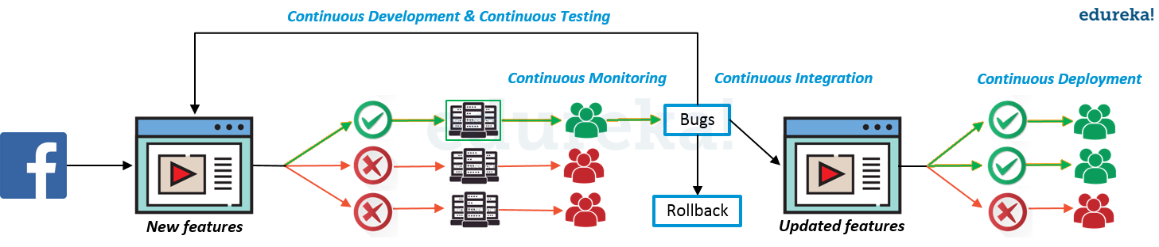

Slide 18


Slide 19
