Slide 1
DevOps

Slide 2
questionnaire?
Name few Continuous Integration Tools?
Jenkins,TeamCity,Bamboo
Name some AWS devops tools?
AWS Code commit , AWS CodePipeline, AWS Code build, AWS Code Deploy,opsWorks

Slide 3

Topics
Current Challenges
DevOps, why DevOps ?
Benefits of DevOps and CI/CD
DevOps Tools
DevOps Case Studies

Slide 4



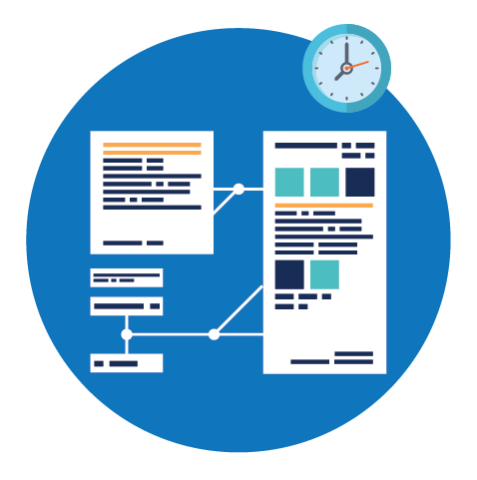
Current Challenges
Current IT operating models are not designed for today’s high-velocity business environment.
More time spent on testing, deploying and releasing software than designing and developing it.
High priority on robustness and stability but lower priority placed on speed and agility
A high proportion of production incidents are a result of human errors in the manual release process
Siloed and process driven approach rather than a focus on the business goals of software
Notes:
More time spent on testing, deploying and releasing software than designing and developing it.
A high proportion of production incidents are a result of human errors in the manual release process
Historically many organizations have been vertically structured with poor integration among development, infrastructure, security and support teams. Frequently the groups report into different organizational structures with different corporate goals and philosophies.

Slide 5
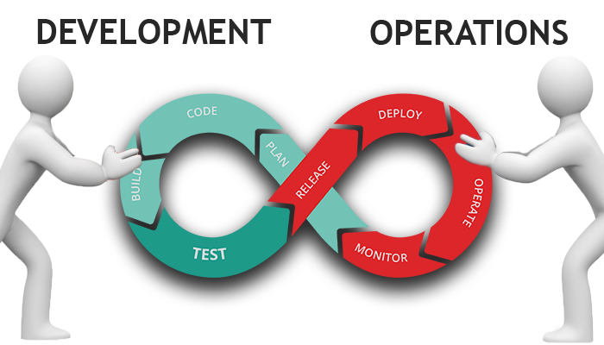
What is the solution?
DevOps

Slide 6
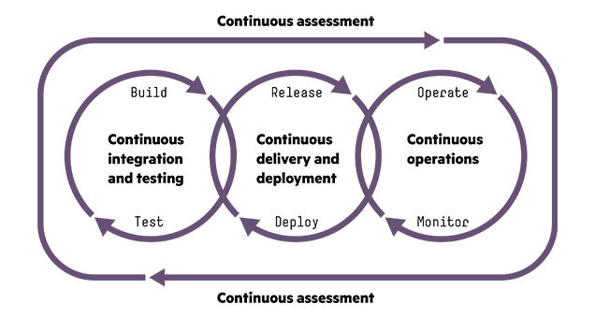
What is Devops
DevOps is a new term that primarily focuses on improved collaboration, communication, and integration between software developers and IT operations. It’s an umbrella term that some describe as a philosophy, cultural change, and paradigm shift

Slide 7
Benefits of Devops
Increased the speed, efficiency and quality of software delivery
Removes the communication barriers between teams in an organization
Increased collaboration and feedback to decisions is rapid
Introduction of automation removes wearisome, monotonous tasks.
Using automation operational costs are drastically lowered
Ease and reliability inspires the confidence to release software frequently.
Continuous feedback is incorporated into future releases making delivery to be truly agile.
Introduction
Notes:
splitting work into small batches and implementing customer feedback) predicts higher IT performance and less deployment pain.
High-performing IT organisations deploy 200 times more frequently than low performers, with 2,555 times faster lead times.
Lean management and continuous delivery practices create the conditions for delivering value faster, sustainably.
And they spend 22 percent less time on unplanned work and rework.

Slide 8
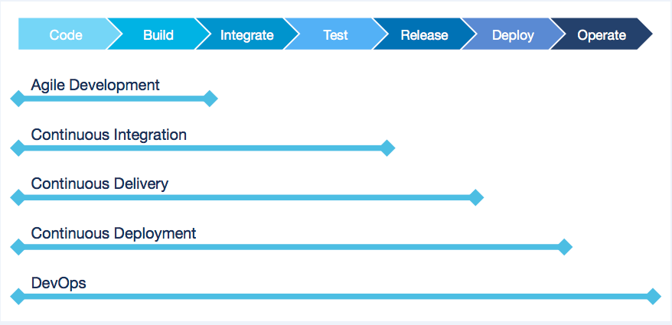
Devops Practices

Slide 9
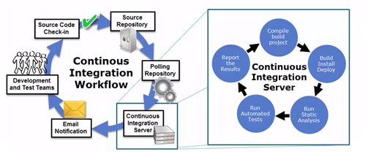
Continuous Integration
Continuous Integration (CI) is a development practice that requires developers to integrate
code into a shared repository frequently(at least daily). Each check-in is then verified
by an automated build including test, allowing teams to detect problems early.
Notes:
Continuous Integration (CI) is a development practice that requires developers to integrate
code into a shared repository frequently(at least daily). Each check-in is then verified
by an automated build including test, allowing teams to detect problems early.

Slide 10
Continuous Integration
Principles of CI:
Maintain a Single Source Repository
Automate the Build
Make Your Build Self-Testing
Everyone Commits To the Mainline Every Day
Keep the Build Fast
Test in a Clone of the Production Environment
Make it Easy for Anyone to Get the Latest Executable
Everyone can see what's happening
Automate Deployment

Slide 11
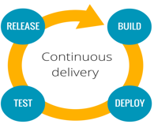
Continuous Delivery
Continuous Delivery is the extension of Continuous Integration An approach
in which teams ensure that every change to the System is releasable. In CD
teams keep producing valuable software in short cycles and ensure that the
Software can be released at any time.
The primary goal of continuous delivery is to make software deployments painless,
low-risk events that can be performed at any time, on demand
Notes:
Continuous delivery can increase companies speed to market with high quality
digital products and services
Continuous Delivery is the extension of Continuous Integration An approach
in which teams ensure that every change to the System is releasable. In CD
teams keep producing valuable software in short cycles and ensure that the
Software can be released at any time

Slide 12
Continuous Delivery
Principles of CD
Automation
Version control everything
Build in quality
Done means released
Everyone is responsible
Notes:
Automate everything – automate your builds, your testing, your releases, your configuration changes and
everything else.
Version control everything – code, configuration, scripts, documentation.
Build in quality – create feedback loops to deal with bugs.
Done means released –
A feature is done only when it is in production. Having a clear definition of “done” right
from the start will help everyone communicate better.
Everyone is responsible –
“It works on my station” was never a valid excuse. Responsibility should extend all
the way to production.

Slide 13
CI/CD best practices
Implement CI early in the project.
It is important to start small and build all components later
Commit Code frequently
Developers must commit code frequently in order to realize the
benefits of CI/CD.
Fix Broken Builds Immediately
A broken build is anything that prevents the build from reporting Success.
For example Compilation error, A failed test case, Deployment error etc.
Every team should convey that fixing a broken build is a top priority.
Automated Tests
A build should be fully automated. In order to run tests for a CI system,
All the test cases must be automated.
In a CI/CD environment, 100% of a project’s automated tests must pass
for your build to pass .
Run a Private Build
Notes:
Commit Code frequently
Developers must commit code frequently in order to realize the
benefits of CI/CD.
Fix Broken Builds Immediately
A broken build is anything that prevents the build from reporting Success.
For example Compilation error, A failed test case, Deployment error etc.
Every team should convey that fixing a broken build is a top priority.
Automated Tests
A build should be fully automated. In order to run tests for a CI system,
All the test cases must be automated.
In a CI/CD environment, 100% of a project’s automated tests must pass
for your build to pass .
Run a Private Build
To prevent integration failures, get changes from other functions by
Getting the latest changes from the repository and run a full integration
build locally

Slide 14
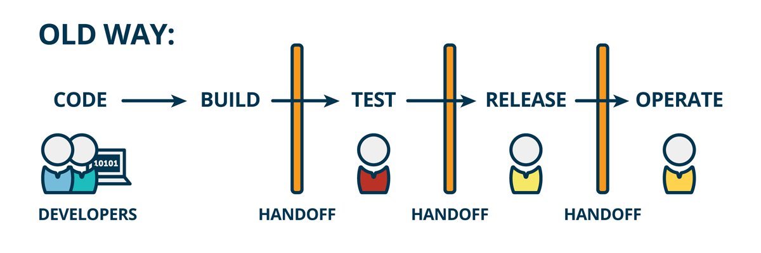
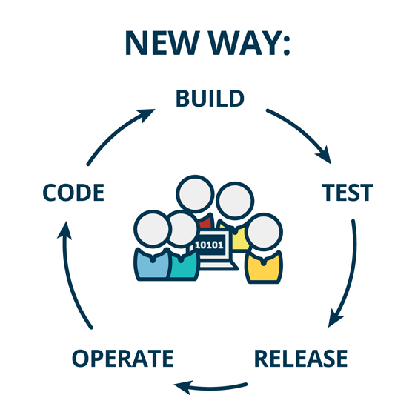
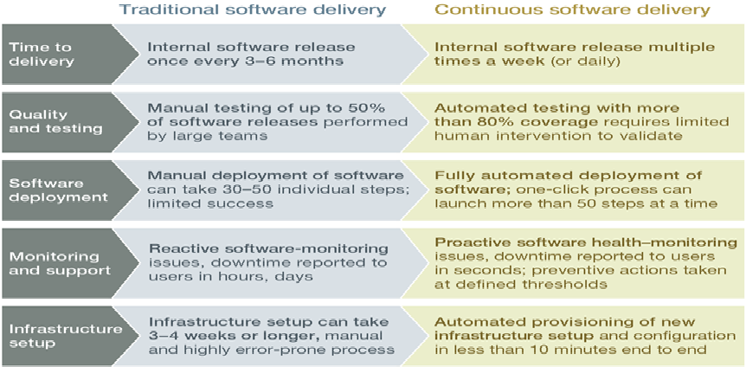
Difference Between Traditional & Continuous Software Delivery

Slide 15
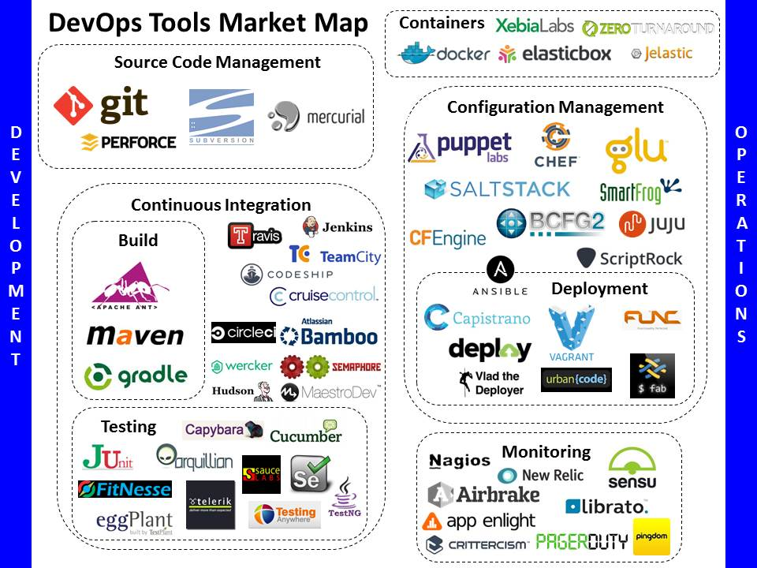

Slide 16
DevOps Case Study
Business Problem
DevOps Solution
Business Team wanted IT to provide agility and speed to market, by helping its business rapidly release products and make changes to existing products. They also wanted IT to reduce cost and improve quality of releases by automating many tasks related to building, testing and deploying software.
Implementing CI / CD capabilities using various tools (tool chain approach)
Tools used
Git for Version Control
Jenkins – Continuous integration
Maven for third party libraries, JIRA for tracking,, Ant and Maven Scripts CI / CD processes
Sonar for Code Quality Analysis
JIRA Release tracking to provide accurate status of each environment.
IBM Urban Code -Automating and Orchestrating Application Package deployment.
Nagios –Monitor production logs and feedback.
DevOps Approach
DevOps Team will review the client’s needs for continuous integration and delivery keeping.
The client’s requirements included the need for releasing code more frequently to production, an automated way to build and unit test code and inform developers about errors, a way to keep track of all the required libraries and dependencies across various modules, perform integration test, and deploy code to on premise and cloud based servers.
DevOps Team will work closely with different stakeholders to implement continuous integration, continuous delivery and other DevOps capabilities.
Benefits
Automation for build, unit and integration tests greatly improved developer productivity, improved product quality and facilitated shorter release cycles.

Slide 17
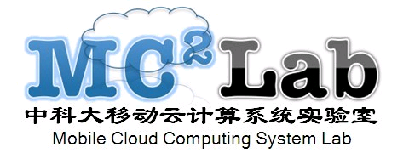
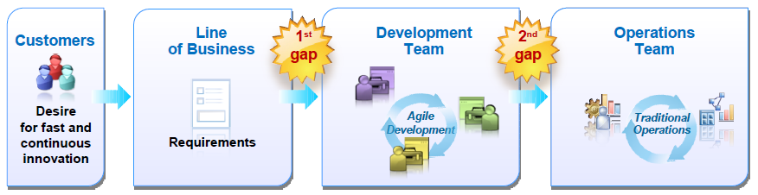
Delivery Challenges
Today’s business and technical needs are pushing traditional delivery approaches to the breaking point
Technical Challenges:Scale Complexity Time Pressures
Technical Trends: SoLoMo

Slide 18
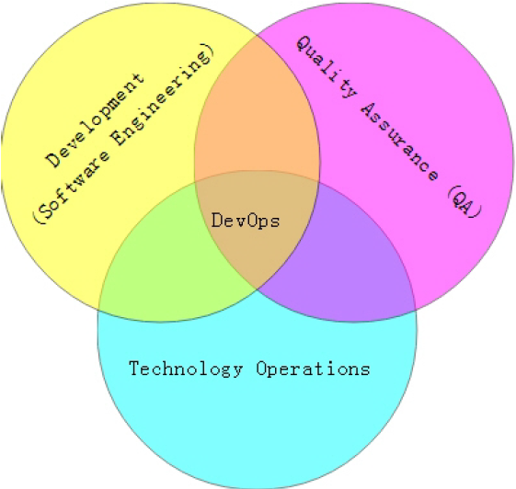
What is DevOps?
DevOps = development & operations
A Methodology of Continuous Delivery
A software development method that stresses communication, collaboration and integration between development and IT professionals.
“Streamlining release process” .

Slide 19
The adoption of DevOps is being driven by factors:
Use of agile and other development processes and methodologies
Demand for an increased rate of production releases from application and business unit stakeholders
Wide availability of virtualized and cloud infrastructure from internal and external providers
Increased usage of data center automation and configuration management tools

Slide 20
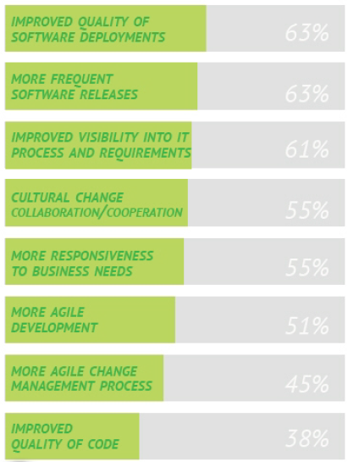
DevOps Benefits
Key benefits identified by the organizations that implement DevOps

Slide 21
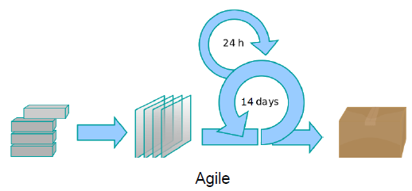
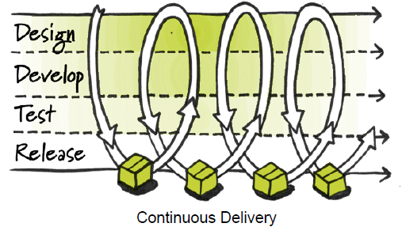
DevOps vs. Agile
DevOps is especially complementary to the Agile software development process.
extends and completes the continuous integration and release process by ensuring that code is production ready and will provide value to the customer
DevOps enables a far more continuous flow of work into IT Operations.
If development delivers code every two weeks but it's deployed only every two months, customers don't get value and the deployments often result in chaos and disruption.

Slide 22
Deployment Pipeline
DevOps is enabled through the Deployment Pipeline:
– Build
– Deployment
– Test
– Release
The purpose of the deployment pipeline:
– Visibility: All aspects of the delivery system are visible to all team members promoting collaboration.
– Feedback:Team members learn of problems as soon as they occur so that issues are fixed as soon as possible.
– Continually Deploy: Through a fully automated process, you can deploy and release any version of the software to any environment.

Slide 23
Few Online Resources On DevOps
Books
The Phoenix Project - Gene Kim
Continuous Delivery - Jez Humble
Infrastructure as Code - Kief Morris
The DevOps Handbook - Gene Kim
https://www.pluralsight.com/courses/devops-big-picture
https://www.visualstudio.com/learn/what-is-devops/
https://xebialabs.com/the-ultimate-devops-tool-chest/open-source/
https://www.atlassian.com/blog/devops/how-to-choose-devops-tools
https://en.wikipedia.org/wiki/DevOps_toolchain

