Slide 1

DevOps

Slide 2

Agenda
What is DevOps & Benefits of DevOps
DevOps CI/CD
DevOps Tools
Case Study : Facebook
Questionnaire

Slide 3
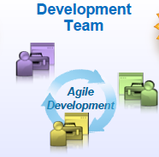
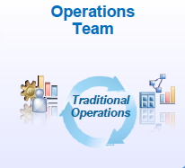
Evolution of DevOps
Traditional Waterfall Model
Agile Development Model
DevOps Approach
Development will take long Time.
No Customer Feedback until delivery
When Software delivered that time customer requirements will be change and no use of the delivered Software.
Requirements change Frequently
Development & Operations Need to be Agile
Collaboration between
different Stakeholders
Automation
Development Needs to be fast
GAP

Slide 4
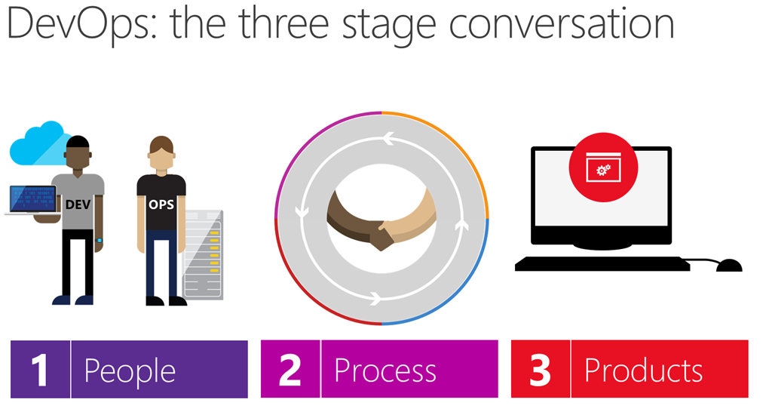
DevOps
DevOps is the union of people, process and products to enable continuous Delivery of value to our end users.

Slide 5
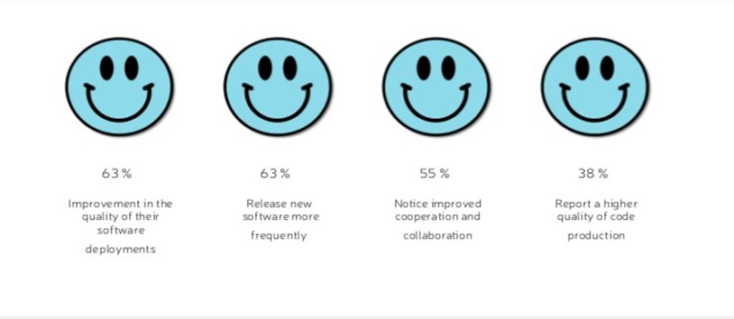
Benefits of Devops
Key benefits identified by the organizations who implemented DevOps
Introduction
Notes:
splitting work into small batches and implementing customer feedback) predicts higher IT performance and less deployment pain.
High-performing IT organisations deploy 200 times more frequently than low performers, with 2,555 times faster lead times.
Lean management and continuous delivery practices create the conditions for delivering value faster, sustainably.
And they spend 22 percent less time on unplanned work and rework.

Slide 6
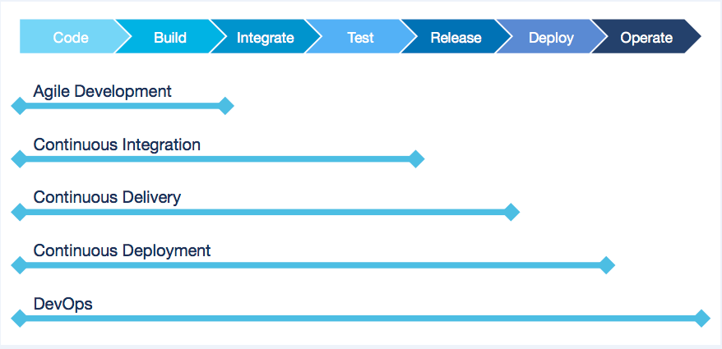
Devops Practices

Slide 7
Deployment Pipeline
DevOps is enabled through the Deployment Pipeline:
– Build
– Deployment
– Test
– Release
The purpose of the deployment pipeline:
– Visibility: All aspects of the delivery system are visible to all team members promoting collaboration.
– Feedback:Team members learn of problems as soon as they occur so that issues are fixed as soon as possible.
– Continually Deploy: Through a fully automated process, you can deploy and release any version of the software to any environment.

Slide 8
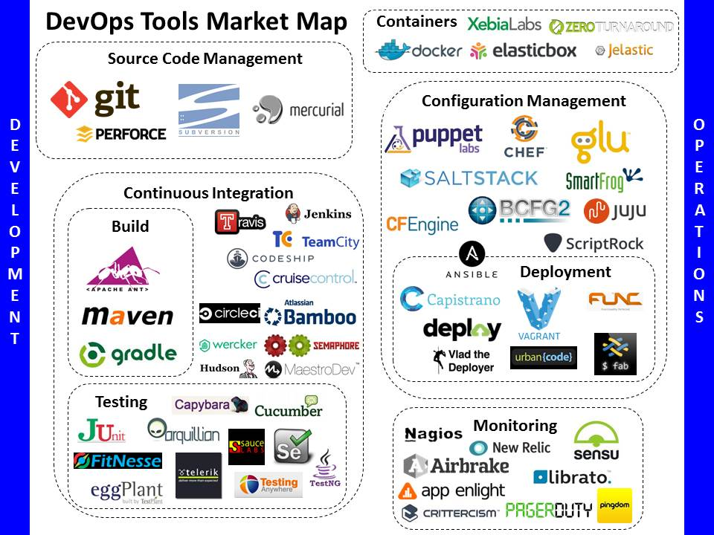

Slide 9

DevOps CaseStudy

Slide 10
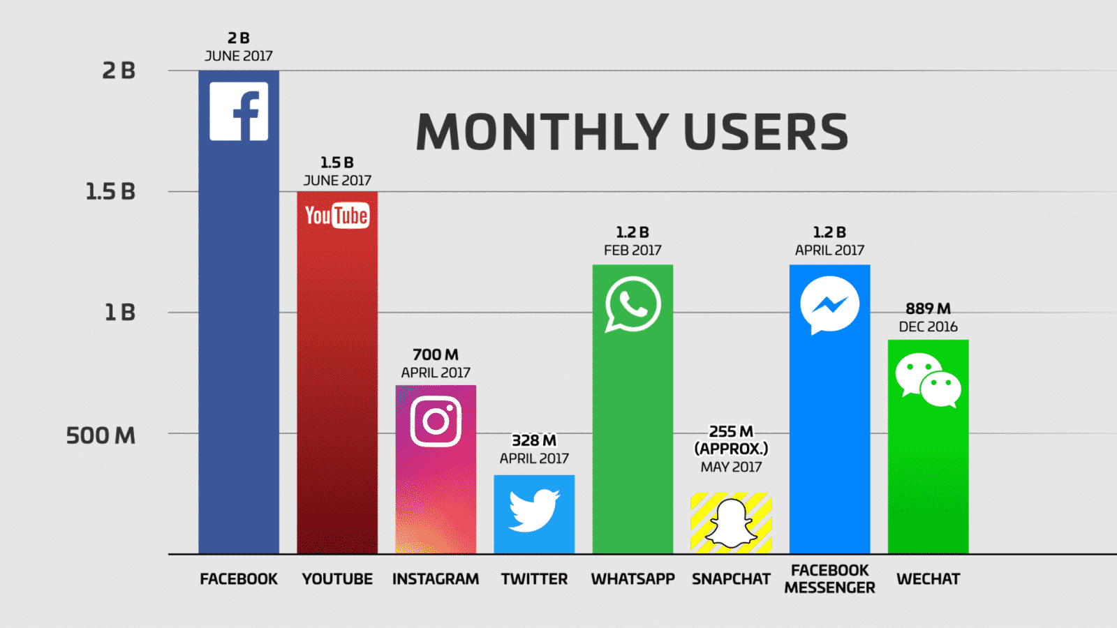

Slide 11
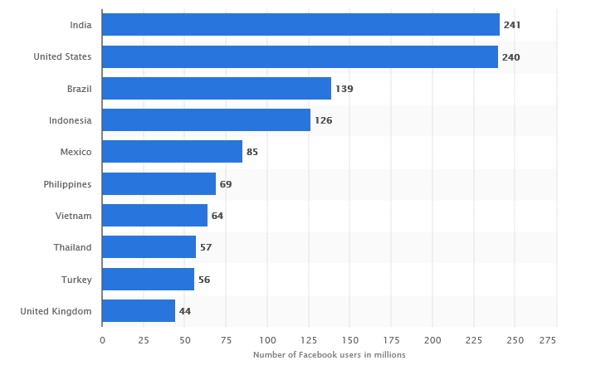
Leading countries based on number of Facebook users as of July 2017 (in millions)

Slide 12
Challenges and Concerns
Number of smart phones were zero 10 years back. In Todays world there are 1.15 billion mobile daily active users
Access anytime anywhere and anyhow – Zero tolerance for digital failure.
Five new profiles are created every second.Photo uploads total 300 million per day.
Customers want to be amazed by the new features. They expect something new, which is exciting and has to be great.
If companies don’t adopt new strategies, they will be out market soon(Example Nokia, Orkut)

Slide 13
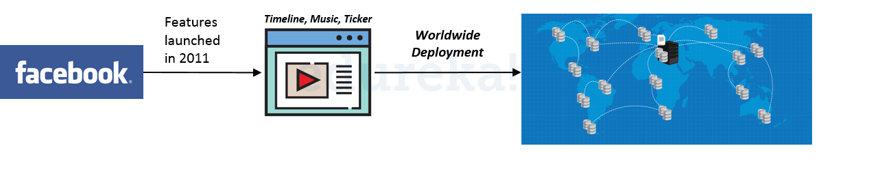
Facebook Case Study
.
Notes:
In 2011, Facebook rolled out new features – timeline, ticker and music functionalities – to its 500 million users spread across the globe. The huge traffic that was generated on Facebook following the release led to a server meltdown. The features that were rolled out garnered mixed response from users which led to inconclusive results of the effectiveness of the new features, leaving them with no actionable insights
This led to an evaluation and reassessment of strategies, resulting in Facebook coming up with the Dark Launching Technique. Using the DevOps principles, Facebook created the following methodology for the launch of its new releases

Slide 14
The Dark Launch
Have you ever wondered why some of your friends get to see the latest Facebook messenger or Gmail upgrade before you do? Why do some people get to play with the newest features weeks before others? And, why do these features sometimes disappear within a week?
The answer is a dark launch
Facebook and Google, along with many leading tech giants, use dark launches to gradually release and test new features to a small set of their users before releasing to everyone. This lets them see if you love it or hate it and assess how it impacts their system’s performance.

Slide 15
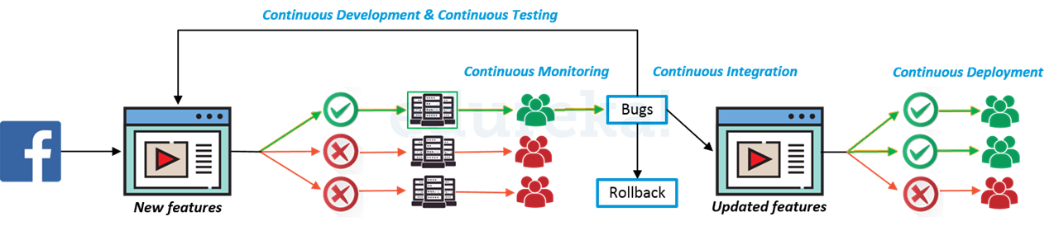
DevOps Adoption
Notes:
In Facebook features are released to a small user base through a dedicated deployment pipeline. The remaining pipelines are all turned off at this point. The specific user base on which the features have been deployed are continuously monitored to collect feedback and identify bugs. These bugs and feedback will be incorporated in development, tested and deployed on the same user base until the features becomes stable. Once stability is achieved, the features will be gradually deployed on other user bases by turning on other deployment pipelines.

Slide 16
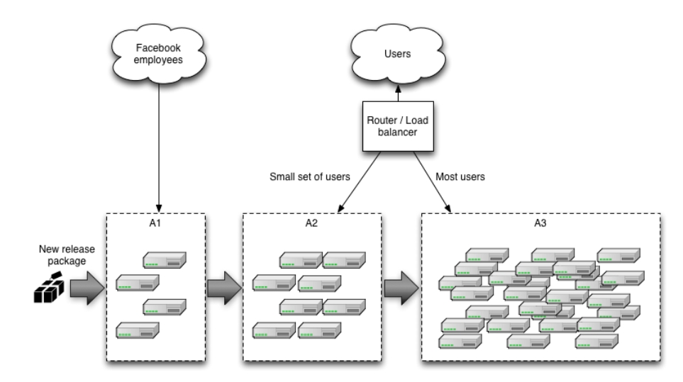

Slide 17
Key Outcomes after Devops Adoption
Time to Delivery:
They have Achieved on an average 200+ deployments per day
Quality and Testing:
Automated testing with more than 80% coverage requires limited human intervention to validate
Monitoring and Support:
Proactive software health-monitoring issues, downtime reported to users in seconds;preventive actions taken at defined thresholds
Infrastructure Setup:
Automated provisioning of new infrastructure setup and configuration in less than 10 min end to end.

Slide 18


