Slide 1
DevOps

Slide 2
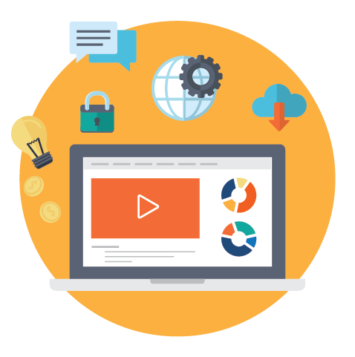
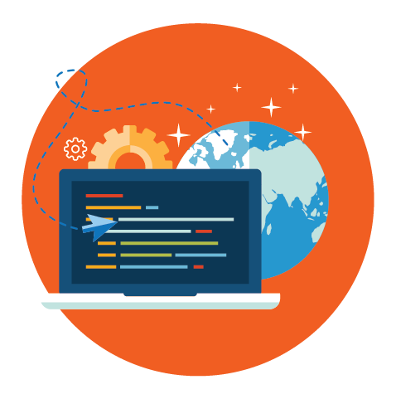
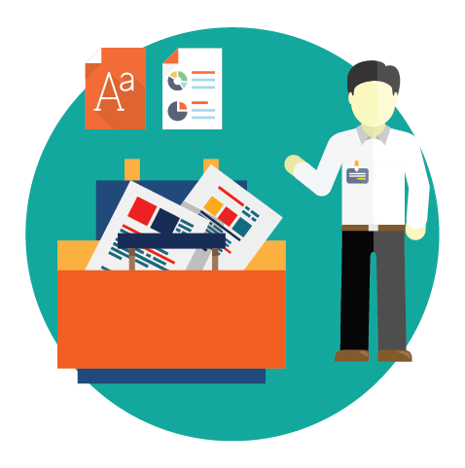
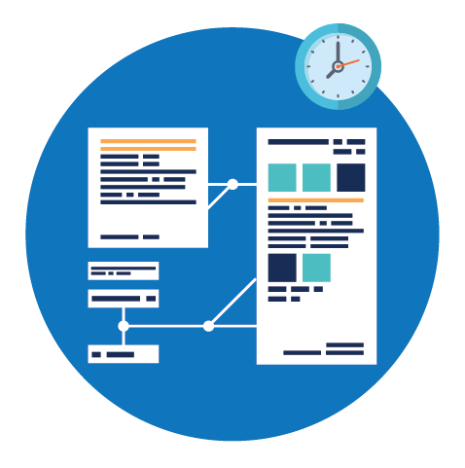
Current Challenges
Current IT operating models are not designed for today’s high-velocity business environment.
More time spent on testing, deploying and releasing software than designing and developing it.
High priority on robustness and stability but lower priority placed on speed and agility
A high proportion of production incidents are a result of human errors in the manual release process
Siloed and process driven approach rather than a focus on the business goals of software
Notes:
More time spent on testing, deploying and releasing software than designing and developing it.
A high proportion of production incidents are a result of human errors in the manual release process
Historically many organizations have been vertically structured with poor integration among development, infrastructure, security and support teams. Frequently the groups report into different organizational structures with different corporate goals and philosophies.

Slide 3
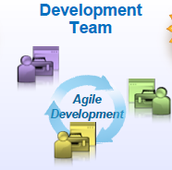
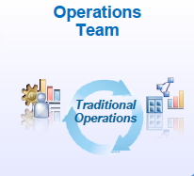
Evolution of DevOps
Traditional Waterfall Model
Agile Development Model
DevOps Approach
Development will take long Time.
No Customer Feedback until delivery
When Software delivered that time customer requirements will be change and no use of the delivered Software.
Requirements change Frequently
Requirements change Frequently
Development Need to be Agile
Development Needs to be fast
Operations Need to be Agile
GAP

Slide 4
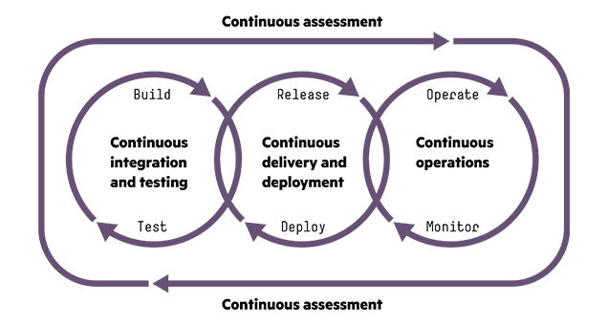
What is Devops
DevOps is a new term that primarily focuses on improved collaboration, communication, and integration between software developers and IT operations. It’s an umbrella term that some describe as a philosophy, cultural change, and paradigm shift

Slide 5
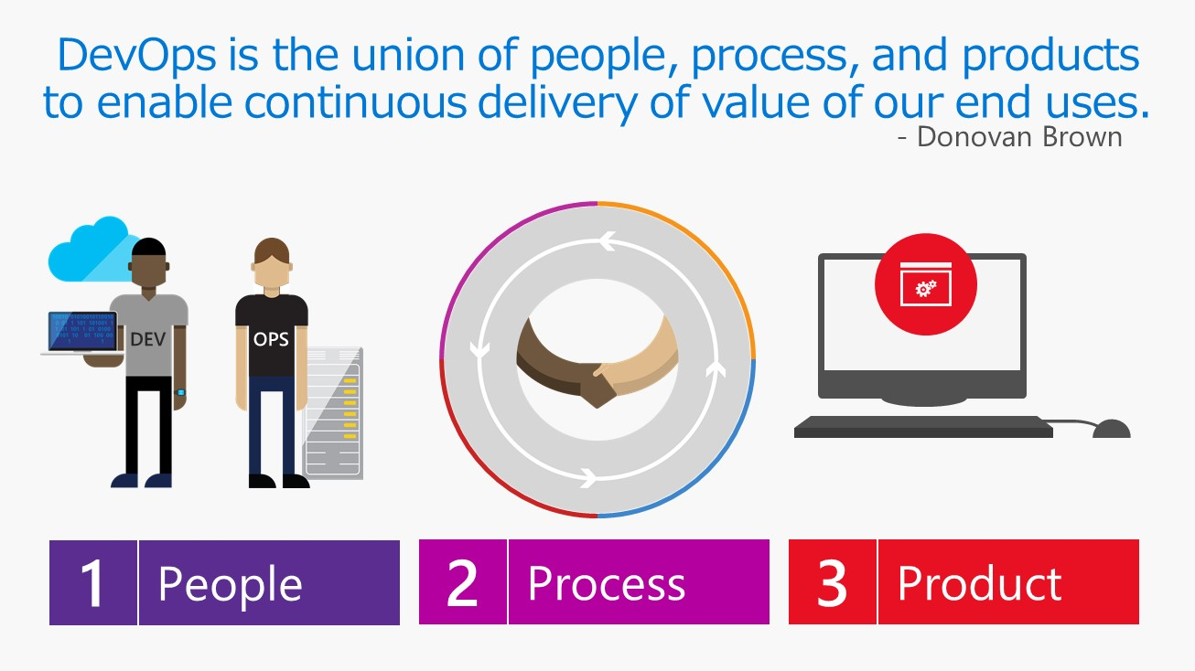

Slide 6
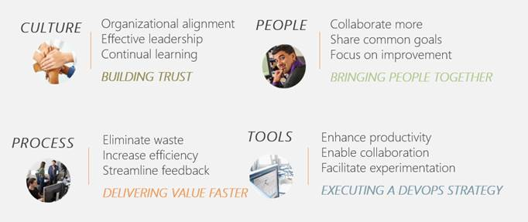

Slide 7
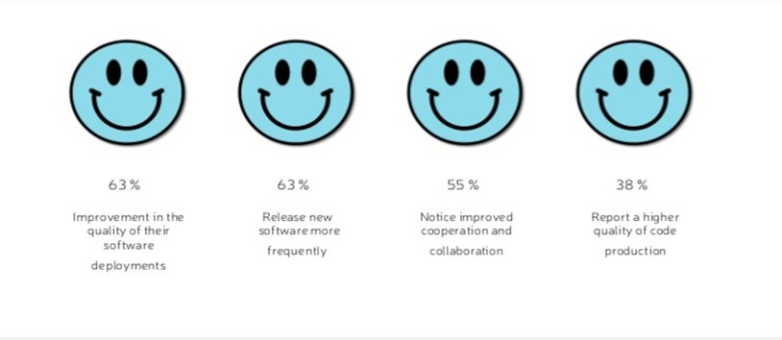
Benefits of Devops
Key benefits identified by the organizations who implemented DevOps
Introduction
Notes:
splitting work into small batches and implementing customer feedback) predicts higher IT performance and less deployment pain.
High-performing IT organisations deploy 200 times more frequently than low performers, with 2,555 times faster lead times.
Lean management and continuous delivery practices create the conditions for delivering value faster, sustainably.
And they spend 22 percent less time on unplanned work and rework.

Slide 8
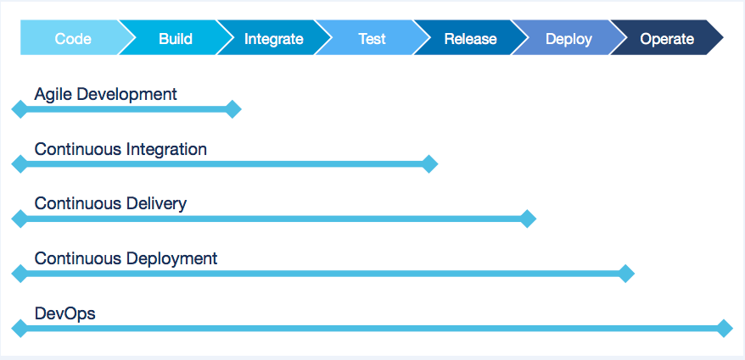
Devops Practices

Slide 9
Deployment Pipeline
DevOps is enabled through the Deployment Pipeline:
– Build
– Deployment
– Test
– Release
The purpose of the deployment pipeline:
– Visibility: All aspects of the delivery system are visible to all team members promoting collaboration.
– Feedback:Team members learn of problems as soon as they occur so that issues are fixed as soon as possible.
– Continually Deploy: Through a fully automated process, you can deploy and release any version of the software to any environment.

Slide 10
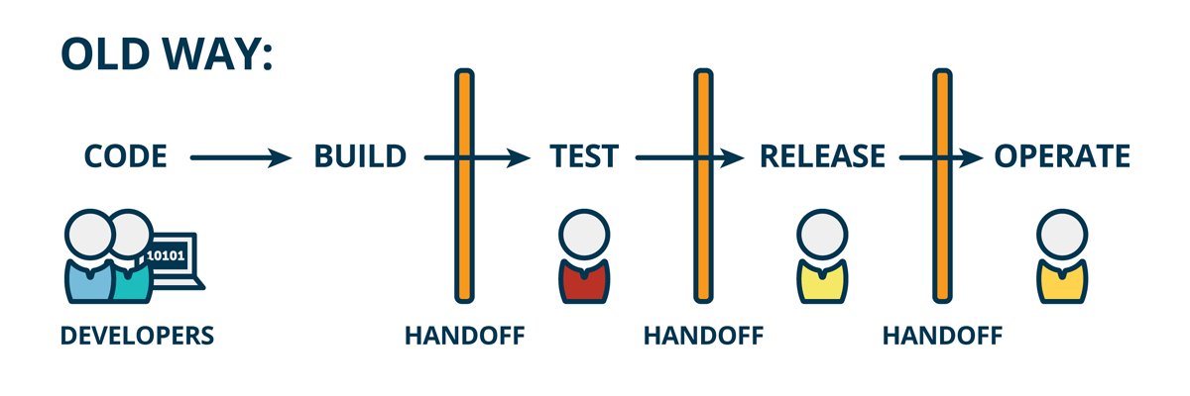
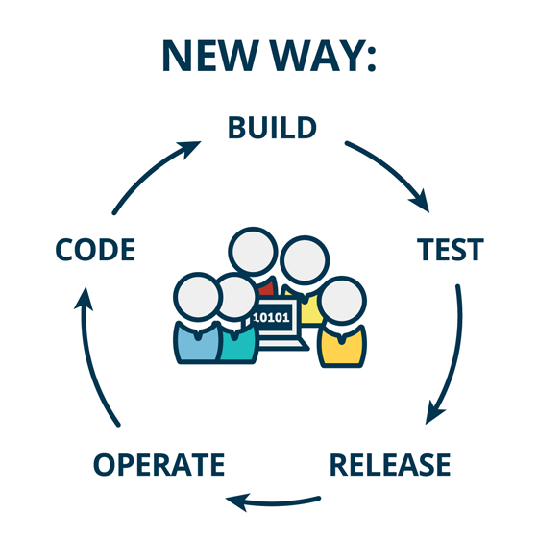
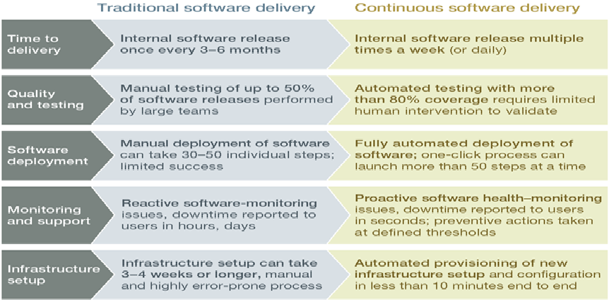
Difference Between Traditional & Continuous Software Delivery

Slide 11
