Slide 1
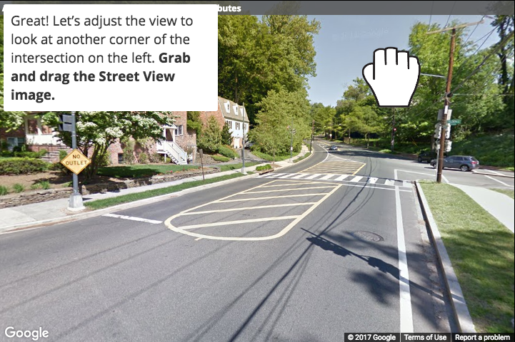
Oops! You turned in the wrong direction. Adjust the view in the direction of the arrow by dragging the screen.

Slide 2
Oops! You turned in the wrong direction. Adjust the view in the direction of the arrow by dragging the screen.

Slide 3
Oops! You turned in the wrong direction. Adjust the view in the direction of the arrow by dragging the screen.
Go this way

Slide 4
Oops! You turned in the wrong direction. Adjust the view in the direction of the arrow by dragging the screen.
Go this way

Slide 5
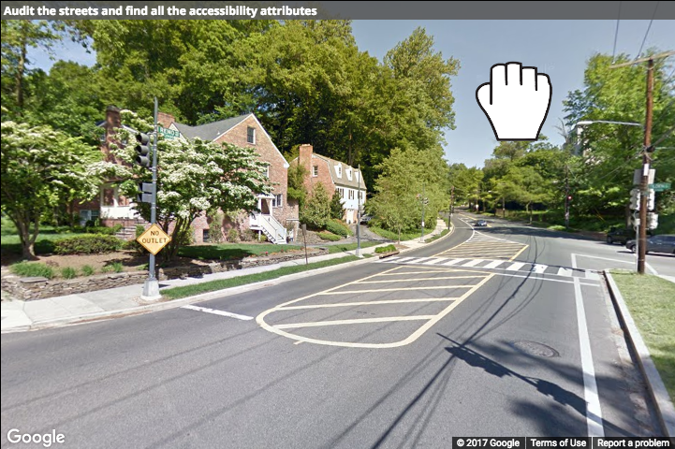
Oops! Try dragging the other way.
Look this way

