Slide 1



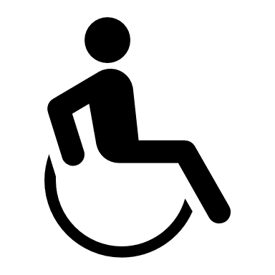

Username
Distance
Missions
Labels
Accuracy
edgarmartinez
24
3.2km
456
93%
mikeysaugstad
22
2.8km
546
94%
aileenzeng
18
1.9km
330
88%
anotheruser
18
1.5km
330
90%
anotheruser2
18
1.3km
220
80%
anotheruser3
17
1.1km
155
80%

