Slide 1
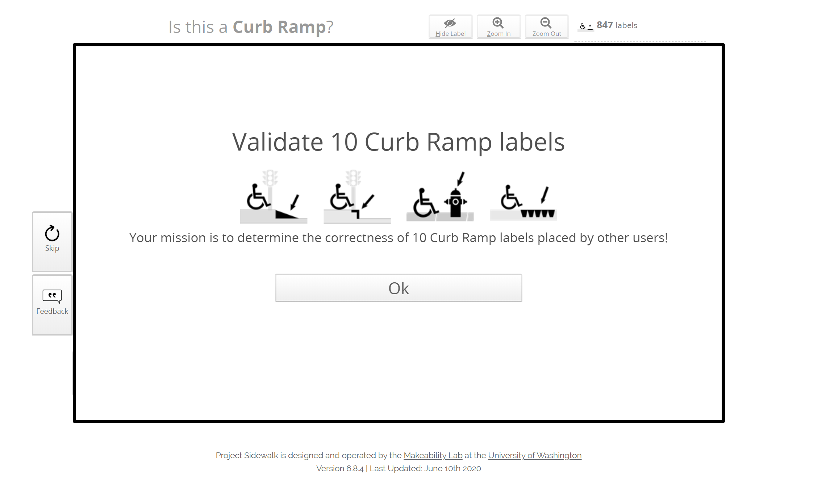

Slide 2
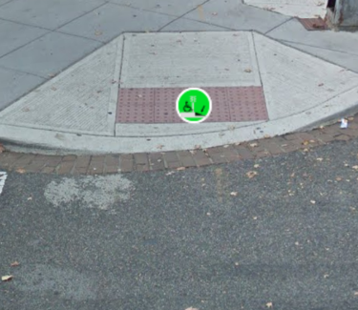
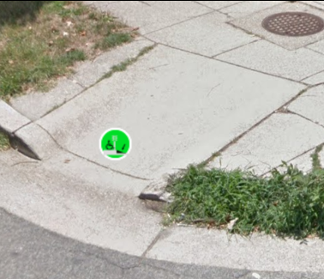
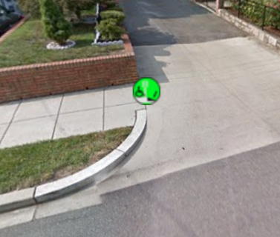
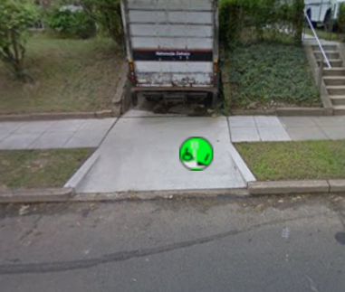
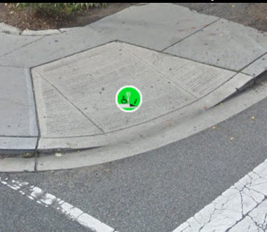


Your Mission: Validate 10 Curb Ramps
Correct examples. Mark Agree.
Incorrect examples. Mark Disagree.
Sidewalk-driveway transitions typically don’t need curb ramps
Driveways should not be marked as curb ramps
Start Mission: Validate 10 Curb Ramps

Slide 3
Your Mission: Validate 10 Curb Ramps
Correct examples. Mark Agree.
Incorrect examples. Mark Disagree.
Sidewalk-driveway transitions typically don’t need curb ramps
Driveways should not be marked as curb ramps
Start Mission: Validate 10 Curb Ramps

Slide 4
Validate 10 Curb Ramps
Correct examples. Mark Agree.
Incorrect examples. Mark Disagree.
Sidewalk-driveway transitions typically don’t need curb ramps
Driveways should not be marked as curb ramps
Let’s go!

Slide 5
Validate 10 Curb Ramps
Correct examples. Select “Agree”
Incorrect examples. Select “Disagree”
This is an ADA compliant curb ramp with wide flares, turnaround space, and a friction strip
This is a narrow curb ramp that is overly narrow and lacks a friction strip. But it’s still a curb ramp.
There is a smooth seam between the driveway and sidewalk, so a curb ramp is not needed.
Driveways should not be labeled as curb ramps
Let’s go!

Slide 6

Your Mission: Validate 10 Curb Ramps
Correct examples. Select “Agree”
Incorrect examples. Select “Disagree”
Correct label. This is an ADA compliant curb ramp with wide flares, turnaround space, and a friction strip
Correct label. This is a narrow curb ramp that is overly narrow and lacks a friction strip. But it’s still a curb ramp.
Incorrect label. Driveways should not be labeled as curb ramps. This is an extremely common labeling mistake!
Incorrect label. There is a smooth seam between the driveway and sidewalk, so no curb ramp exists.
Let’s do it!

Slide 7
Your Mission: Validate 10 Curb Ramps
What if we put more badge and leaderboard information on this? I think that would be good!
Correct examples. Select “Agree”
Incorrect examples. Select “Disagree”
Correct label. This is an ADA compliant curb ramp with wide flares, turnaround space, and a friction strip
Correct label. This is a narrow curb ramp that is overly narrow and lacks a friction strip. But it’s still a curb ramp.
Incorrect label. Driveways should not be labeled as curb ramps. This is an extremely common labeling mistake!
Incorrect label. There is a smooth seam between the driveway and sidewalk, so no curb ramp exists.
Start mission!

