Slide 1
 | Metric | Rank
Distance | 0.55 mi | 3rd (Top X%)
Labels | 984 | 5th (Top Y%)
Accuracy | 91% | 4th (Top X%)
Missions Completed | 14 | 6th (Top X%)
Label Type | Count | Rated Correct | Rated Incorrect | Rated Unsure
Curb Ramp | 102 | XX/YY (X%) | XX/YY (X%) | XX/YY (X%)
Missing Curb Ramp | 98 | XX/YY (X%) | XX/YY (X%) | XX/YY (X%)
Obstacle in Path | 67 | XX/YY (X%) | XX/YY (X%) | XX/YY (X%)
Surface Problem | 140 | XX/YY (X%) | XX/YY (X%) | XX/YY (X%)
No Sidewalk | 130 | XX/YY (X%) | XX/YY (X%) | XX/YY (X%)
Total | 356 | XX/YY (y%) | XX/YY (y%) | XX/YY (y%)

Slide 2
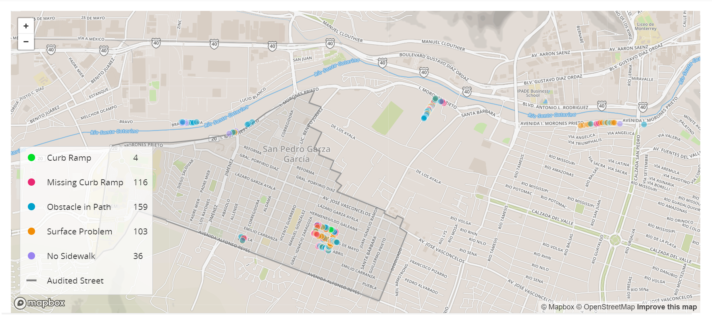




Your DISTANCE
Num Labels
Accuracy
missions
0.56 mi
984
86%
15
Notes:
https://thenounproject.com/search/?q=distance&i=2587675
https://thenounproject.com/search/?q=location+pin&i=2342268
https://thenounproject.com/search/?q=accuracy&i=3485590
https://thenounproject.com/search/?q=missions&i=2673795

Slide 3
Your DISTANCE
Num Labels
Accuracy
missions
Top 5%
0.56 mi
984
86%
15
Notes:
https://thenounproject.com/search/?q=distance&i=2587675
https://thenounproject.com/search/?q=location+pin&i=2342268
https://thenounproject.com/search/?q=accuracy&i=3485590
https://thenounproject.com/search/?q=missions&i=2673795

Slide 4
Your DISTANCE
Num Labels
Accuracy
missions
4th Place
0.56 mi
984
86%
15
Notes:
https://thenounproject.com/search/?q=distance&i=2587675
https://thenounproject.com/search/?q=location+pin&i=2342268
https://thenounproject.com/search/?q=accuracy&i=3485590
https://thenounproject.com/search/?q=missions&i=2673795

Slide 5

Your DISTANCE
Num Labels
Accuracy
missions
4th Place
0.56 mi
984
86%
15
Notes:
https://thenounproject.com/search/?q=distance&i=2587675
https://thenounproject.com/search/?q=location+pin&i=2342268
https://thenounproject.com/search/?q=accuracy&i=3485590
https://thenounproject.com/search/?q=missions&i=2673795
Actual flag that I used

Slide 6


Missions
Distance
Labels
Accuracy
Validations
4th Place
15
0.56 mi
984
86%
400
Notes:
https://thenounproject.com/search/?q=distance&i=2587675
https://thenounproject.com/search/?q=location+pin&i=2342268
https://thenounproject.com/search/?q=accuracy&i=3485590
https://thenounproject.com/search/?q=missions&i=2673795
Actual flag that I used in icon: https://thenounproject.com/search/?q=flag&i=1108961
Validation icon: https://thenounproject.com/search/?q=validation&i=1876484

Slide 7
Your Distance
Labels
Accuracy
Missions
4th Place
0.56 mi
984
86%
15
Notes:
https://thenounproject.com/search/?q=distance&i=2587675
https://thenounproject.com/search/?q=location+pin&i=2342268
https://thenounproject.com/search/?q=accuracy&i=3485590
https://thenounproject.com/search/?q=missions&i=2673795
Actual flag that I used in icon: https://thenounproject.com/search/?q=flag&i=1108961
Validation icon: https://thenounproject.com/search/?q=validation&i=1876484

Slide 8
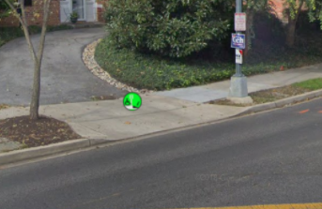
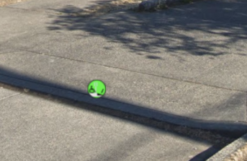
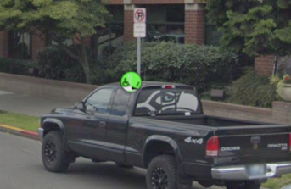
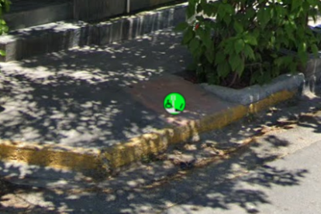
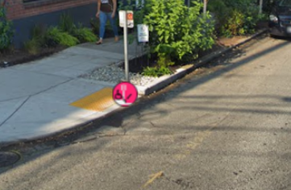
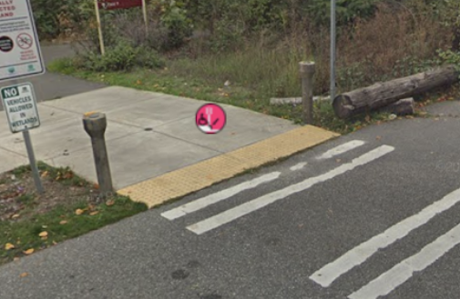
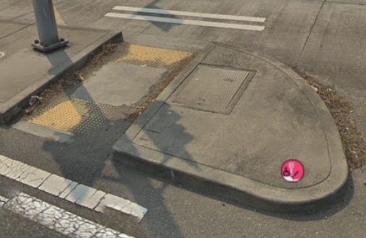
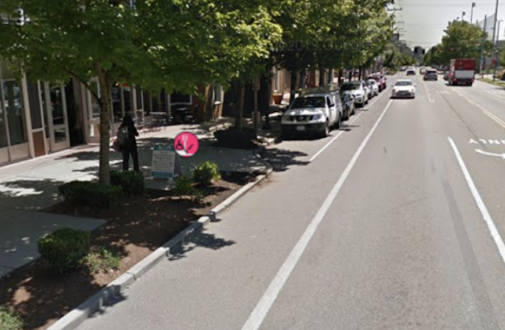
Your recent labels marked incorrect by other users
Your incorrect curb ramp labels
Your incorrect missing curb ramp labels

Slide 9
Your recently validated labels
These are your labels recently validated by other users. While other users can, of course, make mistakes. We’re showing them to you to help you learn and become a better labeler. You can also read our labeling guide here.
Correct curb ramp labels
Incorrect curb ramp labels
Your incorrect missing curb ramp labels

