Slide 1
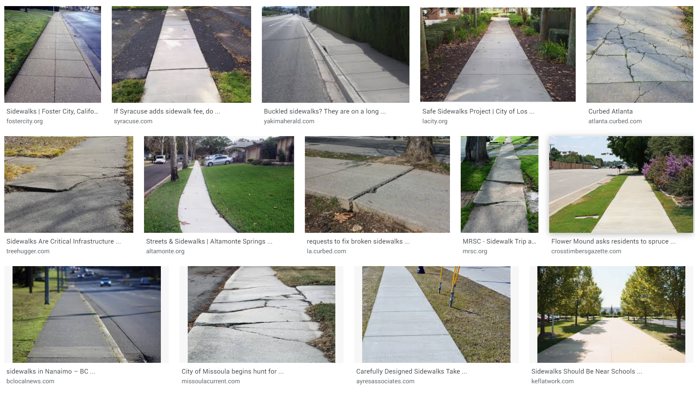
Sort by:
Severity
Show
Curb Ramp
Missing curb ramp
Obstacles
Surface problems
Missing sidewalks
Severity
1
2
3
4
5
Tags
Tree
Vegetation
Pole
Fire hydrant
Another tag

