Slide 1
BaaS & Consensus Mechanism

Slide 2
BaaS
Similar to Software as a Service (SaaS)
In Blockchain is complex in infrastructure setup
Also cost is high for setting up operating Blockchain.
Which may discourage any startups or SME from adopting it.
Cloud based solutions are available to make things simple.
Business can leverage such cloud based solution to build blockchain app, smart contracts and other blockchain function.
In contrast cloud based service provides Infra, Maintenance & other backend activities like security, storage, bandwidth management and resource allocation.

Slide 3
BaaS
It is a lot cheaper to host and run blockchain solution inhouse.
Security is major aspect where error could happen so should be taken care.
All Major Company’s like Microsoft, Google, Amazon and IBM have launched BaaS.

Slide 4
Consensus Protocol
Consensus is general agreement or opinion shared by all people in the group.
A protocol is a system of standard rules
Accepted by all to control the exchange of information in a network.
Consensus protocol aims to overcome classic problem of a distributed computing system known as “Byzantine Generals Problems”.

Slide 5
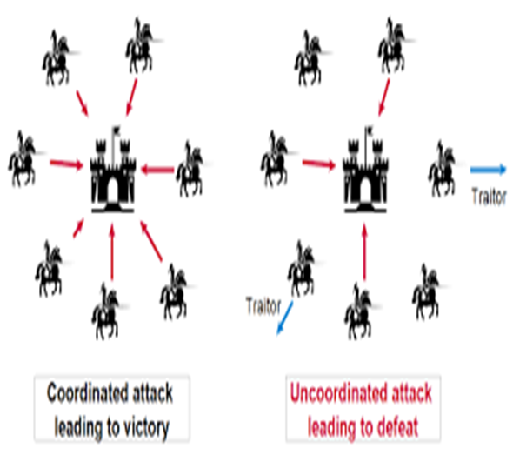
Byzantine Generals Problem

Slide 6
Byzantine Generals Problem
Originally known as “Two-generals Problem”.
It’s a thought experiment introduced in CN classes.
Especially concerning TCP (No guarantee that failure will not occur while two people communicate.)

Slide 7
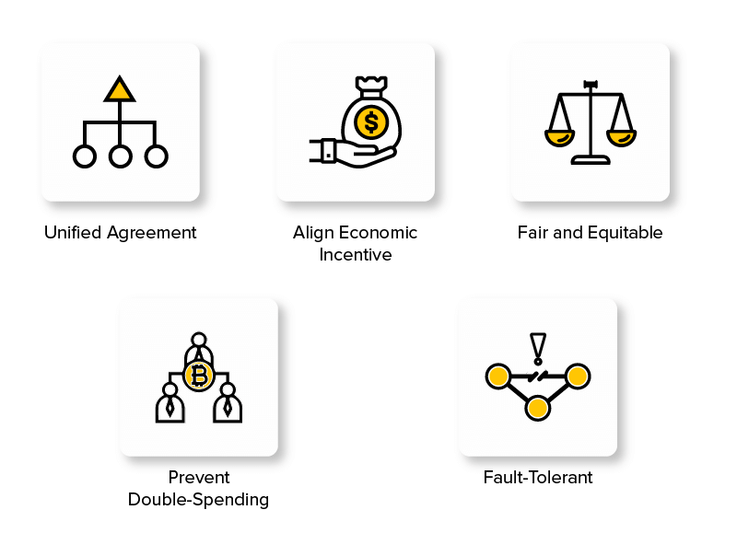
Objective of Consensus Protocol
Unified Agreement
On data is valid and accurate. Protocol rules embedded in network ensures this.
Fault Tolerant
Due to high or many nodes in system makes blockchain fault tolerant.
Usually there are thousands of nodes which act as client / servers.
Failing of few will not take system down.
Collaborative and Participatory
Consensus Mechanism ensures all nodes are participating in overall process.
Else will lead in specific person or group interest.
Egalitarian
Equality between all nodes.
Incentivization
Validating a transaction and securing it on blockchain requires “Miners”.
They solve complex mathematical problem based on cryptographic hash algorithm.
Prevent Double Spending
Possibility of spending digital currency or token being spent more than once by falsification or duplication.
Protocol embedded in the blockchain ensures valid and authentic transaction.

Slide 8
Consensus Algorithms -Proof of Work PoW
Most well-known consensus mechanism in blockchain.
Used by first Blockchain Bitcoin in 2009.
Several Miners competes to solve complex mathematical problem based on cryptographic hash algorithm.
The Solution found after mining is called Proof of Work – PoW
Its very easy to add block without mining but makes it vulnerable.
Mining nodes releases the proof of work to other nodes for verification to agree upon thereby to reach the consensus.
Solution to the problem is difficult to produce but easy for the network to verify.
Mini Process is extremely computensive.
Hence first Miner who produce PoW is rewarded in form of bitcoin or digital currency.
But there are disadvantages of PoW as well.

Slide 9
Consensus Algorithms -Proof of Work PoW
Disadvantages of PoW
Time Consuming
High Energy Consumption
51% Risk
To overcome high energy and time consumption problem some minors form group or mining pool together to save energy and time.
But this is against the principle of distributed ledger.
Mining pool compromised gaining control over 50% of networks computing power can control validation process.
This is referred as 51% attack.

Slide 10
Consensus Algorithms -Proof of Elapsed Time (PoET)
Proof of Elapsed Time (PoET)
Conceived in 2016 by Intel.
Commonly used in permissioned Blockchain network to decide on mining rights or block winner.
Based on principle of fair lottery system.
Each Node is equally likely to be a winner.
Each Miner node in blockchain provided with randomized timer object from trusted code that generates random wait time.
Method aims to circumvent any attempt by a miner to get time with shorter period.
Minier who completes the designated waiting time commits a new block to the blockchain.
It broadcast new block info on network

Slide 11
Consensus Algorithms -Proof of Stake (PoS)
Proof of Stake(PoS)
Was implemented as a consensus algorithm for Peercoin in 2012.
Makes it vulnerable as its heavily rely on trusted execution environment.
The more stake one has in the validating node the less chance to corrupt the process.
Users with highest stake in crypto will have more interest to keep network honest. In fear to diminish the network.
Miners are called Validators / Forgers / Delegates.
A forger has to commit some of his / her stake as collateral.
To get chance for validation.
An Algorithm will select forger randomly on percentage of stake he holds.

Slide 12
Consensus Algorithms -Proof of Stake (PoS)
Proof of Stake(PoS)
Validating node can validate same amount of transaction.
Eg 10% stake will be able to validate 10% Transaction.
Energy Consumption is less
Time Need is less.
Disadvantages
Cheaper to attack
Centralization Risk

