Slide 1

Blockchain based Identity Management System
Prakruti Bhavsar – 21104067
Payal Gupta – 21104057
Urvi Joshi – 21104100
Project Guide
Mr. Mandar Ganjapurkar
Notes:
1

Slide 2
Contents
Introduction
Objectives
Scope
Literature Survey
Proposed System
Project Outcomes
Block Diagram
Use Case/DFD
Technology Stack
Notes:
2

Slide 3
1. Introduction
Problem Identified :
In the digital world, users are required to repeatedly provide personal information to access various services, which poses significant privacy and security risks. The centralization of sensitive data in traditional databases makes it vulnerable to cyberattacks and unauthorized access. Moreover, users often face the inconvenience of filling out forms or submitting personal details for each new interaction with a service. This creates a need for a more secure and efficient method of managing identity verification, where users can maintain control over their data and reduce the risk of identity theft.
Notes:
3

Slide 4
1. Introduction
Solution Proposed :
The proposed system is a Blockchain-based Identity Management platform that enables secure user registration, encrypted data storage, and smart contract-driven verification. Users register once with personal details, which are stored on the blockchain. Service providers verify user eligibility by accessing only the required data (e.g., age, ID) through smart contracts, ensuring privacy and reducing redundant data sharing. The system is scalable and applicable across sectors like insurance, healthcare, banking, and education.
Notes:
4

Slide 5
2. Objectives
To store users' personal data securely on the blockchain, ensuring that it is tamper-proof, transparent, and decentralized.
To enable service providers to verify user eligibility for various services (e.g., insurance, healthcare, etc.) by referencing blockchain-stored data, without requiring users to submit personal details repeatedly.
To reduce the risk of data breaches, identity theft, and fraud by using blockchain's inherent security features like cryptographic hashing and decentralized storage.
To create a system that can be adapted and applied across various industries, including insurance, healthcare, banking, education, and government services, offering a universal solution for digital identity management.
Notes:
5

Slide 6
3. Scope
Covers user registration, secure data storage, and identity verification.
Users submit personal details (name, gender, DOB, address, unique ID).
Data is encrypted and stored on the blockchain.
Service providers access only necessary details (e.g., age, unique ID) for verification.
Supports multiple sectors: insurance, healthcare, finance, education, government.
Ensures users have control over their data and can share selectively.
Notes:
6

Slide 7
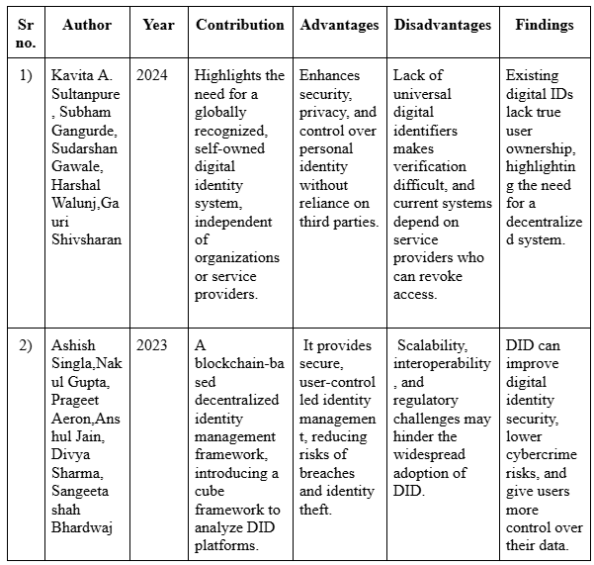
4. Literature Survey
Notes:
7

Slide 8
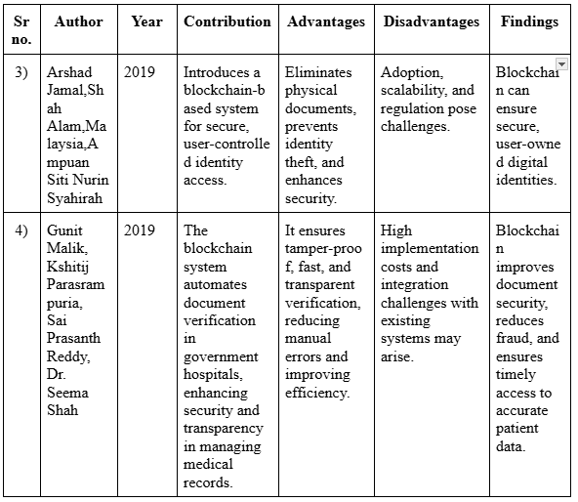
4. Literature Survey
Notes:
8

Slide 9
5. Proposed System
User registration via front-end with personal details (name, DOB, Aadhaar, etc.)
Data is encrypted and stored on blockchain using smart contracts (Truffle + Ganache).
Backend (Node.js + TypeScript) ensures secure communication with blockchain.
Minimal user data is shared with service providers (e.g., name, age, ID).
Eligibility is verified by retrieving necessary info from the blockchain.
Protects user privacy and reduces data breaches.
Scalable across sectors: insurance, healthcare, banking, education, government.
Notes:
9

Slide 10
6. Project Outcome
Enhanced Data Privacy: User data is encrypted and stored on the blockchain, minimizing the risk of leaks or tampering.
Decentralized Identity Verification: Enables seamless and secure verification without relying on a central authority.
User Convenience: Reduces repetitive form-filling and identity proof submission by allowing one-time registration.
Service Provider Efficiency: Facilitates quick and secure eligibility checks through smart contract execution.
Cross-Domain Applicability: A flexible system architecture suitable for use in insurance, healthcare, education, banking, and government sectors.
Notes:
10

Slide 11
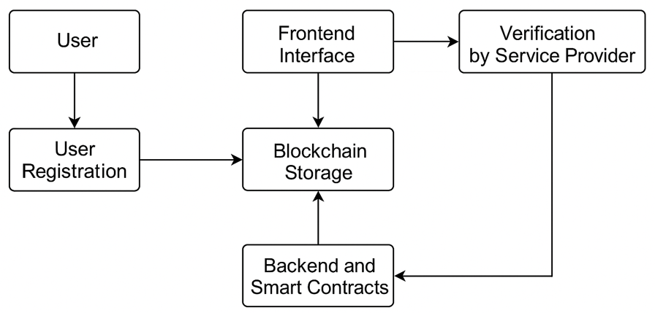
7. Block Diagram
Notes:
11

Slide 12
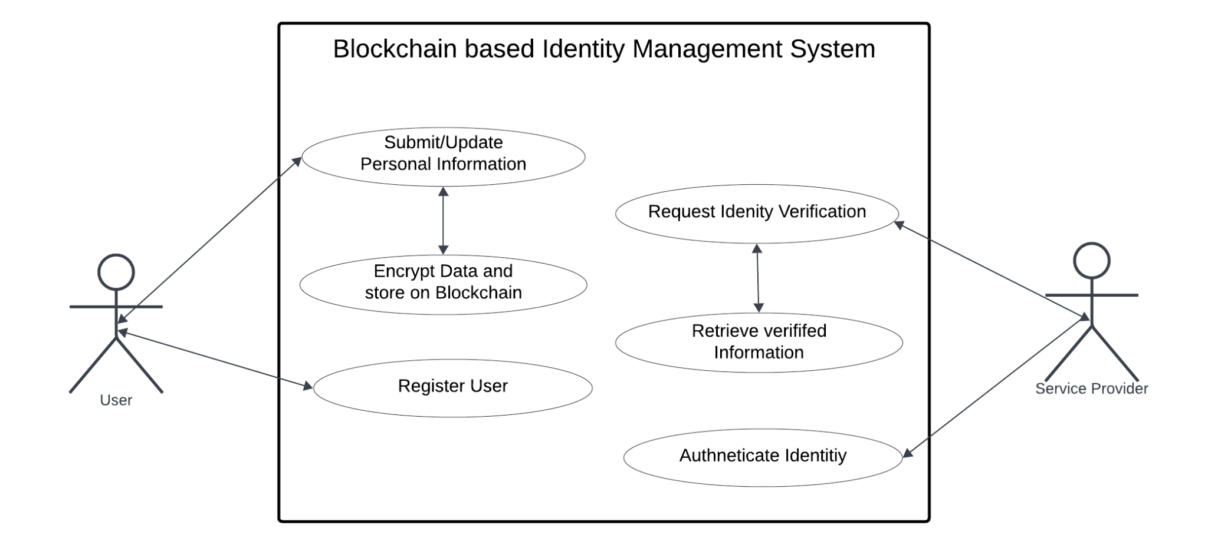
8. Use Case/Data Flow Diagram
Use Case Diagram
Notes:
12

Slide 13
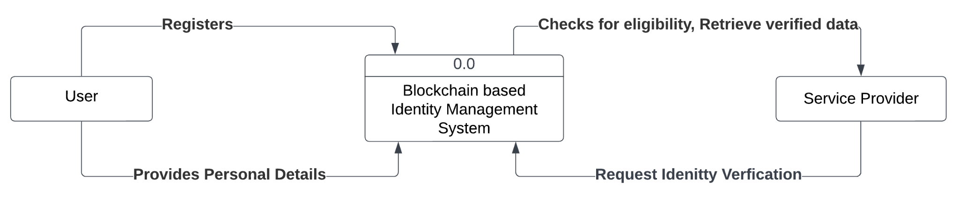
8. Use Case/Data Flow Diagram
Level 0 DFD
Notes:
13

Slide 14
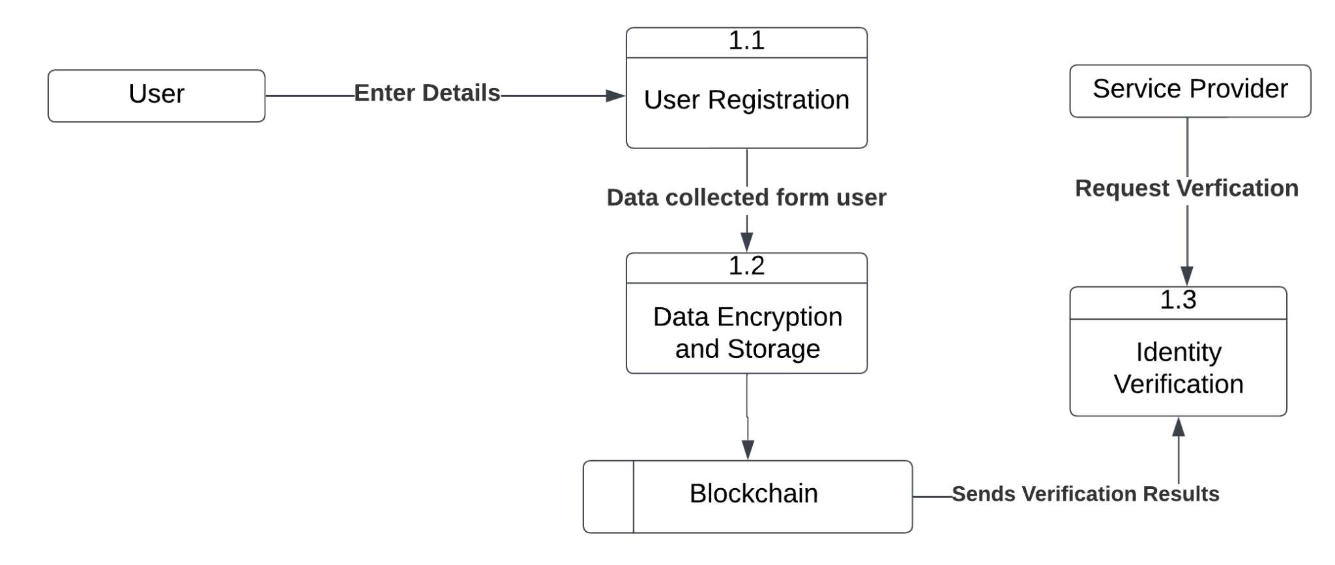
8. Use Case/Data Flow Diagram
Level 1 DFD
Notes:
14

Slide 15
9. Technology Stack
Frontend:
jQuery
Bootstrap
TypeScript
Backend & Blockchain:
Node.js
ExpressJS
Truffle
Ganache
Notes:
15

Slide 16
Thank You...!!
Notes:
16

