Slide 1
Vrijstellingen & Trajecten
Sam, Joachim, Tiem & Toon
Notes:
Hello and welcome to our presentation. The name of our project is Vrijstellingen en Trajecten. Our names are Sam, Toon, Tiem and Joachim. We will explain what our project is and why we do it. Also we will talk about the used technologies.

Slide 2
Objective
Accomplishments
Problems
Notes:
Our objective is to simplify the asministrative work trajectbegeleiders have to do when the academic year starts. We have accomplished a system where students can request exemptions for certain courses. They can upload proof and explain why it should be approved. There were some problems with testing the application because we had to rely on a service which can only be accessed at our production server, so we can’t test it locally. However we recently came up with a solution to this problem.

Slide 3

Case
Notes:
Our case was the create a web platform where teachers, administrators and students can follow the required procedure to complete an application for an exemption.

Slide 4
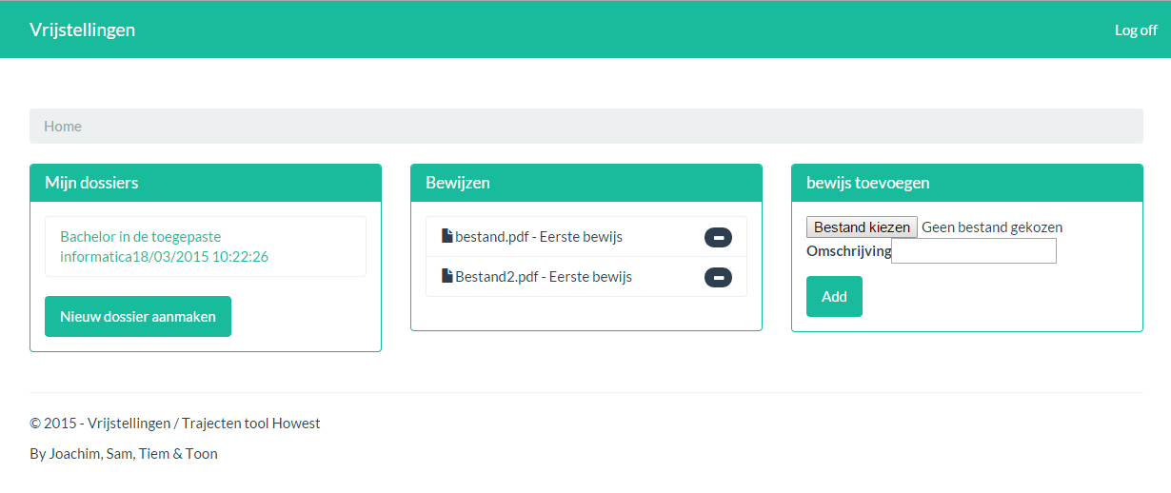
Student - Main
Notes:
Here you can see the main screen of the student.
The screen consists of 3 parts:
On the left is a list to view your open records, with a button to create one if the students has no open record yet.
In the center is a list of all the evidence that the student has provided.
And finally on the right the student can upload more evidence if he needs to.

Slide 5
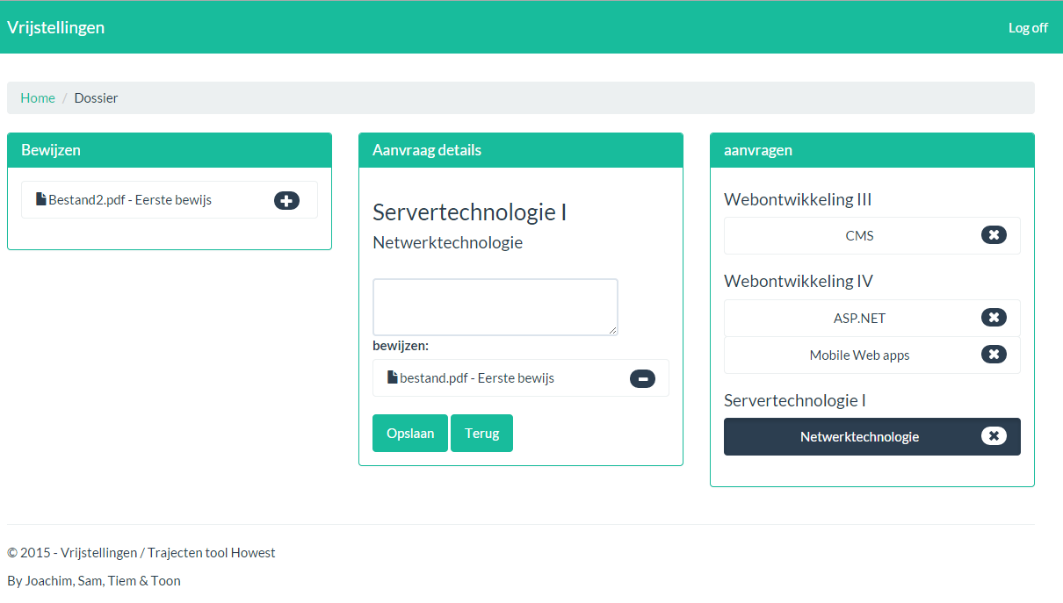
Student - Dossier
Notes:
This is a part of the application in which the students can add courses to ask for exemptions.
For each course the student has to fill in an explanation, why they deserve the exemption.
They also need to add evidence to backup there explanation, which can be selected in the first column, by clicking the add button or drag it into the details screen.
When a detail gets updated it will be saved automatically in the background so it is no hassle for the user to save every change he makes.
On the right you can see that the course that is selected gets highlighted and every course can also be deleted from the application.

Slide 6
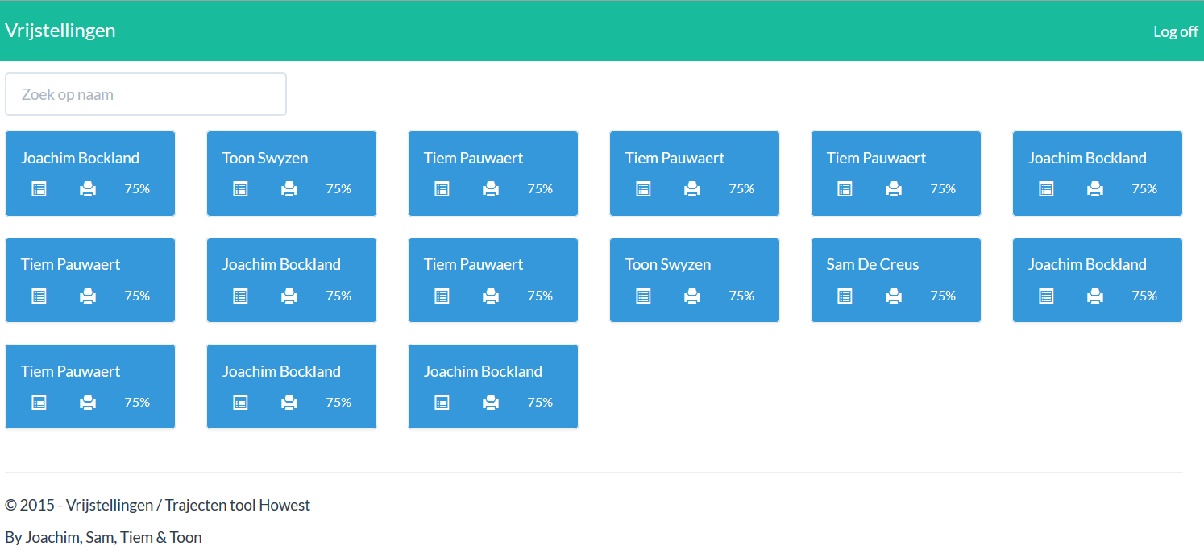
Trajectbegeleider - Overzicht
Notes:
What you can see here is the dashboard for the administrators displaying all files for individual students in the form of tiles. The administrator is able to filter through these by simply typing the name of a student in the search field.

Slide 7
Process backing
Users
Database
Webserver
Bamaflex
Identity- services
Notes:
We use 3 databases, 2 we only use to get the information about students and courses, our own database we use for all the data we need to use on regular basis.
There is also the user interface which consists of forms, scripts and a lot of data. We made sure that the user interface is only used to display and transfer data.
At last we have the webserver, this is where everything gets processed and executed. All the incoming data is checked for tampering for security reasons.

Slide 8
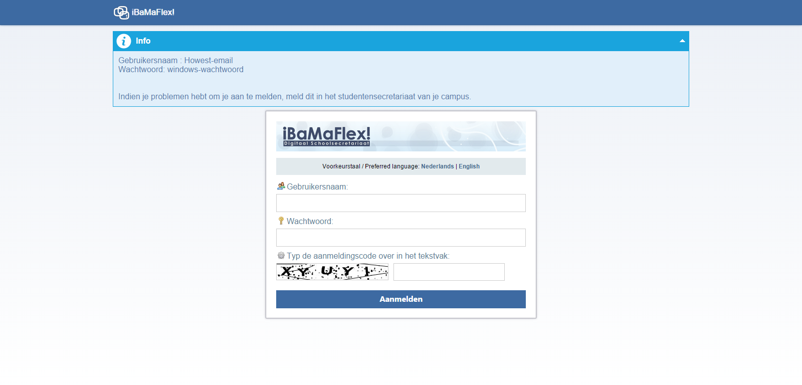
Ibamaflex
Notes:
We use IBAMAFLEX to get all the information we need about the students, teachers and program counselors.
This not only the personal information but also everything we need to know about the course the student is applying for.

Slide 9

Identity services
Notes:
This service id needed to authenticate users using their Howest Email and password. It checks if the password is correct and returns whether it is correct or not.

Slide 10

Our own database
Notes:
Aside from the Bamaflex database and the identityService we also make use of a local database where we store dummy data. This data is pure for testing phase and will not be required for the final version. What is stored on there and is required in the final version would be the duplicated (“cached”) data from bamaflex that we store because we can’t fuly rely on a service which we aren’t associated with.

Slide 11

Our webserver
Notes:
Obviously the website has to be run somewhere, for us this would be the bru-teamfound server located at the Howest site. We ere required to use this webserver because it’s in the up-range allowed to establish a connection to identityservices.

Slide 12
Chain of events
STUDENT
ADMINISTRATOR
TEACHER
Makes an application
Asks for opinion
Approval
No approval
Finalizes the appilication
Prints out the file
Notes:
So how does it all work ?
First of all the students creates an application with all the provides information that is needed.
That application is then reviewed by the program counselor and will then ask the teacher of that particular course for his opinion.
Based on the teacher’s opinion the request for that course will then be approved or declined.
Once all the courses on the application are done, the program counselor will finalize the application and print it out.

Slide 13
Goal of the case
Easier task for administrators
Notes:
The main goal for us was to going experience and make something that will improve and automate all the exemptions that are currently being handled manually. Something usefull, that we later can look back on and we can learn from.

Slide 14



How?
We were presented with three programming language choices:
Notes:
Last year there already was a project with the same goal, but it has failed and is currently not used. It was written in ASP.NET MVC but it was technically not usable. For our project we could choose for several programming languages and frameworks.

Slide 15
WE chose...
Notes:
We wanted to use node.js because it was new and fresh. And we would learn a lot of new things. But because we had to use a server from school because we needed access to identity and bamaflex, we had no other choice then to go with asp.net. Which for us at the beginning was pretty new too cause we only had just started to get the course. Right now we are well beyond what we will see in the course.

Slide 16

Version control
Commit, pull, commit, push, stash, pull, commit, push, ...
Notes:
We use Github to manage our project.
This way we can work on the same project at the same time.
It’s easy to use and everyone always has the latest version of the project.

Slide 17

Database
Notes:
For data we use Microsoft SQL server and for dataaccess we use Entity framework. This enables us to program much faster because now we dont have to write SQL server. Instead we use LINQ to write queries to the database.

Slide 18

Production workflow
Notes:
The production workflow is quite the hassle. To uderstand this you must know remember that identiservices (used to log in and for other minor yet essential activities) can only be acces by the webserver and thus not by our own – local- laptops. Meaning to test something we are forced to publich it to the website, test it there and then make changes accordingly.

Slide 19


On schedule!
Notes:
We made sure to start as soon as we could and do as much as soon as possible to make sure we would be done on schedule. Right now we know it was a great decision because we have had some delays. Right know our application stopped working because the bamaflex services have been updated and we haven’t been able to get the patch notes so we haven’t been able to patch the errors.

Slide 20
Thank you for listening!
Questions?
Remarks?
Notes:
Are there any questions ?

