Slide 1

BIOINF 2071 Spring 2022 Block 4 Lecture 3 – Learning Causality from Data
Department of Biomedical Informatics
University of Pittsburgh School of Medicine
http://www.dbmi.pitt.edu
Xia Jiang, PhD

Slide 2
Learning CBN Structure : Constraint-Based Approach
  Generally, two steps:
  Identify the set of conditional independencies in a probability distribution.
  Search for a PDAG for which the Markov condition entails all and only those conditional independencies.
  Faithfulness Condition
  Markov Condition

Slide 3
Number of PDAGs Given Number of Variables n
n | Number of PDAGs | n! | n^{n}
1 | 1 | 1 | 1
2 | 2 | 2 | 4
3 | 11 | 6 | 27
4 | 185 | 24 | 256
5 | 8782 | 120 | 3125
6 | 1067825 | 720 | 46656
7 | 312510571 | 5040 | 823543
8 | 212133402500 | 40320 | 16777216
9 | 326266056291213 | 362880 | 387420489
10 | 1,118,902,054,495,975,141 | 3,628,800 | 10,000,000,000
SB,Gillispie and MD, Perlman, Enumerating Markov Equivalence Classes of Acyclic Digraph Models, UAI, 2001 p 171]

Slide 4
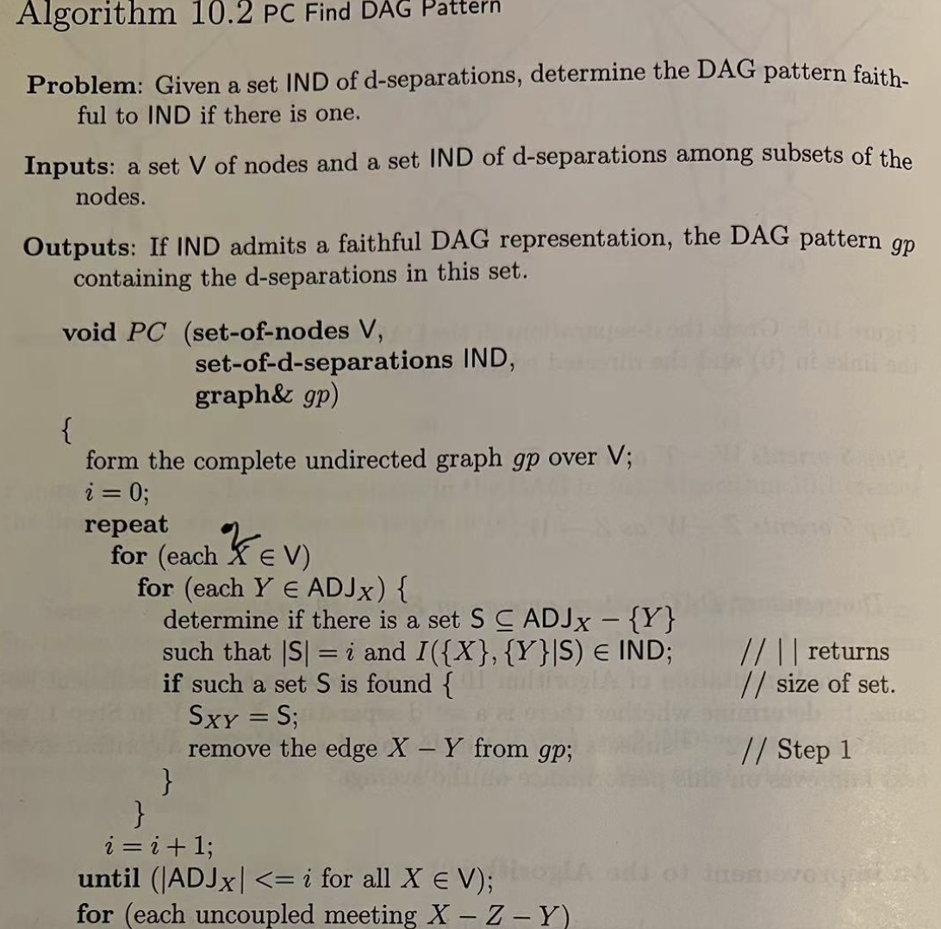
PC Algorithm –Part1
PC was developed by Peter Sprites and Clark Glymour.
This writeup of the algorithm was presented in a 2004 book titled “Learning Bayesian network”, by Richard E. Neapolitan
The first part of the algorithm is about searching for removable edges

Slide 5
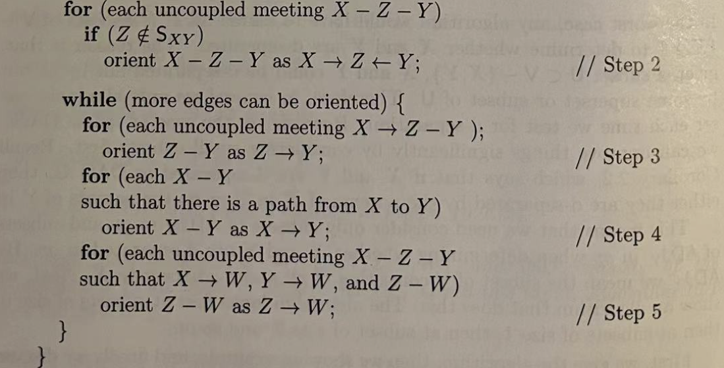
PC Algorithm-Part 2
The second part of the algorithm is about determining directions of edges

Slide 6
Some Key Points Concerning PC Algorithm
ADJ_{X} is the set of nodes that are “adjacent” to node X
Two nodes are adjacent if there is an edge between them
Edge between X and Y ⇒ $¬$I_{G}({X},{Y}| $Z)$
Faithfulness condition
I_{G}({X},{Y}| $Z)$ ⇒ no Edge between X and Y
I_{P}({X},{Y}| $Z) \text{⇒}$ I_{G}({X},{Y}| $Z)$ ⇒ no Edge between X and Y
no Edge between X and Y $\text{⇒} \text{I}\text{G}\text{(\{}\text{X}\text{\}}\text{,}\text{\{}\text{Y}\text{\}}\text{|} Z) \text{⇒}$ I_{P}({X},{Y}| $Z)$
condition
Therefore, $¬$I_{P}({X},{Y}| $Z) \text{⇒}$ Edge between X and Y

Slide 7
An Example for Illustrating PC Algorithm
Variable 1 | Variable 2 | P-Value
ED_Visit | COVI2 | 2.782E-06
ED_Visit | COPD | 0.0051
ED_Visit | Dyspnea | 4.0095E-28
Dyspnea | COVID | 1.0915E-86
Dyspnea | COPD | 4.3951E-19
COPD | COVID | 0.8145
COPD
COVID
Dyspnea
ED_Visits
COPD | V₁
COVID | V₂
Dyspnea | V₃
ED_Visits | V₄
I’d like to rename the variables. A personal preference!
True DAG
🧛‍♀️
Notes:
So let’s assume that we have measured these four variables, and some of the independencies that hold in the joint distribution are the independencies we see here next to the graph.

Slide 8

$$Until (\left|{ADJ}_{x}\right|≤i for all X∈V )$$
alpha = 0.05
S is a subset of ADJ_{x} –{Y}
V={V₁, V₂, V₃, V₄}
X | ADJ_{x} | Y∊ ADJ_{x} | ADJ_{x}–{Y} | S (Size=i) | I({X},{Y}|S)? | Remove?
V₁ | {V₂, V₃, V₄} | V₂ | {V₃, V₄} | ∅ | I({V₁},{V₂}|∅)✓ | Yes
i=0
V₁
V₂
V₃
V₄
COPD | V₁
COVID | V₂
Dyspnea | V₃
ED_Visits | V₄

Slide 9
alpha = 0.05
S is a subset of ADJ_{x} –{Y}
V={V₁, V₂, V₃, V₄}
X | ADJ_{x} | Y∊ ADJ_{x} | ADJ_{x}–{Y} | S (Size=i) | I({X},{Y}|S)? | Remove?
V₁ | {V₂, V₃, V₄} | V₂ | {V₃, V₄} | ∅ | I({V₁},{V₂}|∅)✓ | Yes
i=0
V₁
V₂
V₃
V₄
COPD | V₁
COVID | V₂
Dyspnea | V₃
ED_Visits | V₄

Slide 10
alpha = 0.05
S is a subset of ADJ_{x} –{Y}
V={V₁, V₂, V₃, V₄}
X | ADJ_{x} | Y∊ ADJ_{x} | ADJ_{x}–{Y} | S (Size=i) | I({X},{Y}|S)? | Remove?
V₁ | {V₂, V₃, V₄} | V₂ | {V₃, V₄} | ∅ | I({V₁},{V₂}|∅)✓ | Yes
 |  | V₃ | {V₂, V₄} | ∅ | I({V₁},{V₃}|∅)✘ | No
i=0
V₁
V₂
V₃
V₄
COPD | V₁
COVID | V₂
Dyspnea | V₃
ED_Visits | V₄

Slide 11
alpha = 0.05
S is a subset of ADJ_{x} –{Y}
V={V₁, V₂, V₃, V₄}
X | ADJ_{x} | Y∊ ADJ_{x} | ADJ_{x}–{Y} | S (Size=i) | I({X},{Y}|S)? | Remove?
V₁ | {V₂, V₃, V₄} | V₂ | {V₃, V₄} | ∅ | I({V₁},{V₂}|∅)✓ | Yes
 |  | V₃ | {V₂, V₄} | ∅ | I({V₁},{V₃}|∅)✘ | No
 |  | V₄ | {V₂, V₃} | ∅ | I({V₁},{V₄}|∅)✘ | No
i=0
V₁
V₂
V₃
V₄
COPD | V₁
COVID | V₂
Dyspnea | V₃
ED_Visits | V₄

Slide 12
alpha = 0.05
S is a subset of ADJ_{x} –{Y}
V={V₁, V₂, V₃, V₄}
X | ADJ_{x} | Y∊ ADJ_{x} | ADJ_{x}–{Y} | S (Size=i) | I({X},{Y}|S)? | Remove?
V₁ | {V₂, V₃, V₄} | V₂ | {V₃, V₄} | ∅ | I({V₁},{V₂}|∅)✓ | Yes
 |  | V₃ | {V₂, V₄} | ∅ | I({V₁},{V₃}|∅)✘ | No
 |  | V₄ | {V₂, V₃} | ∅ | I({V₁},{V₄}|∅)✘ | No
V₂ | {V₃, V₄} | V₃ | {V₄} | ∅ | I({V₂},{V₃}|∅)✘ | No
i=0
V₁
V₂
V₃
V₄
COPD | V₁
COVID | V₂
Dyspnea | V₃
ED_Visits | V₄

Slide 13
alpha = 0.05
S is a subset of ADJ_{x} –{Y}
V={V₁, V₂, V₃, V₄}
X | ADJ_{x} | Y∊ ADJ_{x} | ADJ_{x}–{Y} | S (Size=i) | I({X},{Y}|S)? | Remove?
V₁ | {V₂, V₃, V₄} | V₂ | {V₃, V₄} | ∅ | I({V₁},{V₂}|∅)✓ | Yes
 |  | V₃ | {V₂, V₄} | ∅ | I({V₁},{V₃}|∅)✘ | No
 |  | V₄ | {V₂, V₃} | ∅ | I({V₁},{V₄}|∅)✘ | No
V₂ | {V₃, V₄} | V₃ | {V₄} | ∅ | I({V₂},{V₃}|∅)✘ | No
 |  | V₄ | {V₃} | ∅ | I({V₂},{V₄}|∅)✘ | No
i=0
V₁
V₂
V₃
V₄
COPD | V₁
COVID | V₂
Dyspnea | V₃
ED_Visits | V₄

Slide 14

alpha = 0.05
S is a subset of ADJ_{x} –{Y}
V={V₁, V₂, V₃, V₄}
X | ADJ_{x} | Y∊ ADJ_{x} | ADJ_{x}–{Y} | S (Size=i) | I({X},{Y}|S)? | Remove?
V₁ | {V₂, V₃, V₄} | V₂ | {V₃, V₄} | ∅ | I({V₁},{V₂}|∅)✓ | Yes
 |  | V₃ | {V₂, V₄} | ∅ | I({V₁},{V₃}|∅)✘ | No
 |  | V₄ | {V₂, V₃} | ∅ | I({V₁},{V₄}|∅)✘ | No
V₂ | {V₃, V₄} | V₃ | {V₄} | ∅ | I({V₂},{V₃}|∅)✘ | No
 |  | V₄ | {V₃} | ∅ | I({V₂},{V₄}|∅)✘ | No
V₃ | {V₁, V₂, V₄} | V₁ | {V₂, V₄} | ∅ | I({V₃},{V₁}|∅)✘ | No
i=0
V₁
V₂
V₃
R
V₄
COPD | V₁
COVID | V₂
Dyspnea | V₃
ED_Visits | V₄

Slide 15
alpha = 0.05
S is a subset of ADJ_{x} –{Y}
V={V₁, V₂, V₃, V₄}
X | ADJ_{x} | Y∊ ADJ_{x} | ADJ_{x}–{Y} | S (Size=i) | I({X},{Y}|S)? | Remove?
V₁ | {V₂, V₃, V₄} | V₂ | {V₃, V₄} | ∅ | I({V₁},{V₂}|∅)✓ | Yes
 |  | V₃ | {V₂, V₄} | ∅ | I({V₁},{V₃}|∅)✘ | No
 |  | V₄ | {V₂, V₃} | ∅ | I({V₁},{V₄}|∅)✘ | No
V₂ | {V₃, V₄} | V₃ | {V₄} | ∅ | I({V₂},{V₃}|∅)✘ | No
 |  | V₄ | {V₃} | ∅ | I({V₂},{V₄}|∅)✘ | No
V₃ | {V₁, V₂, V₄} | V₁ | {V₂, V₄} | ∅ | I({V₃},{V₁}|∅)✘ | No
 |  | V₂ | {V₁, V₄} | ∅ | I({V₃},{V₂}|∅)✘ | No
i=0
V₁
V₂
V₃
R
R
V₄
COPD | V₁
COVID | V₂
Dyspnea | V₃
ED_Visits | V₄

Slide 16
alpha = 0.05
S is a subset of ADJ_{x} –{Y}
V={V₁, V₂, V₃, V₄}
X | ADJ_{x} | Y∊ ADJ_{x} | ADJ_{x}–{Y} | S (Size=i) | I({X},{Y}|S)? | Remove?
V₁ | {V₂, V₃, V₄} | V₂ | {V₃, V₄} | ∅ | I({V₁},{V₂}|∅)✓ | Yes
 |  | V₃ | {V₂, V₄} | ∅ | I({V₁},{V₃}|∅)✘ | No
 |  | V₄ | {V₂, V₃} | ∅ | I({V₁},{V₄}|∅)✘ | No
V₂ | {V₃, V₄} | V₃ | {V₄} | ∅ | I({V₂},{V₃}|∅)✘ | No
 |  | V₄ | {V₃} | ∅ | I({V₂},{V₄}|∅)✘ | No
V₃ | {V₁, V₂, V₄} | V₁ | {V₂, V₄} | ∅ | I({V₃},{V₁}|∅)✘ | No
 |  | V₂ | {V₁, V₄} | ∅ | I({V₃},{V₂}|∅)✘ | No
 |  | V₄ | {V₁, V₂} | ∅ | I({V₃},{V₄}|∅)✘ | No
i=0
V₁
V₂
V₃
R
R
V₄
COPD | V₁
COVID | V₂
Dyspnea | V₃
ED_Visits | V₄

Slide 17
alpha = 0.05
S is a subset of ADJ_{x} –{Y}
V={V₁, V₂, V₃, V₄}
X | ADJ_{x} | Y∊ ADJ_{x} | ADJ_{x}–{Y} | S (Size=i) | I({X},{Y}|S)? | Remove?
V₁ | {V₂, V₃, V₄} | V₂ | {V₃, V₄} | ∅ | I({V₁},{V₂}|∅)✓ | Yes
 |  | V₃ | {V₂, V₄} | ∅ | I({V₁},{V₃}|∅)✘ | No
 |  | V₄ | {V₂, V₃} | ∅ | I({V₁},{V₄}|∅)✘ | No
V₂ | {V₃, V₄} | V₃ | {V₄} | ∅ | I({V₂},{V₃}|∅)✘ | No
 |  | V₄ | {V₃} | ∅ | I({V₂},{V₄}|∅)✘ | No
V₃ | {V₁, V₂, V₄} | V₁ | {V₂, V₄} | ∅ | I({V₃},{V₁}|∅)✘ | No
 |  | V₂ | {V₁, V₄} | ∅ | I({V₃},{V₂}|∅)✘ | No
 |  | V₄ | {V₁, V₂} | ∅ | I({V₃},{V₄}|∅)✘ | No
i=0
V₁
V₂
V₃
R
R
V₄
COPD | V₁
COVID | V₂
Dyspnea | V₃
ED_Visits | V₄

Slide 18
alpha = 0.05
S is a subset of ADJ_{x} –{Y}
V={V₁, V₂, V₃, V₄}
X | ADJ_{x} | Y∊ ADJ_{x} | ADJ_{x}–{Y} | S (Size=i) | I({X},{Y}|S)? | Remove?
V₁ | {V₂, V₃, V₄} | V₂ | {V₃, V₄} | ∅ | I({V₁},{V₂}|∅)✓ | Yes
 |  | V₃ | {V₂, V₄} | ∅ | I({V₁},{V₃}|∅)✘ | No
 |  | V₄ | {V₂, V₃} | ∅ | I({V₁},{V₄}|∅)✘ | No
V₂ | {V₃, V₄} | V₃ | {V₄} | ∅ | I({V₂},{V₃}|∅)✘ | No
 |  | V₄ | {V₃} | ∅ | I({V₂},{V₄}|∅)✘ | No
V₃ | {V₁, V₂, V₄} | V₁ | {V₂, V₄} | ∅ | I({V₃},{V₁}|∅)✘ | No
 |  | V₂ | {V₁, V₄} | ∅ | I({V₃},{V₂}|∅)✘ | No
 |  | V₄ | {V₁, V₂} | ∅ | I({V₃},{V₄}|∅)✘ | No
V₄ | {V₁, V₂, V₃} | V₁ | {V₂, V₃} | ∅ | I({V₄},{V₁}|∅)✘ | No
i=0
V₁
V₂
V₃
R
R
V₄
R
COPD | V₁
COVID | V₂
Dyspnea | V₃
ED_Visits | V₄

Slide 19
alpha = 0.05
S is a subset of ADJ_{x} –{Y}
V={V₁, V₂, V₃, V₄}
X | ADJ_{x} | Y∊ ADJ_{x} | ADJ_{x}–{Y} | S (Size=i) | I({X},{Y}|S)? | Remove?
V₁ | {V₂, V₃, V₄} | V₂ | {V₃, V₄} | ∅ | I({V₁},{V₂}|∅)✓ | Yes
 |  | V₃ | {V₂, V₄} | ∅ | I({V₁},{V₃}|∅)✘ | No
 |  | V₄ | {V₂, V₃} | ∅ | I({V₁},{V₄}|∅)✘ | No
V₂ | {V₃, V₄} | V₃ | {V₄} | ∅ | I({V₂},{V₃}|∅)✘ | No
 |  | V₄ | {V₃} | ∅ | I({V₂},{V₄}|∅)✘ | No
V₃ | {V₁, V₂, V₄} | V₁ | {V₂, V₄} | ∅ | I({V₃},{V₁}|∅)✘ | No
 |  | V₂ | {V₁, V₄} | ∅ | I({V₃},{V₂}|∅)✘ | No
 |  | V₄ | {V₁, V₂} | ∅ | I({V₃},{V₄}|∅)✘ | No
V₄ | {V₁, V₂, V₃} | V₁ | {V₂, V₃} | ∅ | I({V₄},{V₁}|∅)✘ | No
 |  | V₂ | {V₁, V₃} | ∅ | I({V₄},{V₂}|∅)✘ | No
i=0
V₁
V₂
V₃
R
R
V₄
R
R
COPD | V₁
COVID | V₂
Dyspnea | V₃
ED_Visits | V₄

Slide 20
alpha = 0.05
S is a subset of ADJ_{x} –{Y}
V={V₁, V₂, V₃, V₄}
X | ADJ_{x} | Y∊ ADJ_{x} | ADJ_{x}–{Y} | S (Size=i) | I({X},{Y}|S)? | Remove?
V₁ | {V₂, V₃, V₄} | V₂ | {V₃, V₄} | ∅ | I({V₁},{V₂}|∅)✓ | Yes
 |  | V₃ | {V₂, V₄} | ∅ | I({V₁},{V₃}|∅)✘ | No
 |  | V₄ | {V₂, V₃} | ∅ | I({V₁},{V₄}|∅)✘ | No
V₂ | {V₃, V₄} | V₃ | {V₄} | ∅ | I({V₂},{V₃}|∅)✘ | No
 |  | V₄ | {V₃} | ∅ | I({V₂},{V₄}|∅)✘ | No
V₃ | {V₁, V₂, V₄} | V₁ | {V₂, V₄} | ∅ | I({V₃},{V₁}|∅)✘ | No
 |  | V₂ | {V₁, V₄} | ∅ | I({V₃},{V₂}|∅)✘ | No
 |  | V₄ | {V₁, V₂} | ∅ | I({V₃},{V₄}|∅)✘ | No
V₄ | {V₁, V₂, V₃} | V₁ | {V₂, V₃} | ∅ | I({V₄},{V₁}|∅)✘ | No
 |  | V₂ | {V₁, V₃} | ∅ | I({V₄},{V₂}|∅)✘ | No
 |  | V₃ | {V₄, V₃} | ∅ | I({V₄},{V₂}|∅)✘ | No
i=0
V₁
V₂
V₃
R
R
V₄
R
R
COPD | V₁
COVID | V₂
Dyspnea | V₃
ED_Visits | V₄
R

Slide 21
$$Until (\left|{ADJ}_{x}\right|≤i for all X∈V )$$
S is a subset of ADJ_{x} –{Y}
V={V₁, V₂, V₃, V₄}
X | ADJ_{x} | Y∊ ADJ_{x} | ADJ_{x}–{Y} | S (Size=i) | I({X},{Y}|S)? | Remove?
V₁ | {V₃, V₄} | V₃ | {V₄} | {V₄} | I({V₁},{V₃}|{V₄}) ✘ | No
i=1
V₁
V₂
V₃
V₄
COPD | V₁
COVID | V₂
Dyspnea | V₃
ED_Visits | V₄

Slide 22
S is a subset of ADJ_{x} –{Y}
V={V₁, V₂, V₃, V₄}
X | ADJ_{x} | Y∊ ADJ_{x} | ADJ_{x}–{Y} | S (Size=i) | I({X},{Y}|S)? | Remove?
V₁ | {V₃, V₄} | V₃ | {V₄} | {V₄} | I({V₁},{V₃}|{V₄}) ✘ | No
 |  | V₄ | {V₃} | {V₃} | I({V₁},{V₄}|{V₃}) ✓ | Yes
i=1
V₁
V₂
V₃
V₄
COPD | V₁
COVID | V₂
Dyspnea | V₃
ED_Visits | V₄

Slide 23
S is a subset of ADJ_{x} –{Y}
V={V₁, V₂, V₃, V₄}
X | ADJ_{x} | Y∊ ADJ_{x} | ADJ_{x}–{Y} | S (Size=i) | I({X},{Y}|S)? | Remove?
V₁ | {V₃, V₄} | V₃ | {V₄} | {V₄} | I({V₁},{V₃}|{V₄}) ✘ | No
 |  | V₄ | {V₃} | {V₃} | I({V₁},{V₄}|{V₃}) ✓ | Yes
V₂ | {V₃, V₄} | V₃ | {V₄} | {V₄} | I({V₂},{V₃}|{V₄}) ✘ | No
i=1
V₁
V₂
V₃
V₄
COPD | V₁
COVID | V₂
Dyspnea | V₃
ED_Visits | V₄

Slide 24
S is a subset of ADJ_{x} –{Y}
V={V₁, V₂, V₃, V₄}
X | ADJ_{x} | Y∊ ADJ_{x} | ADJ_{x}–{Y} | S (Size=i) | I({X},{Y}|S)? | Remove?
V₁ | {V₃, V₄} | V₃ | {V₄} | {V₄} | I({V₁},{V₃}|{V₄}) ✘ | No
 |  | V₄ | {V₃} | {V₃} | I({V₁},{V₄}|{V₃}) ✓ | Yes
V₂ | {V₃, V₄} | V₃ | {V₄} | {V₄} | I({V₂},{V₃}|{V₄}) ✘ | No
 |  | V₄ | {V₃} | {V₃} | I({V₂},{V₄}|{V₃}) ✓ | Yes
i=1
V₁
V₂
V₃
V₄
COPD | V₁
COVID | V₂
Dyspnea | V₃
ED_Visits | V₄

Slide 25
S is a subset of ADJ_{x} –{Y}
V={V₁, V₂, V₃, V₄}
X | ADJ_{x} | Y∊ ADJ_{x} | ADJ_{x}–{Y} | S (Size=i) | I({X},{Y}|S)? | Remove?
V₁ | {V₃, V₄} | V₃ | {V₄} | {V₄} | I({V₁},{V₃}|{V₄}) ✘ | No
 |  | V₄ | {V₃} | {V₃} | I({V₁},{V₄}|{V₃}) ✓ | Yes
V₂ | {V₃, V₄} | V₃ | {V₄} | {V₄} | I({V₂},{V₃}|{V₄}) ✘ | No
 |  | V₄ | {V₃} | {V₃} | I({V₂},{V₄}|{V₃}) ✓ | Yes
i=1
V₁
V₂
V₃
V₄
COPD | V₁
COVID | V₂
Dyspnea | V₃
ED_Visits | V₄

Slide 26
S is a subset of ADJ_{x} –{Y}
V={V₁, V₂, V₃, V₄}
X | ADJ_{x} | Y∊ ADJ_{x} | ADJ_{x}–{Y} | S (Size=i) | I({X},{Y}|S)? | Remove?
V₁ | {V₃, V₄} | V₃ | {V₄} | {V₄} | I({V₁},{V₃}|{V₄}) ✘ | No
 |  | V₄ | {V₃} | {V₃} | I({V₁},{V₄}|{V₃}) ✓ | Yes
V₂ | {V₃, V₄} | V₃ | {V₄} | {V₄} | I({V₂},{V₃}|{V₄}) ✘ | No
 |  | V₄ | {V₃} | {V₃} | I({V₂},{V₄}|{V₃}) ✓ | Yes
V₃ | {V₁, V₂, V₄} | V₁ | {V₂, V₄} | {V₂} | I({V₃},{V₁}|{V₂}) ✘ | No
i=1
V₁
V₂
V₃
V₄
COPD | V₁
COVID | V₂
Dyspnea | V₃
ED_Visits | V₄

Slide 27
S is a subset of ADJ_{x} –{Y}
V={V₁, V₂, V₃, V₄}
X | ADJ_{x} | Y∊ ADJ_{x} | ADJ_{x}–{Y} | S (Size=i) | I({X},{Y}|S)? | Remove?
V₁ | {V₃, V₄} | V₃ | {V₄} | {V₄} | I({V₁},{V₃}|{V₄}) ✘ | No
 |  | V₄ | {V₃} | {V₃} | I({V₁},{V₄}|{V₃}) ✓ | Yes
V₂ | {V₃, V₄} | V₃ | {V₄} | {V₄} | I({V₂},{V₃}|{V₄}) ✘ | No
 |  | V₄ | {V₃} | {V₃} | I({V₂},{V₄}|{V₃}) ✓ | Yes
V₃ | {V₁, V₂, V₄} | V₁ | {V₂, V₄} | {V₂} | I({V₃},{V₁}|{V₂}) ✘ | No
 |  |  |  | {V₄} | I({V₃},{V₁}|{V₄}) ✘ | No
 |  | V₂ | {V₁, V₄} | {V₁} | I({V₃},{V₂}|{V₁}) ✘ | No
i=1
V₁
V₂
V₃
V₄
COPD | V₁
COVID | V₂
Dyspnea | V₃
ED_Visits | V₄

Slide 28
S is a subset of ADJ_{x} –{Y}
V={V₁, V₂, V₃, V₄}
X | ADJ_{x} | Y∊ ADJ_{x} | ADJ_{x}–{Y} | S (Size=i) | I({X},{Y}|S)? | Remove?
V₁ | {V₃, V₄} | V₃ | {V₄} | {V₄} | I({V₁},{V₃}|{V₄}) ✘ | No
 |  | V₄ | {V₃} | {V₃} | I({V₁},{V₄}|{V₃}) ✓ | Yes
V₂ | {V₃, V₄} | V₃ | {V₄} | {V₄} | I({V₂},{V₃}|{V₄}) ✘ | No
 |  | V₄ | {V₃} | {V₃} | I({V₂},{V₄}|{V₃}) ✓ | Yes
V₃ | {V₁, V₂, V₄} | V₁ | {V₂, V₄} | {V₂} | I({V₃},{V₁}|{V₂}) ✘ | No
 |  |  |  | {V₄} | I({V₃},{V₁}|{V₄}) ✘ | No
 |  | V₂ | {V₁, V₄} | {V₁} | I({V₃},{V₂}|{V₁}) ✘ | No
 |  |  |  | {V₄} | I({V₃},{V₂}|{V₄}) ✘ | No
i=1
V₁
V₂
V₃
V₄
COPD | V₁
COVID | V₂
Dyspnea | V₃
ED_Visits | V₄

Slide 29
S is a subset of ADJ_{x} –{Y}
V={V₁, V₂, V₃, V₄}
X | ADJ_{x} | Y∊ ADJ_{x} | ADJ_{x}–{Y} | S (Size=i) | I({X},{Y}|S)? | Remove?
V₁ | {V₃, V₄} | V₃ | {V₄} | {V₄} | I({V₁},{V₃}|{V₄}) ✘ | No
 |  | V₄ | {V₃} | {V₃} | I({V₁},{V₄}|{V₃}) ✓ | Yes
V₂ | {V₃, V₄} | V₃ | {V₄} | {V₄} | I({V₂},{V₃}|{V₄}) ✘ | No
 |  | V₄ | {V₃} | {V₃} | I({V₂},{V₄}|{V₃}) ✓ | Yes
V₃ | {V₁, V₂, V₄} | V₁ | {V₂, V₄} | {V₂} | I({V₃},{V₁}|{V₂}) ✘ | No
 |  |  |  | {V₄} | I({V₃},{V₁}|{V₄}) ✘ | No
 |  | V₂ | {V₁, V₄} | {V₁} | I({V₃},{V₂}|{V₁}) ✘ | No
 |  |  |  | {V₄} | I({V₃},{V₂}|{V₄}) ✘ | No
 |  | V₄ | {V₁, V₂} | {V₁} | I({V₃},{V₄}|{V₁}) ✘ | No
i=1
V₁
V₂
V₃
V₄
COPD | V₁
COVID | V₂
Dyspnea | V₃
ED_Visits | V₄

Slide 30
S is a subset of ADJ_{x} –{Y}
V={V₁, V₂, V₃, V₄}
X | ADJ_{x} | Y∊ ADJ_{x} | ADJ_{x}–{Y} | S (Size=i) | I({X},{Y}|S)? | Remove?
V₁ | {V₃, V₄} | V₃ | {V₄} | {V₄} | I({V₁},{V₃}|{V₄}) ✘ | No
 |  | V₄ | {V₃} | {V₃} | I({V₁},{V₄}|{V₃}) ✓ | Yes
V₂ | {V₃, V₄} | V₃ | {V₄} | {V₄} | I({V₂},{V₃}|{V₄}) ✘ | No
 |  | V₄ | {V₃} | {V₃} | I({V₂},{V₄}|{V₃}) ✓ | Yes
V₃ | {V₁, V₂, V₄} | V₁ | {V₂, V₄} | {V₂} | I({V₃},{V₁}|{V₂}) ✘ | No
 |  |  |  | {V₄} | I({V₃},{V₁}|{V₄}) ✘ | No
 |  | V₂ | {V₁, V₄} | {V₁} | I({V₃},{V₂}|{V₁}) ✘ | No
 |  |  |  | {V₄} | I({V₃},{V₂}|{V₄}) ✘ | No
 |  | V₄ | {V₁, V₂} | {V₁} | I({V₃},{V₄}|{V₁}) ✘ | No
 |  |  |  | {V₂} | I({V₃},{V₄}|{V₁}) ✘ | No
i=1
V₁
V₂
V₃
V₄
COPD | V₁
COVID | V₂
Dyspnea | V₃
ED_Visits | V₄

Slide 31
S is a subset of ADJ_{x} –{Y}
V={V₁, V₂, V₃, V₄}
X | ADJ_{x} | Y∊ ADJ_{x} | ADJ_{x}–{Y} | S (Size=i) | I({X},{Y}|S)? | Remove?
V₁ | {V₃, V₄} | V₃ | {V₄} | {V₄} | I({V₁},{V₃}|{V₄}) ✘ | No
 |  | V₄ | {V₃} | {V₃} | I({V₁},{V₄}|{V₃}) ✓ | Yes
V₂ | {V₃, V₄} | V₃ | {V₄} | {V₄} | I({V₂},{V₃}|{V₄}) ✘ | No
 |  | V₄ | {V₃} | {V₃} | I({V₂},{V₄}|{V₃}) ✓ | Yes
V₃ | {V₁, V₂, V₄} | V₁ | {V₂, V₄} | {V₂} | I({V₃},{V₁}|{V₂}) ✘ | No
 |  |  |  | {V₄} | I({V₃},{V₁}|{V₄}) ✘ | No
 |  | V₂ | {V₁, V₄} | {V₁} | I({V₃},{V₂}|{V₁}) ✘ | No
 |  |  |  | {V₄} | I({V₃},{V₂}|{V₄}) ✘ | No
 |  | V₄ | {V₁, V₂} | {V₁} | I({V₃},{V₄}|{V₁}) ✘ | No
 |  |  |  | {V₂} | I({V₃},{V₄}|{V₁}) ✘ | No
V₄ | {V₃} | V₃ | { }
i=1
V₁
V₂
V₃
V₄
COPD | V₁
COVID | V₂
Dyspnea | V₃
ED_Visits | V₄

Slide 32
$$Until (\left|{ADJ}_{x}\right|≤i for all X∈V )$$
S is a subset of ADJ_{x} –{Y}
V={V₁, V₂, V₃, V₄}
X | ADJ_{x} | Y∊ ADJ_{x} | ADJ_{x}–{Y} | S (Size=i) | I({X},{Y}|S)? | Remove?
V₁ | {V₃} | V₃ | { }
i=2
V₁
V₂
V₃
V₄
COPD | V₁
COVID | V₂
Dyspnea | V₃
ED_Visits | V₄

Slide 33
S is a subset of ADJ_{x} –{Y}
V={V₁, V₂, V₃, V₄}
X | ADJ_{x} | Y∊ ADJ_{x} | ADJ_{x}–{Y} | S (Size=i) | I({X},{Y}|S)? | Remove?
V₁ | {V₃} | V₃ | { }
V₂ | {V₃} | V₃ | { }
i=2
V₁
V₂
V₃
V₄
COPD | V₁
COVID | V₂
Dyspnea | V₃
ED_Visits | V₄

Slide 34
S is a subset of ADJ_{x} –{Y}
V={V₁, V₂, V₃, V₄}
X | ADJ_{x} | Y∊ ADJ_{x} | ADJ_{x}–{Y} | S (Size=i) | I({X},{Y}|S)? | Remove?
V₁ | {V₃} | V₃ | { }
V₂ | {V₃} | V₃ | { }
V₃ | {V₁, V₂, V₄} | V₁ | {V₂, V₄} | {V₂, V₄} | I({V₃},{V₁}|{V₂,V₄}) | No
i=2
V₁
V₂
V₃
V₄
COPD | V₁
COVID | V₂
Dyspnea | V₃
ED_Visits | V₄

Slide 35
S is a subset of ADJ_{x} –{Y}
V={V₁, V₂, V₃, V₄}
X | ADJ_{x} | Y∊ ADJ_{x} | ADJ_{x}–{Y} | S (Size=i) | I({X},{Y}|S)? | Remove?
V₁ | {V₃} | V₃ | { }
V₂ | {V₃} | V₃ | { }
V₃ | {V₁, V₂, V₄} | V₁ | {V₂, V₄} | {V₂, V₄} | I({V₃},{V₁}|{V₂,V₄}) | No
 |  | V₂ | {V₁, V₄} | {V₁, V₄} | I({V₃},{V₂}|{V₁,V₄}) | No
i=2
V₁
V₂
V₃
V₄
COPD | V₁
COVID | V₂
Dyspnea | V₃
ED_Visits | V₄

Slide 36
S is a subset of ADJ_{x} –{Y}
V={V₁, V₂, V₃, V₄}
X | ADJ_{x} | Y∊ ADJ_{x} | ADJ_{x}–{Y} | S (Size=i) | I({X},{Y}|S)? | Remove?
V₁ | {V₃} | V₃ | { }
V₂ | {V₃} | V₃ | { }
V₃ | {V₁, V₂, V₄} | V₁ | {V₂, V₄} | {V₂, V₄} | I({V₃},{V₁}|{V₂,V₄}) | No
 |  | V₂ | {V₁, V₄} | {V₁, V₄} | I({V₃},{V₂}|{V₁,V₄}) | No
 |  | V₄ | {V₁, V₂} | {V₁, V₂} | I({V₃},{V₄}|{V₁,V₂}) | No
i=2
V₁
V₂
V₃
V₄
COPD | V₁
COVID | V₂
Dyspnea | V₃
ED_Visits | V₄

Slide 37
S is a subset of ADJ_{x} –{Y}
V={V₁, V₂, V₃, V₄}
X | ADJ_{x} | Y∊ ADJ_{x} | ADJ_{x}–{Y} | S (Size=i) | I({X},{Y}|S)? | Remove?
V₁ | {V₃} | V₃ | { }
V₂ | {V₃} | V₃ | { }
V₃ | {V₁, V₂, V₄} | V₁ | {V₂, V₄} | {V₂, V₄} | I({V₃},{V₁}|{V₂,V₄}) | No
 |  | V₂ | {V₁, V₄} | {V₁, V₄} | I({V₃},{V₂}|{V₁,V₄}) | No
 |  | V₄ | {V₁, V₂} | {V₁, V₂} | I({V₃},{V₄}|{V₁,V₂}) | No
V₄ | {V₃} | V₃ | { }
i=2
V₁
V₂
V₃
V₄
COPD | V₁
COVID | V₂
Dyspnea | V₃
ED_Visits | V₄

Slide 38
$$Until (\left|{ADJ}_{x}\right|≤i for all X∈V )$$
S is a subset of ADJ_{x} –{Y}
V={V₁, V₂, V₃, V₄}
X | ADJ_{x} | Y∊ ADJ_{x} | ADJ_{x}–{Y} | S (Size=i) | I({X},{Y}|S)? | Remove?
V₁ | {V₃} | V₃ | { }
V₂ | {V₃} | V₃ | { }
V₃ | {V₁, V₂, V₄} | V₁ | {V₂, V₄} | {V₂, V₄} | I({V₃},{V₁}|{V₂,V₄}) | No
 |  | V₂ | {V₁, V₄} | {V₁, V₄} | I({V₃},{V₂}|{V₁,V₄}) | No
 |  | V₄ | {V₁, V₂} | {V₁, V₂} | I({V₃},{V₄}|{V₁,V₂}) | No
V₄ | {V₃} | V₃ | { }
V₁ | {V₃}
V₂ | {V₃}
V₃ | {V₁, V₂, V₄}
i=3
V₁
V₂
V₃
V₄
COPD | V₁
COVID | V₂
Dyspnea | V₃
ED_Visits | V₄

Slide 39
The second part of the algorithm is about determining directions of edges

Slide 40
Illustration of the Second Part of the Algorithm
Step 2. For each uncoupled meeting X−Z−Y, if Z is not in the d-separating set of X, Y:
X
Y
X
Y
Z
Z

Slide 41
Illustration of the Second Part of the Algorithm
Step 3. For each uncoupled meeting X→Z⎯Y:
X
Y
X
Y
Z
Z

Slide 42
Illustration of the Second Part of the Algorithm
Step 4. For each X⎯Y such that there is a path from X to Y:
X
Y
X
Y
Z
Z

Slide 43
Illustration of the Second Part of the Algorithm
Step 5. For each uncoupled meeting X−Z−Y such that X→W, Y→W, and Z−W:
W
W
X
Y
X
Y
Z
Z

Slide 44
Based on step 2
🧛‍♀️
V₁
V₂
V₃
S_{XY}
I({V₁},{V₂}|∅)
I({V₁},{V₄}|{V₃})
I({V₂},{V₄}|{V₃})
V₄

Slide 45
Based on step 2
🧛‍♀️
V₁
V₂
V₃
S_{XY}
I({V₁},{V₂}|∅)
I({V₁},{V₄}|{V₃})
I({V₂},{V₄}|{V₃})
V₄

Slide 46
Based on step 3
🧛‍♀️
V₁
V₂
V₃
S_{XY}
I({V₁},{V₂}|∅)
I({V₁},{V₄}|{V₃})
I({V₂},{V₄}|{V₃})
V₄

Slide 47
Based on step 3
🧛‍♀️
V₁
V₂
V₃
S_{XY}
I({V₁},{V₂}|∅)
I({V₁},{V₄}|{V₃})
I({V₂},{V₄}|{V₃})
V₄

Slide 48
Final output of PC
🧛‍♀️
V₁
V₂
V₃
V₄

Slide 49
V₁
V₂
V₃
COPD
COVID
Dyspnea
V₄
COPD | V₁
COVID | V₂
Dyspnea | V₃
ED_Visits | V₄
ED_Visits

Slide 50
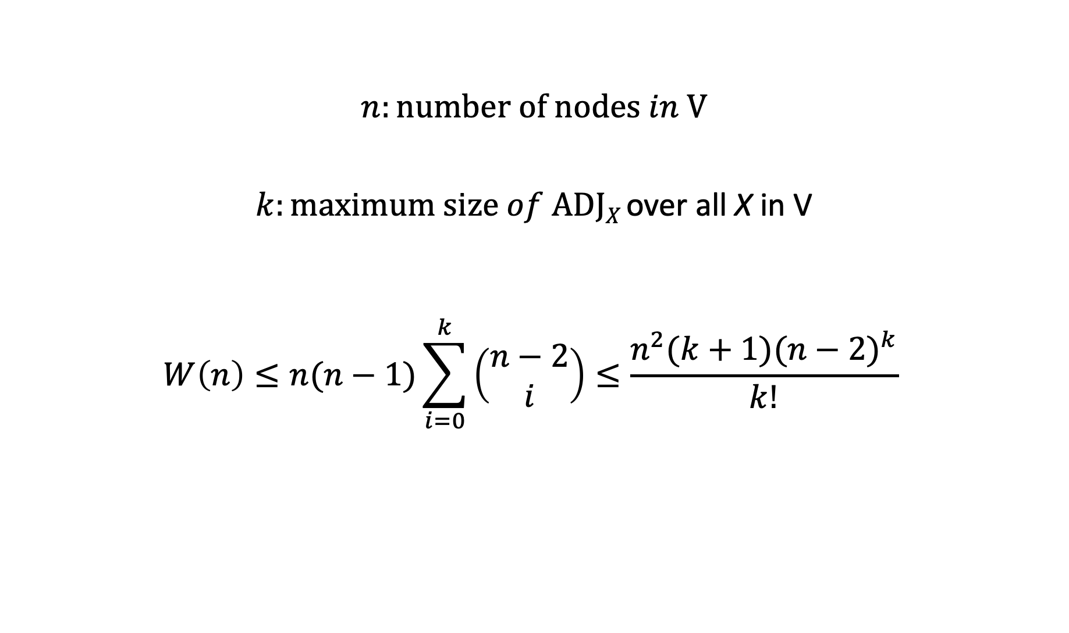
PC Algorithm – Time Complexity Analysis
$$n:number of nodes in V$$
$k:maximum size of ADJX$ over all X in V
$$W\left(n\right)≤n(n−1)\sum_{i=0}^{k}{\left(\begin{matrix}n−2 \\ i\end{matrix}\right)≤\frac{n^{2}(k+1){(n−2)}^{k}}{k!} }$$

Slide 51
Learning CBN Structure from Data : The Score-based Approach
Model selection is to select a ”good” causal model from among all possible models, and use it as if it were the correct model.
When we apply model selection to causal Bayesian network structure learning, how do we decide whether or not a model is ”good”?
The answer is that we can use a Bayesian scoring criterion to measure the relative strength of a model.

Slide 52
A Bayesian Score Criterion
A Bayesian score criterion for a DAG is a function that assigns a value to the DAG under consideration based on data.
Assuming G is a variable that represents a possible DAG, P(data|G) is a Bayesian score criterion that we can use in our model selection approach of learning BN structures.
In this class, we will introduce two formulas for obtaining P(data|G), that is, the K2 Score and the BDeu Score.

Slide 53
The Probability of a DAG given Data
Assuming Data is a variable that represents our observed data, assuming G₁ is a variable that represents a possible DAG of the “true” model, G₂ is a variable that represents another possible DAG of the “true” model, then
if P(G₁|Data) > P(G₂|Data)
We can say that between G₁ and G₂, G₁ is more likely to be the DAG of the “true” model that is responsible for the data we observed.
Why a Bayesian score criterion can be a measure of the strength of a Model?
🧛‍♀️

Slide 54
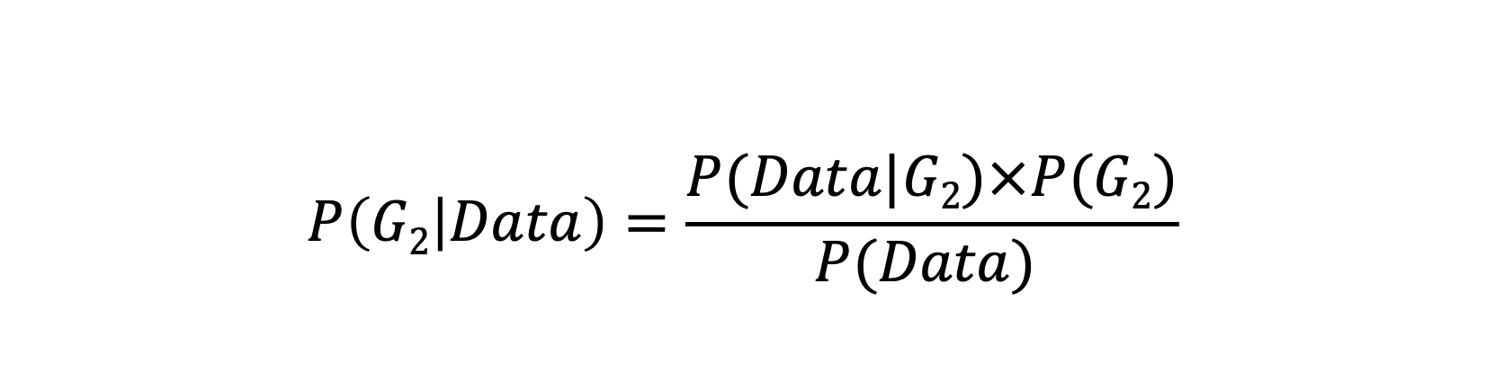
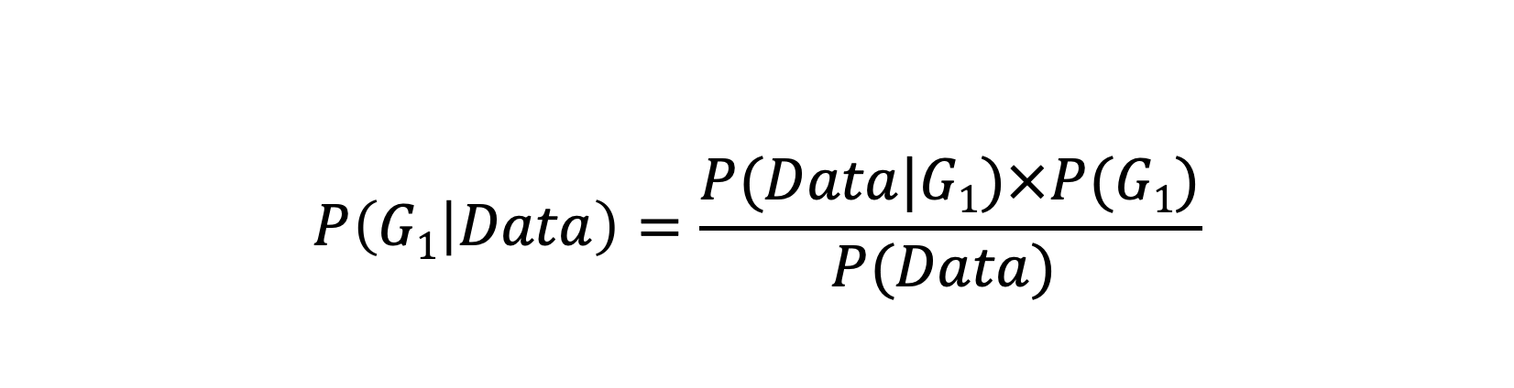
The Probability of a DAG given Data
$$P\left(G1 | Data\right)=\frac{P(Data|G1)×P(G1)}{P(Data) }$$
Bayes’ Rule
$$P\left(G2 | Data\right)=\frac{P(Data|G2)×P(G2)}{P(Data) }$$

Slide 55
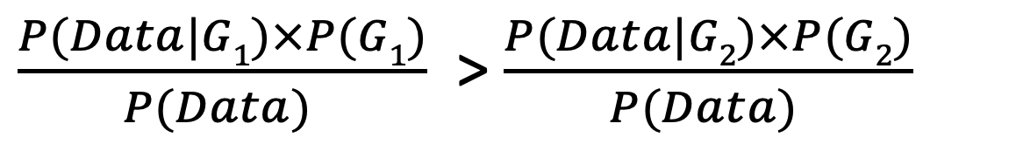
The Probability of a DAG given Data
P(G₁|Data) > P(G₂|Data)
Likelihood Function
$\frac{P(Data|G1)×P(G1)}{P(Data) }$ > $\frac{P(Data|G2)×P(G2)}{P(Data) }$

Slide 56
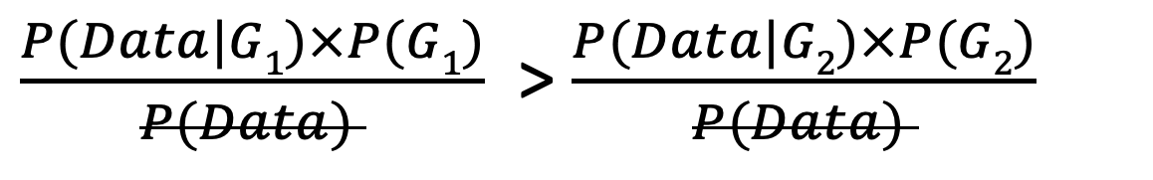
The Probability of a DAG given Data
P(G₁|Data) > P(G₂|Data)
$\frac{P(Data|G1)×P(G1)}{P(Data) }$ > $\frac{P(Data|G2)×P(G2)}{P(Data) }$
P(Data) can be treated as a constant in our comparison.
Normalization Constant
🧛‍♀️

Slide 57
The Probability of a DAG given Data
P(G₁|Data) > P(G₂|Data)
Prior Probability of the DAG structure
When we have no prior knowledge about the DAG structures, we can assume that P(G₁) and P(G₂) are equal. In that case, can you think of a principle that we previously covered that allows us to make this assumption?
$\frac{P(Data|G1)×P(G1)}{P(Data) }$ > $\frac{P(Data|G2)×P(G2)}{P(Data) }$
So P(Data|G) is used as the score criterion
🧛‍♀️

Slide 58

How do We Compute P(Data|G)?
G₁
Example
HEAD
HEAD
TAIL
TAIL
TAIL
HEAD
TAIL
P(HEAD) = 𝜃=0.5
P(TAIL)= 1-𝜃=0.5
IID stands for Independently obtained and following Identical Distribution.
P(Data| 𝜃,G₁) =𝜃³ (1-𝜃)⁴
= (0.5)³(0.5)⁴
G₂
Data should be IID!
P(HEAD)=𝜃=0.4
P(TAIL)=1-𝜃= 0.6
🧛‍♀️
P(Data| 𝜃,G₁) =(0.4)³(0.6)⁴

Slide 59

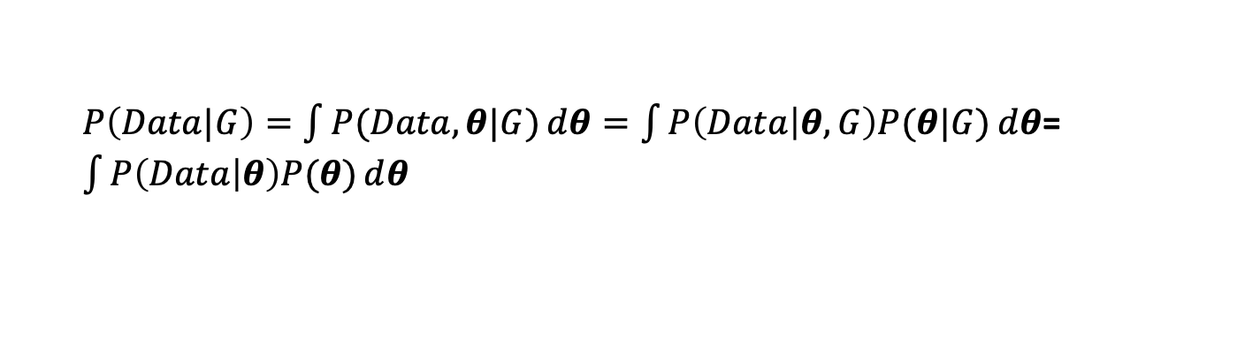
How do We Compute P(Data|G)? A More general case
Assuming Data is a variable that represents our data concerning one single multinomial variable X that has r different values, assuming G is a variable that represents a possible DAG of the “true” model, assuming IID, how do we compute P(Data|G)?
$θ$={$θ_{1},…,θ_{r}\}$
What is this based on?
$P\left(Data|G\right)=\int{P(Data,θ|G)}ⅆθ=\int{P\left(Data | θ, G\right)P(θ|G)ⅆθ}$= $\int{P\left(Data | θ\right)P(θ)ⅆθ}$
🧛‍♀️

Slide 60
How do We Compute P(Data|G)? A More general case
Assuming Data is a variable that represents our data concerning one single multinomial variable X that has r different values, assuming G is a variable that represents a possible DAG of the “true” model, assuming IID, how do we compute P(Data|G)?
$θ$={$θ_{1},…,θ_{r}\}$
What is this based on?
$P\left(Data|G\right)=\int{P(Data,θ|G)}ⅆθ=\int{P\left(Data | θ, G\right)P(θ|G)ⅆθ}$= $\int{P\left(Data | θ\right)P(θ)ⅆθ}$
🧛‍♀️

Slide 61
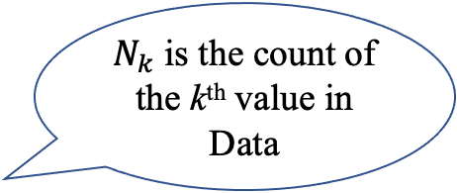
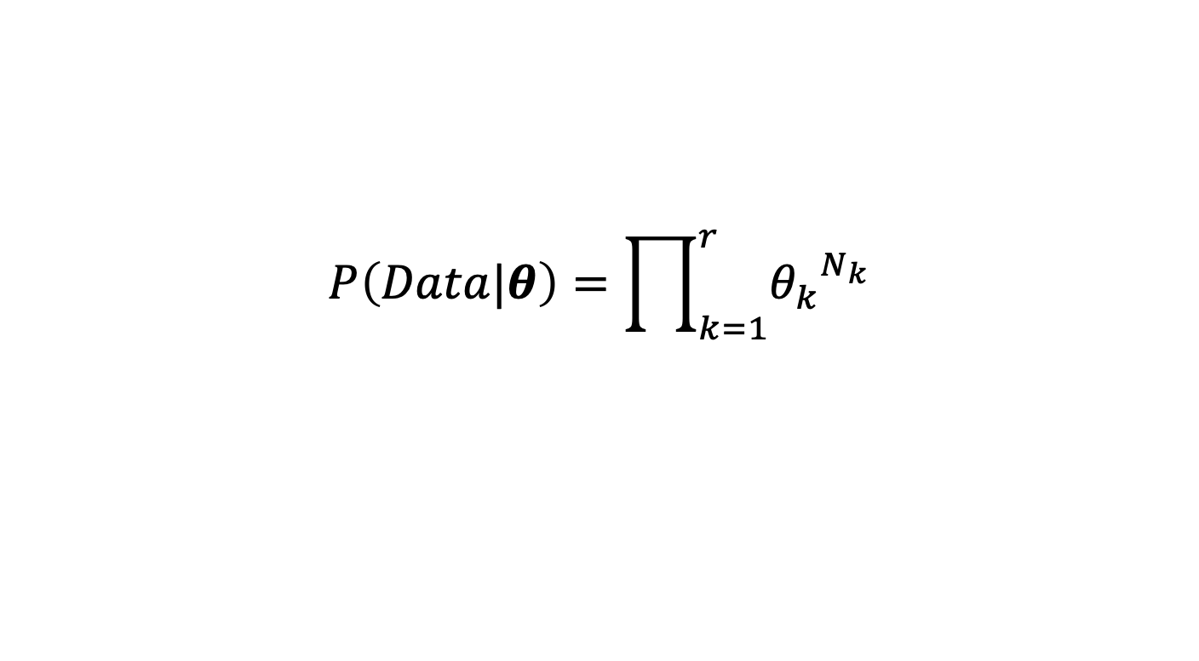
How do we compute P(Data|G)? A More general case
Assuming Data is a variable that represents our data concerning one single multinomial variable X that has r different values, assuming G is a variable that represents a possible DAG of the “true” model, assuming IID, how do we compute P(Data|G)?
$N_{k}$ is the count of the k^{th} value in Data
$$P\left(Data|θ\right)=\prod_{k=1}^{r}{{θ_{k}}^{N_{k}}}$$
True for IID Data and single multinomial variable !
🧛‍♀️

Slide 62
How do we compute P(Data|G)?
G₁
Example
HEAD
HEAD
TAIL
TAIL
TAIL
HEAD
TAIL
P(HEAD) = 𝜃=0.5
P(TAIL)= 1-𝜃=0.5
IID stands for Independently obtained and following Identical Distribution.
P(Data|𝜃, G₁) =𝜃³ (1-𝜃)⁴
= (0.5)³(0.5)⁴
G₂
Data should be IID!
P(HEAD)=𝜃=0.4
P(TAIL)=1-𝜃= 0.6
🧛‍♀️
P(Data|𝜃,G₂) =(0.4)³(0.6)⁴

Slide 63
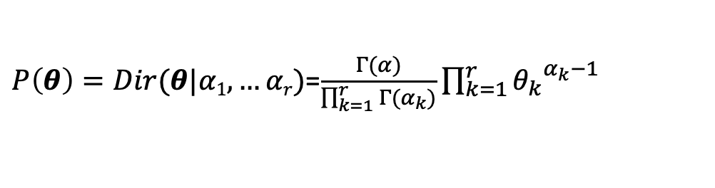
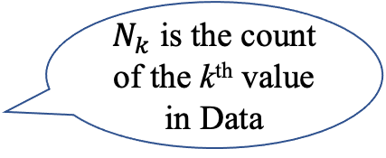
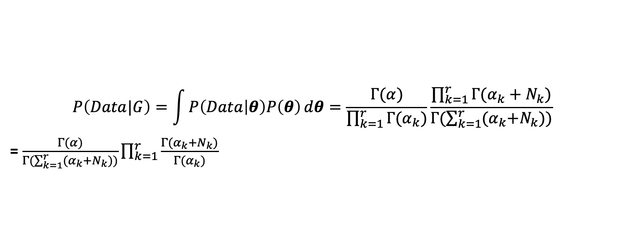
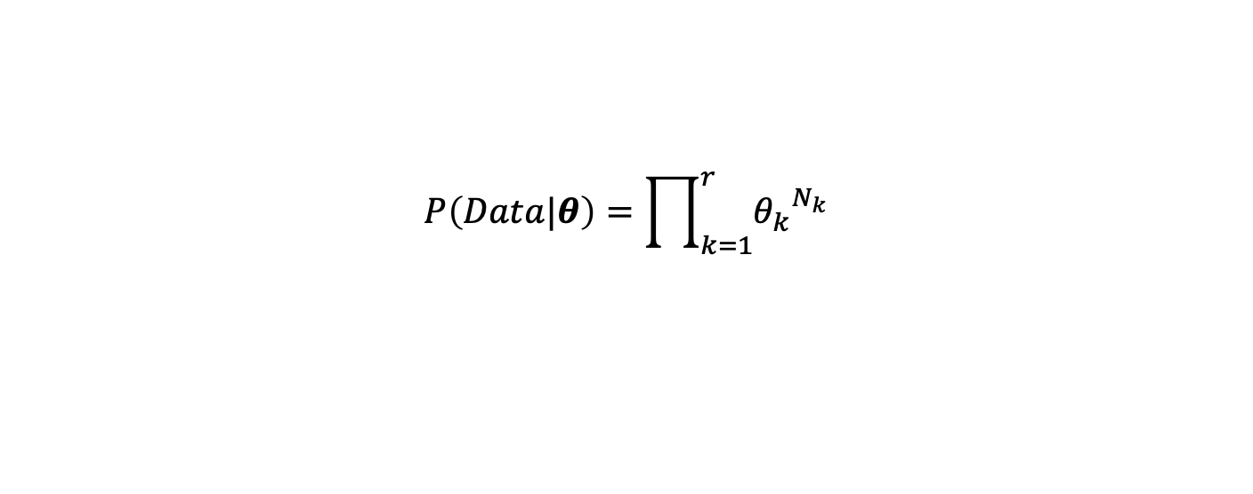

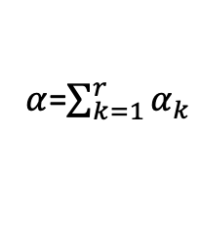
How do we compute P(Data|G)? A More general case
Assuming Data is a variable that represents our data concerning one single multinomial variable X that has r different values, assuming G is a variable that represents a possible DAG of the “true” model, assuming IID, how do we compute P(Data|G)?
$α$=$\sum_{k=1}^{r}{α_{k}}$
$θ$={$θ_{1},…,θ_{r}\}$
$P\left(θ\right)=Dir(θ|α1, …αr)$=$\frac{Γ(α)}{\prod_{k=1}^{r}{Γ(α_{k})}}\prod_{k=1}^{r}{{θ_{k}}^{α_{k}−1}}$
$N_{k}$ is the count of the k^{th} value in Data
True when G contains a single multinomial variable and IID data!
$$P\left(Data|θ\right)=\prod_{k=1}^{r}{{θ_{k}}^{N_{k}}}$$
$$P\left(Data|G\right)=\int{P\left(Data | θ\right)P\left(θ\right)ⅆθ=\frac{Γ(α)}{\prod_{k=1}^{r}{Γ(α_{k})}}\frac{\prod_{k=1}^{r}{Γ(α_{k}+N_{k})}}{Γ(\sum_{k=1}^{r}{{(α}_{k}+N_{k}}))}}$$
= $\frac{Γ(α)}{Γ(\sum_{k=1}^{r}{{(α}_{k}+N_{k}}))}\prod_{k=1}^{r}{\frac{Γ(α_{k}+N_{k})}{Γ(α_{k})}}$

Slide 64
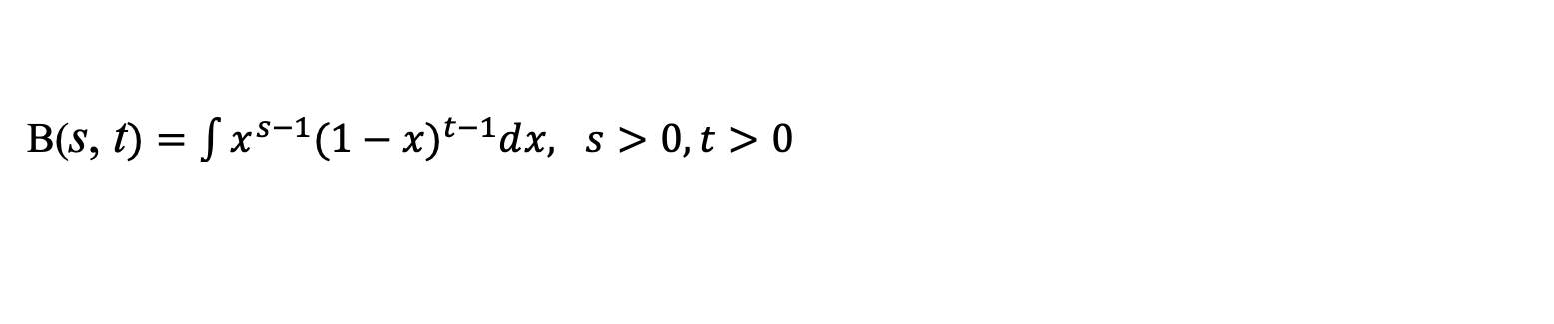
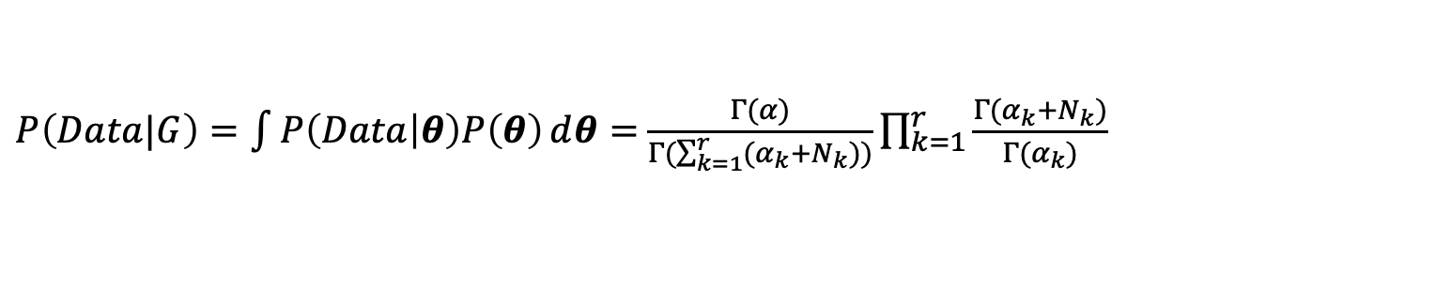
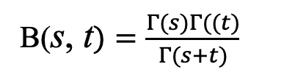
How do we compute P(Data|G)? A More general case
Assuming Data is a variable that represents our data concerning one single multinomial variable X that has r different values, assuming G is a variable that represents a possible DAG of the “true” model, assuming IID, how do we compute P(Data|G)?
$α$=$\sum_{k=1}^{r}{α_{k}}$
$θ$={$θ_{1},…,θ_{r}\}$
$P\left(θ\right)=Dir(θ|α1, …αr)$=$\frac{Γ(α)}{\prod_{k=1}^{r}{Γ(α_{k})}}\prod_{k=1}^{r}{{θ_{k}}^{α_{k}−1}}$
True when G contains a single multinomial variable and IID data!
$N_{k}$ is the count of the k^{th} value in Data
$$P\left(Data|θ\right)=\prod_{k=1}^{r}{{θ_{k}}^{N_{k}}}$$
$P\left(Data|G\right)=\int{P\left(Data | θ\right)P\left(θ\right)ⅆθ=}$ $\frac{Γ(α)}{Γ(\sum_{k=1}^{r}{{(α}_{k}+N_{k}}))}\prod_{k=1}^{r}{\frac{Γ(α_{k}+N_{k})}{Γ(α_{k})}}$
B(s, t$)=\int{x^{s−1}{(1−x)}^{t−1}ⅆx, s>0, t>0}$
B(s, t$)=\frac{Γ(s)Γ((t)}{Γ(s+t)}$
$Γ\left(n\right)=\left(n−1\right)!, when n$≥$1 and n is an integer$

Slide 65
The Bayesian score
Recall we have previously derived this for the single variable case.
🧛‍♀️

Slide 66
K2 Score
n
q
i
Γ
(
r
)
r
i
score
(
G
:
Data
)
=
P
(
Data
|
G
)
=
∏
∏
i
∏
Γ
(
1
+
s
)
K2
Γ
(
r
+
∑
r
i
s
)
ijk
i
=
1
j
=
1
i
k
=
1
ijk
k
=
1

Slide 67
BDeu Score

Slide 68
Example
Consider a binary disease variable D and a binary symptom E. Both variables have the values T (present) and F (absent). Suppose a physician, Dr. Roberts, believes that the following two causal Bayesian network structures G₁ and G₂ are possible, with the prior probabilities shown. Use the BDeu score with 𝜶 =4 to learn from the given data the most probable DAG structure, that is to obtain and compare the P(G₁ | data) and P(G₂ | data).
D | E
T | F
T | T
F | T
T | T
F | F
E
E
P(G₂)=0.7
P(G₁)=0.3
D
D

Slide 69

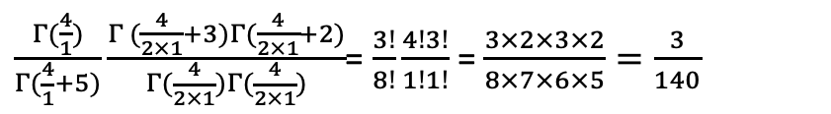

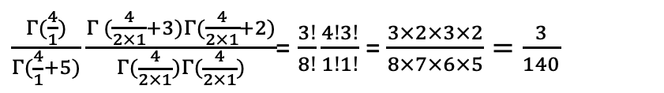
Example
D | E
T | F
T | T
F | T
T | T
F | F
What is the value of P(data | G₁)?
$$α=4$$
$\frac{Γ(\frac{4}{1})}{Γ(\frac{4}{1}+5)}\frac{Γ (\frac{4}{2×1}+3)Γ(\frac{4}{2×1}+2)}{Γ(\frac{4}{2×1})Γ(\frac{4}{2×1})}$= $\frac{3!}{8!}\frac{4!3!}{1!1!}$ = $\frac{3×2×3×2}{8×7×6×5}=\frac{3}{140}$
_{Term for Node D}
$\frac{Γ(\frac{4}{1})}{Γ(\frac{4}{1}+5)}\frac{Γ (\frac{4}{2×1}+3)Γ(\frac{4}{2×1}+2)}{Γ(\frac{4}{2×1})Γ(\frac{4}{2×1})}$= $\frac{3!}{8!}\frac{4!3!}{1!1!}$ = $\frac{3×2×3×2}{8×7×6×5}=\frac{3}{140}$
_{Term for Node E}
E
E
P(G₂)=0.7
P(G₁)=0.3
$P\left(Data | G1\right)=\frac{9}{19600}$=4.5918$×{10}^{−4}$
D
D

Slide 70
Class Exercise 1
D | E
T | F
T | T
F | T
T | T
F | F
What is the value of P(data | G₂)?
$$α=4$$
E
E
P(G₂)=0.7
P(G₁)=0.3
D
D

Slide 71


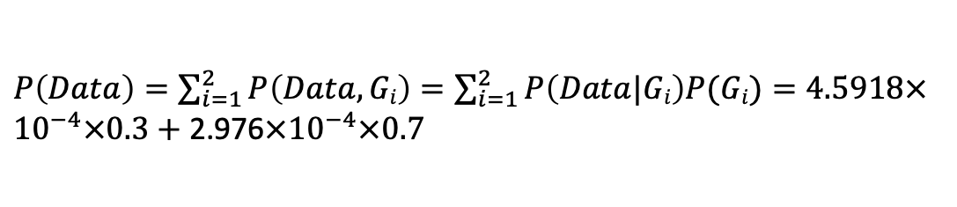
Example
D | E
T | F
T | T
F | T
T | T
F | F
What is the P(G₁ | data) and what is P(G₂ | data), using the likelihoods that we just derived?
$P\left(Data\right)=\sum_{i=1}^{2}{P\left(Data, Gi\right)=\sum_{i=1}^{2}{P\left(Data|Gi\right)P(Gi)}}=4.5918×{10}^{−4}×0.3+$ 2.976$×{10}^{−4}×0.7$
$P\left(G1|Data\right)=\frac{P\left(Data|G1\right)P(G1)}{P(Data)}$=$\frac{4.5918×{10}^{−4}×0.3}{4.5918×{10}^{−4}×0.3+\text{ 2.976}×{10}^{−4}×0.7}$=0.398
E
E
Thought about Bayesian priors?
P$\left(G2|Data\right)$=1-0.398=0.602
🧛‍♀️
$P\left(Data | G1\right)=\frac{9}{19600}$=4.5918$×{10}^{−4}$
D
D
P(G₂)=0.7
P(G₁)=0.3
$P\left(Data | G2\right)=\frac{3}{12×6x140}$=2.976$×{10}^{−4}$

Slide 72
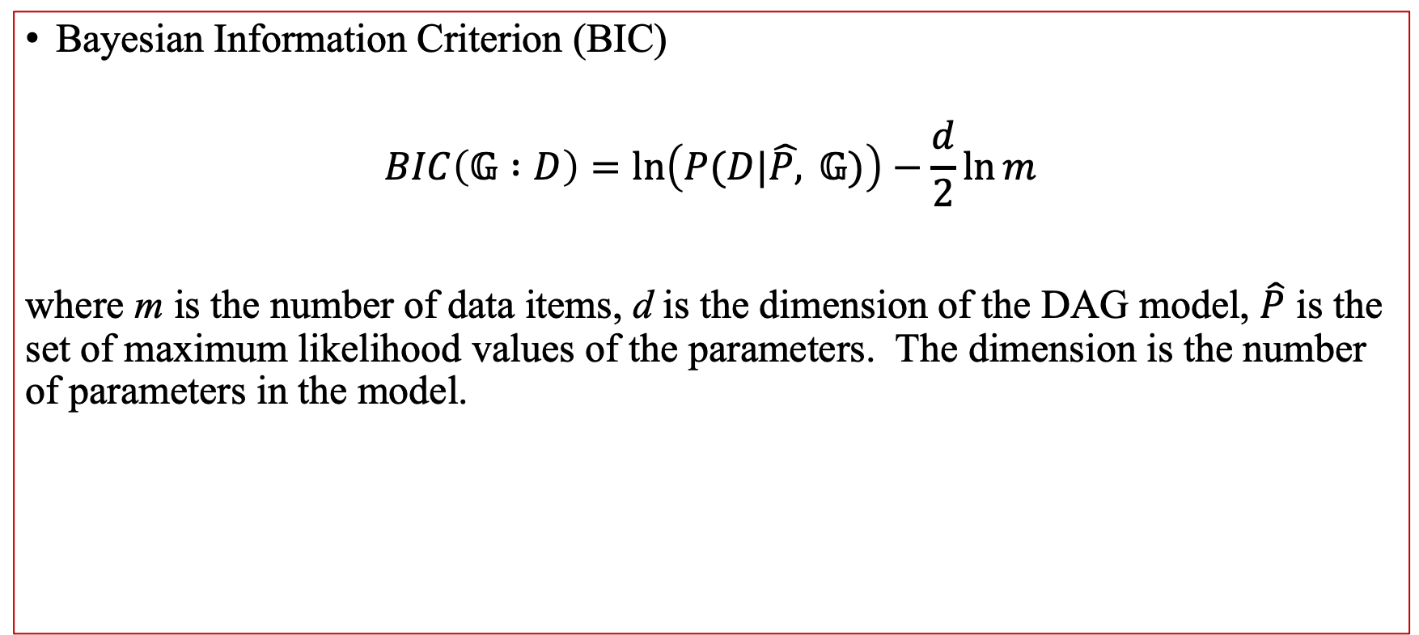
Score-based approach: BIC Score
Bayesian Information Criterion (BIC)
$$BIC\left(𝔾 :D\right)=\ln\left(P(D|\hat{P,} 𝔾)\right)−\frac{d}{2}\ln{m}$$
where m is the number of data items, d is the dimension of the DAG model, $\hat{P}$ is the set of maximum likelihood values of the parameters. The dimension is the number of parameters in the model.

Slide 73
Class Exercise 2
Find and draw all possible DAG structures given three variables R, J and A .
R
J
A

Slide 74
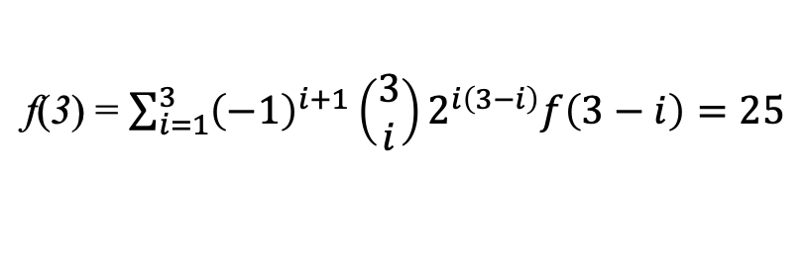
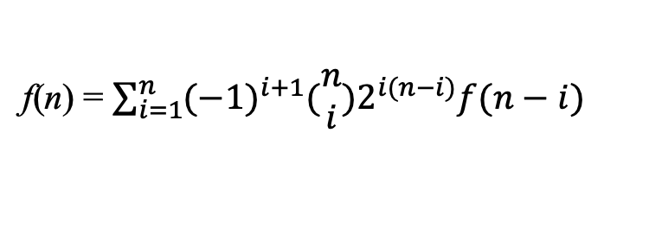
How Big is the DAG Search Space?
The number of DAGs containing n nodes can be computed using the following recurrence:
n > 2
f(0)=1
f(n) = $\sum_{i=1}^{n}{{(−1)}^{i+1}(\begin{matrix}n \\ i\end{matrix})2^{i(n−i)}f(n−i)}$
f(1)=1
n | f(n)
1 | 1
2 | 3
3
f(3) = $\sum_{i=1}^{3}{{\left(−1\right)}^{i+1}\left(\begin{matrix}3 \\ i\end{matrix}\right)2^{i\left(3−i\right)}f\left(3−i\right)=25}$
RW, Robinson “Continuing Unlabeled Acyclic Digraphs,” in Little, C.H.C. (Ed): Lecture Notes in Mathematics Springer-Verlag, 1977

Slide 75
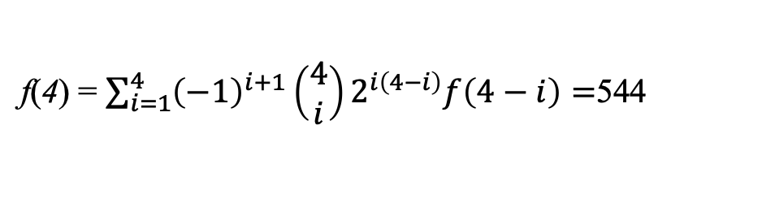
How Big is the DAG Search Space?
The number of DAGs containing n nodes can be computed using the following recurrence:
n > 2
f(0)=1
f(n) = $\sum_{i=1}^{n}{{(−1)}^{i+1}(\begin{matrix}n \\ i\end{matrix})2^{i(n−i)}f(n−i)}$
f(1)=1
n | f(n)
1 | 1
2 | 3
3 | 25
4
f(3) = $\sum_{i=1}^{3}{{\left(−1\right)}^{i+1}\left(\begin{matrix}3 \\ i\end{matrix}\right)2^{i\left(3−i\right)}f\left(3−i\right)=25}$
f(4) = $\sum_{i=1}^{4}{{\left(−1\right)}^{i+1}\left(\begin{matrix}4 \\ i\end{matrix}\right)2^{i\left(4−i\right)}f\left(4−i\right)=}$544
RW, Robinson “Continuing Unlabeled Acyclic Digraphs,” in Little, C.H.C. (Ed): Lecture Notes in Mathematics Springer-Verlag, 1977

Slide 76
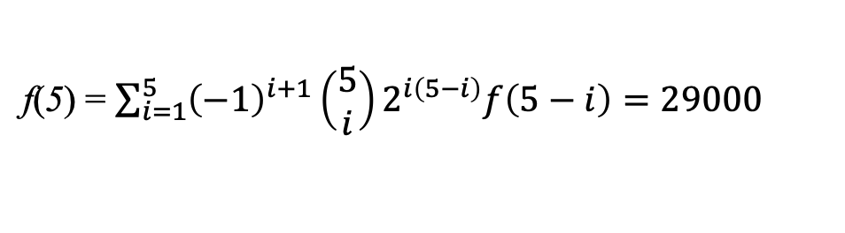
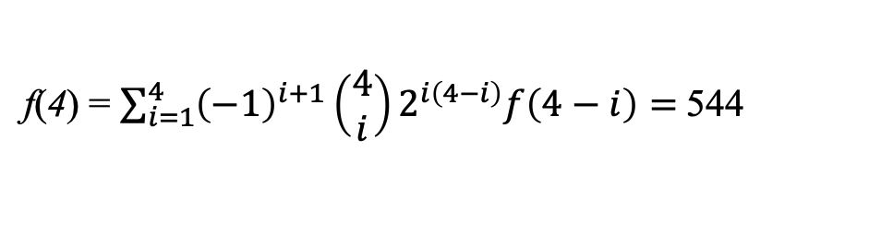
How Big is the DAG Search Space?
The number of DAGs containing n nodes can be computed using the following recurrence:
n > 2
f(0)=1
f(n) = $\sum_{i=1}^{n}{{(−1)}^{i+1}(\begin{matrix}n \\ i\end{matrix})2^{i(n−i)}f(n−i)}$
f(1)=1
n | f(n)
1 | 1
2 | 3
3 | 25
4 | 544
5
f(3) = $\sum_{i=1}^{3}{{\left(−1\right)}^{i+1}\left(\begin{matrix}3 \\ i\end{matrix}\right)2^{i\left(3−i\right)}f\left(3−i\right)=25}$
f(4) = $\sum_{i=1}^{4}{{\left(−1\right)}^{i+1}\left(\begin{matrix}4 \\ i\end{matrix}\right)2^{i\left(4−i\right)}f\left(4−i\right)= }$544
f(5) = $\sum_{i=1}^{5}{{\left(−1\right)}^{i+1}\left(\begin{matrix}5 \\ i\end{matrix}\right)2^{i\left(5−i\right)}f\left(5−i\right)=29000}$
RW, Robinson “Continuing Unlabeled Acyclic Digraphs,” in Little, C.H.C. (Ed): Lecture Notes in Mathematics Springer-Verlag, 1977

Slide 77

How Big is the DAG Search Space?
The number of DAGs containing n nodes can be computed using the following recurrence:
n > 2
f(0)=1
f(n) = $\sum_{i=1}^{n}{{(−1)}^{i+1}(\begin{matrix}n \\ i\end{matrix})2^{i(n−i)}f(n−i)}$
f(1)=1
n | f(n)
1 | 1
2 | 3
3 | 25
4 | 544
5 | 29000
f(3) = $\sum_{i=1}^{3}{{\left(−1\right)}^{i+1}\left(\begin{matrix}3 \\ i\end{matrix}\right)2^{i\left(3−i\right)}f\left(3−i\right)=25}$
f(4) = $\sum_{i=1}^{4}{{\left(−1\right)}^{i+1}\left(\begin{matrix}4 \\ i\end{matrix}\right)2^{i\left(4−i\right)}f\left(4−i\right)= }$544
f(5) = $\sum_{i=1}^{5}{{\left(−1\right)}^{i+1}\left(\begin{matrix}5 \\ i\end{matrix}\right)2^{i\left(5−i\right)}f\left(5−i\right)=29000}$
…
$$f\left(10\right)>{10}^{18}$$

Slide 78
Readings
RE Neapolitan Learning Bayesian Networks, Pearson Prentice Hall, 2004, chapter 8 and 10
P Sprites and C Glymour, Causation, Prediction, Springer Verlag, New York, 1993, 2nd ed: MIT Press, Cambridge, Massachusetts, 2000

