Slide 1
Presentatie 3
Anne Visser

Slide 2
In hoeverre is het mogelijk om, bij gebruik van querychat met ollama als client, via natural language prompts betrouwbare SQL-queries te genereren voor een RVAT-database (gdb)?
Hoe werkt ollama?
Hoe werkt querychat met ollama als client?
Aan welke eisen moet een database voldoen om bruikbaar te zijn voor querychat?
Hoe wordt de RVAT database gegenereerd en hoe is deze aanpasbaar?
Welk LLM model binnen ollama is het meest geschikt voor het genereren van SQL-queries?
Hoe kan querychat aan de rvat-database gekoppeld worden?
In hoeverre kan met deze setup de benchmarkvragen van de opdrachtgever betrouwbaar beantwoord worden?

Slide 3
Slide with R Output
VAR_id | CHROM | POS | ID | REF | ALT | QUAL | FILTER | AC | AN | AF | gene_name
1 | chr1 | 11013912 | NA | A | G | 722.13 | NA | 1 | 45484 | 2.19858e-05 | TARDBP
2 | chr1 | 11013928 | rs755357622 | C | T | 2598.23 | NA | 1 | 49194 | 2.03277e-05 | TARDBP

Slide 4
HighImpact | ModerateImpact | Synonymous | CADDphred | PolyPhen | SIFT
0 | 1 | 0 | 24.8 | P | D
0 | 0 | 1 | . | . | .

Slide 5
ALS_1 | ALS_2 | ALS_3 | ALS_4 | ALS_5 | Control_1 | Control_2 | Control_3 | Control_4 | Control_5
2 | 0 | 2 | 0 | 1 | 1 | 0 | 1 | 1 | 2
2 | 0 | 1 | 1 | 0 | 2 | 0 | 1 | 1 | 0

Slide 6
question_nr | prompt | type_question | gold_truth
1 | Select number of variants in NEK1 | lookup | SELECT COUNT(VAR_id) AS number_of_variants

Slide 7
model | succesful_toolcalls
llama3.1:8b | 4
llama3.2 | 5
qwen3.5 | 5
qwen3:8b | 5
FROM varInfo_synthetic WHERE gene_name = 'NEK1' |
12|What is the average age of ALS cases? |nc |NA | 13|Is VAR_id 100 previously reported as pathogenic? |nc |NA | 15|What is the sex distribution of carriers? |nc |NA | 16|Which variants are most important? |nc |NA | 17|Which variants are both synonymous and high impact? |nc |NA | 14|What is the allele frequency of VAR_id 30 in Europeans? |nc |NA | 2|Select variants in NEK1 that with HighImpact and a CADDphered > 20 |lookup |SELECT * FROM varInfo_synthetic WHERE HighImpact = 1 AND CADDphred > 20 AND gene_name = ‘NEK1’ | 3|How many variants in TARDBP are predicted deletorious by SIFT? |lookup |SELECT COUNT(*) AS number_of_variants_with_SIFT_D FROM varInfo_synthetic WHERE gene_name = ‘TARDBP’ AND SIFT = ‘D’ | 6|What is the variant with the highest allele frequency |analytical |SELECT VAR_id, MAX(AF) AS highest_allele_frequency FROM varInfo_synthetic | 7|What is te average allele frequency for synonymous, moderate, and high-impact variants? |analytical |SELECT AVG(CASE WHEN Synonymous = 1 THEN AF END) AS average_AF_synonymous, AVG(CASE WHEN ModerateImpact = 1 THEN AF END) AS average_AF_moderate, AVG(CASE WHEN HighImpact = 1 THEN AF END) AS average_AF_high FROM varInfo_synthetic | 8|How many high-impact variants does the ALS_1 patient carry? |analytical |SELECT SUM(CASE WHEN ALS_1 = 1 THEN 1 ELSE 0 END) AS heterozygous, SUM(CASE WHEN ALS_1 = 2 THEN 1 ELSE 0 END) AS homozygous FROM varInfo_synthetic WHERE HighImpact = 1; | 10|Are there more variants in cases than controls? |analytical |SELECT VAR_id, gene_name, (ALS_1 + ALS_2 + ALS_3 + ALS_4 + ALS_5) AS case_count, (Control_1 + Control_2 + Control_3 + Control_4 + Control_5) AS control_count, ((ALS_1 + ALS_2 + ALS_3 + ALS_4 + ALS_5) * 1.0) / NULLIF((Control_1 + Control_2 + Control_3 + Control_4 + Control_5), 0) AS case_control_ratio FROM varInfo_synthetic ORDER BY case_control_ratio DESC LIMIT 10; | 11|Summarize variant info for each gene. Only select genes that have more than 10 variants. Order the results by the number of variants. |analytical |SELECT gene_name, CHROM, COUNT(*) AS total_variants, SUM(CASE WHEN HighImpact = 1 THEN 1 ELSE 0 END) AS high_impact_count, SUM(CASE WHEN ModerateImpact = 1 THEN 1 ELSE 0 END) AS moderate_impact_count, SUM(CASE WHEN Synonymous = 1 THEN 1 ELSE 0 END) AS synonymous_count, AVG(AF) AS mean_AF, MIN(POS) AS start_pos, MAX(POS) AS end_pos, (MAX(POS) - MIN(POS)) AS length FROM varInfo_synthetic GROUP BY gene_name, CHROM HAVING total_variants > 10 ORDER BY total_variants DESC | 4|Which high-impact variants have at least one ALS patient that is homozygous for this variant? |lookup |SELECT * FROM varInfo_synthetic WHERE HighImpact = 1 AND (ALS_1 = 2 OR ALS_2 = 2 OR ALS_3 = 2 OR ALS_4 = 2 OR ALS_5 = 2) | 5|What are the ten most deleterious variants in ABCA4 |lookup |SELECT * FROM varInfo_synthetic WHERE CADDphred > 20 AND SIFT = ‘D’ AND PolyPhen = ‘D’ AND gene_name = ‘ABCA4’ ORDER BY CADDphred DESC LIMIT 10; | 9|What is the total burden of cases versus controls (so how many effect alleles do the ALS cases carry vs controls) |analytical |SELECT SUM(ALS_1 + ALS_2 + ALS_3 + ALS_4 + ALS_5) AS total_cases_burden, SUM(Control_1 + Control_2 + Control_3 + Control_4 + Control_5) AS total_controls_burden FROM varInfo_synthetic; |

Slide 8
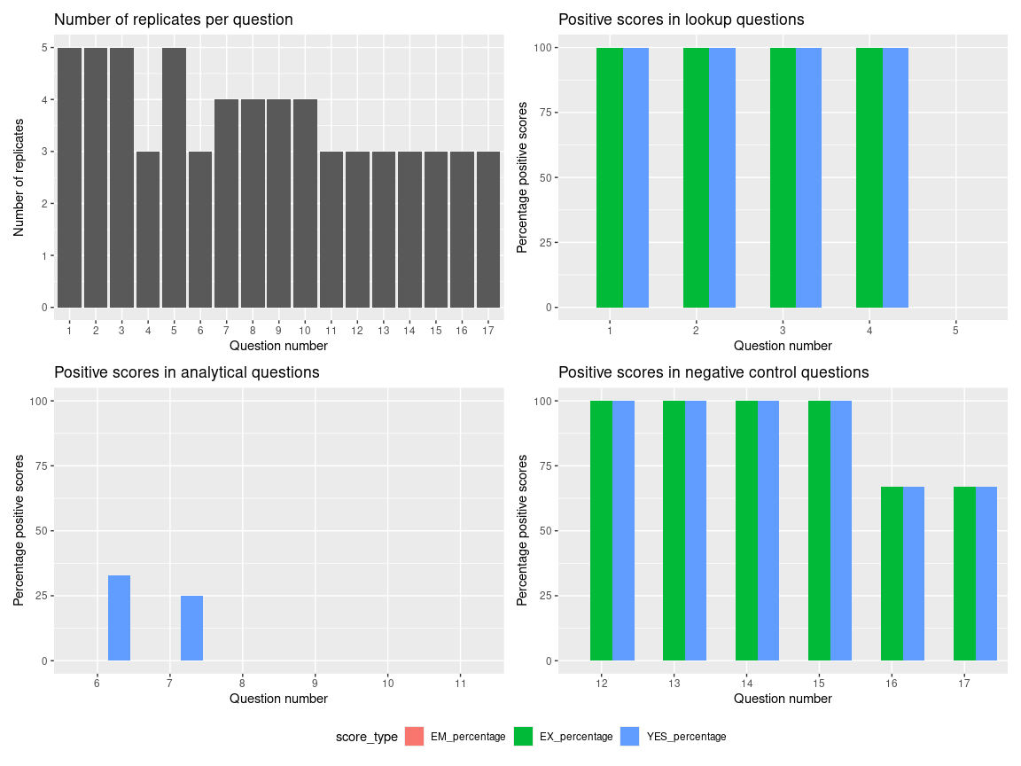
Results chats qwen3:8b

