Slide 1




SUBTRACK
PRESENTATION
2025

Slide 2


INTRODUCTION
In today’s fast-paced world, juggling multiple subscriptions and keeping track of utility bills can quickly become overwhelming. SubTrack is a unified desktop application that streamlines the entire lifecycle—from adding and monitoring subscriptions to automating renewals and logging bill payments—in one intuitive interface. By combining real-time dashboards, configurable alerts, and seamless data management, SubTrack empowers users to stay on top of recurring charges, avoid missed payments, and gain clear insights into their spending habits.

Slide 3

Key
Features
Powerful
Filtering
&
Search
Comprehensive Subscription Management
Flexible
Renewal
Workflows
Dynamic Dashboard & Insights
Utility Bill
Payment
Tracking

Slide 4
Tech
Stack
– Java : For modern language features.
– Swing : Provides full control over look & feel
– MySQL : Transactional safety & data integrity
– JDBC : database connectivity used by DAO layer
– Maven : For build & dependency management

Slide 5

System
Architecture
Three-Tier Architecture :
PRESENTATION LAYER (SWING UI)
SERVICE LAYER
(OPERATION LOGIC)
DATA ACCESS LAYER
(DAO)

Slide 6
UI Panels
Models
– Subscription Panel
– Subscription Payments
Panel
– Bill Panel
– Bill Payments Panel
– Dashboard Panel
– Subscription
– Payment
– Bill
– Bill Payment

Slide 7
Data Access Objects
Services &Utilities
– SubscriptionDAO
– BillDAO
– BillPaymentDAO
– PaymentDAO
–Subscription Renewal
Service
–Service Renewal
(Bill reconciliation)
page 06

Slide 8
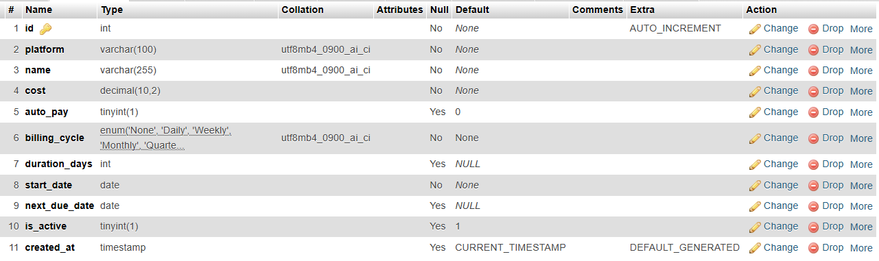
TABLES
subscriptions :

Slide 9
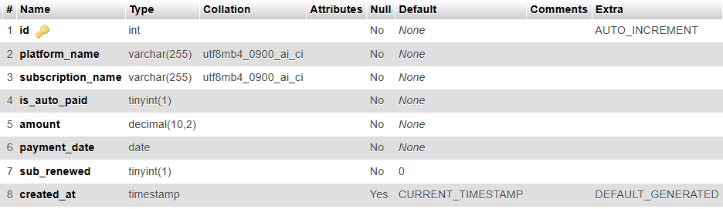
TABLES
payments :

Slide 10
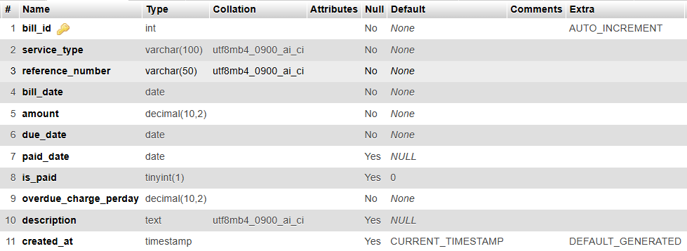
TABLES
utillity_bills :

Slide 11
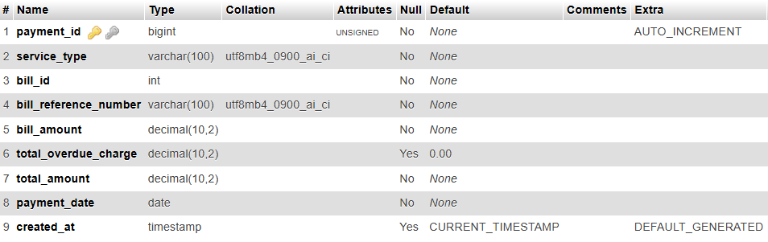
TABLES
utillity_bill_payments:

Slide 12
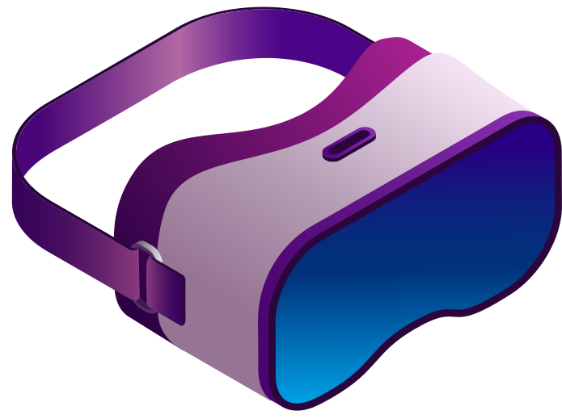
– Enhance UI/UX
– Add reporting module
– Integrate email notifications
– Implement user authentication
– Integrate bill and subscription
management using unique bill
and payment ID
– Integrate platform specific
connections and data transfer
Future
Prospects

Slide 13
Demo
Time

Slide 14
THANK YOU!

